Slide 1
Creation of New Load Zones
CMWG 7/18/22

Slide 2
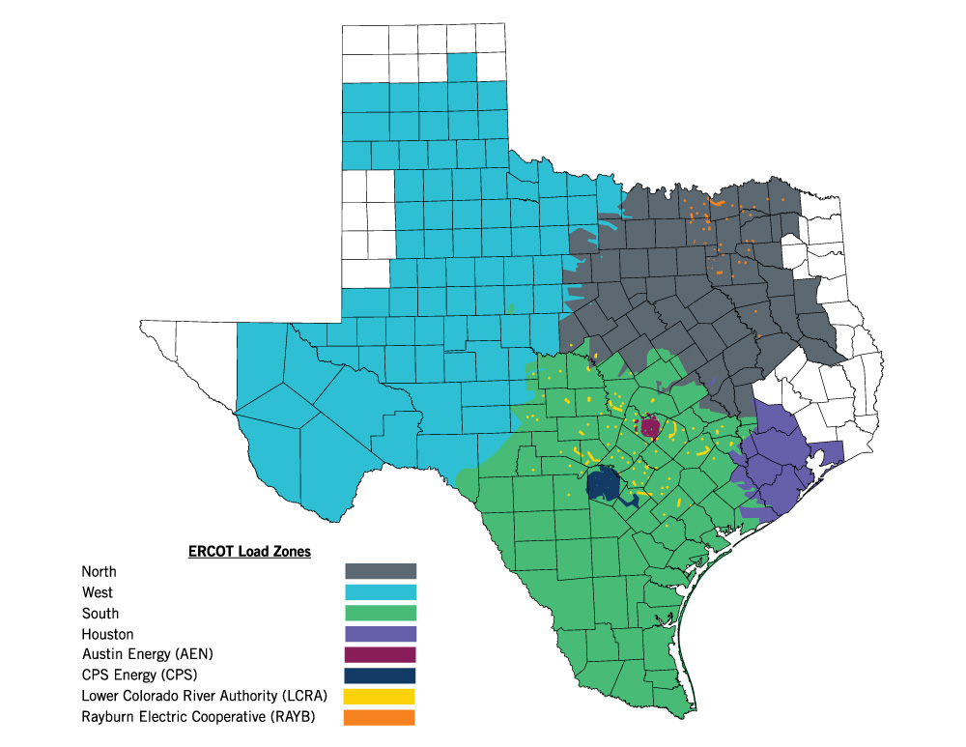
Existing Load Zones

Slide 3
Establish Criteria to Subdivide Existing Zones
GOALS : To create zones such that:
Aggregations can meaningfully exist (larger the better)
SCED can clear the aggregation correctly in regard to constraint impacts (smaller the better)
Considerations
New zones must be subdivisions of existing load zones
Will allow existing LZ settlement values to be calculated
All load will be settled against the new load zone values
Should NOIE LZs be included?

Slide 4
Choices
Subdivide all existing zones into the same number of new zones?
If not, how do we choose an effective number?
Is there a minimum load level needed in any new zone?
Cluster around shift factor relationship to historic constraints?
Cluster around historic pricing to approximate shift factor correlations to potential constraints?
Using price will organically include time and price weight components
Using price can incorrectly correlate nodes when multiple constraints are present
Cluster around shift factor relationship to anticipated future constraints?
Other?

Slide 5
Proposal
Create a study
Subdivide the existing zones into 3, 4, and 5 new zones
Cluster the new zones based on price
Present the results of each existing zone showing:
Color graphic of the new load zone options (3, 4 or 5)
Resulting load in each new zone
Statistical correlation of the pricing for the new zones
Make a recommendation for WMS/TAC/Board approval
Once approved draft NPRR to affect change

Slide 6
Questions

