Slide 1
System-wide vs Local RDPA Comparison
Thomas Urquhart
Engineer, Market Analysis & Validation
ERCOT
Congestion Management Working Group (CMWG)
July 18, 2022

Slide 2
Background
This analysis provides supplemental info for the discussion of RDPA on 6/13/2022.
Five Operating Days with RUCs were analyzed:
9/21/2021 – high wind, high curtailment that quickly turned into moderate wind, low curtailment around settlement interval 75
2/24/2022 – stressed grid conditions; low wind, very low curtailment, high RDPA
3/29/2022 – high wind, high curtailment
4/22/2022 – discussed on 6/13/2022; high wind, high curtailment
5/13/2022 – low wind, low curtailment
For each OD, we compare:
BP and LMP deltas between the pricing and dispatch runs during the SCED interval with the highest total calculated indifference payment*
Current RTRDASIAMT (reliability component of AS imbalance payment) to calculated indifference payments
Indifference payments by fuel type
*Calculation as proposed by Shams Siddiqi here
Indifference payment = ΔLMP * ΔBP; only consider positive values
We do not consider the change to energy payments

Slide 3
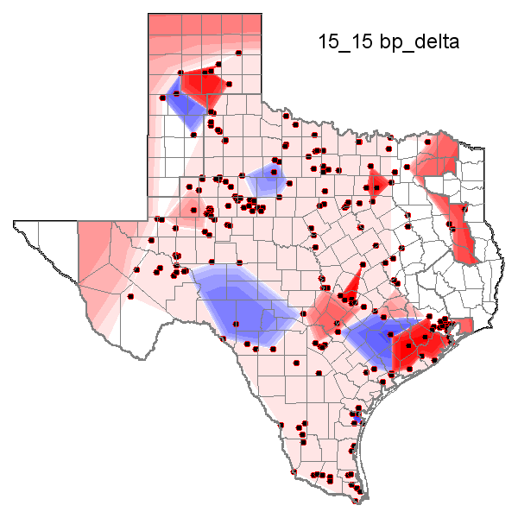
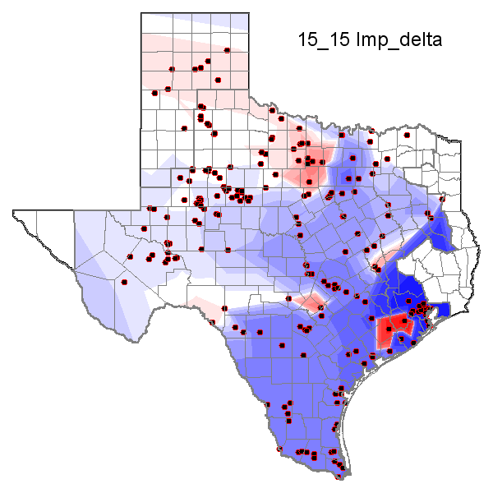
9/21/2021 15:15, RDPA = $0.00/MWh
Red, positive values represent pricing run value > dispatch run value

Slide 5
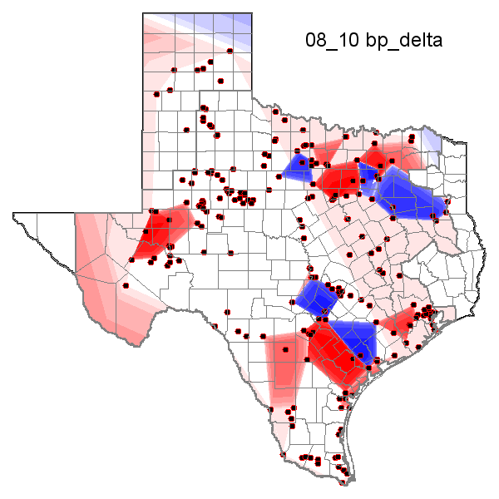
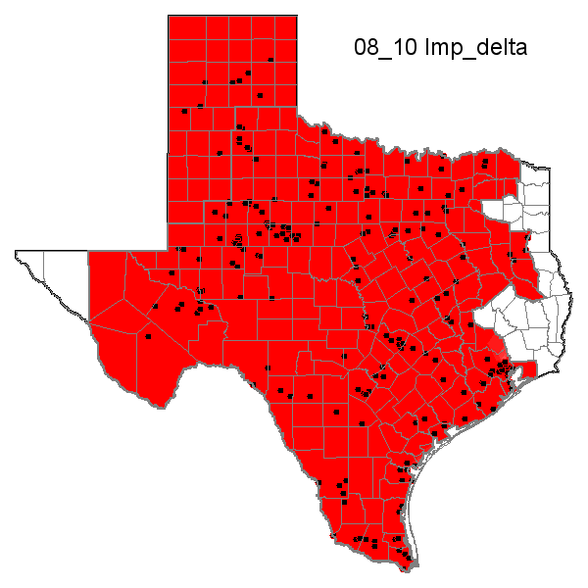
2/24/2022 08:10, RDPA = $1,391.63/MWh
Red, positive values represent pricing run value > dispatch run value

Slide 7
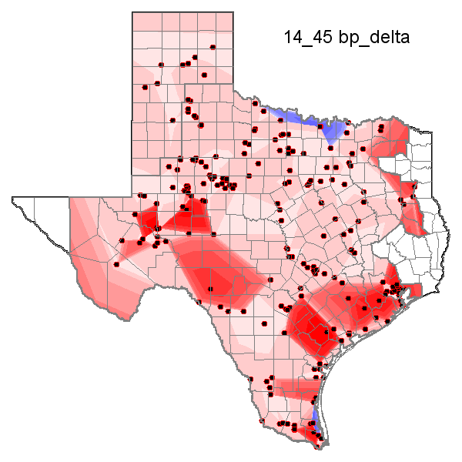
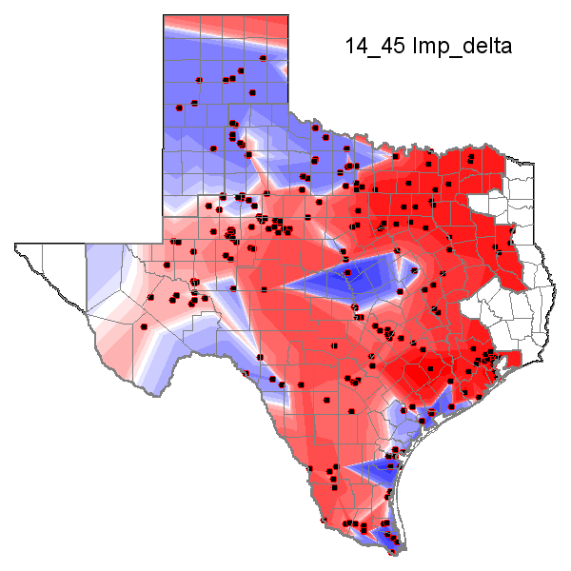
3/29/2022 14:45, RDPA = $16.58/MWh
Red, positive values represent pricing run value > dispatch run value

Slide 9
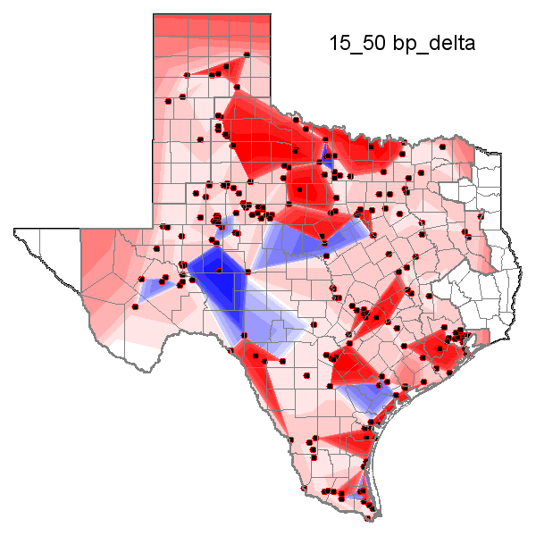
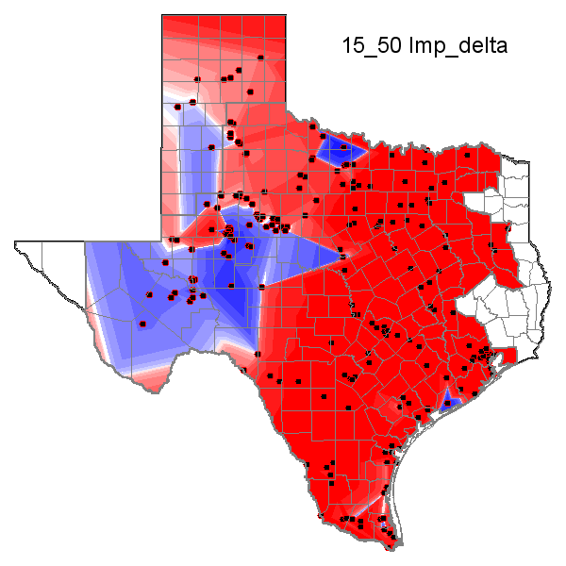
4/22/2022 15:50, RDPA = $374.94/MWh
Red, positive values represent pricing run value > dispatch run value

Slide 11
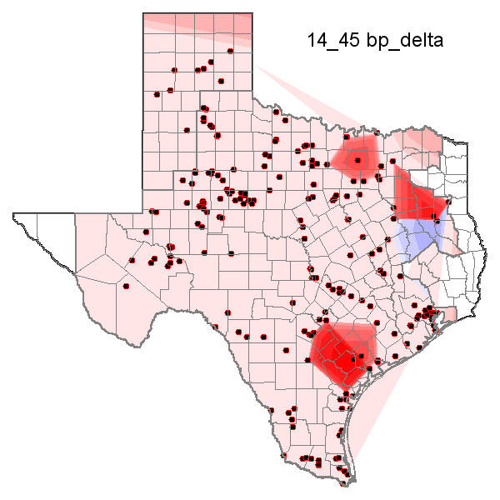
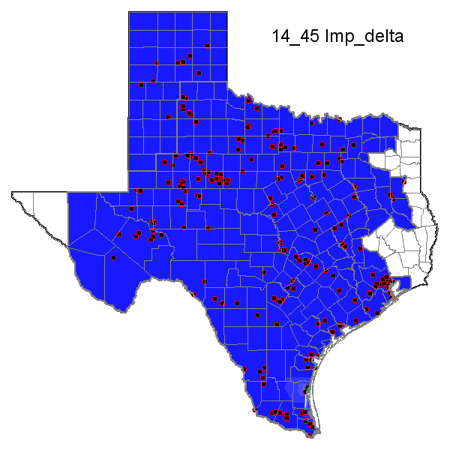
5/13/2022 14:45, RDPA = $0.00/MWh
Red, positive values represent pricing run value > dispatch run value

Slide 13
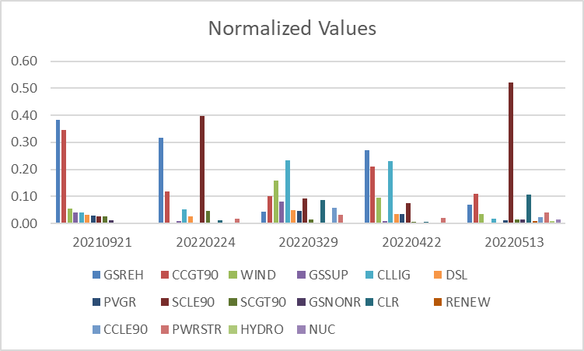
Calculated Indifference Payments by Fuel Type

Slide 14
Observations
There are two major factors that cause large differences in the pricing run relative to the dispatch run: the removal of RUCed resources which moves LMPs up and the ramp rate relaxation to 60 minutes which moves LMPs down.
The calculated indifference payments are generally lower than the current RTRDASIAMT. However, there are days with a negative RTRDASIAMT which cannot happen for the indifference payment.
There isn’t one fuel type that dominates indifference payments. This calculation is driven by marginal resources which are typically thermal plants.

