Slide 1
ERCOT IBRTF: NERC and Other Industry Updates
Julia Matevosyan
Chief Engineer
ESIG
7/8/2022

Slide 2
NERC Updates – EMT SAR
NERC Inverter-Baser Resource Performance Subcommittee: Survey of OEM Plans for IEEE 2800 Adoption, expected completion date July 13th.
NERC Reliability and Security Technical Committee approved Standard Authorization Request on inclusion of EMT models and studies in planning related NERC Standards.
The goal is:
  Ensure interconnection process is clear regarding modelling and study requirements, including EMT modelling and studies (modifications to FAC-002)
  Ensure that models are available for the purposes of reliability studies – interconnection studies per FAC-002 and planning assessments per TPL-001 (using MOD-032 as the modeling data standard, or a new standard if deemed necessary)
  Ensure that model quality issues are addressed during interconnection studies per FAC-002 and during annual case creation and planning assessment (MOD-032/TPL-001)
  Ensure that EMT studies are conducted during interconnection studies and annual planning assessment if TP or PC identifies reliability need for such studies.
Notes:
The SAR has subsequently been submitted to Standards Committee

Slide 3
NERC Updates – PRC-024 SAR
NERC-sponsored Standard Authorization Request for PRC-024:
The existing PRC-024-3 is an equipment settings standard focused solely on voltage and frequency protection
The purpose of this SAR is to retire PRC-024-3 and replace it with a performance-based ride-through standard that ensures generators remain connected to the BPS during system disturbances.
Specifically, this SAR focuses on the generator protection and control systems that can result in the output reduction or disconnection of generating resources during disturbances.
The SAR also ensures protection or controls that fail to ride through system events are analyzed, addressed with a corrective action plan (if possible), and reported to necessary entities for situational awareness.
The goal of the new standard is to mitigate the ongoing and systemic performance issues identified across multiple Interconnections and across many disturbances analyzed by NERC and the Regions.
These performance issues in many causes were unrelated to voltage and frequency protection settings as dictated by the currently effective version of PRC-024.

Slide 4
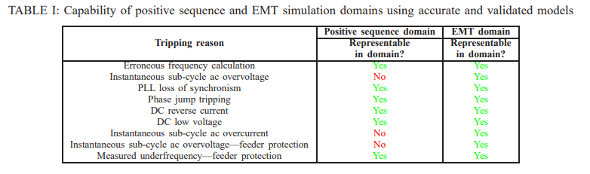
Other Updates – EPRI Modelling White Paper
EPRI* White Paper: “Differentiating between Applicability of Simulation Domains and Inverter Mathematical Models in these Domains”
* Deepak Ramasubramanian, Wes Baker, Parag Mitra, Sudipta Dutta, and Anish Gaikwad

Slide 5
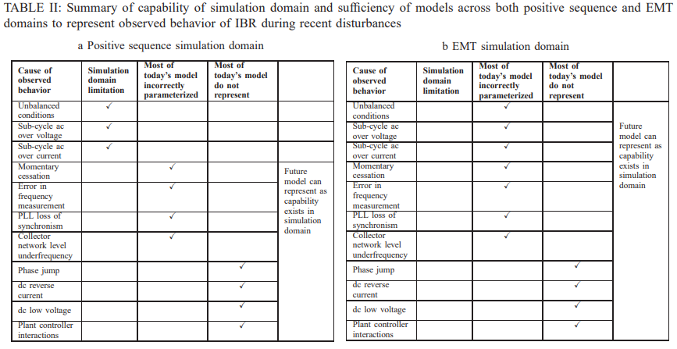
Other Updates – EPRI Modelling White Paper

Slide 6
Other Updates - FERC NOPR
FERC NOPR on Improvements to Generator Interconnection Procedures and Agreements proposes to reform the Commission’s standard generator interconnection procedures and agreements.
The proposed reforms are intended to address interconnection queue backlogs, improve certainty, and prevent undue discrimination for new technologies to ensure that the pro forma generator interconnection procedures are just and reasonable and not unduly discriminatory or preferential.
FERC’s Interconnection Notice of Proposed Rulemaking in Docket No. RM22-14 was published in the Federal Register on July 5th .
Comments are due by October 13th and reply comments are due by November 14th.
ESIG/NAGF/NERC/FERC/EPRI are planning a virtual workshop to provide education and inform industry comments, afternoons on August 9-11
Topics: interconnection process, studies and modelling, interconnection requirements/IEEE2800

Slide 7
Other Updates – GB Stability Pathfinder, Phase 2
Five grid forming batteries were awarded along-side five synchronous condensers to provide stability services in Great Britain
The focus was on increasing short circuit level in Scotland but also substitute for diminishing inertia.
These were procured through Stability Pathfinder Phase 2 tender
These resources will have to comply with recently approved Minimum Specification Required for Provision of GB Grid Forming (GBGF) Capability.
In-service date of April 2024.

Slide 8
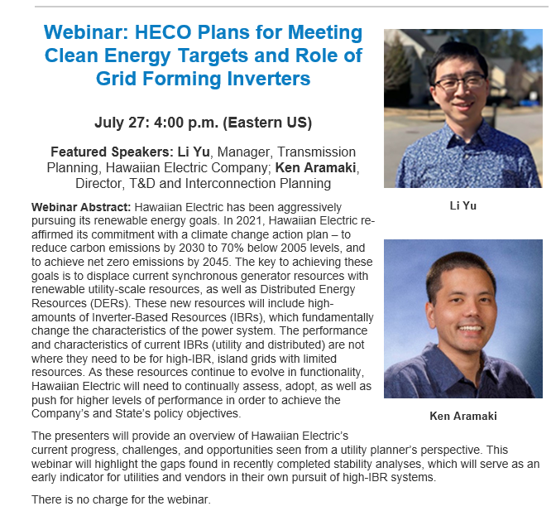
ESIG Webinar: HECO Plans for Meeting Clean Energy Targets and Role of Grid Forming Inverters
Event Page and Registration: https://www.esig.energy/event/webinar-heco-plans-for-meeting-clean-energy-targets-and-role-of-grid-forming-inverters/

Slide 9
Grid –Forming Technology in Energy Systems Integration
Julia Matevosyan
julia@esig.energy

