Slide 1
Resource Integration – Small Generation Topics
Small Gen process and New AVR Testing Template
Zach Reich, P.E.
ERCOT
Resource Integration Working Group
June 28, 2022

Slide 2
Topics: Small Generation
Small Gen Timelines, Process and Flows
New AVR Testing Template

Slide 3
Small Gen Timelines and Process Flows:

Slide 5
  This is the preferred method of submission

Slide 6
New AVR Testing Template:

Slide 7
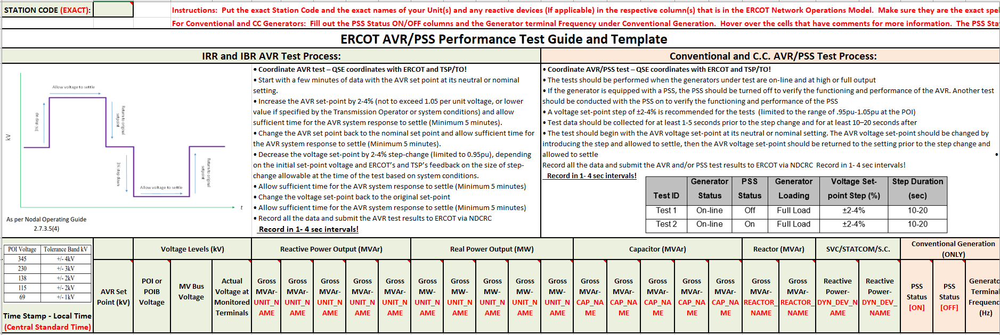
New AVR Test Template:
  Exact 2–8 character Station Code
  Local or Central Standard Time
  Exact 2–8 character Code for all devices
  Conventional and C.C. Generation need to fill this out

Slide 8
Voltage Setpoint for AVR Voltage Control test For DGR ESR/BESS and ALL IRRs and IBRs
Coordinate test with ERCOT and TDSP
Report data in 4 second intervals or smaller
Exceptions to 3% step requirement:
  If a 3% step will cause the voltage to exceed 1.05 p.u. or drop below 0.95 p.u.
  The TDSP has placed additional restrictions on the voltage setpoint
  Don’t violate any DSP or TSP restrictions
  Acceptance Criteria is on a case by bases based on agreements between the RE and TDSP
Allow voltage to settle
3% step up
Return to original setpoint
kV
3% step down
Return to original setpoint
Allow voltage to settle
t

Slide 9
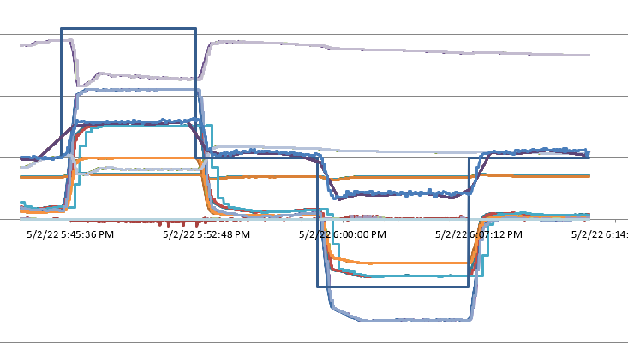
DGR / DESR Timelines and Process Flows:
  New template will cross check RE data with PI data
  Location of the new AVR Test Template:
https://www.ercot.com/services/rq/integration

Slide 10
Other contact information
ResourceIntegrationDepartment@ercot.com is distribution list for Resource Integration department
Mailing List
  RESOURCE_INTEGRATION@LISTS.ERCOT.COM

Slide 11

Questions?
Thank you!

