Slide 1
2022 Update to Rooftop Solar PV Growth Projections
Supply Analysis Working Group
June 24, 2022

Slide 2
S-Curve Growth Projections
Initial Methodology Proposed at April 12, 2019 SAWG Meeting
http://www.ercot.com/calendar/2019/4/12/172702-SAWG
Curves revised annually based on installed data
2020 Projections
http://www.ercot.com/content/wcm/key_documents_lists/195745/SAWG_April_2020_Solar_PV_Growth_Projection_Discussion.pptx
2021 Projections
https://www.ercot.com/files/docs/2021/05/18/SAWG__Meeting_5-18-2021_Updated_Rooftop_Solar_Growth_Projectionsv3.pptx
Minor update made to the moderate curve input variables since the S-curve equation tries to force solution in shorter timeframe.
Start of ramp shifted from 2019 to 2020
Provides smoother (although slightly delayed) growth

Slide 3
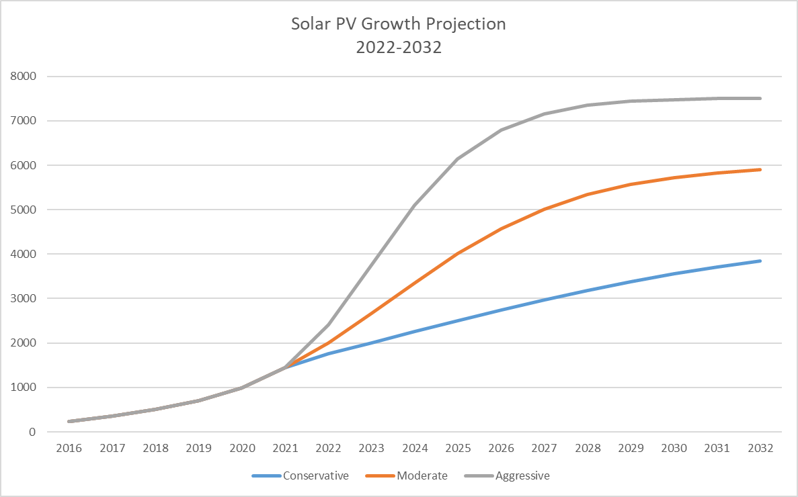
2021 Rooftop Solar PV Summary
Total of ~1440 MW for NOIES plus Competitive Choice areas
2020 moderate curve projection was ~1630 MW (pre-Covid)

Slide 4
Observations
Scenarios deviate significantly
Conservative reaches ~2500 by 2025 and ~3900 MW by 2032
Moderate reaches ~4000 MW by 2025 and ~5900 MW by 2032
Aggressive reaches ~6100 MW by 2025 and ~7500 MW by 2032
2016-2021 Data matches the “Moderate” profile best (so far).
Discussion?

