Slide 1
CDR/SARA Improvement Project Update
Pete Warnken
Resource Adequacy Dept.
June 24, 2022

Slide 2
Commissioner McAdams CDR-SARA Memo / June 16 PUCT Open Meeting

Slide 3
Commissioner McAdams Memo / June 16 Open Meeting
Highlights:
  “Framework of principles” to be in market rules by December 2022 that tie the CDR/SARA to Phase 2 market design
  Release CDR on a quarterly basis with seasonal outlooks
    Include probabilistic metric(s) (Lake)
    Gather stakeholder feedback on Reliability Standard and metrics in parallel with Consultant Phase 2 analysis (Cobos)
    Standards should support resiliency goals (McAdams)
    Put target publication dates in the Rules
      Should allow some flexibility though (Lake)
  Monthly “SARA” reports
    Identify “downside” seasonal scenarios that the fleet needs to prepare for to provide sufficient reliability (Lake)

Slide 4
Commissioner McAdams Memo / June 16 Open Meeting, continued
  Rulemaking for voluntary registration of Large Flexible Loads and critical loads
    Tie to LFLTF progress (Lake)
  Other reforms, like load forecasting improvement, resource accreditation, and scenario analysis can be managed by ERCOT rather than codify in the Rules
    Continue to collaborate with the Commission
    Maintain data and methodology transparency for stakeholders

Slide 5
ELCC Study

Slide 6
ELCC Study Rationale
Develop a library of ELCC values that can be used in the CDR/SARA successor reports
  For example, given the forecasted mix of wind, solar and battery storage (along with technology types and other attributes) for a given future year, we would have ELCC values appropriate for those resource portfolios
Lay the analytical groundwork for developing a capacity accreditation program that supports the future reliability obligation/standard (outcome of Phase 2 of the Market Design blueprint)

Slide 7
ELCC Study Statement of Work
Perform hourly analysis to obtain ELCC values for the following resource classes (total of up to 100 unique scenarios):
  Solar (25 – 50 GW in five GW steps with today’s penetration of wind/storage
  Wind (35 – 60 GW in five GW steps with today’s penetration of solar/storage
  Storage (5 – 30 GW in five GW steps with today’s penetration of solar/wind)
At one or more penetrations, test location effects on ELCC values for wind and solar
At one or more penetrations, test fixed vs tracking technology effect on solar ELCC values

Slide 8
ELCC Statement of Work, continued
At one or more penetrations, test inverter loading ratio effects on solar ELCC values
Increase wind/solar/storage in tandem up to max of +10 GW storage/ +20 GW solar/ +20 GW wind
Simulations to understand average contribution of all existing solar, wind and storage
Perform analysis to obtain ELCC values for high-risk hours of solar, wind, and storage at one selected penetration level

Slide 9
ELCC Results Matrices

Slide 10
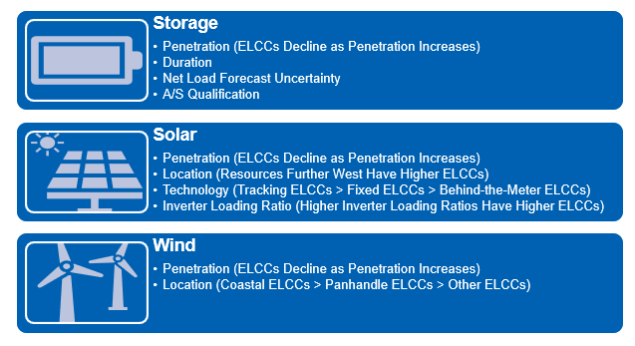
Effect of Resource Attributes on ELCCs

Slide 11
Thermal Resource ELCC
Challenge for developing thermal resource ELCCs is to separate normal random outage variability from correlated outage variability due to extreme weather events and common mode failures (e.g., major gas pipeline outage)
  Current industry methods such as UCAP apply availability adjustments based on average Equivalent Forced Outage Rates for a seasonal time period; CAISO includes outages for just the “tightest supply cushion” hours)
Will focus on February 2011 and 2021 Winter Storm Uri events as test cases for extreme cold weather/fuel limitation correlated outage evaluation

Slide 12
Thermal Resource ELCC – Results Matrix

Slide 13
ELCC for Other Resource Types
Private Use Network Generators and PUN Generators with co-located loads - TBD
Interruptible Loads - TBD

