Slide 1
Large Flexible Loads & PUNs
Evan Neel
Resource Adequacy
6/24/2022

Slide 2
Topic Agenda
LFLTF Update
LFL_49 Action Item
LFLs & PUNs in the CDR/SARA
Potential Impact to CDR/SARA
LFL & PUN Behavior
Questions/Discussion

Slide 3
LFLTF Update
Issues at hand have been categorized, split into action items, and been assigned breakout teams to work on them.
These categorizations are:
  Interconnection/Planning
  Operations
  Markets
Will be holding their 6th meeting today to check in on the progress of interconnection related action items.
Currently prioritizing the creation of an updated interim interconnection process to recommend for approval by TAC.
Next meeting will be June 29 @ 9:30 am (In-person & WebEx)

Slide 4
LFL_49 Action Item
Consider how co-located or Stand-alone LFLs and Resources should be considered in resource adequacy reports, including if they should be classified as Private Use Networks in ERCOT reports.
Action Item Owners:
  ERCOT (Evan Neel)
  Lancium (Eric Goff)
  AEP
  Oncor (Martha Henson)
  Jupiter Power (Caitlin Smith)
ERCOT’s intention is to work closely with SAWG on this item.

Slide 5
LFL_49 Action Item – Broken Down
Treatment of behind the meter loads in Resource Adequacy reports like the SARA and CDR with respect to reserve margin
  How should the generating units co-located with these loads be classified and accounted for (ex. PUN or another categorization) and what should be their granularity of reporting (ex. aggregate vs. individual)
  What methodology should be used to calculate a capacity contribution, or similar metric, for this group of resources
  Determine eligibility criteria for SARA/CDR inclusion of LFLs co-located with generation
  Characterization of deterministic risk scenarios for LFL penetration in the SARA
Determine how to appropriately incorporate stand-alone LFLs into Resource Adequacy reports through the long-term peak load forecast or other method
How will LFLs (stand-alone & co-located) be represented probabilistically in SERVM (Reserve Margin Study & ELCCs) and the probabilistic SARA operating reserve risk model

Slide 6
LFLs & PUNs in the CDR/SARA
All resources where netting occurs, and the load is not independently metered, are automatically considered PUNs in ERCOTs network model for the purpose of calculating accurate load zone prices (NPRR 945).
This does not mean they are a PUN from a legal standpoint.
However, all resources co-located with new LFLs are currently being classified as PUNs.
Commissioner McAdams of the PUC expressed in a memo the desire to have increased visibility of LFLs in resource adequacy reporting.
A separate classification for LFL resources is possible within the CDR/SARA. Will need to make decisions on:
  Granularity of reporting (individual vs. aggregate)
  Contribution calculations separate from traditional PUNs
  Qualification criteria (voluntary reporting or other)

Slide 7
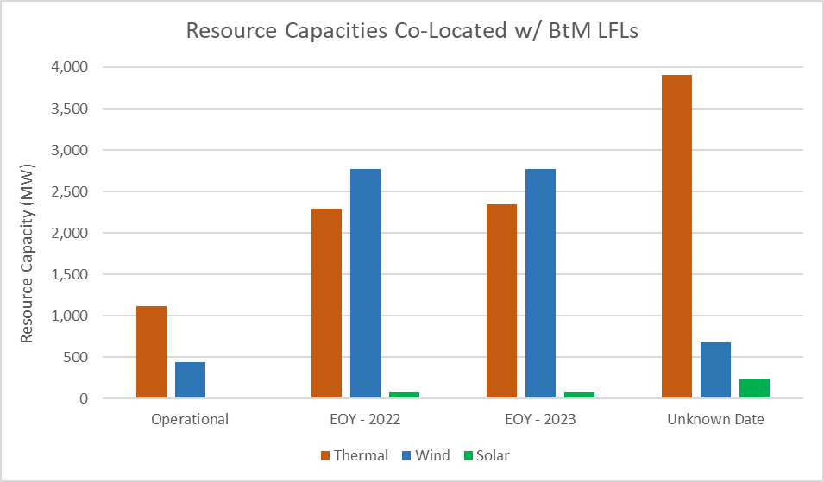
CDR/SARA Potential Impact
~ 10,000 MW could move to the PUN/LFL categorization in the coming years

Slide 8
LFL & PUN Behavior
The majority of new LFLs are Bitcoin first mining facilities.
These loads offer unique characteristics:
  Price sensitive
  Quick ramping rates
Because of this, we expect these loads to behave differently than traditional PUN loads during peak hours.
Current PUN capacity contribution calculations are based on 3 years of historical data and do not account for wind/solar capacity contributions.
Because LFLs are brand new, a historical based capacity contribution cannot be accurately calculated for newly co-located resources.
ERCOT is exploring talking with prominent Bitcoin mining companies to gain insight on load behavior in peak hours.

Slide 9
Discussion
Questions?
evan.neel@ercot.com

