Slide 1
Operating Reserve Risk Model, Summer 2022 Results
Supply Analysis Working Group
Pete Warnken
Resource Adequacy
June 24, 2022
Notes:
Welcome to

Slide 2
EEA Risk Measure: Capacity Available for Operating Reserves (CAFOR)
CAFOR Formula:
  = Seasonal Maximum Expected Resource Generation Capability
  – Demand
  – Uses of Reserves*
  + EEA Resources if CAFOR < 2,300 MW
* Uses of Reserves:
  Higher-than-expected peak demand
  Thermal unit outages
  Renewable generation below expected values

Slide 3
Model Updates

Slide 4
Model Changes
Reflects resources in the May 2022 SARA report
  Exception is that the WA Parish Unit 8 (610 MW summer rating) removed in response to ERCOT receipt of an extended outage Notice of Suspension of Operations form
Developed peak demand probability distributions for all hours, and included inter-hour correlations
  Previous approach used a probability distribution for HE 1700 only, and applied shaping factors to get values for the other hours that are proportional to the load forecast values

Slide 5
Model Changes, continued
Incremental price-responsive demand reduction supply schedule updated based on 2021 Annual Report of Demand Response in the ERCOT Region (December 2021)
  Overall lower amounts than the 2020 report, but new schedule triggers amounts at a lower peak demand threshold
New Schedule
Old Schedule

Slide 6
Simulation Results

Slide 7
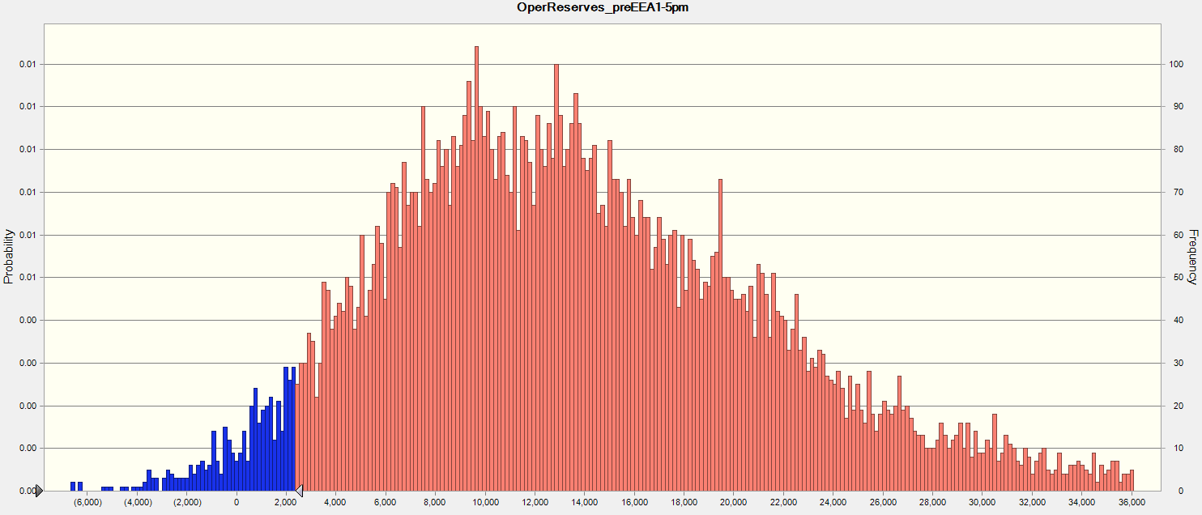
“Capacity for Operating Reserves” Outcome Distribution, HE 5:00 PM (10,000 Trial Simulation)
Energy Emergency Alert outcomes,
N = 419
Simulation Outcome Range: 55,729 MW to -6,674 MW
Most extreme scenario for 2022 Summer SARA: -7,756 MW

Slide 8
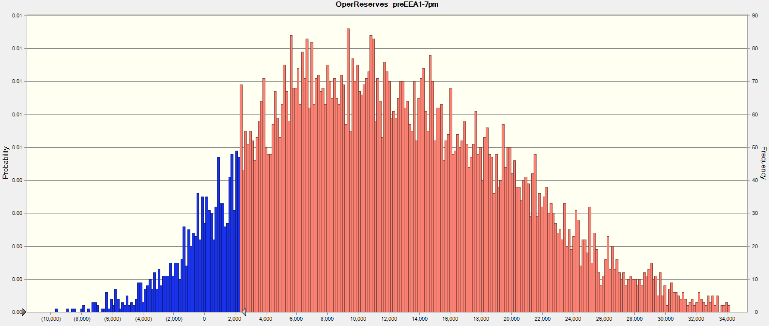
“Capacity for Operating Reserves” Outcome Distribution, HE 7:00 PM (10,000 Trial Simulation)
Energy Emergency Alert outcomes
(N = 1,049)
Simulation Outcome Range: 43,611 MW to -10,667 MW

Slide 9
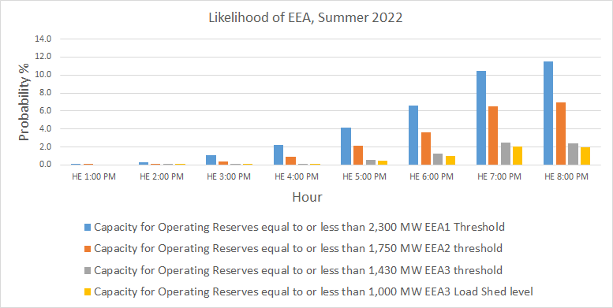
Hourly Risk Profile, Summer 2022
Increased solar penetration shifting highest-risk hours for reserve capacity shortages to later hours

Slide 10
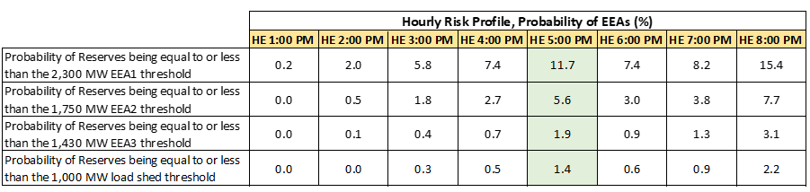
Hourly Risk Profiles, Summer 2022 vs. 2021

