Slide 1
NOGRR 226 Studies
Preliminary Results & Recommendations
ERCOT Staff
June 23, 2022
OWG

Slide 2
Introduction
NOGRR226 proposes to raise the first 5% Transmission Operator (TO) Load shedding relay set point requirement from 59.3 Hz to 59.4 Hz.
NOGRR226 indicates that when the frequency falls below 59.4 Hz, there is risk of damage to turbine blades and that in order to avoid this damage, a relay is triggered that will trip the generator Off-Line after nine minutes. By raising the 1st stage UFLS threshold, the risk of operating at frequency levels that may cause damage may be reduced.
Since mid-February ERCOT has been conducting studies in the following areas to investigate the relevant impacts of changing the first-stage Under Frequency Load Shed (UFLS) relay set point from 59.3 Hz to 59.4 Hz and other relevant ideas.
Impact on Responsive Reserve Service Requirements & Critical Inertia
Impact on Energy Emergency Alert (EEA) Level 3 Physical Responsive Capability (PRC) analysis
Impact on UFLS
The following slides will summarize ERCOT’s findings and recommendations based on this analysis.

Slide 3
Summary of Findings & Recommendations
ERCOT does not recommend changes to the 1st stage UFLS setting as proposed in NOGRR226, because with 1st stage UFLS setting at 59.4 Hz, ERCOT’s RRS program is no longer able to meet ERCOT’s design criteria for RRS*.
Specifically, if the 1st Stage of UFLS is changed to 59.4 Hz, when system inertia is below 150 GW.s, speed of response from Load Resource (LRs) that provide RRS-UFR is not sufficient to keep frequency nadir at or above 59.5Hz for loss of 2,805 MW.
To address the risk of damage and loss of life concerns that were raised in NOGRR226, ERCOT considered two alternative options. Specifically,
With 1st stage UFLS setting changed to 59.4 Hz, to operate at inertia levels lower than 150 GW.s, faster response time setting of around 15 cycles is needed for Load Resources that provide RRS-UFR.
Feasibility of implementing 15 cycle response in a reliable manner is a concern with this alternative.
Include an additional anti-stall UFLS stage that triggers earlier than the current 1st stage UFLS setting of 59.3Hz. It is recommended that,
a higher trigger frequency setting of around 59.5 Hz be used to limit exposure of potential equipment damage due to operating at lower frequency levels and
a larger time delay starting at around 90 seconds be used to avoid triggering this anti-stall UFLS stage during a Frequency Measurable Event.
*RRS is designed to meet ERCOT’s FRO under BAL-003. Specifically, for the loss of 2,805 MW nadir of frequency must stay above 1st stage UFLS setting. RRS studies maintain an additional 100 mHz margin. 2,805 MW is ERCOT’s Resource Loss Protection Criteria (RLPC) under BAL-003.

Slide 4
Summary of Findings & Recommendations
The minimum level of Physical Responsive Capability (PRC) that will be maintained during emergency operations to ensure that sufficient response is available to protect against the loss of 1,430 MW** must be increased.
With current setting for 1st stage UFLS, a minimum PRC of around 1,500 MW must be maintained during emergency operations.
If 1st stage UFLS is changed to 59.4 Hz, a minimum PRC of around 1,800 MW must be maintained during emergency operations.
Note that the above PRC level recommendations do not take into account any potential inconsistencies in telemetered information.
**1,430 MW is ERCOT’s Most Severe Single Largest Contingency (MSSC).

Slide 5
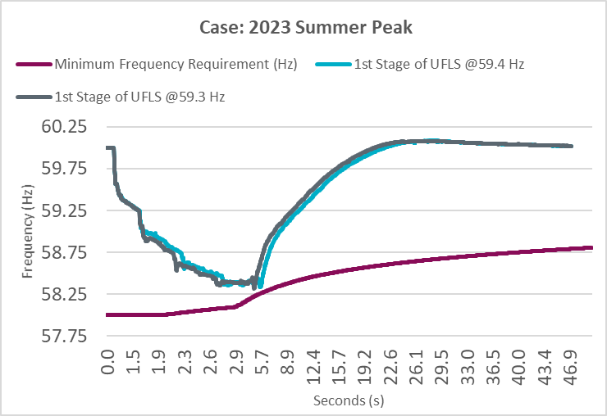
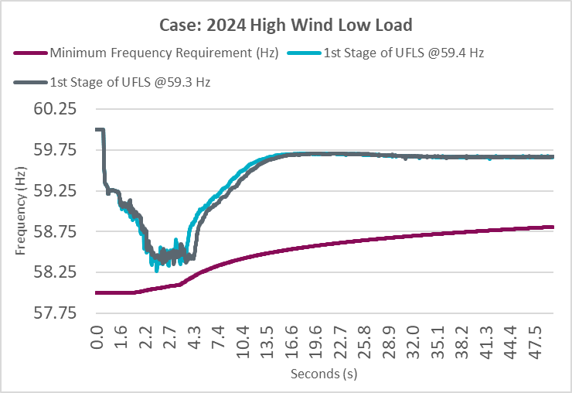
Impact of changing 1st Stage UFLS: Dynamic Studies Summary
Scenario 1: Changing the first stage frequency set point to 59.4 Hz from 59.3 Hz for 25% imbalance
Observation:
Rate of return for frequency seems consistent with change in first stage frequency relay set point.
Amount of Load shed as a result of UFLS triggering was not significantly different across the two cases for both High Wind Low Load (HWLL) and Summer Peak conditions.
Scenario 2: Test how the units that tripped due to frequency reasons during Feb 2021 Winter storm respond to large frequency deviations in these studies with submitted models
Observation:
Units that experienced forced outages during 2021 Winter storm did not trip in UFLS simulations due to any automatic response within the model. It worth recognizing that during 2021 Winter storm, the mechanisms by which the unit trips are likely not represented in the current dynamic models. In future, as the ERCOT’s models evolve additional studies may be needed to analyze if these operational limitations may manifest during an UFLS event and determine if changes to UFLS block sizes/frequency setpoint may be needed.

Slide 6
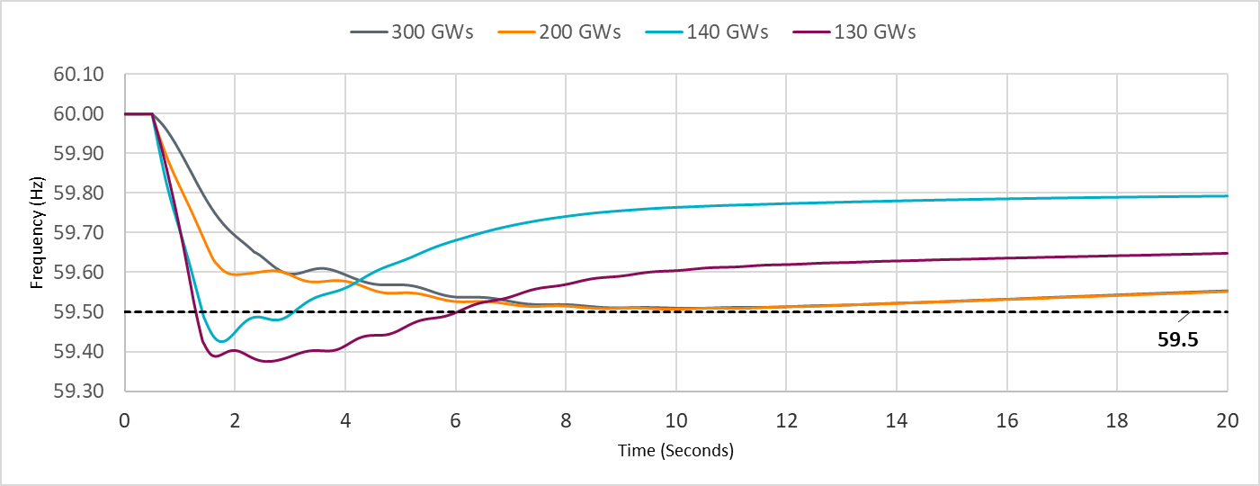
Impact of changing 1st Stage UFLS: RRS Dynamic Studies
If the 1st Stage of UFLS is changed to 59.4 Hz, when system inertia is below 150 GW.s, the speed of response from Load Resource (LRs) that provide RRS-UFR is not sufficient to keep frequency nadir at or above 59.5Hz for loss of 2,805 MW.
*RRS is designed to meet ERCOT’s FRO under BAL-003. Specifically, for the loss of 2,805 MW nadir of frequency must stay above 1st stage UFLS setting. RRS studies maintain an additional 100 mHz margin. 2,805 MW is ERCOT’s Resource Loss Protection Criteria (RLPC) under BAL-003.

Slide 7
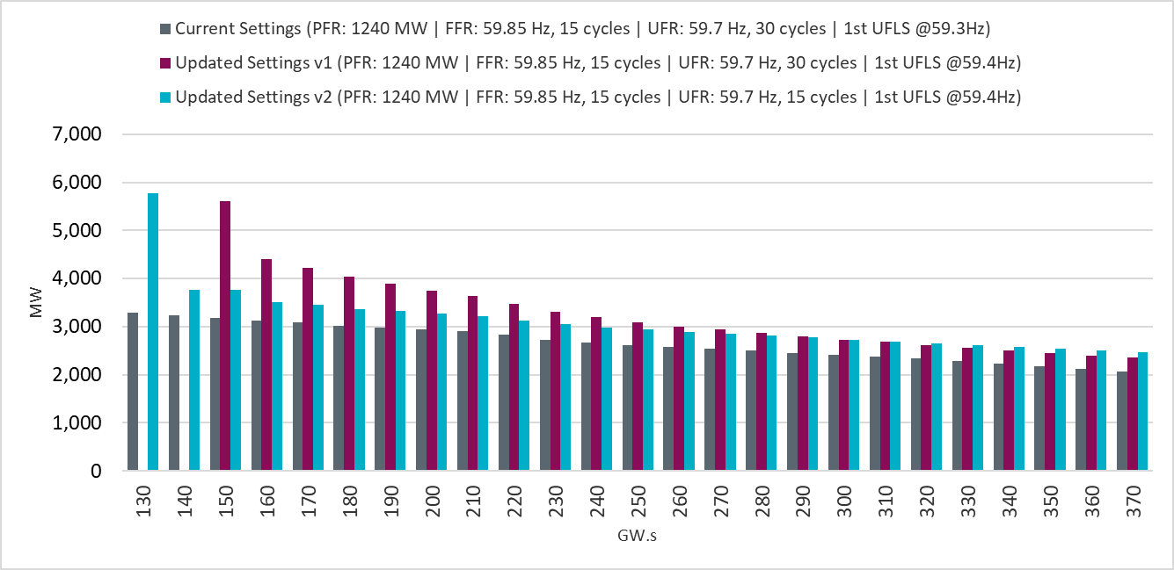
Impact of changing 1st Stage UFLS: RRS Requirement
If the 1st Stage of UFLS is changed to 59.4 Hz and with current RRS-UFR settings (i.e. triggered at 59.7Hz with 30 cycle response time)
To reiterate, at inertia levels below 150 GW.s, no amount of Load Resource response was able to meet ERCOT’s design criteria for RRS. AND
For inertia levels between 150 GW.s and 370 GW.s, the RRS quantities will increase between 300 MW and 2,500 MW.

Slide 8
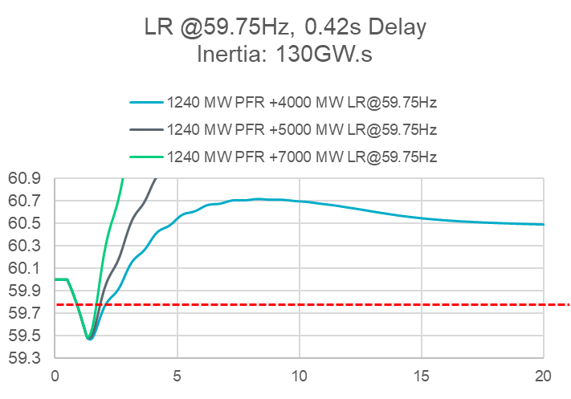
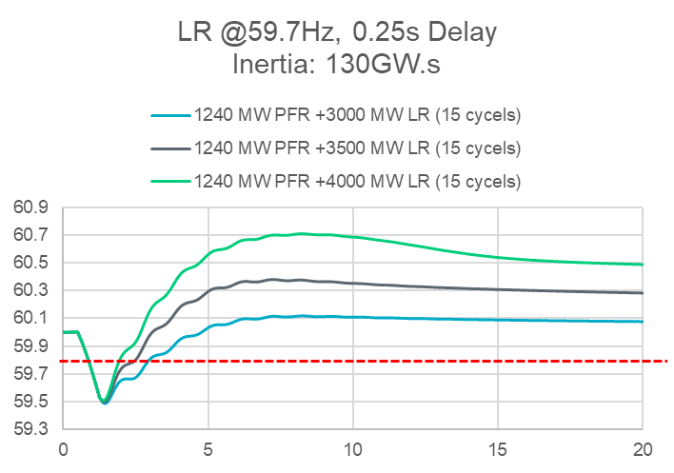
Impact of changing 1st Stage UFLS: Load Resource Settings
With 1st Stage UFLS changed to 59.4 Hz, at inertia level of 130GW.s, around 3,500 MW response within 15 cycles from LRs is necessary to meet ERCOT’s design criteria for RRS*.
*RRS is designed to meet ERCOT’s FRO under BAL-003. Specifically, for the loss of 2,805 MW nadir of frequency must stay above 1st stage UFLS setting. RRS studies maintain an additional 100 mHz margin. 2,805 MW is ERCOT’s Resource Loss Protection Criteria (RLPC) under BAL-003.
Trigger Frequency: 59.7Hz 59.75Hz
Response time:0.42s 0.25s (15 cycle)
 | 4000 MW LR | 5000 MW LR | 7000 MW LR
C Point (Hz) | 59.47 | 59.48 | 59.48
 | 3000 MW LR | 3500 MW LR | 4000 MW LR
C Point (Hz) | 59.49 | 59.50 | 59.51

Slide 9
Anti Stall UFLS Proposal: Dynamic Studies
Study: The impact of adding an Anti-Stall UFLS stage to existing UFLS relays at frequency level that are at or above the first stage UFLS at 59.3 Hz with time delay of 10 seconds was studied.
Study Results
Frequency Threshold | TO Load Relief | Delay to Trip
59.4 Hz | At least 1% of the TO Load | 30 seconds
59.4 Hz | At least 1% of the TO Load | 60 seconds
59.4 Hz | At least 1% of the TO Load | 90 seconds
59.4 Hz | At least 1% of the TO Load | 120 seconds
Study Data | Summer Peak |  |  | High Wind Low Load
 | 4% Load Trip | 3% Load Trip | 1% Load Trip | 4% Load Trip | 3% Load Trip | 1% Load Trip
Frequency Nadir (Hz) (Point C) | 59.32 | 59.32 | 59.32 | 59.35 | 59.35 | 59.35
Load Resource Deployed (MW) | 1390 | 1390 | 1390 | 1379 | 1379 | 1379
Load tripped due to anti stall relay (MW) | 2829 | 2148 | 734 | 1598.58 | 1227 | 423.79
(non anti-stall) UFLS deployed | No | No | No | No | No | No
Met Frequency Performance Characteristics | Yes | Yes | Yes | Yes | Yes | Yes
Met V/Hz Performance Characteristics | Yes | Yes | Yes | Yes | Yes | Yes
Post-Disturbance Frequency (Hz) (Point B) | 59.9 | 59.8 | 59.6 | 59.91 | 59.78 | 59.54

Slide 10
Anti-Stall UFLS Stage: Settings Review
Standard UFLS Stages (No change)
Frequency Threshold | TO Load Relief | Delay to Trip
59.3 Hz | At least 5% of the TO Load | No more than 30 cycles
58.9 Hz | A total of at least 15% of the TO Load | No more than 30 cycles
58.5 Hz | A total of at least 25% of the TO Load | No more than 30 cycles
Supplemental Kicker/Anti-Stall UFLS Stages (Proposed)
Frequency Threshold | TO Load Relief | Delay to Trip
59.4 Hz | At least 1% of the TO Load | 30 seconds
59.4 Hz | At least 1% of the TO Load | 60 seconds
59.4 Hz | At least 1% of the TO Load | 90 seconds
59.4 Hz | At least 1% of the TO Load | 120 seconds
Will this be triggered by loss of 2,805 MW?
The next few slides will assess if there is any concern that the proposed anti-stall UFLS could interact with frequency response if it triggers at 59.4 Hz.
Notes:
75mHz

Slide 11
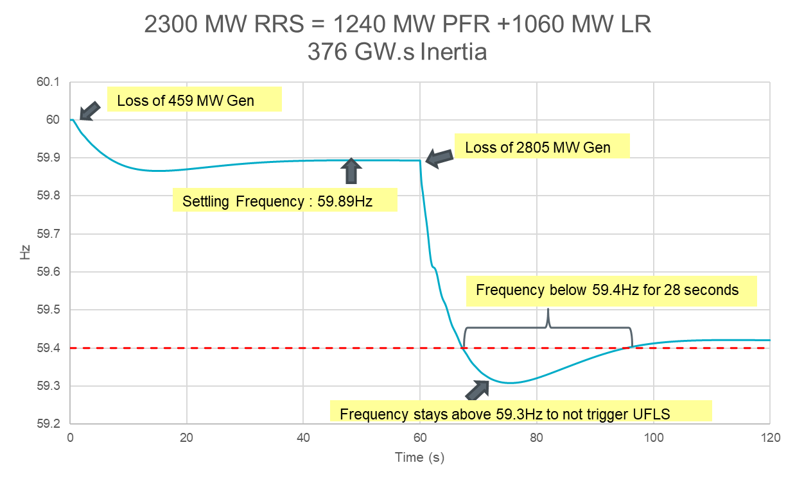
Anti-Stall UFLS Stage: Settings Study Observation
With a starting frequency of around 59.89 Hz, for the loss of 2,805 MW of generation, frequency was below 59.4 Hz for 28 seconds. Hence, with a larger delay (ex. 30s or higher) the likelihood of the anti-stall UFLS stage triggering under typical situations is low.

Slide 12
Anti-Stall UFLS Stage: Settings Review Option 2
Standard UFLS Stages
Frequency Threshold | TO Load Relief | Delay to Trip
59.3 Hz | At least 5% of the TO Load | No more than 30 cycles
58.9 Hz | A total of at least 15% of the TO Load | No more than 30 cycles
58.5 Hz | A total of at least 25% of the TO Load | No more than 30 cycles
Supplemental Kicker/Anti-Stall UFLS Stages
Frequency Threshold | TO Load Relief | Delay to Trip
59.5 Hz | At least 1% of the TO Load | X seconds
59.5 Hz | At least 1% of the TO Load | 60 seconds
59.5 Hz | At least 1% of the TO Load | 90 seconds
59.5 Hz | At least 1% of the TO Load | 120 seconds
Will this be triggered by loss of 2,805 MW?
The next few slides will assess if there is any concern that the proposed anti-stall UFLS could interact with frequency response if it triggers at 59.5 Hz.

Slide 13
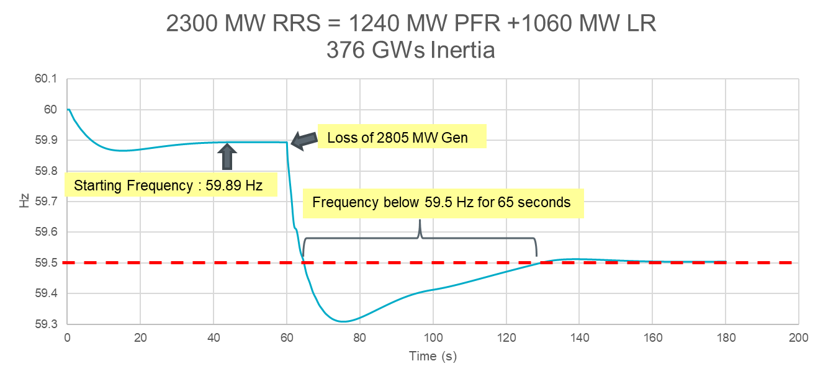
Anti-Stall UFLS Stage: Settings Study Observation
With a starting frequency at 59.89 Hz, for the loss of 2,805 MW generation, frequency was below 59.5 Hz for at least 52 seconds. Hence, even in this scenario, a larger delay (ex. 90s or higher) is recommended so that the anti-stall UFLS stage does not trigger for a Frequency Measurable Event (FME).

Slide 14
Anti-Stall UFLS Stage Settings – Recommendation
Addition of an anti-stall UFLS stage alone may be sufficient to limit exposure potential equipment damage due to operating at lower frequency levels and provide ERCOT Control Room additional time to respond to evolving grid conditions.
It is recommended that,
a higher trigger frequency setting of around 59.5 Hz* be used to limit exposure potential equipment damage due to operating at lower frequency levels and
a larger time delay starting at around 90 seconds be used to avoid triggering this anti-stall UFLS stage during a Frequency Measurable Event.
Below is one possible option of how the anti-Stall UFLS at 59.5 Hz may be designed.
Note that if option of triggering at 59.5 Hz is acceptable, ERCOT is open to exploring additional variations in quantity of load shed and number of triggers.
*Since 2000 there have been only two events that ERCOT is aware of wherein frequency has dropped below 59.5 Hz (see slide 20 for more details on these events).
Frequency Threshold | TO Load Relief | Delay to Trip
59.5 Hz | At least 1% of the TO Load | 90 seconds
59.5 Hz | At least 1.5% of the TO Load | 120 seconds
59.5 Hz | At least 2.0% of the TO Load | 130 seconds
59.5 Hz | At least 2.0% of the TO Load | 150 seconds

Slide 15
EEA Level 3 Studies: Introduction
The objective during EEA Level 3 is to “maintain frequency responsive headroom such that trip of ERCOT’s Most Severe Single Contingency (MSSC) will not cause 1st stage of UFLS to trigger”
Study 1: With no load ramp (starting from a frequency 60 Hz), for loss of 1,430 MW, identify the amount of PFR needed to keep frequency nadir just above 59.4 Hz
Study 2: With load ramp (starting from a frequency lower than 60 Hz), for loss of 1,430 MW, identify the amount of PFR needed to keep frequency nadir just above 59.4 Hz

Slide 16
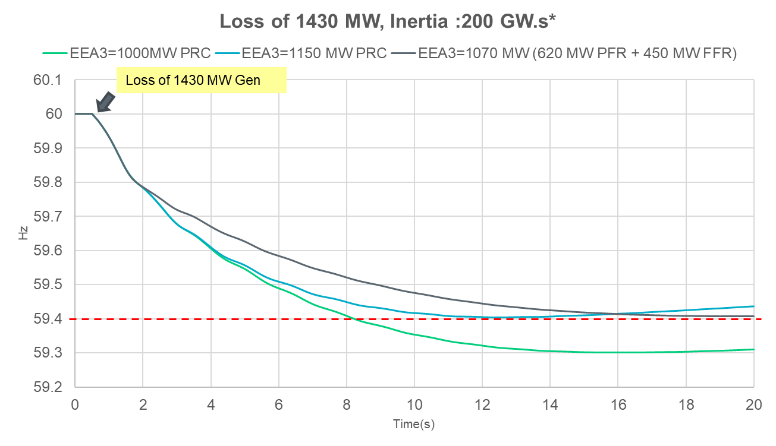
EEA3 Study 1 @ Mid Inertia Level
*Since Jan 1, 2019 during hours when grid operating conditions were tight, system inertia stayed above 200 GW.s inertia level.

Slide 17
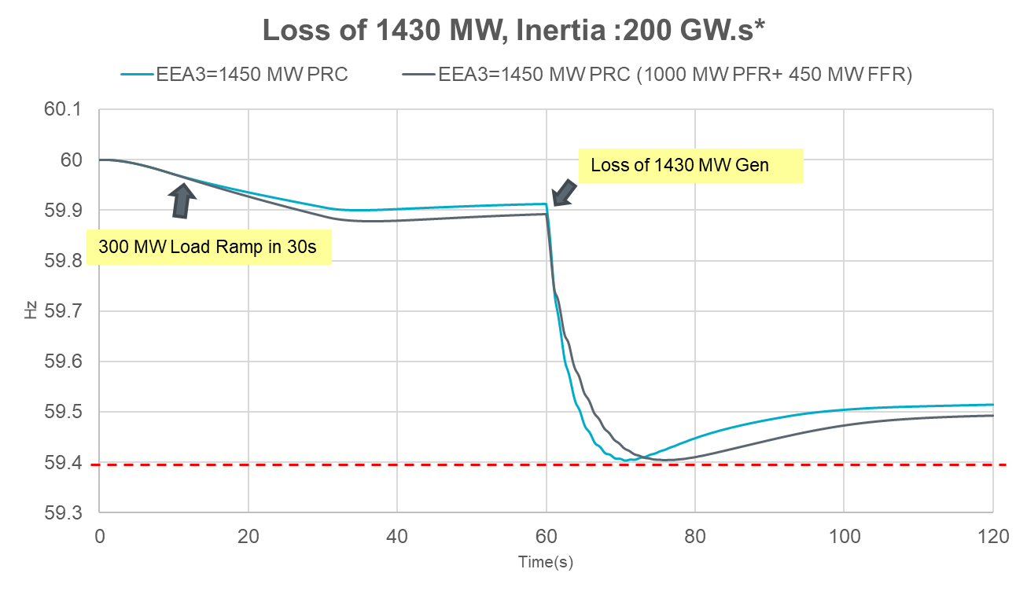
EEA3 Study 2 (300 MW Load Ramp) @ Mid Inertia Level
*Since Jan 1, 2019 during hours when grid operating conditions were tight, system inertia stayed above 200 GW.s inertia level.

Slide 18
EEA3 Study Results Summary
EEA3 Trigger For Inertia:200 GW.s* | UFLS @ 59.3 Hz |  | UFLS @ 59.4 Hz
 | w/o FFR | w/ 450 MW FFR | w/o FFR | w/ 450 MW FFR
w/o Load Ramp | 1,150 MW | 1,070 MW | 1,450 MW | 1,410 MW
w/ 300 MW Load Ramp | 1,450 MW | 1,450 MW | 1,800 MW | 1,700 MW
The minimum level of Physical Responsive Capability (PRC) that will be maintained during emergency operations to ensure that sufficient response is available to protect against the loss of 1,430 MW** must be increased.
With current setting for 1st stage UFLS, a minimum PRC of around 1,500 MW must be maintained during emergency operations.
If 1st stage UFLS is changed to 59.4 Hz, a minimum PRC of around 1,800 MW must be maintained during emergency operations.
Note that the above PRC level recommendations do not take into account any potential inconsistencies in telemetered information.
ERCOT expects to file an NPRR to address this issue in the near future.
*Since Jan 1, 2019 during hours when grid operating conditions were tight, system inertia stayed above 200 GW.s inertia level.
**1,430 MW is ERCOT’s Most Severe Single Largest Contingency (MSSC).

Slide 19
Appendix

Slide 20
Past Events
ERCOT has had two instances since 2000 wherein frequency has dropped below 59.5 Hz
May 15, 2003: Two Comanche Peak unit tripped causing frequency to drop to 59.29 Hz and triggered first stage of UFLS; Frequency was below 59.4 Hz for a few seconds.
Feb 15, 2021: A “slow frequency event” caused by steady loss of generation caused frequency to drop to 59.303 Hz and caused 276.24 MW of Load on UFLS to trip; Frequency was below 59.4 Hz for 4 minutes 24 seconds.

Slide 21
Feb 15, 2021 EEA Event – Generator Outages due to Equipment Issues
Four units (two Coal and two Natural Gas) derated or tripped offline due to equipment issues caused by the changes in frequency between 1:30 am and 2:45 am on Feb 15, 2021. Below are some anecdotes from the cause information shared with ERCOT.
Cause of the trip was a high exhaust back pressure trip on the unit, owing to an unexpected low frequency response owing to extreme cold weather.
When frequency increased rapidly to 60.2 Hz, the unit rapidly decreased output however the inertia that remained in the machine from the rapid ramp created too much steam in the boiler resulting in the safety valves lifting; ultimately tripping (the unit) offline due to low differential pressure in the boiler water circulating pumps.
After unit was stabilized from throttle pressure impulse line freezing, significant system frequency event caused boiler upset and subsequent trip.

