Slide 1
ERCOT Frequency Control Report
May 2022
ERCOT
Operations Planning
PDCWG | June 16th, 2022

Slide 2
Summary of May 2022
CPS1: 172.61%
Current CPS1 12-Month Rolling Average: 172.65%
0 BAAL Exceedance(s)
2 hourly CPS1 score below 100%
BAAL-003 Events have updated through 2020
2020 BAAL-003 FRM Performance: -789.34
2022 RMS1 Statistics
  Mean: 15.40 mHz
  Min: 12.43 mHz
  Max: 19.12 mHz
Energy Statistics
  Total Energy: 38,601,553 MWh
  Wind Energy: 12,466,309 MWh
  Percent Energy from Wind: 32.29 %
  Solar Energy: 2,334,986 MWh
  Percent Energy from Solar: 6.05%
Minimum System Inertia
  Mean: 200,821 MW*s
  Max: 255,165 MW*s on May 15th
  Min: 151,876 MW*s on May 2nd

Slide 3
Frequency Control
CPS1, BAAL, & RMS1

Slide 4
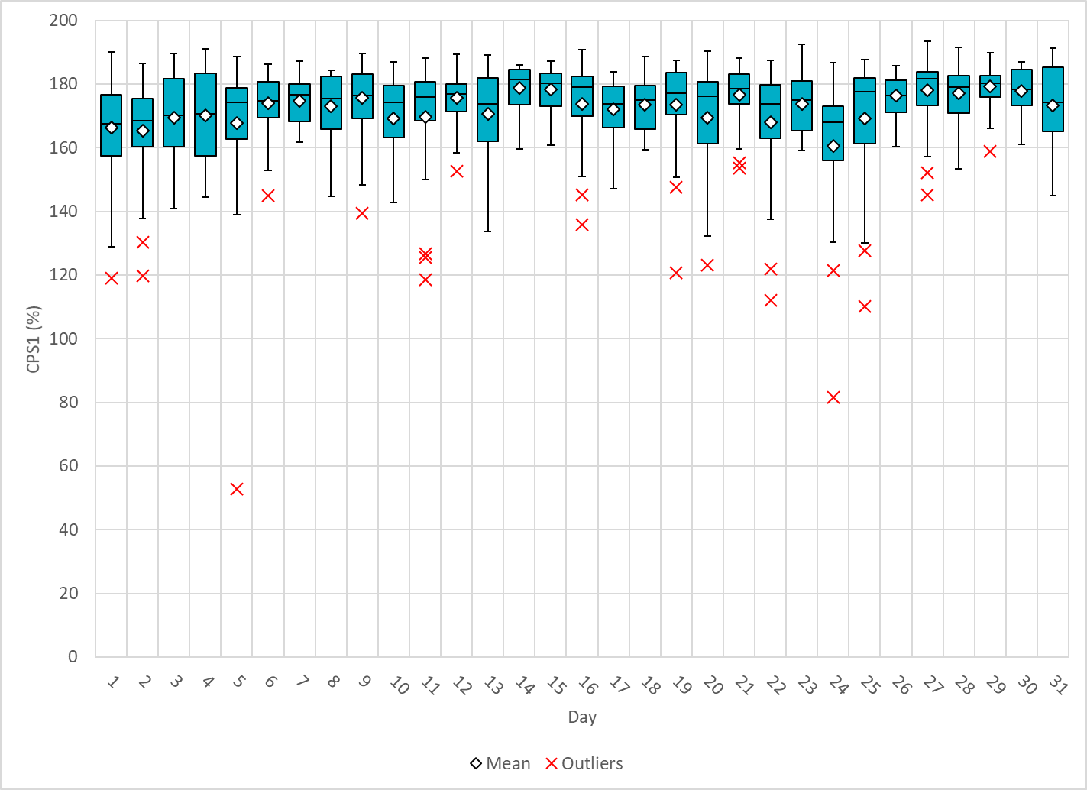
Hourly CPS1 by Day
May-22 CPS1 (%): 172.61
Notes:
1. 52.87%@ 5/5/2022 HE 20:00
Expected Generation Deviation
Between 19:00-20:00 the Expected gen dev remained negative. The largest expected gen dev was -13098 MW @ 19:42am with signification contribution from wind generation.
IRR Ramps
Between 19:00-20:00 wind ramped down by ~4400MW and solar ramped down by ~4400 MW
Regulation: Regulation up was exhausted during the second and third quarters of the hour. One manual SCED offset of 350 MW.
2. 81.62% @ 5/24/2022 HE 08:00
Expected Generation Deviation
Expected gen dev remained negative for the first half of the hour. The largest expected gen dev was -2550 MW @ 7:07am with signification contribution from wind resources.
IRR Ramps
Between 7:00pm to 7:15am wind ramped down by ~1400 MW
Regulation: Regulation up was exhausted at the start of the hour. Multiple SCED offsets were applied, the largest being a 350 MW SCED manual offset.

Slide 5
BAAL Exceedances & Violations
There are 0 BAAL exceedance(s) in May

Slide 6
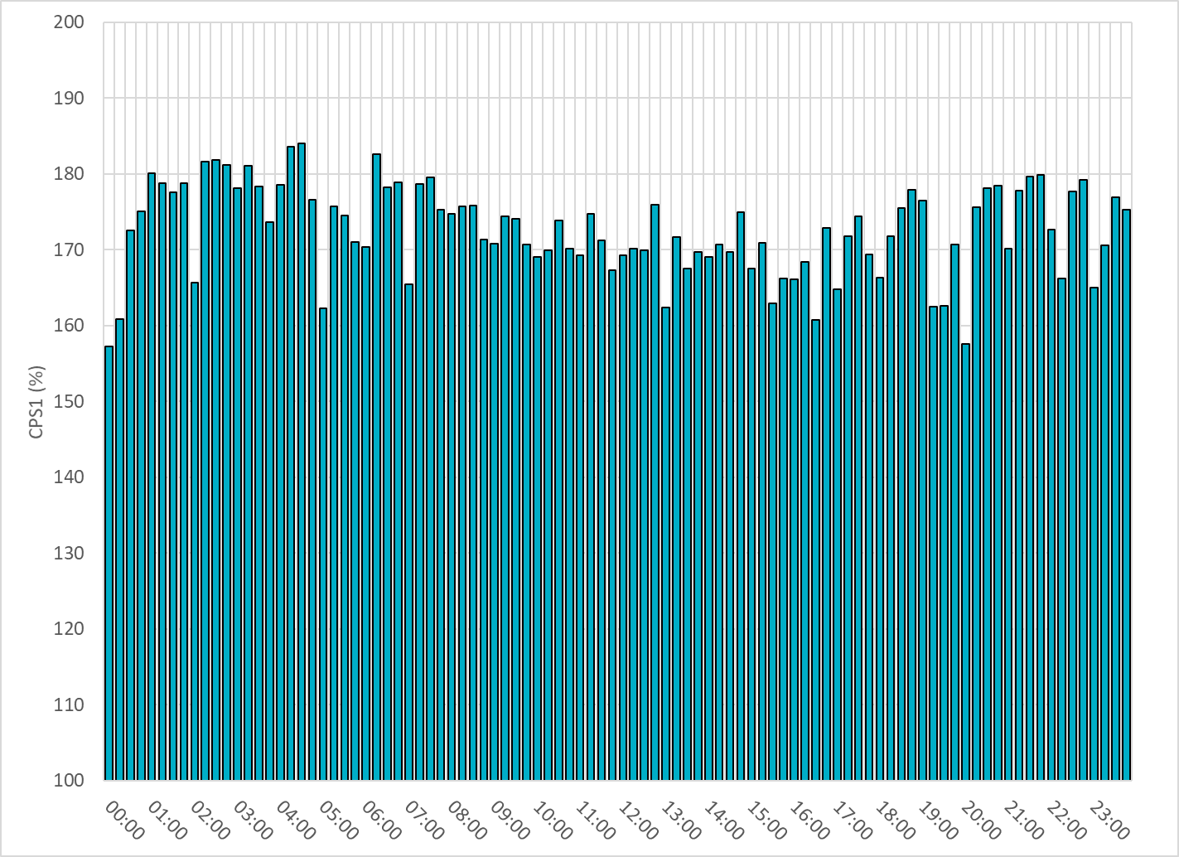
15-Minute Average CPS1%
May-22 CPS1 (%): 172.61
Notes:
Overall the 15 min CPS1 score is above 160, Between 19:00 and 20:00 ,the CPS1 is slightly below 160 due to solar down ramps.

Slide 7
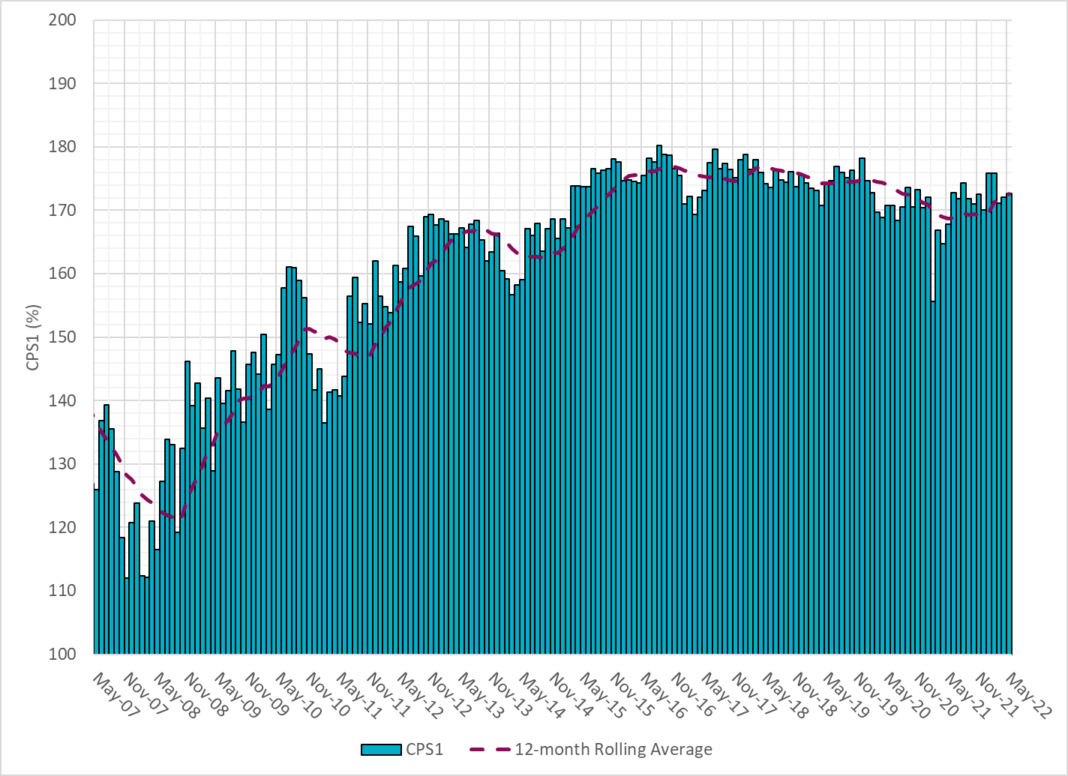
12-Month Rolling Average CPS1
Current 12-Month Rolling Average: 172.65%
Notes:
12 month rolling average CPS1 score is 172.65, which is good and CPS1 score for May is slightly higher than the last month.

Slide 8
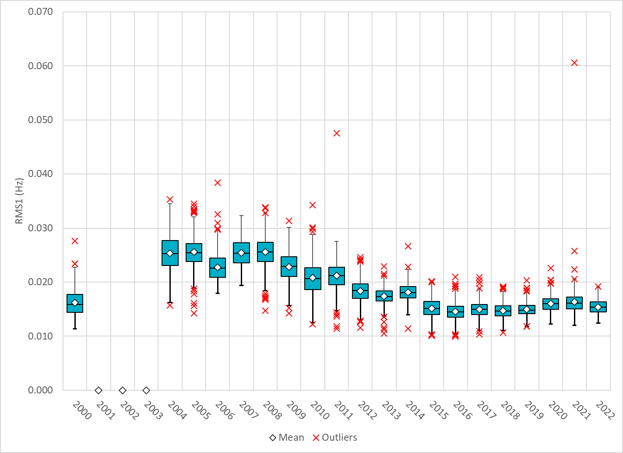
Daily RMS1 of ERCOT Frequency by Year
Notes:
Daily RMS1 frequency by year is so far slightly smaller overall compared with the 2021.
Mean: 15.40 mHz
Min: 12.43 mHz
Max: 19.12 mHz

Slide 9
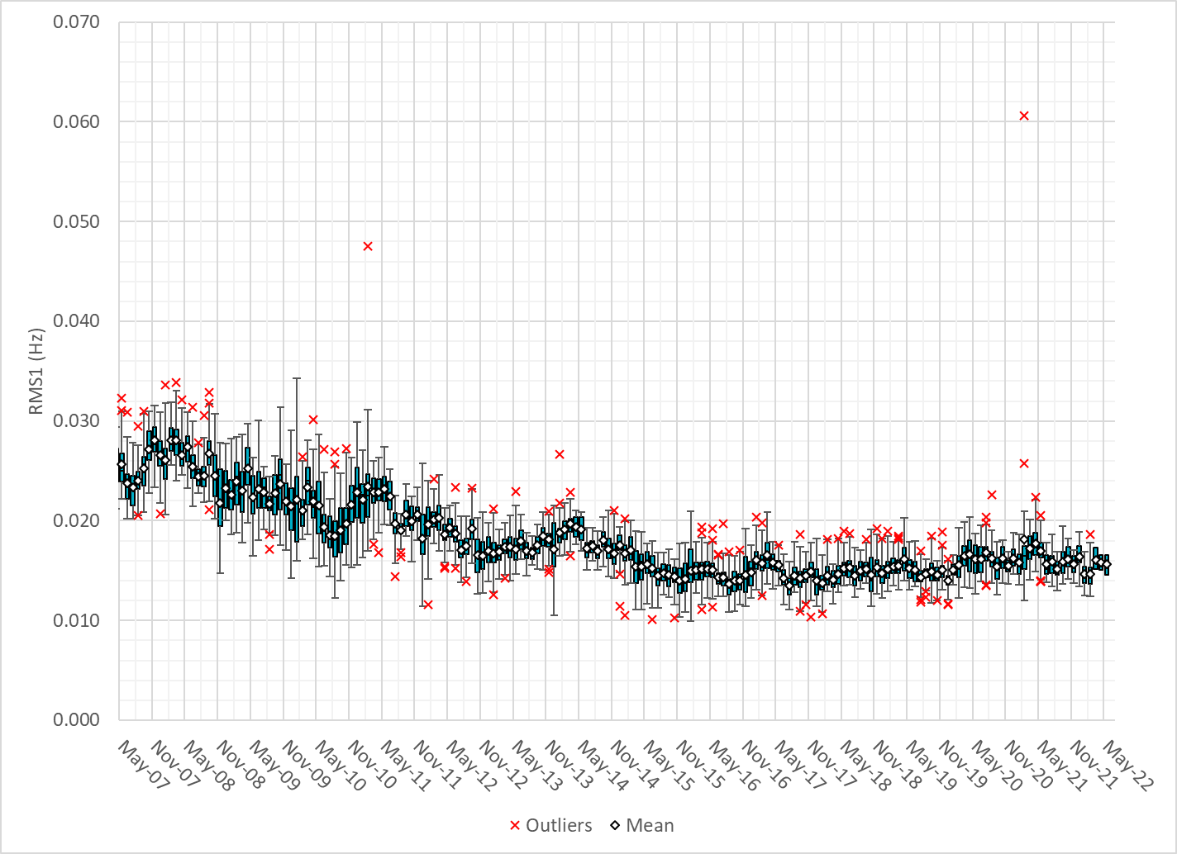
Daily RMS1 of ERCOT Frequency by Month
Notes:
A More granular look at last 15 years of RMS1 by month
15.66Mhz on avg for May 2022

Slide 10
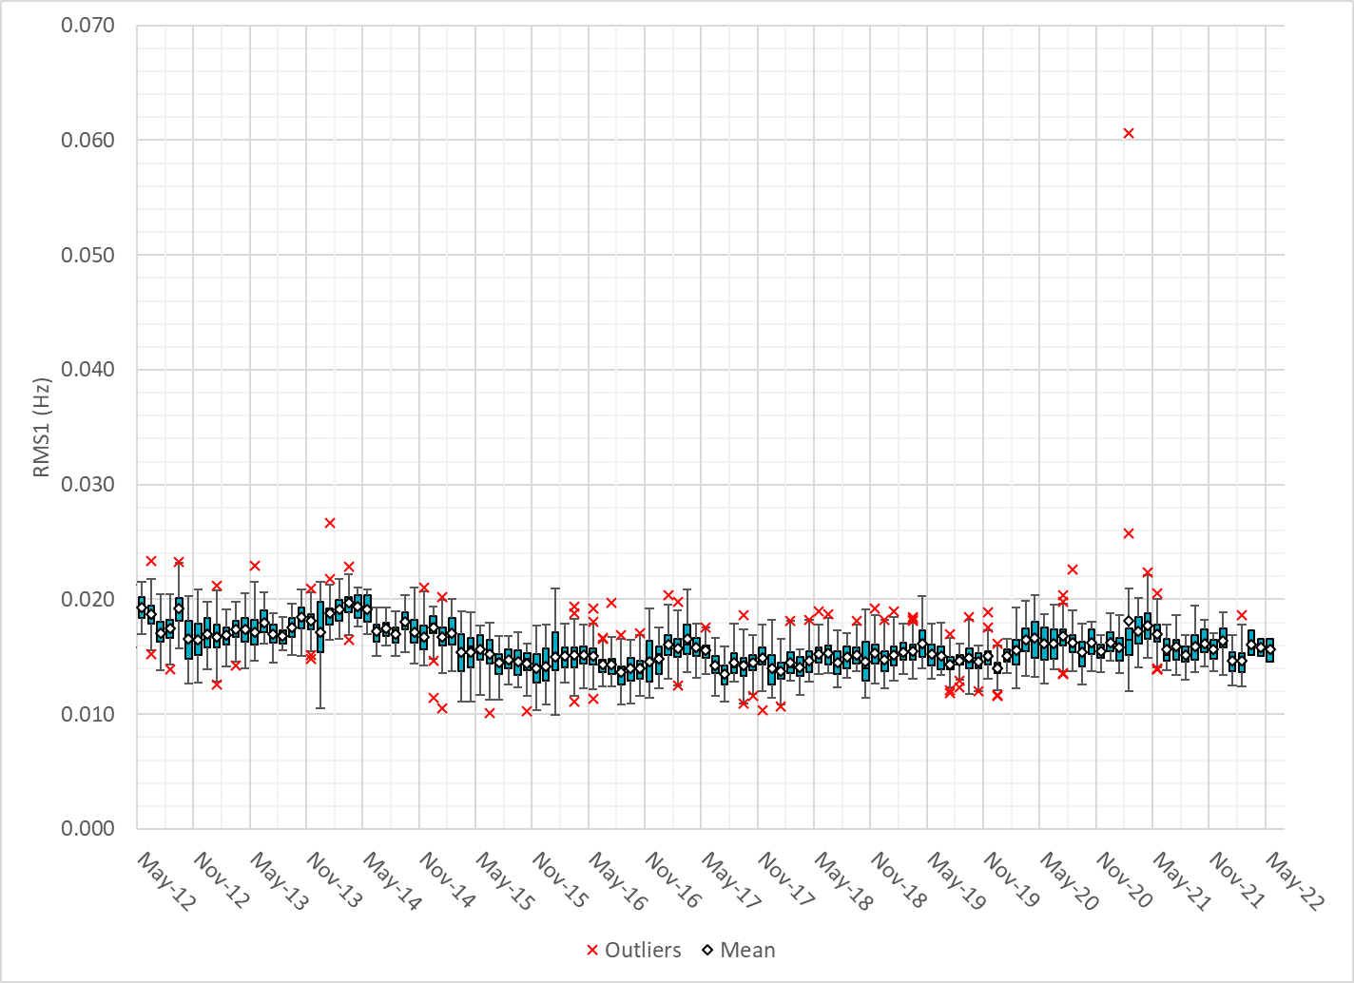
Daily RMS1 of ERCOT Frequency by Month
Notes:
Same data but only showing for the last 10 years

Slide 11
Frequency Profile Comparison

Slide 12
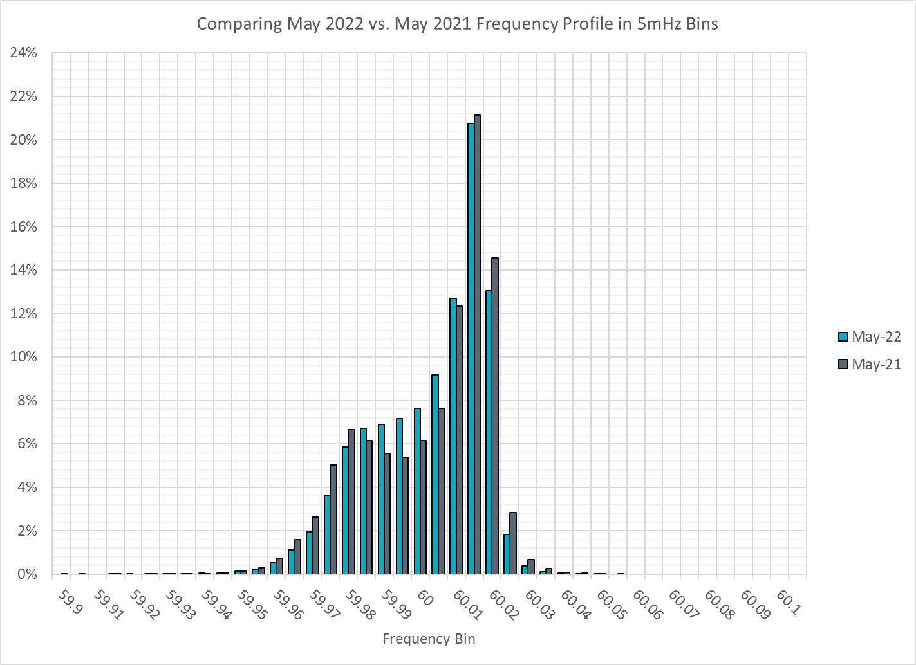
Frequency Profile Comparison
Notes:
Comparison of frequency profile for May 2021 and May 2022, for 2022 we see fewer instances of frequency hovering at or below the lower deadband. Overall frequency profile is on par with last year.

Slide 13

Frequency Profile Comparison
Notes:
Comparison of frequency profile for May 2020 and May 2022, very similar trend here. we see fewer instances of frequency hovering at or below the lower deadband in may 2022.

Slide 14
Time Error Correction

Slide 15
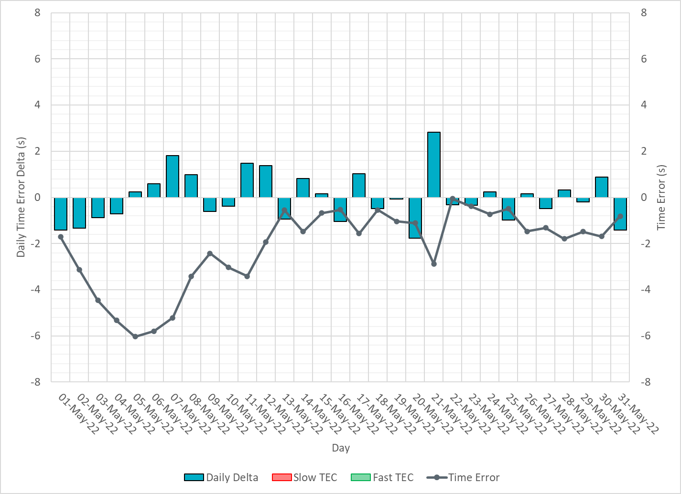
ERCOT Daily Time Error
Notes:
We did not make time error corrections.

Slide 16
Time Error Corrections Log Summary
There have been no time error corrections since December 2016

Slide 17
BAL-003 Performance

Slide 18
Op. Year 2020 BAL-003 Selected Events – Update
Notes:
BAL-003

Slide 19
Op. Year 2020 BAL-003 FRM Performance - Update
Notes:
OP2018: FRO = -381.0, FRM_median = -843.17, FRM_average = -959.7
OP2019: FRO = -381.0, FRM_median = -811.14, FRM_average = -892.5
OP2020: FRO = -425.0, FRM median = -789.34, FRM average = -879.0
OP2021: FRO =

Slide 20
ERCOT Energy Statistics

Slide 21
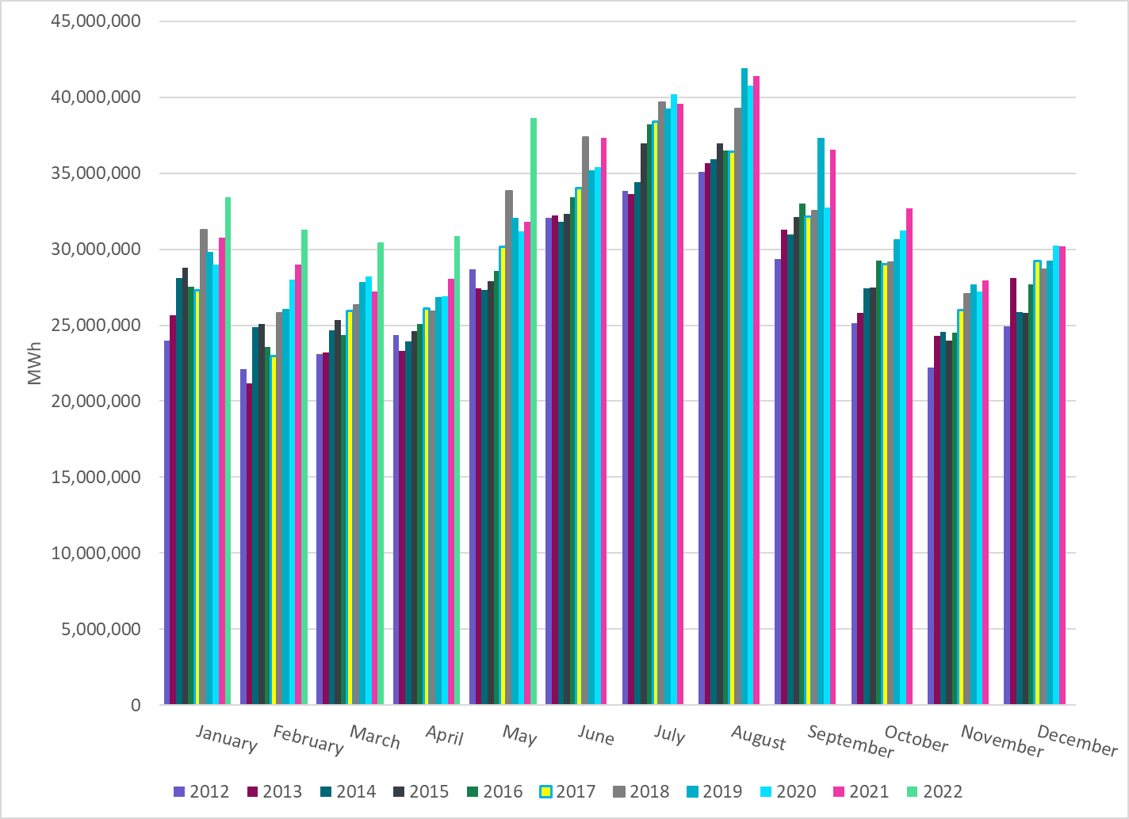
Total Energy
Notes:
38,601,553 MWh
There is an increase in total energy compared to last year

Slide 22
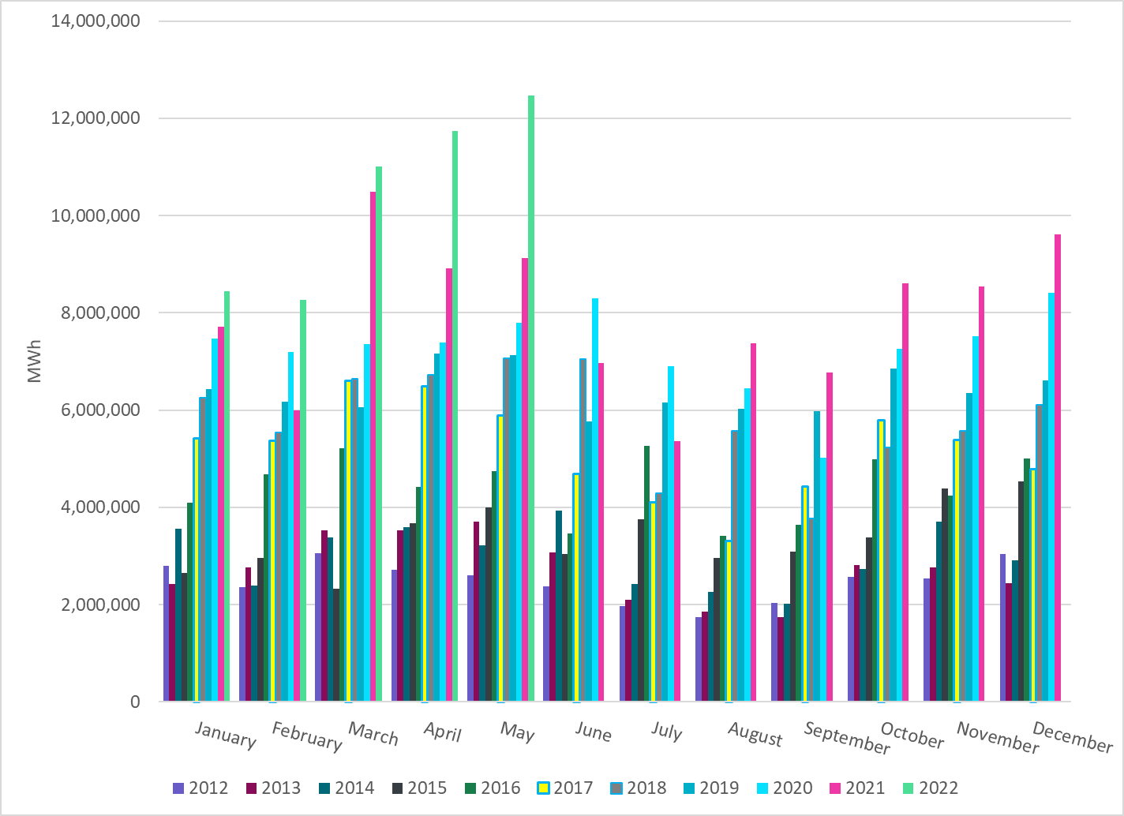
Total Energy from Wind Generation
Notes:
12,466,309 MWh
We see notable increase in the wind energy production in May.

Slide 23
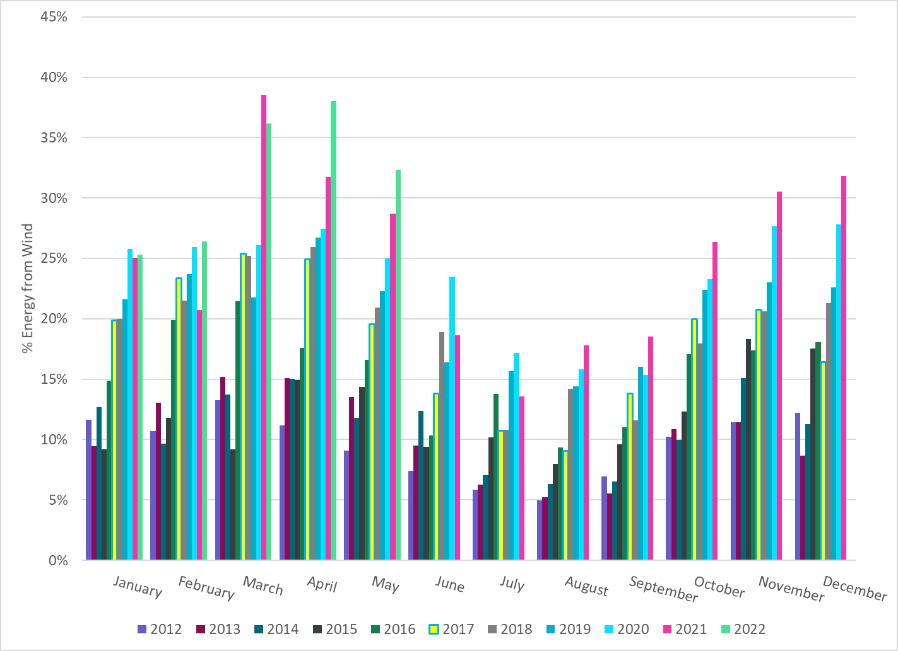
% Energy from Wind Generation
Notes:
32.29%
of total energy was provided by wind generation

Slide 24
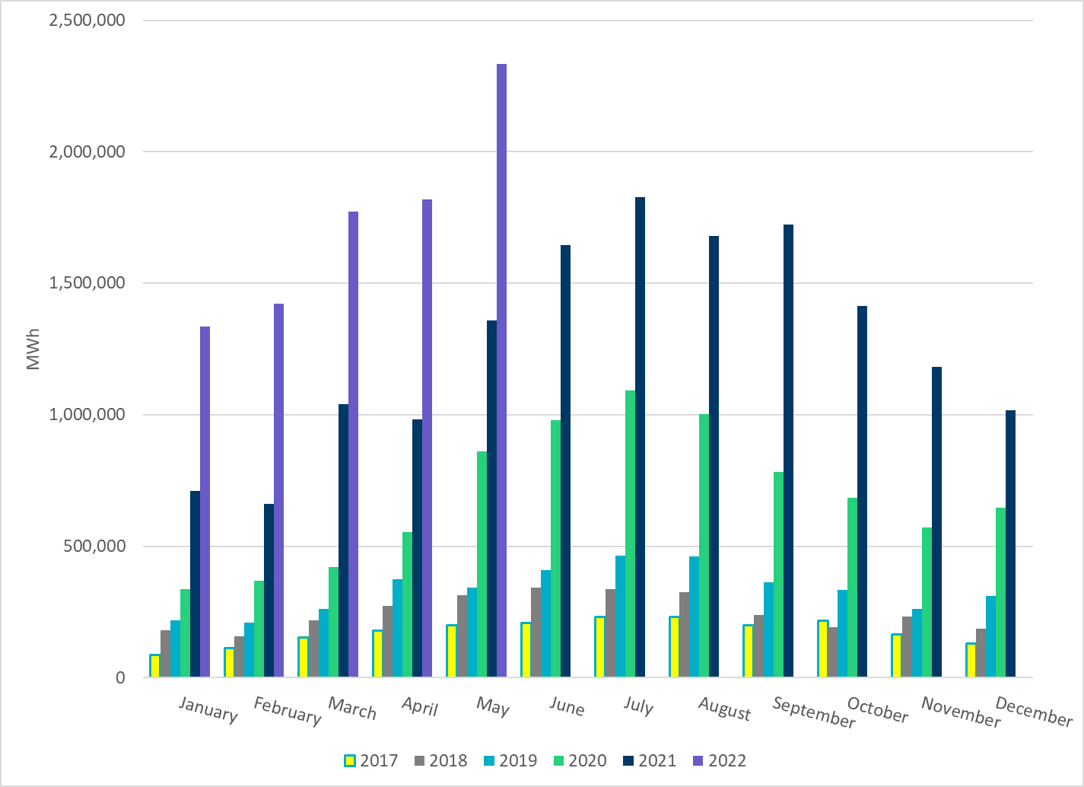
Total Energy From Solar Generation
Notes:
2,334,986 MWh
There is also a notable increase in solar energy production in May.

Slide 25
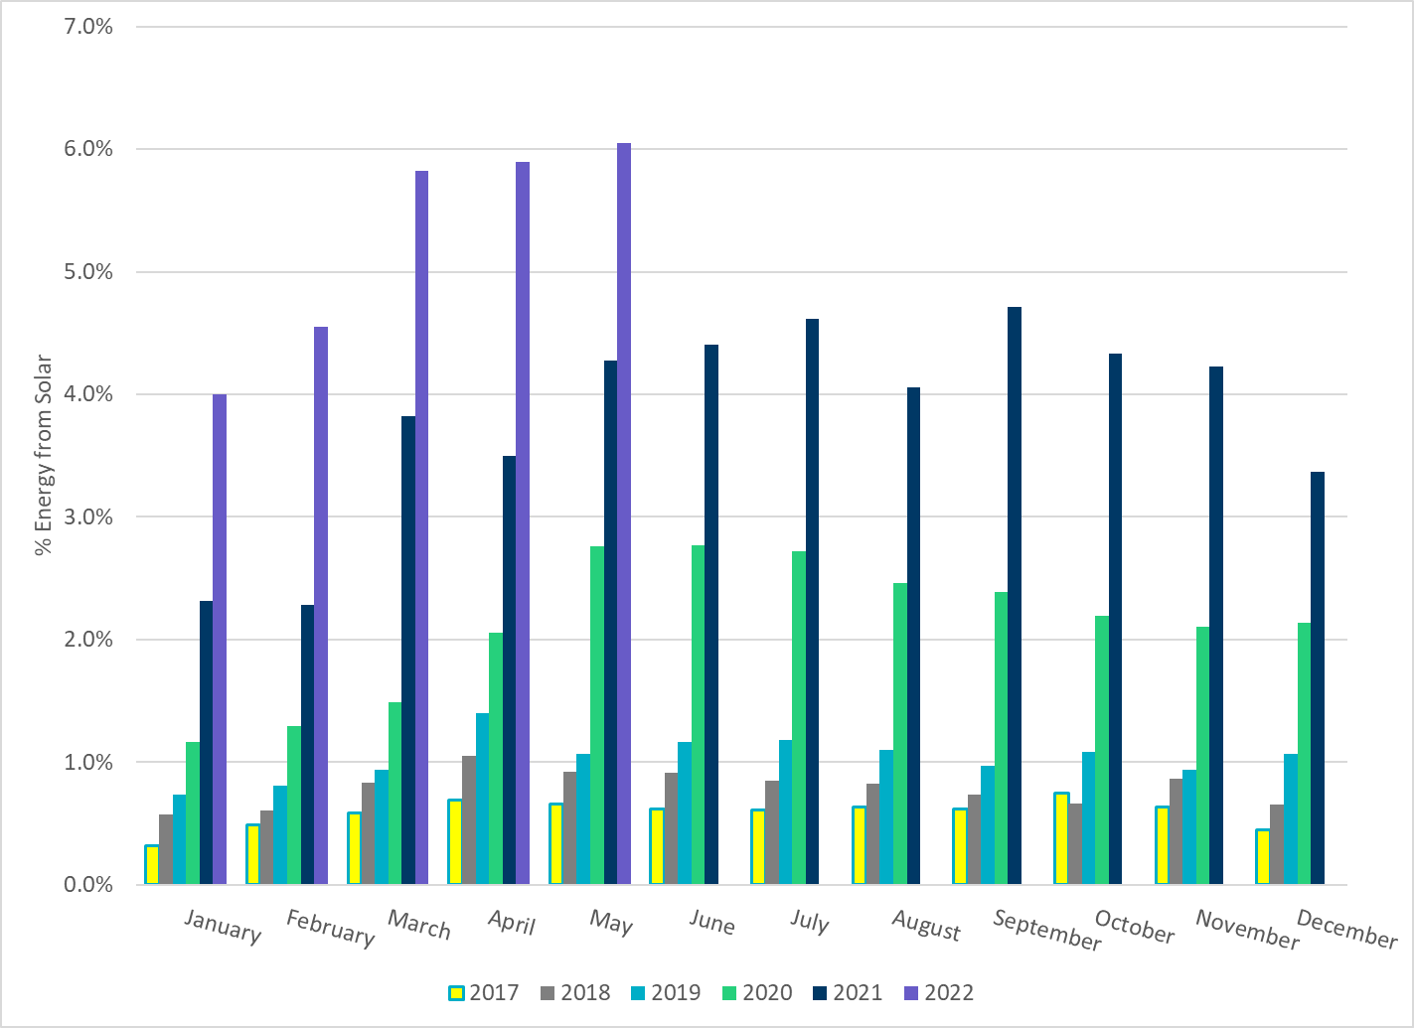
% Energy from Solar Generation
Notes:
6.05% of total energy was provided by soalr generation

Slide 26
ERCOT System Inertia

Slide 27
Daily Minimum System Inertia
Notes:
Minimum Inertia =151,8763 MW*s on 05/02/2022
Previous Minimum was 109,029 MW*s on 3/22/2021
Data:
Mean: 200,821 MW*s
Max: 255,165 MW*s on May 15th
Min: 151,876 MW*s on May 2nd

Slide 28
Questions?
Thank you!

