Slide 1
ERCOT Frequency Events
May 2022
ERCOT
Operations Planning
PDCWG | June 16, 2022

Slide 2
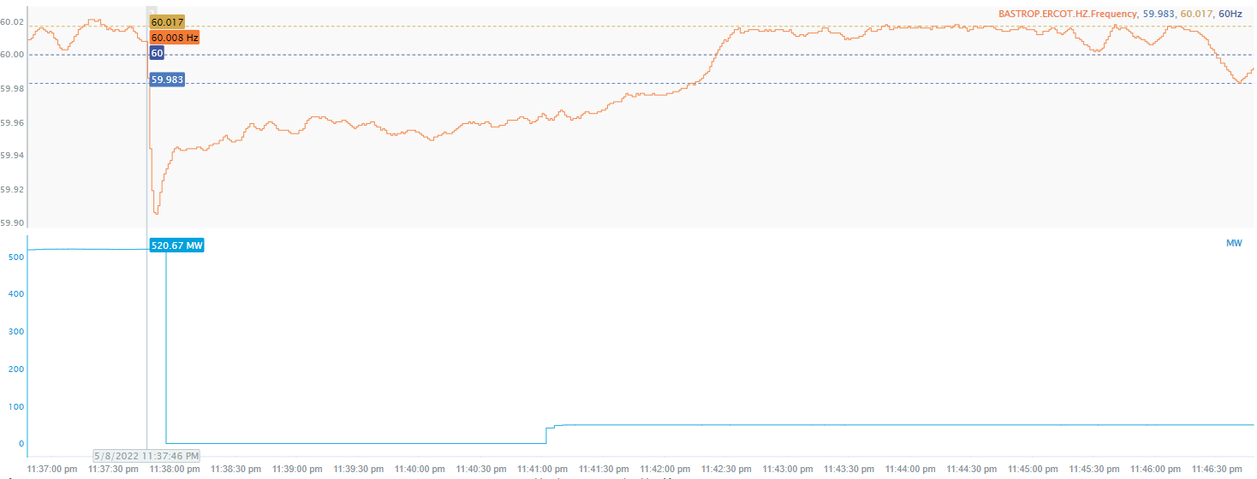
5/8/2022 23:37:46(FME)
Notes:
The units tripped offline while carrying approximately 521 MW.
Starting Frequency: 60.008 Hz
Maximum Frequency: 59.905 Hz
A-C Time : 5 seconds
Recovery Time(back to deadband): 4 minutes 24 seconds
RRS Deployed: 555 MW
Trip Reason: Fire on main turbine
Contextual Information: A total of 116 MW of regulation up was deployed.

Slide 3
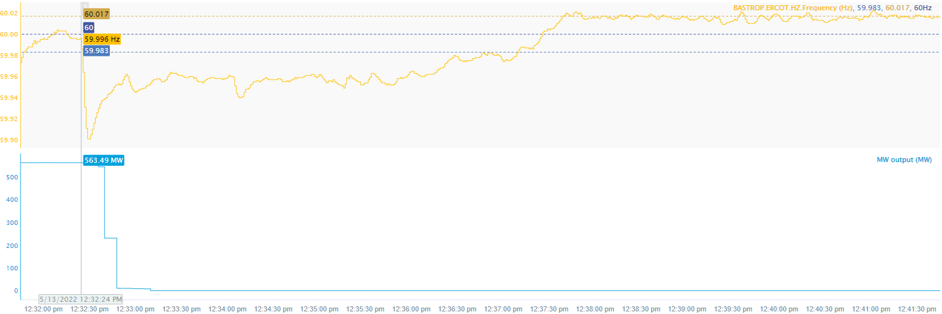
5/13/2022 12:32:24(FME)
Notes:
The units tripped offline while carrying approximately 563MW.
Starting Frequency: 59.996 Hz
Minimum Frequency: 59.901 Hz
A-C Time : 5 seconds
Recovery Time(back to deadband): 4 minutes and 46 seconds
RRS Deployed: 553 MW
Trip Reason: Loss of transmission line
Contextual Information: A total of 495 MW of regulation up was deployed during the event.

Slide 4
5/22/2022 1:26:37(FME)
Notes:
Loss of approximately 573 MW of load
Starting Frequency: 59.995 Hz
Maximum Frequency: 60.107 Hz
A-C Time: 4 seconds
Recovery Time (back to deadband): 6 minutes 46 seconds
Trip Reason: Unknown
Contextual Information: A total of 296 MW of regulation down was deployed during the event.

Slide 5
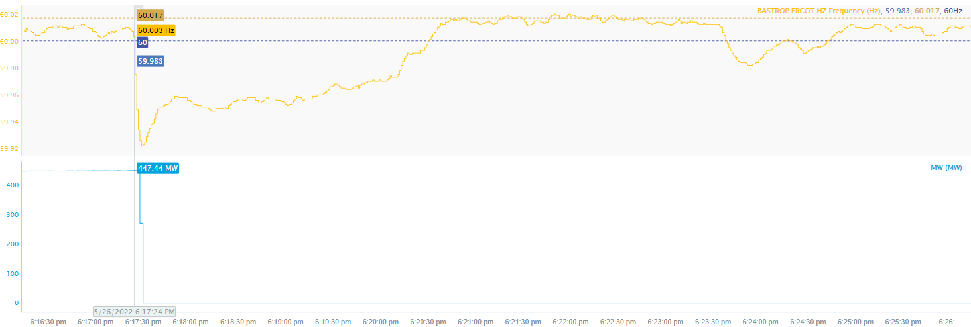
5/26/2022 18:17:24(NON-FME)
Notes:
The units tripped offline while carrying a total of approximately 447 MW
Starting Frequency: 60.003Hz
Minimum Frequency: 59.922Hz
A-C Time : 5 seconds
Recovery Time(back to deadband): 2 minutes and 44 seconds
Trip Reason: Unknown
Contextual Information: A total of 198 MW of regulation up was deployed during the event.
No Selection Reason: The MW lost is 447 MW and overall it is small event.

Slide 6
6/4/22 12:59:26 (NON-FME)
Notes:
14 Solar facilities tripped offline or reduced their output for loss of approximately 1666 MW and Three combined cycles tripped offline for loss of approximately 853 MW. Approximately 2519 MW’s were lost during this event.
Starting Frequency: 60.007 Hz
Minimum Frequency: 59.706 Hz
A-C Time : 4 seconds
Recovery Time(back to deadband): 1 minute
RRS Deployed: 1227 MW
Trip Reason: Lightning arrestor fault on 345 kV line
Contextual Information: A total of 264 MW of regulation Up was deployed during the event.
Categorized as NERC Event Analysis Category3 (Gen loss >2000 MW) and RFI’s were sent out.

Slide 7
Appendix for 6/4/22 event

Slide 8
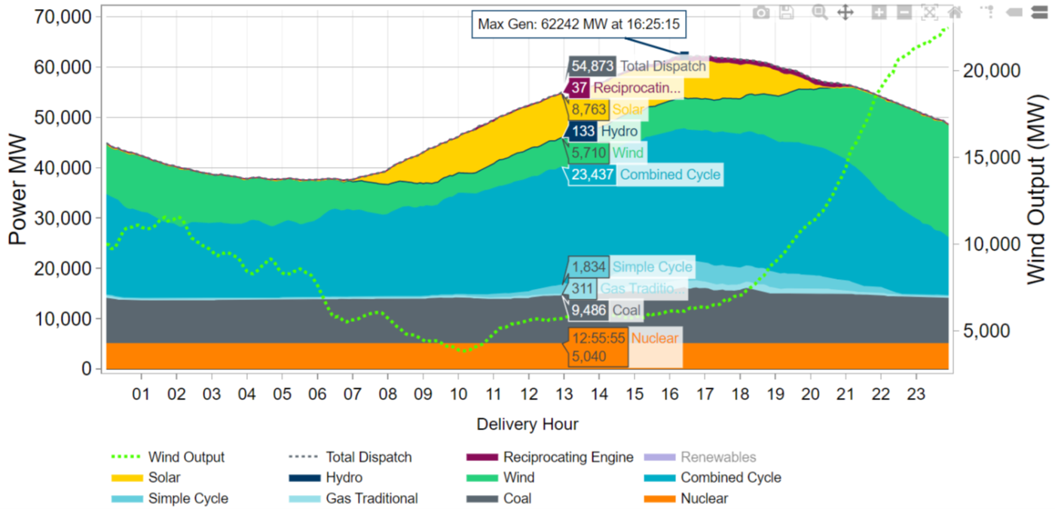
Additional information on 6/4/22 event
Total System Inertia = 310,669 (MW-s)
Generation Mix before the event
Generation Dispatch by Resource Type at 12:55:55

Slide 9
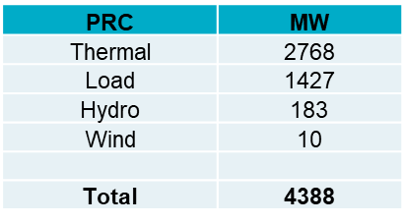
Additional information on 6/4/22 event
ERCOT was carrying 1,207 MW of RRS from the load resources and approximately 1,116 MW of high set under frequency load resources were automatically deployed.
ERCOT PRC breakdown
At the 6/10/22 IBRTF meeting, ERCOT presented initial findings on the event
- Slide Deck

Slide 10
Wind Output

Slide 11
Solar Output

Slide 12
ESR Response

Slide 13
Regulation and RRS deployment

Slide 14
Response from resources carrying RRS

Slide 15
Response from resources not carrying RRS

Slide 16
Spinning and PRC

Slide 17
Questions?
Thank you!

