Slide 1
Monthly Review of Reliability Unit Commitment Market Impacts - May 2022
Wholesale Market Working Group
ERCOT Staff
June 17, 2022

Slide 2
RUC Resource-Hours
May 2022 | Total | Opt-Out | Non-Opt-Out
Instructed Resource-Hours
Total Count | 673.0 | 241.0 | 432.0
Effective Resource-Hours*
Total Count | 601.0 | 218.5 | 382.5
Average LSL | 102.0 | 133.5 | 84.2
Average LDL | 125.0 | 181.1 | 93.2
Average BP | 132.4 | 192.1 | 98.7
Average HSL | 283.4 | 290.5 | 279.3
* The difference between “Instructed” and “Effective” values is a result of Resources starting up, shutting down, receiving partial hour instructions, or otherwise not being dispatchable by SCED.

Slide 3
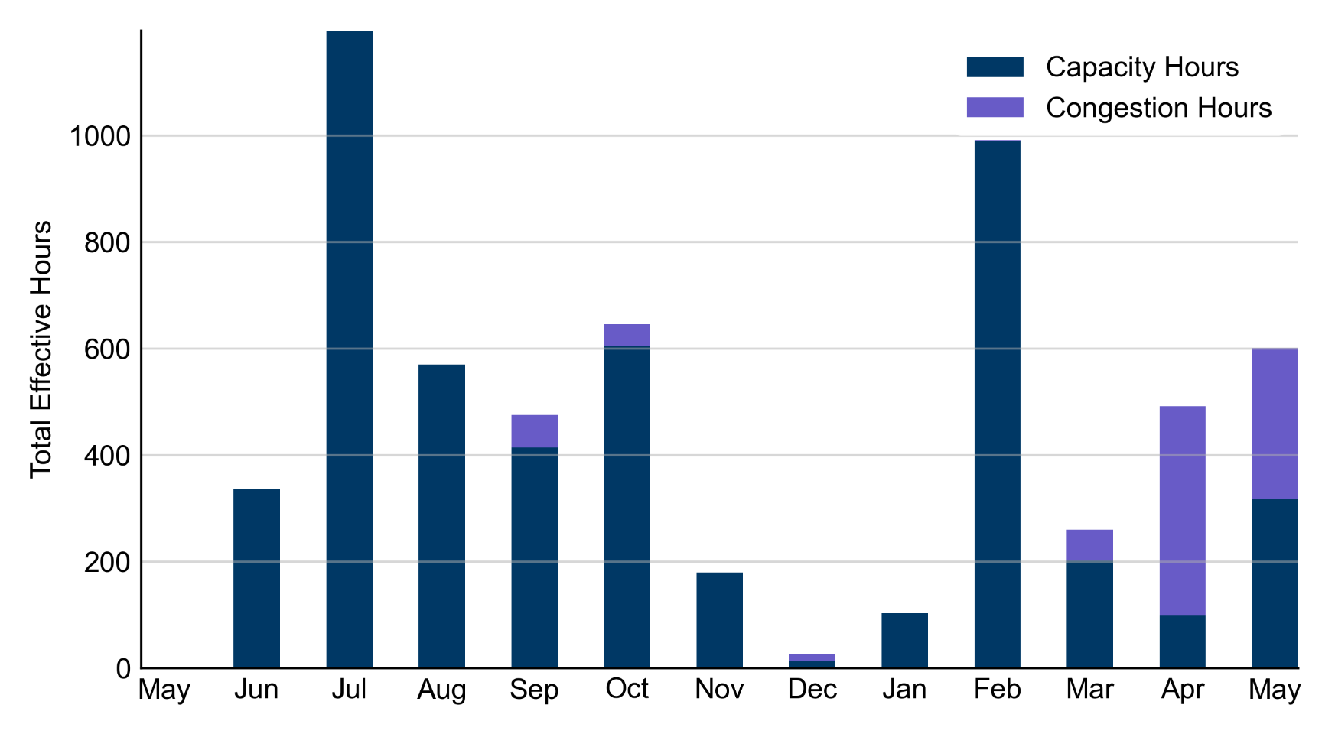
RUC Instruction Reasons: Last 13 Months RUCs in May 2022 were driven by both capacity and congestion concerns

Slide 4
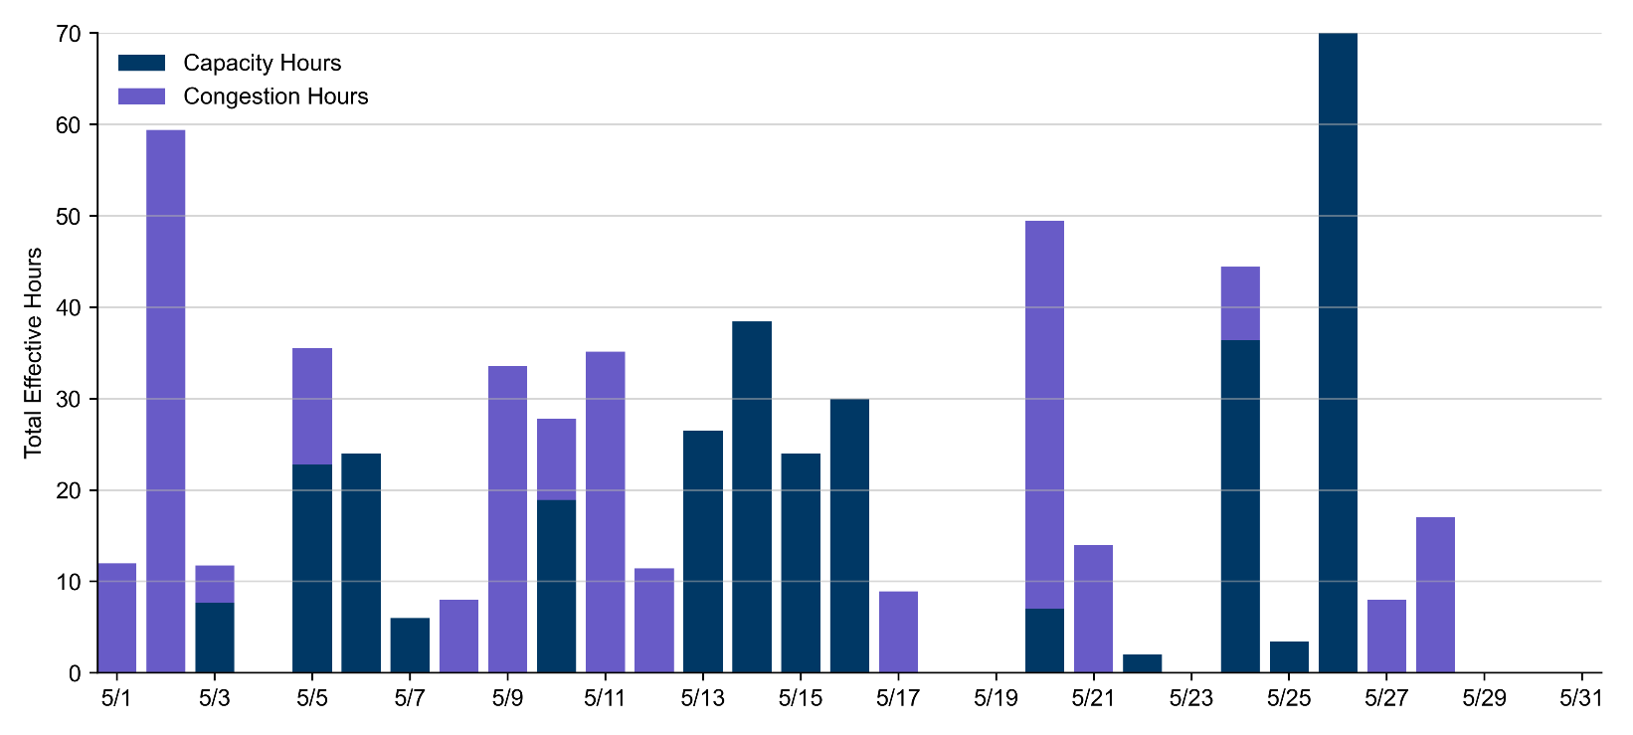
RUC Instruction Reasons
May 2022
601.0 effective RUC Resource-hours.
317.2 Resource-hours (52.78%) for capacity concerns.
283.8 Resource-hours (47.22%) for congestion concerns.

Slide 5
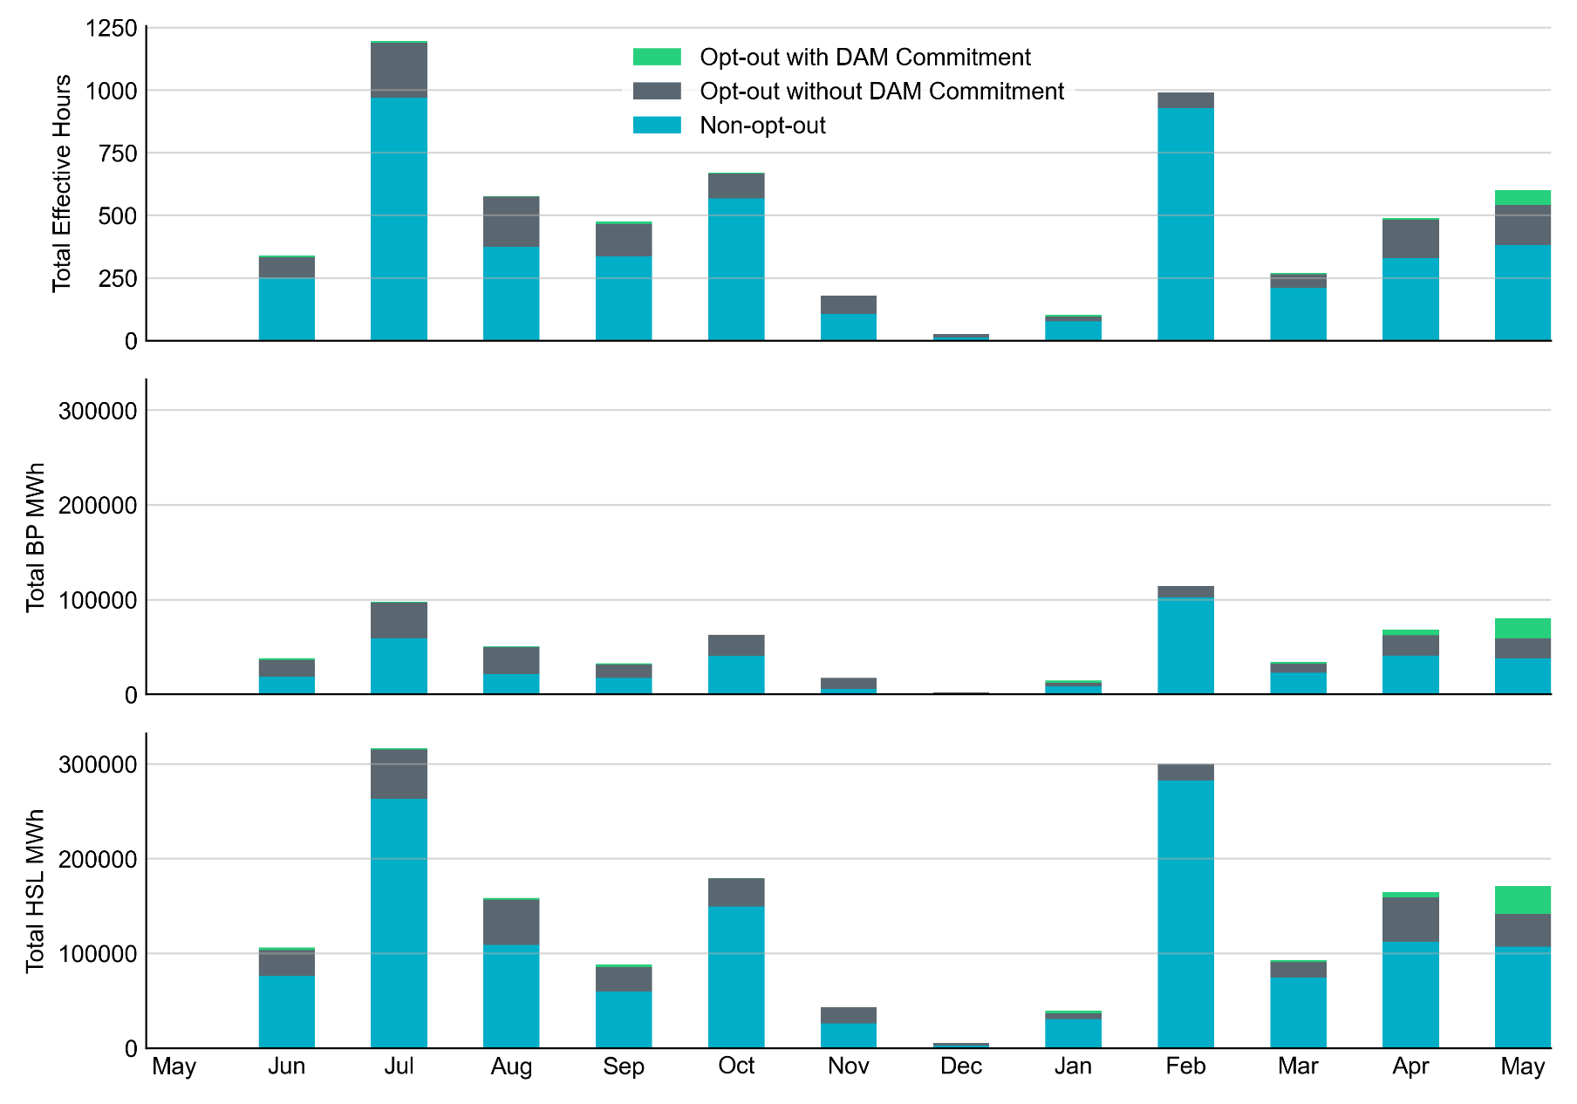
Non-opt-out and Opt-out Totals: Last 13 Months May 2022 had a total of 382.5 non-opt-out effective Resource-hours (63.6%) and 218.5 opt-out effective Resource-hours (36.4%).

Slide 6
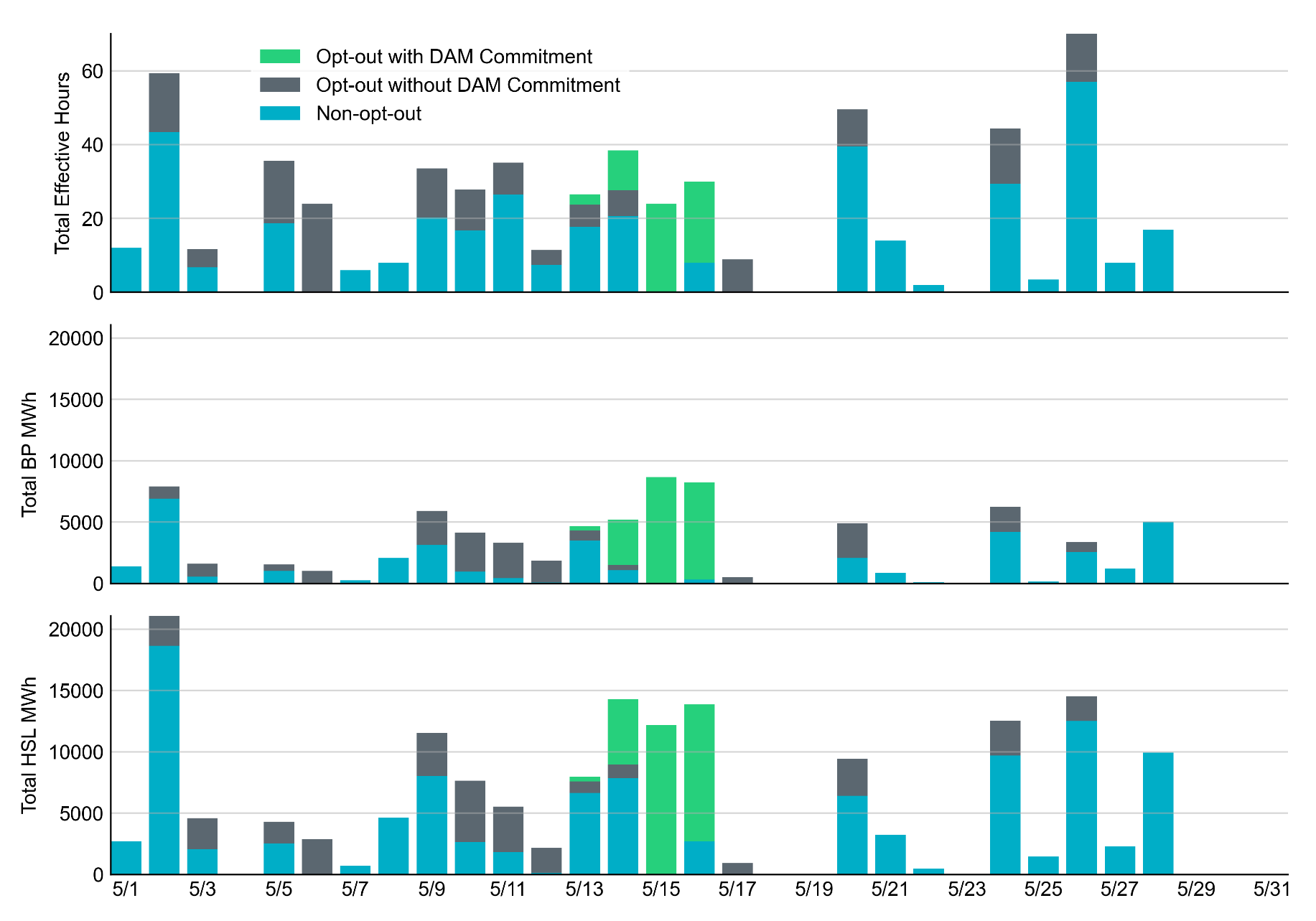
Non-opt-out and Opt-out Totals: May 2022

Slide 7
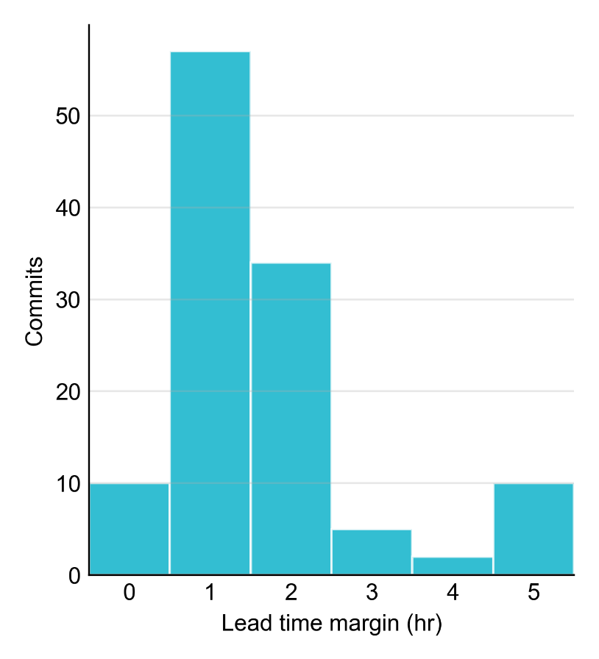
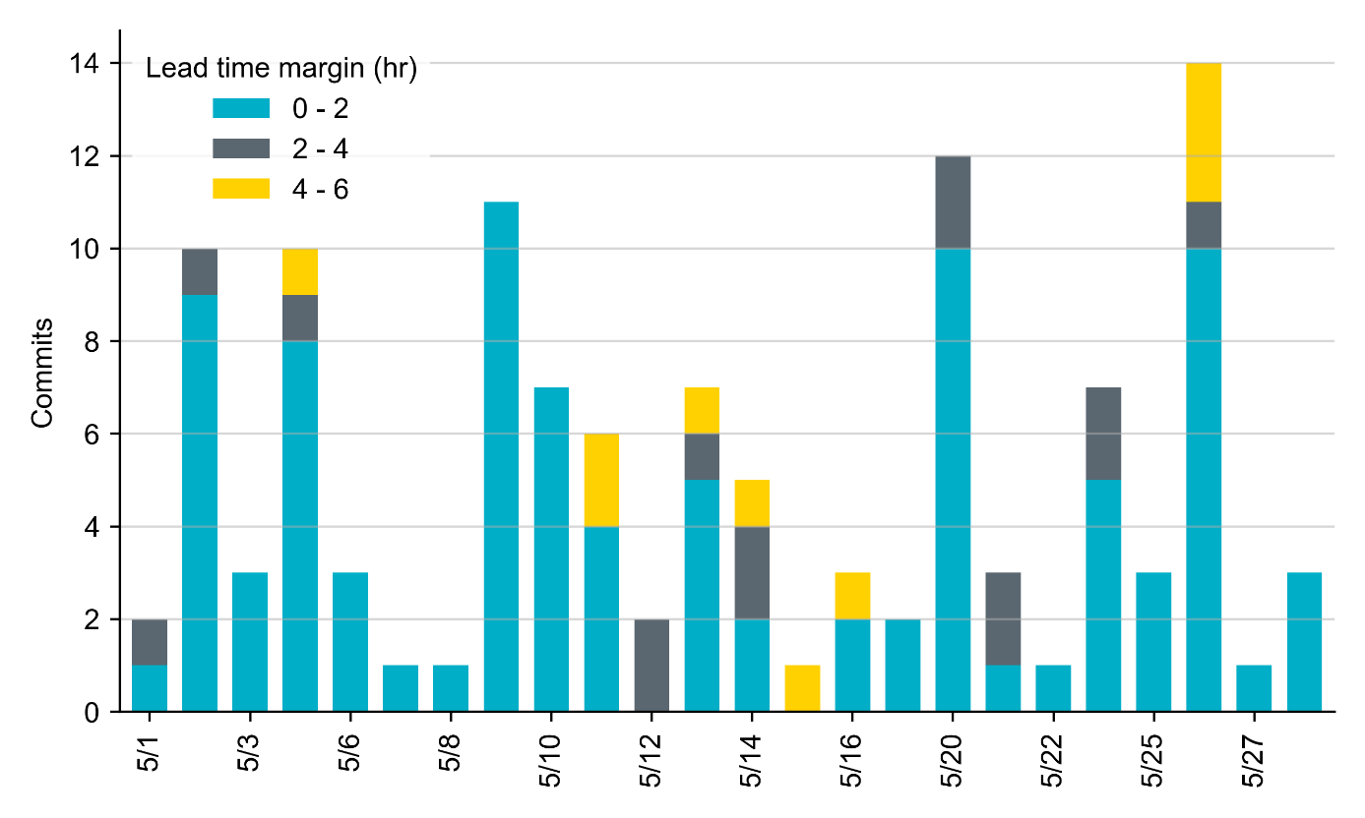
RUC Lead Time Margin: May 2022
Most RUC commit windows had lead time margin below 2 hours.
Lead time refers to the length of time between a RUC instruction and the start of the commitment window.
Lead time margin is the difference between lead time and the Resource’s startup time.
In cases where a Resource is committed for multiple back-to-back time blocks, lead time margin is calculated from the first instruction.

Slide 8
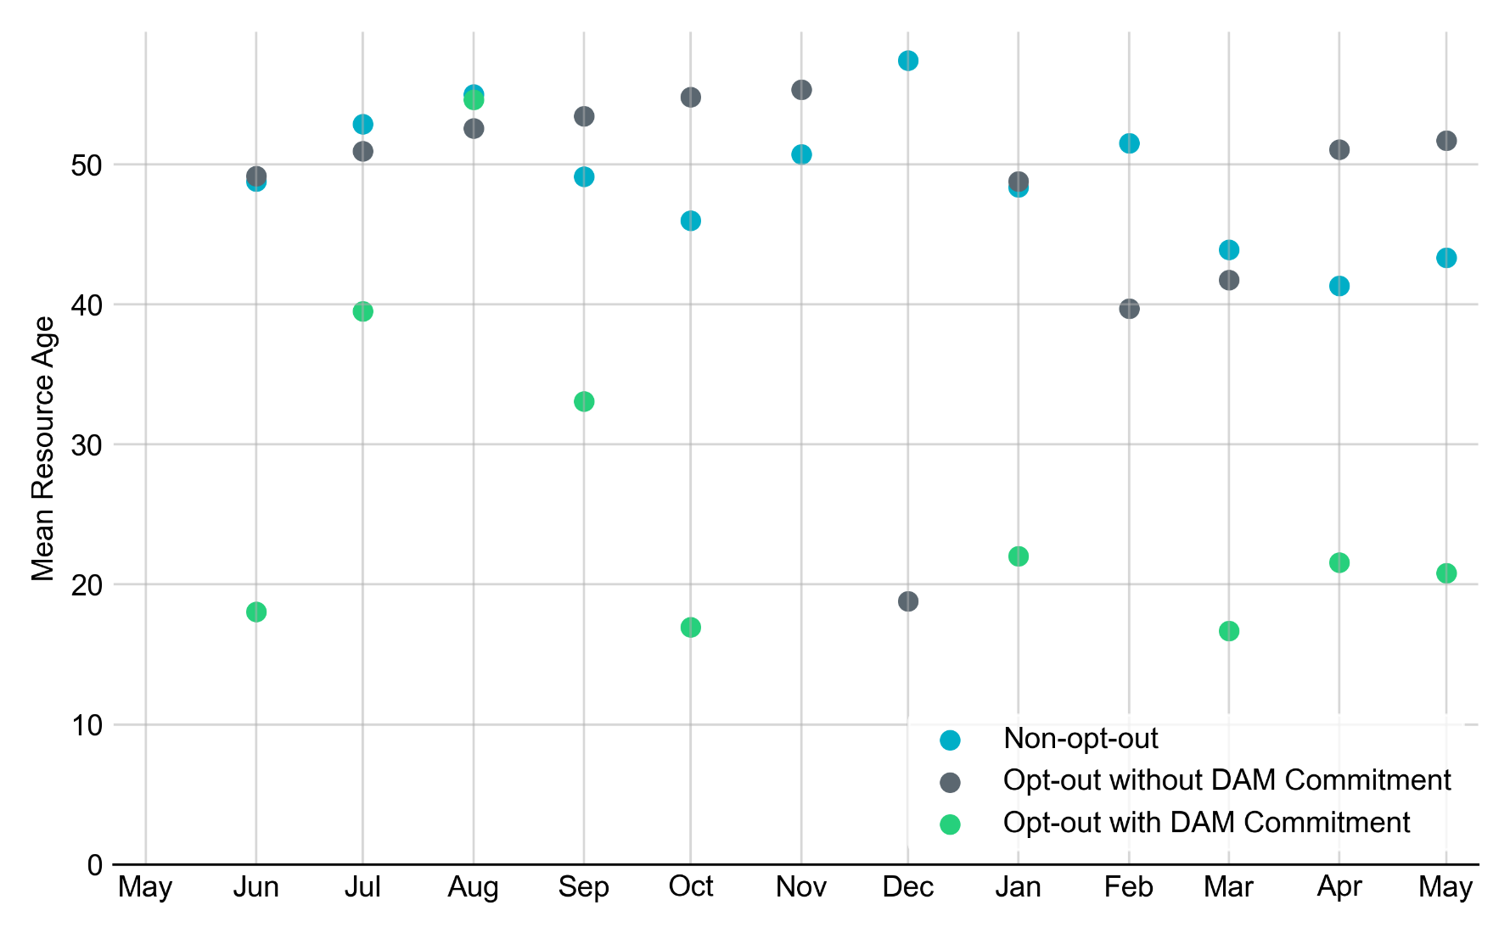
Average Resource Age In May 2022, mean opt-out Resource age for RUC-committed Resources is 20.8 years for DAM-committed Resources, and 51.7 years for non-DAM-Committed Resources. Mean non-opt-out Resource age is 43.4 years.
Note: For Resource configurations with multiple physical generators, the age of the oldest generator is used.

Slide 9
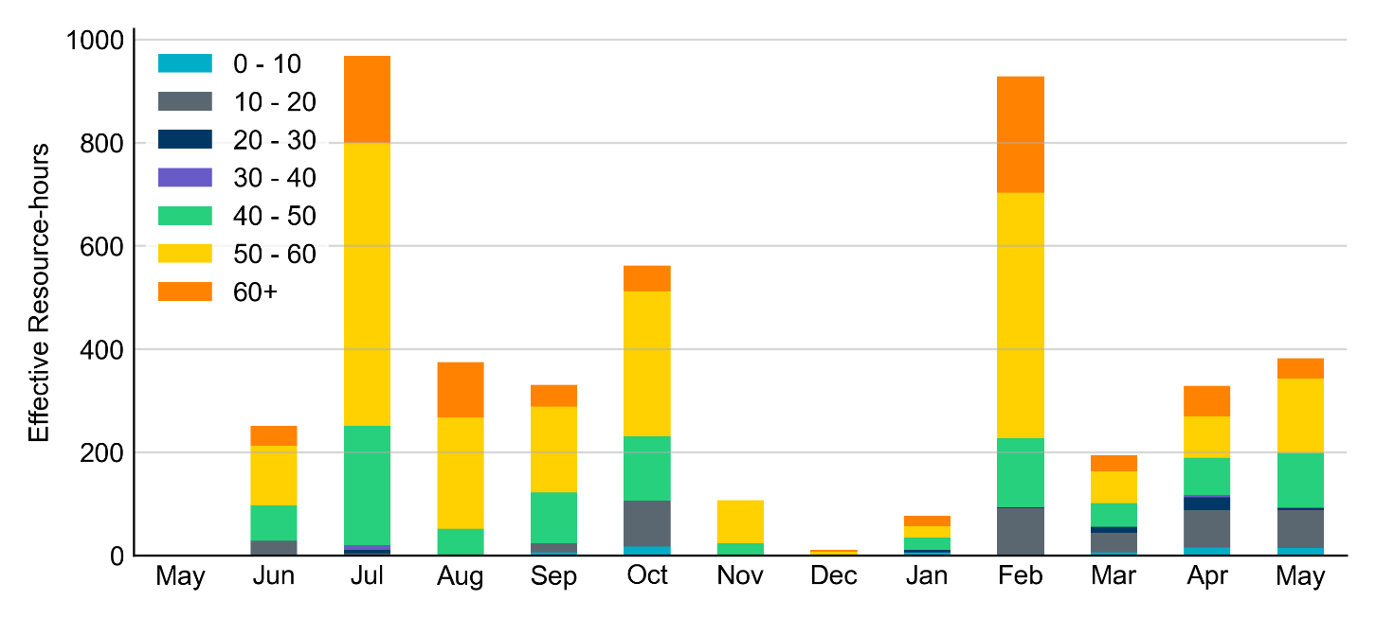
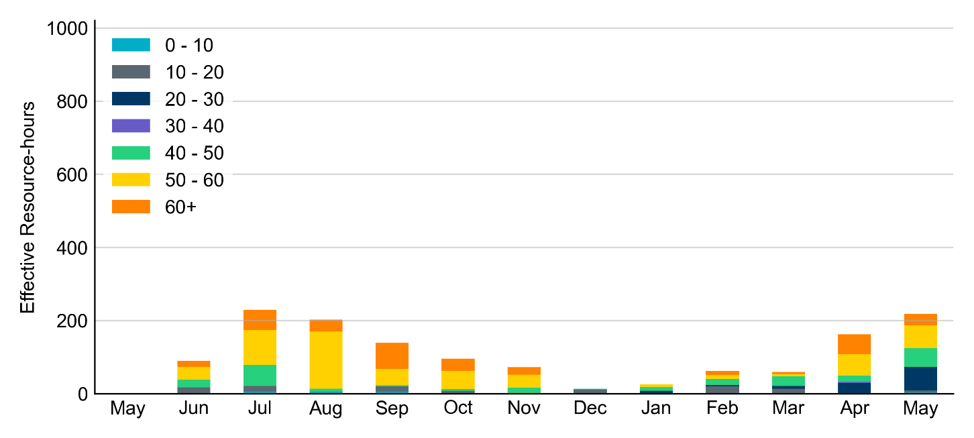
Age Category Most RUC-Committed Resources in May 2022 were older than 40 years.
Non-opt-out
Opt-out

Slide 10
RUC-Instructed Resource Dispatch above LDL
May 2022
When Resources did not successfully opt out, there were 54.9 effective Resource-hours for which the Resource was dispatched above its LDL.
For 16.1 of these Resource-hours, the LMP for the RUC-instructed Resource was above the RUC offer floor.
Note: The RUC offer floor was changed from $1,500/MWh to $250/MWh effective on OD 5/13/2022 according to NPRR1092. All 16.1 Resource-hours with LMP above the floor occurred after this change.
For 38.8 of these Resource-hours, the LMP for the RUC-instructed Resource was below the RUC offer floor.
For 32.0 of these Resource-hours, the RUC-instructed Resource was mitigated.
The remaining 6.8 Resource-hours are associated with RUCs for additional capacity.
There were no Exceptional Fuel Cost submissions for RUC-Committed Resources in May 2022.

Slide 11
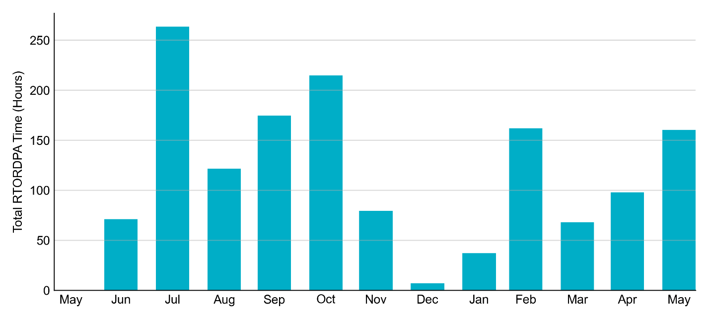
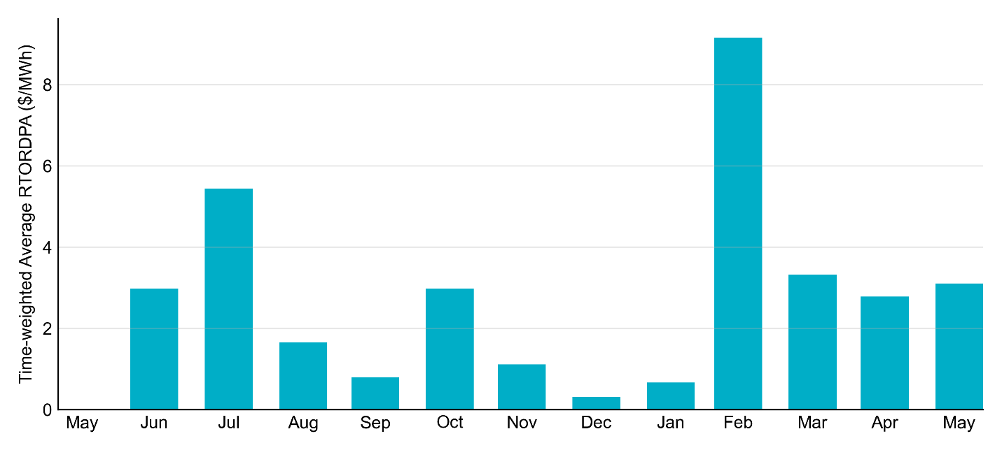
Reliability Deployment Price Adder: Last 13 Months May 2022 had a total of 160.5 RTORDPA hours with an average value of $3.11/MWh.

Slide 12
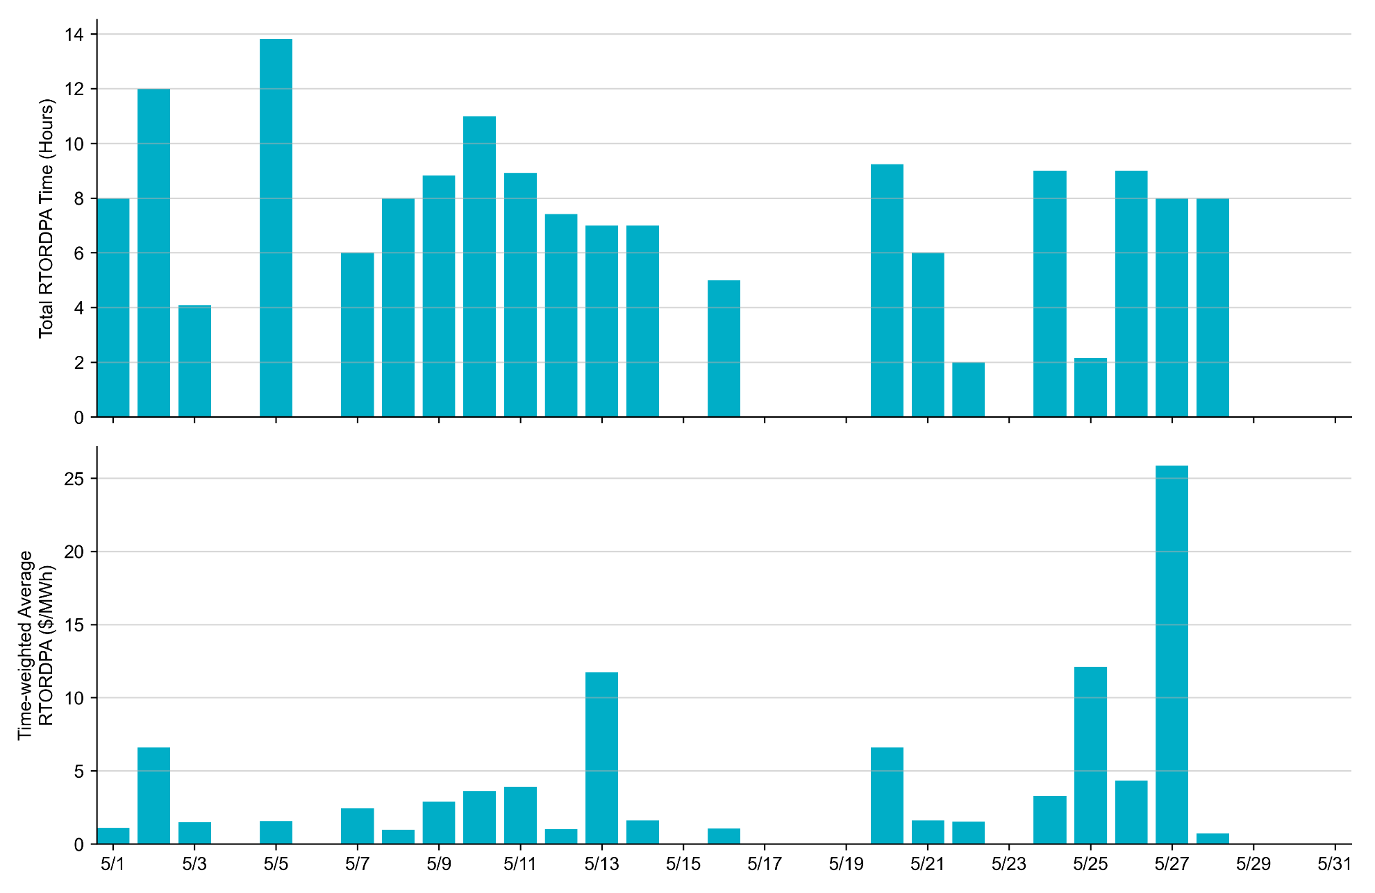
Reliability Deployment Price Adder: May 2022 OD 5/27 had the highest daily average RTORDPA: $25.87/MWh.

Slide 13
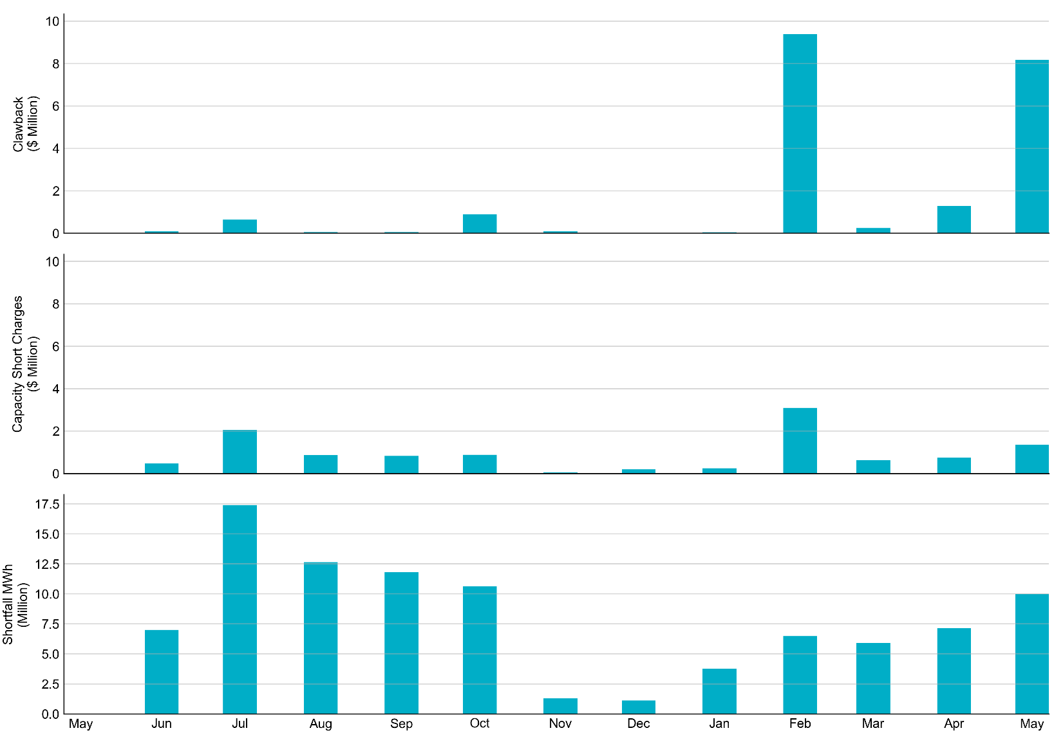
RUC Clawback, Capacity Short Charges, and Shortfall For May 2022, the total Clawback charge was $8.17 million. The total Make-Whole payment was $1.37 million, which was almost exclusively covered through capacity-short charges.
In May 2022, $1.37M in Make-Whole was paid out. Only $2.06 was uplifted to load due to rounding.

