Slide 1
2022 REP-Utility
Summer Preparedness Communication
Workshop
Wednesday, June 15, 1:30 PM to 3:30 PM Web-ex only
John Schatz, Vistra Debbie McKeever, Oncor
RMS Chair RMS Vice Chair

Slide 2
Agenda
Scope and Purpose of workshop
ERCOT Energy Emergency Alerts (EEA)
ERCOT Role and Responsibilities
TSP/TDU Role and Responsibilities
ERCOT EEA Procedures Matrix
Overview of Mass Transition Processes
Helpful Web-site links containing related information
Questions and Answers
Adjourn

Slide 3
Scope and Purpose
During some major weather events, it is necessary for ERCOT to deploy emergency operation plans in order to preserve and protect the integrity and reliability of the ERCOT electric grid.
This REP/Utility Summer Prep Communication Workshop is being held to provide attendees an overview of processes and procedures established for the ERCOT Retail market which may be executed in the event of a major weather event.
Additionally this workshop will include an overview of Mass Transition Processes as currently included in ERCOT Market Rules.
A REP/Utility Winter Prep Communication Workshop will be held in Fall of 2022.

Slide 4
ERCOT Energy Emergency Alert (EEA) Operations

Slide 5
ERCOT EEA Operations
When electric supply and demand can’t be balanced with normal procedures, ERCOT begins emergency operations using three levels of Energy Emergency Alerts (EEAs). Each level provides access to resources that can only be deployed when an energy emergency is declared.
These tools are in place to protect the reliability of the electric system and prevent an uncontrolled system-wide outage.
ERCOT currently has about 2,300 MW of additional capacity available to address tight grid conditions and can also issue a conservation request to help reduce demand at any time. One megawatt (MW) is enough to power about 200 Texas homes during peak demand.
As part of the ERCOT system improvements made over the past six months to enhance grid reliability, the Public Utility Commission has approved policy changes that allow ERCOT to deploy some of the 2,300 MW of resources prior to declaring an energy emergency.
The decision to deploy these resources sooner is based on real time grid conditions.

Slide 6
Resource Deployments Prior to an Energy Emergency
ERCOT continually monitors Grid conditions 24x7.
If operating reserves drop below 3,000 MW and are not expected to recover within 30 minutes:
• Bring all available generation online and release any unused reserves
• Deploy Emergency Response Service (commercial/small industrial customers who are contractually paid to reduce their power within either 10 or 30 minutes): 1,020 MW
• Voltage reduction by transmission companies if controlled outages are NOT expected: 100-200 MW

Slide 7
ERCOT Energy Emergency Alerts (EEA) Matrix

Slide 8
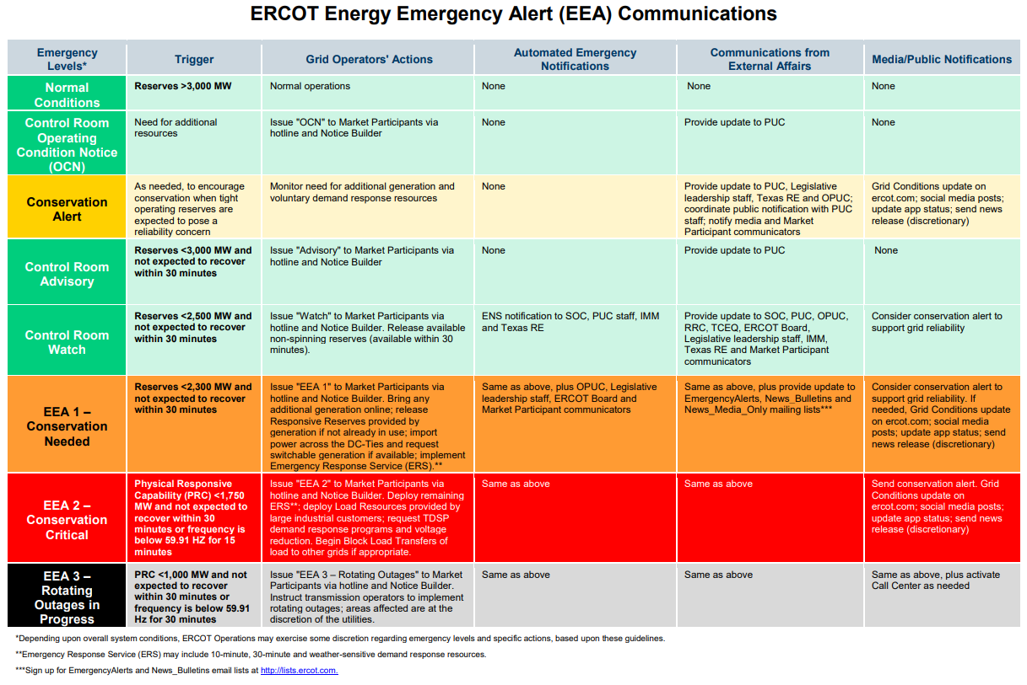

Slide 9
EEA Levels and Actions
Level 1
If operating reserves drop below 2,300 MW and are not expected to recover within 30 minutes:
Increase other generation supplies and use demand response to lower electric demand, including:
• Imports from neighboring electric grids, if available: up to 1,220 MW
• Switchable generation that can serve multiple electric grids, if available: up to 568 MW
• Remaining Emergency Response Service if applicable (commercial/small industrial customers who are paid to reduce their power during emergencies): 1,020 MW

Slide 10
EEA Levels and Actions
Level 2
If operating reserves drop below 1,750 MW and are not expected to recover within 30 minutes:
Request energy conservation from public (if not already in effect): MW vary
Reduce power by deploying remaining demand response programs, including:
• Deploy operating reserves carried by Load Resources (large industrial customers who are paid to reduce their power): 1,691 MW
• Load management programs from transmission companies: 211 MW for winter season
• Voltage reduction by transmission companies if not already deployed: 100-200 MW

Slide 11
EEA Levels and Actions
Level 3
If operating reserves drop below 1,375 MW, ERCOT moves into level 3.
If operating reserves drop below 1,000 MW and are not expected to recover within 30 minutes and/or the grid’s frequency level cannot be maintained at 60 Hz:
As a last resort, ERCOT will instruct transmission companies to reduce demand on the electric system. These are controlled outages.
Note:
Some steps may occur simultaneously and do not include additional voluntary demand response programs, where electric service from other ERCOT business and residential customers is interrupted during emergencies.

Slide 13
ERCOT Load Shed Table Posting date April, 21, 2022
Transmission Operator | 2021 Total Transmission Operator Load (% MW)
AEP Texas Central Company | 8.41
Brazos Electric Power Cooperative Inc. | 4.85
Brownsville Public Utilities Board | 0.37
Bryan Texas Utilities | 0.52
CenterPoint Energy Houston Electric LLC | 25.89
City of Austin DBA Austin Energy | 3.54
City of College Station | 0.28
City of Garland | 0.73
City of Lubbock | 0.58
CPS Energy (San Antonio) | 6.44
Denton Municipal Electric | 0.48
GEUS (Greenville) | 0.14
Golden Spread Electric Cooperative Inc. | 0.36
Lamar County Electric Cooperative Inc* | 0.07
LCRA Transmission Services Corporation | 5.89
Oncor Electric Delivery Company LLC | 35.47
Rayburn Country Electric Cooperative Inc. DBA Rayburn Electric | 1.34
South Texas Electric Cooperative Inc. | 1.92
Texas-New Mexico Power Company | 2.72
ERCOT Total | 100.00
* Lamar County Electric Cooperative is a registered TO not on the ERCOT Hotline, City of Garland receives all their calls.

Slide 14
ERCOT Nodal Protocol 6.5.9.3.4 Emergency Notice
(1) Emergency Notice is the communication issued by ERCOT when operating in an Emergency Condition.
(2) ERCOT shall issue an Emergency Notice for one or both of the following reasons:
(a) ERCOT cannot maintain minimum reliability standards (for reasons including fuel shortages) during the Operating Period using every Resource practicably obtainable from the market; or
(b) Immediate action cannot be taken to avoid or relieve a Transmission Element operating above its Emergency Rating.
(3) The actions ERCOT takes during an Emergency Condition depend on the nature and severity of the situation.
(4) ERCOT is considered to be in an Emergency Condition whenever ERCOT Transmission Grid status is such that a violation of security criteria, as defined in the Operating Guides, presents the threat of uncontrolled separation or cascading Outages and/or large-scale service disruption to Load (other than Load being served from a radial transmission line) and/or overload of a Transmission Element, and no timely solution is obtainable through SCED or CMPs.
(5) If the Emergency Condition is the result of a transmission problem, ERCOT shall act immediately to return the ERCOT System to a reliable condition, including instructing Resources to change output, curtailing any remaining DC Tie Load, and instructing TSPs or DSPs to drop Load.

Slide 15
TSP/DSP Role & Responsibilities

Slide 16
Once the TSP/DSP receives Energy Emergency Alert (EEA) Load Shedding instructions from ERCOT, the TSP/DSP’s responsibility is to perform all necessary actions as prescribed in the ERCOT Nodal Operating Guide.
Nodal Operating Guide 4.5.3.4 Load Shed Obligation
(1) Each Transmission Operator (TO) shall take and direct actions to ensure that ERCOT Load shed instructions are effectuated. Each DSP shall comply with any reasonable instruction given by its TO to effectuate Load shed obligations.
(2) Percentages for Level 3 Load shedding will be based on the previous year’s TSP peak Loads, as reported to ERCOT, and will be reviewed by ERCOT and revised annually or as otherwise appropriate to reflect any new or changed TO designation. ERCOT shall maintain a Load Shed Table posted on the ERCOT website that reflects each TO’s total Load shed obligation.
(3) Following ERCOT’s annual peak Load review or ERCOT’s receipt of any new or changed TO designation, ERCOT shall post any anticipated revisions to the Load Shed Table on the ERCOT website. ERCOT shall issue a Market Notice announcing the posting of the revisions at least ten days prior to the effective date of the revisions or as soon as practicable if ERCOT determines there is a need to correct the Market Notice less than ten days before the effective date.

Slide 17
Example: Timing of ERCOT Instructions to TSP/DSP
Initial Instructions:
ERCOT will instruct TSP/DSPs to shed X MWs on the Distribution System within 30 minutes.
Follow-up Instructions:
After completing the initial 30 minute instruction, ERCOT operator may continue with further instructions if the Physical Responsive Capability (PRC) has not been restored.
Follow up instructions can range from ten (10) to thirty (30) minute durations with specific instructions for TSP/DSPs to continue load shedding procedures until ERCOT declares the EEA event has been terminated.
Note: TDSPs rotate outages on the Distribution system only. The Transmission system is not subject to rotating outages.

Slide 18
EEA Termination

Slide 19
Nodal Operating Guide 4.5.3.5, EEA Termination
(1) ERCOT shall:
(a) Continue EEA until sufficient Resources are available to ERCOT to eliminate the shortfall and restore adequate reserves;
(b) Restore full reserve requirements (normally 2300 MW);
(c) Terminate the levels in reverse order, where practical;
(d) Notify each QSE and TO of EEA level termination; and
(e) Maintain a stable ERCOT System frequency when restoring Load.
(2) QSEs and TOs shall:
(a) Implement actions to terminate previous actions as EEA levels are released in accordance with these Operating Guides;
(b) Notify represented Market Participants of EEA levels changes;
(c) Report back to the ERCOT System Operator when each level is accomplished; and
(d) Loads will be restored when specifically authorized by the ERCOT.

Slide 20
TDU Evaluation and approval of Critical Care, Chronic Condition & Critical Load applications

Slide 21
For your Reference
PUCT Subst. Rule §25.497
Critical Load Industrial Customers, Critical Load Public Safety Customers, Critical Care Residential Customers, and Chronic Condition Residential Customers
PUCT Subst. Rule §25.497
Subchapter R. CUSTOMER PROTECTION RULES FOR RETAIL ELECTRIC SERVICE
Section (a) Definitions
Section (b) Eligibility for Protection
Section (c) Benefits for Critical Load Public Safety Customers, Critical Load Industrial Customers, Critical Care Residential Customers, and Chronic Condition Residential Customers.
Section (d) Notice to customers concerning Critical Care Residential Customer and Chronic Condition Residential Customer status
Section (e) Procedure for obtaining Critical Care Residential Customer or Chronic Condition Residential Customer designation.

Slide 22
Critical Load, Critical Care, Chronic Condition
(c) Benefits for Critical Load Public Safety Customers, Critical Load Industrial Customers, Critical Care Residential Customers, and Chronic Condition Residential Customers.
(1) A Critical Load Public Safety Customer or a Critical Load Industrial Customer qualifies for notifications of interruptions or suspensions of service as provided in Sections 4.2.5, 5.2.5, and 5.3.7.1 of the TDU’s tariff for retail delivery service.
(2) A Critical Care Residential Customer or Chronic Condition Residential Customer qualifies for notification of interruptions or suspensions of service, as provided in Sections 4.2.5, 5.2.5, and 5.3.7.1, and for Critical Care Residential Customers protections against suspension or disconnection, as provided in Section 5.3.7.4(1)(D) and (E), of the TDU’s tariff for retail delivery service.
(3) A Critical Care Residential Customer or Chronic Condition Residential Customer is also eligible for certain protections as described in §25.483 (relating to Disconnection of Service).
(4) Designation as a Critical Load Customer, Critical Care Residential Customer, or Chronic Condition Residential Customer does not guarantee the uninterrupted supply of electricity.

Slide 23
Critical Load, Critical Care, Chronic Condition
A complete step-by-step procedure for obtaining Critical Care Residential Customer or Chronic Condition Residential Customer designation is provided in 25.497(e).
The TDU is responsible for evaluation and approval of Critical Care, Chronic Condition and Critical Load status through the submittal of the PUCT-approved form, which is posted on the PUCT website and on each TDU’s website.
Following TDU evaluation and approval, the TDU will update ESI ID attributes to reflect the Critical Care, Chronic Condition or Critical Load status via 814_20 ESIID Maintenance transaction through ERCOT, which is passed to the CR of Record.

Slide 24
Helpful Web-site links for related information
Summer 2022 ERCOT Web page Summer 2022 (ercot.com)
ERCOT Grid Load Shed Table https://www.ercot.com/gridinfo/load
ERCOT Retail Market Guide https://www.ercot.com/mktrules/guides/retail/current
TDSP specific web-sites for Critical Load, Critical Care applications or additional information.
AEP:
https://www.aeptexas.com/company/about/choice/
Centerpoint:
https://www.centerpointenergy.com/en-us/CustomerService/Pages/CNP_Forms/Critical-Care-Customer-Form.aspx?sa=HO&au=bus
Nueces Electrical Cooperative
https://neccoopenergy.com/about/critical-and-chronic-care-information/
Oncor Electric Delivery:
CHRONIC CONDITION, CRITICAL CARE, CRITICAL LOAD (oncor.com)
TNMP:
https://www.tnmp.com/customers/critical-care-residential

Slide 25
Questions?

Slide 26
TDSP AMS Data Practices TDSP EOP Procedures

Slide 27
Questions?

Slide 28
Overview of Mass Transition process, Timeline, and communications
Note: Mass Transition events are not always tied to an ERCOT EEA event or a TDSP EOP event.
Refer to the Retail Market Guide for Mass Transition process details

Slide 29
Timeline for Initiation of a Mass Transition

Slide 30
Mass Transition Timeline
“Notification Date”
Day 0
Day 1
“Mass Transition Date”
Day 2
Day 3 / Day 4 / Day 5
ERCOT provides notice of Mass Transition event to impacted CRs, TDSPs, and PUCT
Notice before 3pm CT: Proj. Coord. call held by 5pm.
Notice after 3pm CT: Proj. Coord. call held next morning.
Project Coordination
Call 1
Project Coordination
Call 2
Project Coordination
Call 3
Where applicable, TDSPs will send 867_04 and/or 867_03F for SWI/MVI/Drop to POLR transactions completed
ERCOT begins Customer outreach to inform of POLR event (postcard/email/phone/text)
ERCOT forwards any ‘competitive’ 814_03
SWI or MVI to TDSP
ERCOT sends 814_03 “TS” Drop to POLR transactions to TDSPs with an effective date of two calendar days out (“Mass Transition Date”)
TDSP executes
‘competitive’ 814_03
SWI or MVI if rec’d by 7pm CPT
ERCOT forwards any ‘competitive’ 814_03
SWI or MVI to TDSP
TDSP schedules Drop to POLR as requested by ERCOT
Once a default is confirmed, ERCOT provides impacted TDSPs with the Defaulting CR DUNS to prepare systems for a Mass Transition event
TDSP executes SWI or MVI in lieu of scheduled Drop to POLR; ERCOT sends Cancel for Drop to POLR
Beginning 7:01pm CPT, TDSPs execute the remaining population of Drop to POLR transactions (if SWI/MVI hasn’t been already executed by TDSP or Cancelled by ERCOT)
Default CR provides CBCI file to ERCOT
IMPORTANT NOTE:
Per PUCT Subst. R 25.43, if a Mass Transition Drop to POLR’s Effective Date falls on a Sunday or Holiday, non-AMS Operational Day rules and non-Business day rules shall apply. Meaning, no competitive 814_01 Switch or 814_16 Move-In will be scheduled for the same Effective Date, thereby only the Drop to POLR will effectuate.

Slide 31
Market Communications of Mass Transition event

Slide 32
ERCOT Market Communications
PUCT Subst. Rule §25.43(u) – Market Notice of Transition to POLR Service
ERCOT shall notify all affected Market Participants and the Retail Market Subcommittee (RMS) email listserv of a mass transition event within the same day of an initial mass-transition call after the call has taken place. The notification shall include the exiting REP’s name, total number of ESI IDs, and estimated load.
Market Participant suggested steps for Mass Transition event readiness:
Ensure Transition Contacts, Authorized Representative (AR) and Back-up AR contacts are up-to-date. Changes can be made via ERCOT Notice of Change of Information (NCI) form. This will ensure timely ERCOT communications regarding:
Notification of Mass Transition event
Receipt of ESI ID file
Communications through the event
“ERCOT Initiated” MarkeTrak issues may be received by any impacted REPs with in-flight transactions involving exiting CR(s)
Customer Billing and Contact Information (CBCI) file will be received via NAESB
Mass Transition Web-Based Training for familiarity of Mass Transition process

Slide 33
Customer Communications (pre-transition)
PUCT Subst. Rule §25.43(t) - Notice of transition to POLR service to customers
When a customer is moved to POLR service, the customer shall be provided notice of the transition by ERCOT, the REP transitioning the customer, and the POLR provider.
The ERCOT notice shall be provided within two days of the time ERCOT and the transitioning REP know that the customer shall be transitioned and customer contact information is available. If ERCOT cannot provide notice to customers within two days, it shall provide notice as soon as practicable.
(1) ERCOT notice methods shall include a post-card, containing the official commission seal with language and format approved by the commission. ERCOT shall notify transitioned customers with an automated phone-call and email to the extent the information to contact the customer is available pursuant to subsection (p)(6) of this section. ERCOT shall study the effectiveness of the notice methods used and report the results to the commission.

Slide 34
Questions?

