Slide 1
Comparison of Pricing Run to Dispatch Run + RTORDPA
Thomas Urquhart
Engineer, Market Analysis & Validation
ERCOT
Congestion Management Working Group (CMWG)
June 13, 2022

Slide 2
Background
This analysis is to provide supplemental info for the discussion of RTORDPA on 4/22/2022.
This presentation compares
  Dispatch Run Resource LMPs + RTORDPA
  Pricing Run Resource LMPs
Two SCED intervals on 4/22/2022 were picked:
  15:50 SCED interval, where the RTORDPA was the highest ($374.94/MWh) among all intervals on that day.
  13:35 SCED interval, where the RTORDPA was relatively low ($9.65/MWh).

Slide 3
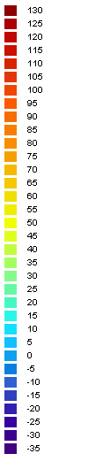
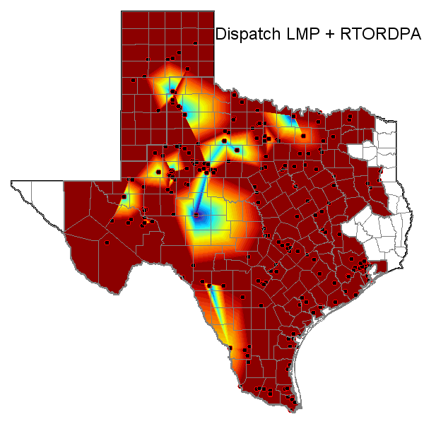
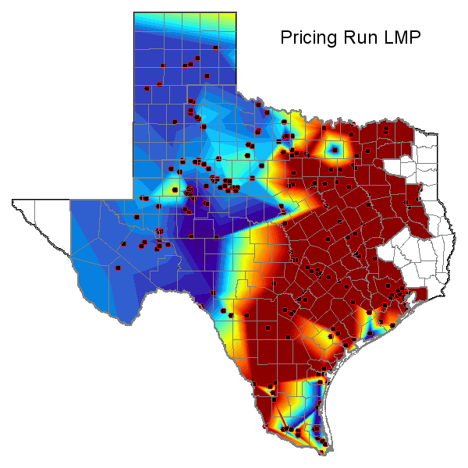
Highest RTORDPA interval (15:50, RTORDPA = $374.94/MWh)
Note: The graphs above show Resource LMPs which are proxies to Settlement Point RTLMPs

Slide 4
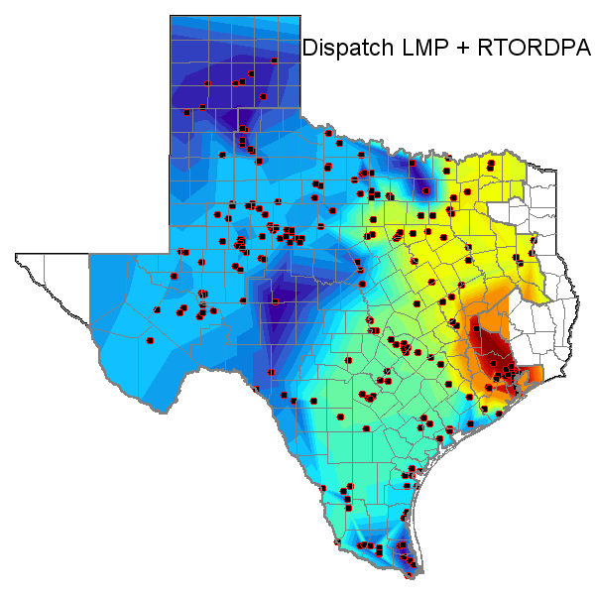
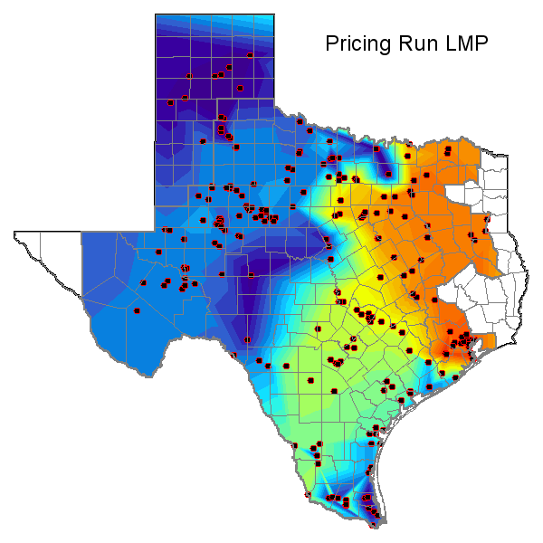
Low RTORDPA interval (11:35, RTORDPA = $9.65/MWh)
Note: The graphs above show Resource LMPs which are proxies to Settlement Point RTLMPs

