Slide 1


TDTMS Update
RMS
June 7th, 2022

Slide 2
TDTMS
Update
Annual overall SLA for system performance is “at risk” with only 30 minutes remaining for balance of the year due to longer than expected past outages
ERCOT is seeking to improve quality and timeliness of market notices specifying impacted systems/functionality
ListServ has experienced no issues
June Retail Release will be able to isolate the scheduled MarkeTrak technical refresh thus not impacted normal retail transaction processing on Saturday, June 4th
Further research by ERCOT for Help Desk ticket improvements:
Can retail processing be severed from “normal” processing?
Creation of external portal for ERCOT media inquiries – August 2022
Utilizing portal for submission of Help Desk tickets w/ response notification email – early 2023

Slide 3
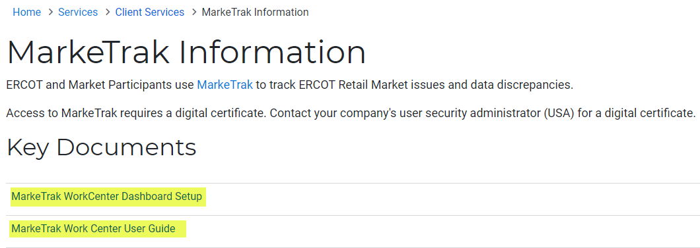
TDTMS
MarkeTrak Upgrade
MarkeTrak Technical Refresh taking place weekend of June 4th – 5th
Additional information has been posted to MarkeTrak Information page on www.ercot.com and updated MarkeTrak Training modules will be available after June 6th
Two Training Workshops were held to introduce market participants to new version and what to expect when logging on June 6th
May 19th @ 9:00 AM – 157 participants
May 24th @ 1:00 PM – 83 participants

Slide 4
TDTMS
Inadvertent Gain Subtype Analysis – Timeline Data
Comparison of analysis:
Full analysis of time required for each transition of the IAS process to provide insight into opportunities for efficiency and performance awareness for REPs
July 2019 – July 2020 – 21,000 IAGs & 23,000 IALs
July 2021 – December 2021 – 9,000 IAGs & 12,000 IALs

Slide 5
IAS Process – Original Transaction to Submittal of MT
How long to Begin Working MT

Slide 6
IAS Process – How long to Agree Once Touched
Agreement Between CRs

Slide 7
IAS Process – Losing CR to send BDMVI
Ready to Receive to BDMVI

Slide 8
IAS Process – Total Resolution Time
If resolution timelines reduced to 15 days, only 76 – 88% of Inadvertent Situations would be resolved.

Slide 9

IAS Process – Summary
Over 55% of MTs are submitted within 7 days of the originating transaction
~50% of MTs are acknowledged same day they are submitted
96% of completed MTs – CRs reach an agreement within 7 days once opened
‘hand-offs’ still exist in sending BDMVIs, however, improved 5-6%
96% of IAGs are resolved in 21 days
91% of IALs are resolved in 21 days
CALL TO ACTION – REPs are encouraged to review their performance to identify any opportunities to streamline their process
  Files will be posted to the main TDTMS meeting page**

Slide 10
TDTMS
Next Meeting
TENTATIVE Thursday, June 16th, 2020
On the Agenda:
WebEx only
ERCOT Updates
MarkeTrak Upgrade Stabilization
Review of Retail Market Guide IAG Invalid Unexecutable Reasons – Fraud/Current Occupant Process
Help Desk Ticket Process Update

