Slide 1
IBR TF update to ROS
Chair: Mohammad Albaijat, PhD
Vice-Chair: Julia Matevosyan, PhD
June 02, 2022

Slide 2
IBR TF meetings
May 23, 2022, meeting
Gap analysis between IEEE2800 and ERCOT Nodal Protocols
Status update on Odessa disturbance
IBR Ride-Thru failures monthly updates
NERC IBRWG and other industry updates
NPRRs, NORRS, PGRRs update
Questionnaire and guideline for new IBR interconnecting in ERCOT
Discussed priorities and items for the following meeting (June 10th)
Four meetings
February 18, 2022
March 18, 2022
April 8, 2022
May 23, 2022

Slide 3
IEEE 2800 Standards Vs. ERCOT Nodal: Gap Analysis
Update on NPRRs, NOGRRs, and PGRRs
Work in progress
Primary Frequency Response
ERCOT nodal protocols 8.5, ERCOT Nodal operating Guide:2.2.7 Turbine Speed Governors, ERCOT NOG Section 8 attachment C, Turbine Governor Speed test : Raise to 2800 and specify shorter PFR response time
Fast Frequency Response
Raise to 2800 and make FFR for UF capability mandatory
Frequency Ride-Through
ERCOT exceeds 2800
ACTION: continue gap analysis to be performed on ERCOT rules vs. IEEE 2800
Next 5-10 days
NPRR to address Communication of Capability and Status of Online IRRs at 0 MW Output.
Is in final review
Next 10-45 days
NPRR to require capability to comply with IEEE P2800 for all new IBRs
Is in SME review
NPRR to require new IBRs to provide reactive capability at no real power output and existing IBRs to enable if capable
Is in SME review
Next 45-90 days
NPRR and NOGRR to enhance ride through requirements
Not started – drafting soon

Slide 4
Odessa Disturbance updates
Overview of Recent Action Items
ERCOT recently had follow up conference calls with REs of 6 solar farms that tripped during Odessa Disturbance for different reasons
Call with OEM rep for momentary cessation and delayed reactive injection
Sent out e mails to all plants with TMEIC inverters to verify loss of synchronism protection disabled
Inverter Overvoltage
Two plants reviewing possible k factor adjustments with TMEIC
Plant 1: to provide PSCAD modeling to replicate event, tune model and ensure complies with PRC-02402
Plant2: no plan/time for adjusting K-factor/tuning. TMEIC has suggested increasing overvoltage trip to 1.4pu and momentary cessation above 1.25pu
Inverter Underfrequency
Single plant that had all inverters trip on underfrequency below 58.4 Hz
Plant has submitted a plan to begin work on 6/17/2022
Momentary Cessation/Slow Recovery
Single plant with legacy inverters which cannot disable momentary cessation without risking equipment damage
Plant installed new plant level control system
Feeder Breaker Overvoltage
Single plant that had all feeder breakers trip on overvoltage above 1.25pu
RE to perform studies to verify if overvoltage protection is sufficient to ride through or needs to be relaxed
Site increased reactive injection after POI voltage returned to nominal
Site also had active power go to zero immediately following fault
Feeder Breaker Underfrequency
Single plant that had one feeder breaker trip on underfrequency < 57.5 Hz
Plant personnel working with OEM to set voltage and frequency ride through curves to equipment tolerances instead of directly on “No Trip Zones”
TMEIC PLL loss of Synchronism
All 3 plants that tripped on loss of synch during Odessa Disturbance have disabled function
Other Remaining work
Two plants with KACO inverters that were not able to identify root cause of trips during Odessa Disturbance
ERCOT to meet with OEM that took over service of KACO inverters
Follow up with plants to make sure they are capable of capturing data/logs/fault records for future events
IBR Ride Thru Failures
April-May Events
3 events in April/May in which possible system fault recorded by PMUs coincides with loss of solar generation
Event 1 on April 8 was site forced offline by TSP due to grid issues
Plant forced offline by TSP
Breakers at station were opened
No IBR performance issues identified
Two events in May were same plants and similar causes as events on 1/20 and 2/17
Plant having issues with catastrophic MVT failures
RE operates neighboring sites with same design issues
ERCOT has had conversations with RE and will monitor

Slide 5
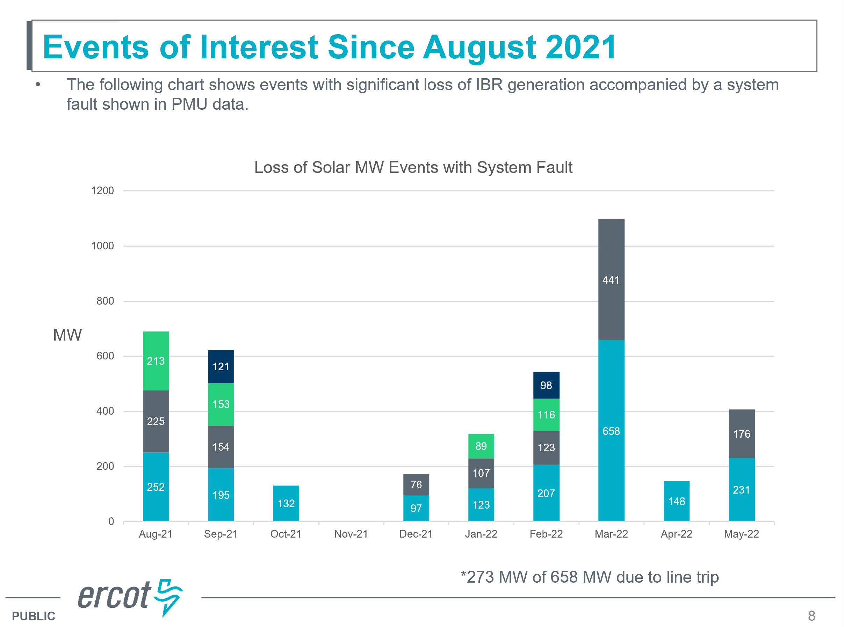

Slide 6
NERC and other Industry updates
NERC: Multiple solar PV disturbances in CAISO
Modelling Challenges and Recommendations
IEEE2800 Adoption Webinars
NERC MOD-026 and MOD-027
Utilizing Excess Capability of BPS-Connected IBRs for Frequency Support
Upcoming ESIG Webinar: EMT Modelling and Simulation
Event Page: https://www.esig.energy/event/webinar-emt-modeling-and-simulation-who-needs-an-emt-model-for-doing-stability-studies/
Upcoming ESIG Special Topic Webinar: Interconnection Study Criteria
Upcoming ESIG Special Topic Webinar: Interconnection Study Criteria
Upcoming Workshops, June 6-9, Denver
Workshop 1: Meteorology & Market Design for Grid Services https://www.esig.energy/event/2022-meteorology-and-market-design-for-grid-services-workshop/
Workshop 2: Special topics : Grid Forming IBRs https://www.esig.energy/event/2022-special-topic-workshop-grid-forming-ibrs/

Slide 7
Questionnaire and Guideline for new Inverter Based Resources Interconnecting in ERCOT
Draft proposal and is not vetted draft for ready for formal proposal
References that questionnaire based are: NERC guidelines, event reports and recommendations, IEEE and NERC standards, ERCOT nodal operating guides and planning guids
Followed four core performance principals
IBR GRs are expected to ride through with no loss of real or reactive power output during system disturbances
IBR GRs are expected to provide and maintain positive sequence PSSE, TSAT, and EMT models that match their actual performance
Minimum capability performance requirements does not necessitate tripping at just beyond those settings
Unnecessary protection settings should be disabled to prevent erroneous or unnecessary trips

Slide 8
Questionnaire:
Has the developer of the new IBR GR or ESR, read and implemented each of the NERC Guidelines related to Inverter Based Resources into its design? If not, please identify which specific guidelines are not incorporated into its design and why it does not apply or is not technically feasible to do so.
Has the developer of the new IBR GR or ESR, read and implemented each of the NERC Event Reports with Recommendations related to Inverter Based Resources into its design? If not, please identify which specific Recommendations are not incorporated into its design and why it does not apply or is not technically feasible to do so.
Is the new IBR GR or ESR a distribution level resource? If no, then mark NA. If yes, then has the developer of the new distribution IBR GR or ESR , read and implemented IEEE 1547 related to distribution level Inverter Based Resources into its design? If not, please identify which specific requirements are not incorporated into its design and why it does not apply or is not technically feasible to do so.
Is the new IBR GR or ESR a transmission level resource (69kV POI or above)? If not, then mark NA. If yes, then has the developer of the new distribution IBR GR, ensured it can comply with IEEE P2800 standard related to transmission level Inverter Based Resources into its design? If not, please identify which specific requirements are not incorporated into its design and why it does not apply or is not technically feasible to do so.
Has the developer of the new IBR GR or ESR, read and implemented PRC-024-2 and Nodal Operating Guides Section 2.6.2 and 2.9 into its design? This includes the understanding that performance is based on voltages and frequency at the Point of Interconnection Bus and that the no trip zones do not mandate tripping when outside the no trip zone. If not, please identify what is being done to ensure compliance with the requirements. Please provide a comparison of the frequency and voltage ride through settings to the actual equipment limitations.
Has the developer of the new IBR GR or ESR confirmed with its OEM that its PLL loss of synch relay is or will be disabled if it is able to do so prior to energization? Please confirm if the IBR GR or ESR can disable its PLL loss of synch.
Has the developer of the new IBR GR or ESR confirmed with its OEM that its feeder protection relays are or will be disabled if it is able to do so prior to energization? Please confirm if and which feeder protection relays IBR GR or ESR can disable.
Has the developer of the new IBR GR or ESR confirmed with its OEM that its under frequency protection relay settings very fast setting has a time delay (e.g. .6 sec or greater) that would prevent erroneous frequency measurements from tripping off the inverter? Please confirm what this setting is. Please also identify any frequency measurement algorithm or filter enhancements that are being made to prevent erroneous frequency measurements.
Has the developer of the new IBR GR or ESR confirmed that the Power Plant Controller will not introduce any ramp or other limitations that prevent the IBR from returning to its pre disturbance MW value within one second after its inverter exits its ride through mode?
Has the developer of the new IBR GR or ESR confirmed the minimum MW level needed to ensure no oscillations will occur at very low MW levels? Please identify what this minimum MW level is and that settings have been coordinated to make this equipment limitation as close to 0 MW as possible.

Slide 9
Priorities and items for next meeting (June 10th)
IEEE 2800 gap analysis update
Update on Odessa event
IBR Ride-Thru failures monthly update
NPRR1138
Discussion Draft interconnection check list

