Slide 1
PDCWG Report to ROS
Chair: Jimmy Jackson, CPS
Vice Chair: Vacant
ROS
June 2nd, 2022

Slide 2
Report Overview & Notes
Report Overview
  Meeting Minutes
  BAL-001-TRE-2 FMEs and IMFR
    3 FMEs in the month of April
    Version 2.11 of Frequency Measurable Event Evaluation Tool was adopted for use beginning April 2022. Some enhancements worth noting are,
      ESRs (charge and discharge sides) response for both PFR (if resource is on or available) and FFR (if being carried) will be evaluated
      IBRs when operating at MW = 0 MW will be evaluated for PFR response
    As a result of the changes above, the volume to resources that did not meet the performance criteria in April FMEs was relatively high compared to previous evaluations conducted.
  Frequency Control Report

Slide 3
Meeting Minutes
PDCWG Meeting 5/18/2022
  SCR800 and SCR809 Presentation
  NPRR 1128 Presentation
  NPRR 1085 Update
  ERCOT Reports
  TRE Report

Slide 4
Frequency Measurable Events Performance

Slide 5
Frequency Measurable Events
There were 3 FMEs in April
  4/13/2022 7:28:39
    Loss of 725 MW of generation
    Interconnection Frequency Response: 853 MW/0.1 Hz
    83 Resources were evaluated. These includes,
      48 Generation Resources
      2 Controllable Load Resources
      33 Energy Storage Resources
    29 of 83 Evaluated Generation Resources had less than 75% of their expected Initial Primary Frequency Response.
    27 of 83 Evaluated Generation Resources had less than 75% of their expected Sustained Primary Frequency Response.

Slide 6
Frequency Measurable Events
There were 3 FMEs in April
  4/19/2022 15:16:19
    Loss of 810 MW of generation
    Interconnection Frequency Response: 1,688 MW/0.1 Hz
    137 Resources were evaluated. These includes,
      100 Generation Resources
      2 Controllable Load Resources
      35 Energy Storage Resources
    61 of 137 Evaluated Generation Resources had less than 75% of their expected Initial Primary Frequency Response.
    51 of 137 Evaluated Generation Resources had less than 75% of their expected Sustained Primary Frequency Response.

Slide 7
Frequency Measurable Events
There were 3 FMEs in April
  4/22/2022 6:54:16
    Loss of 423 MW of load
    Interconnection Frequency Response: 755 MW/0.1 Hz
    334 Resources were evaluated. These includes,
      305 Generation Resources
      0 Controllable Load Resources
      29 Energy Storage Resources
    180 of 334 Evaluated Generation Resources had less than 75% of their expected Initial Primary Frequency Response.
    151 of 334 Evaluated Generation Resources had less than 75% of their expected Sustained Primary Frequency Response.

Slide 8
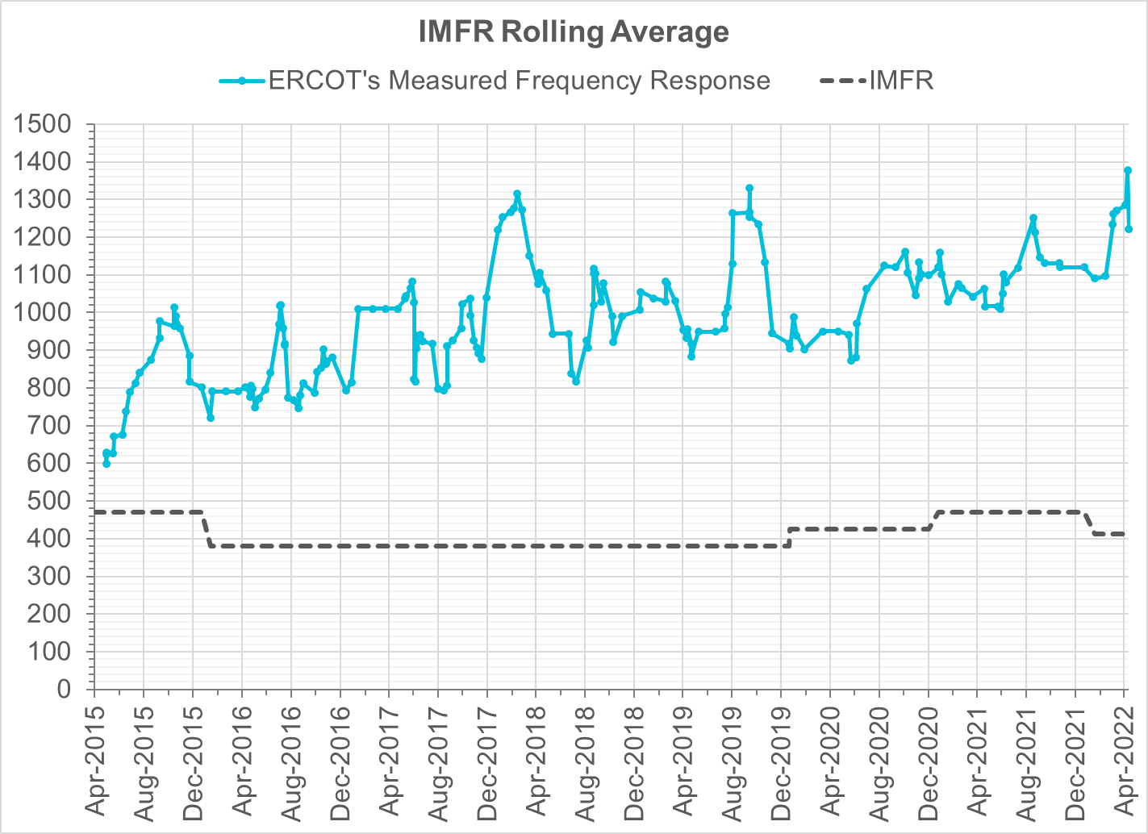
Interconnection Minimum Frequency Response (IMFR) Performance
IMFR Performance currently
1220.87 MW/0.1HZ
Frequency Response Obligation (FRO): 412 MW/0.1 Hz

Slide 9
Questions?

Slide 10
Frequency Control Report
April 2022

Slide 11
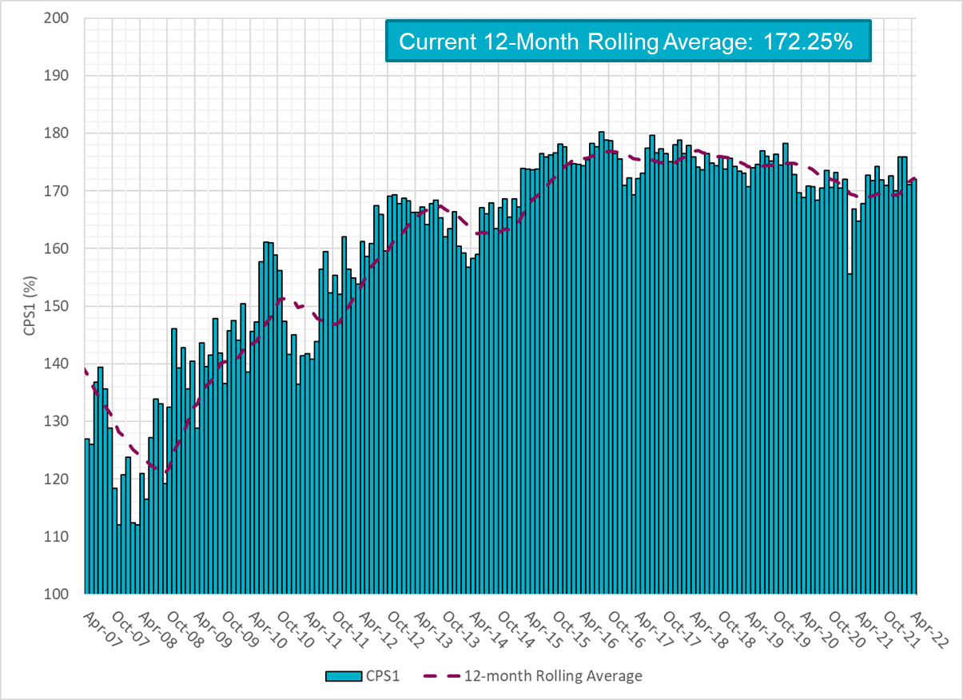
CPS1 Performance

Slide 12
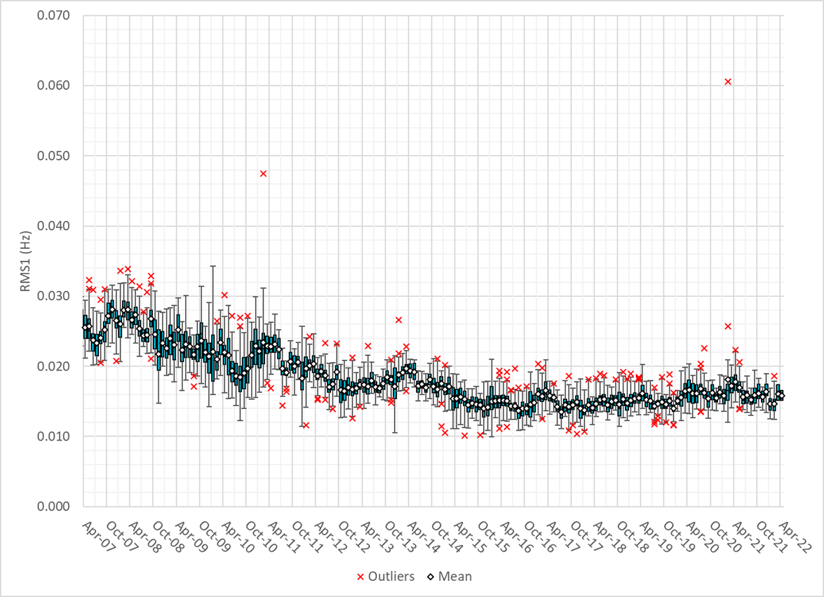
RMS1 Performance of ERCOT Frequency

Slide 13
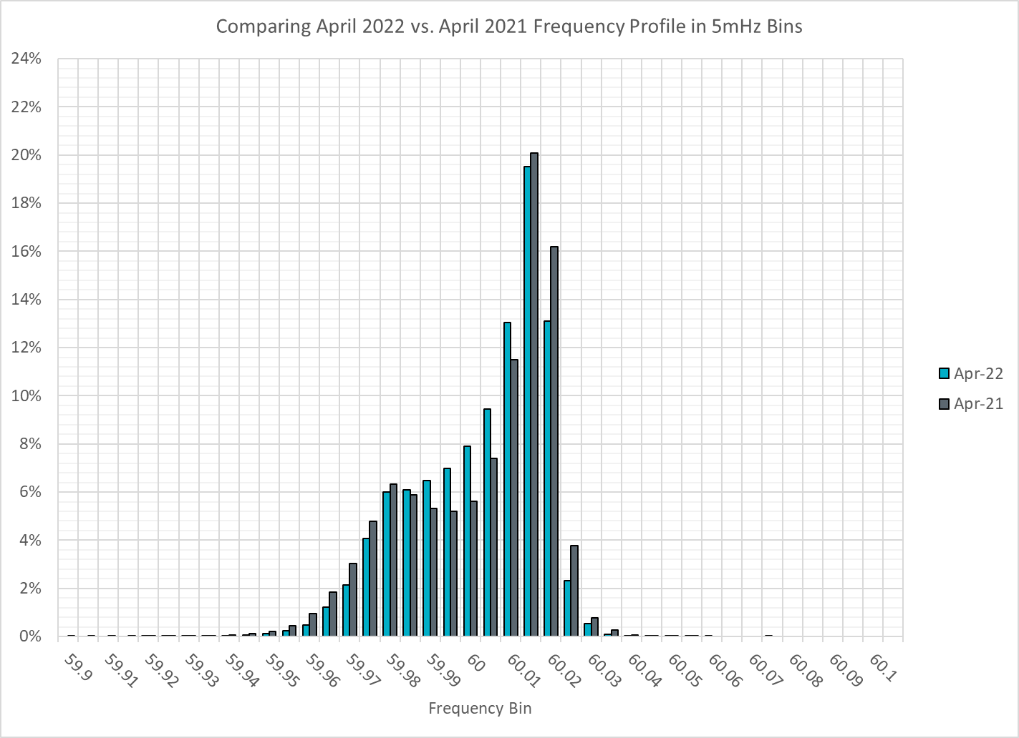
Frequency Profile Analysis

Slide 14
Time Error Corrections

Slide 15
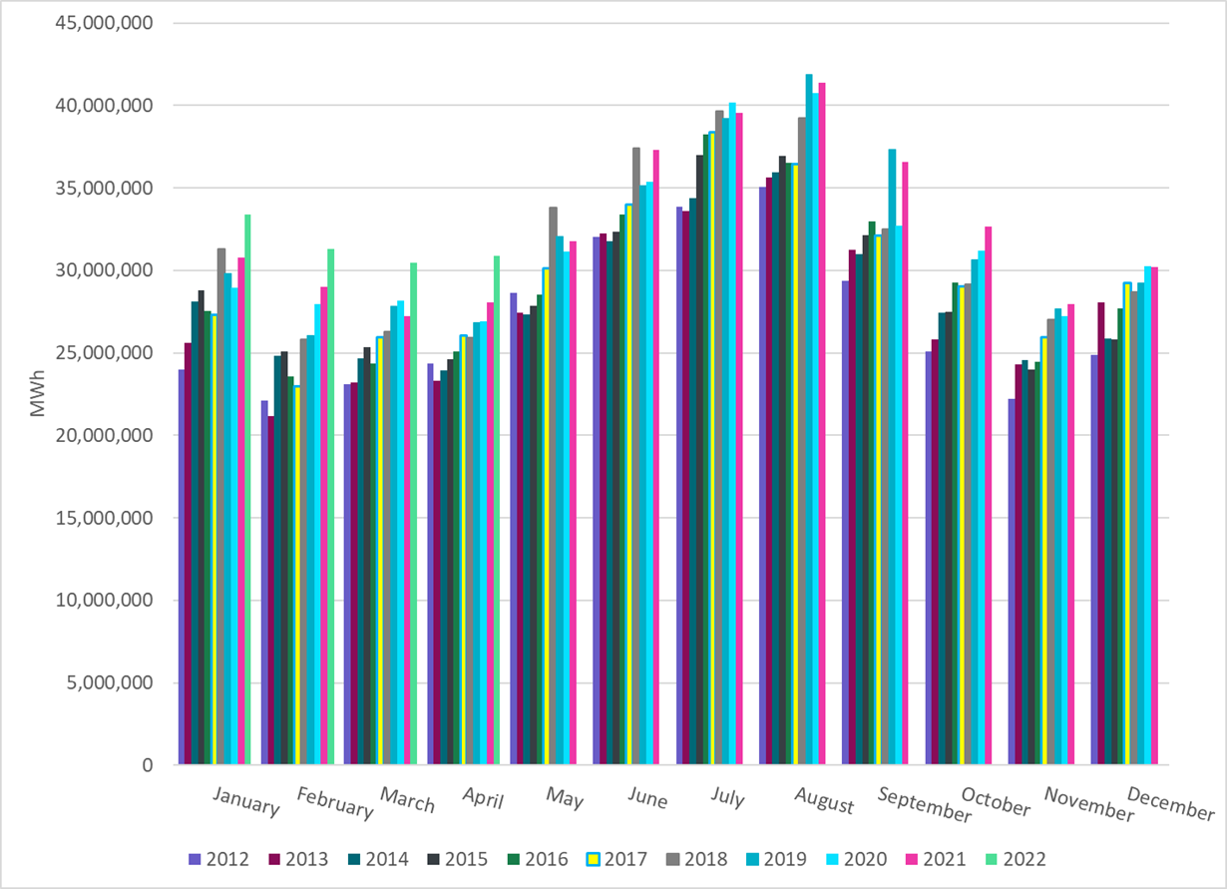
ERCOT Total Energy
Notes:
30,866,082 MWh

Slide 16
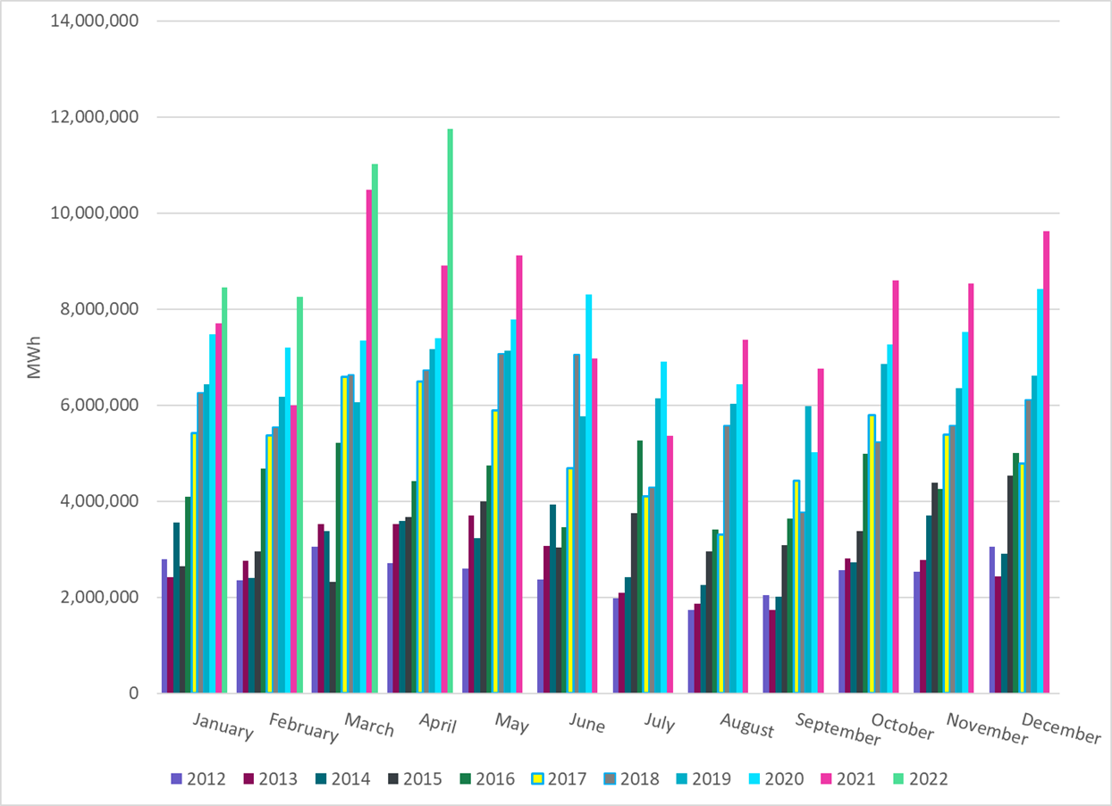
ERCOT Total Energy from Wind Generation
Notes:
11,743,813 MWh

Slide 17
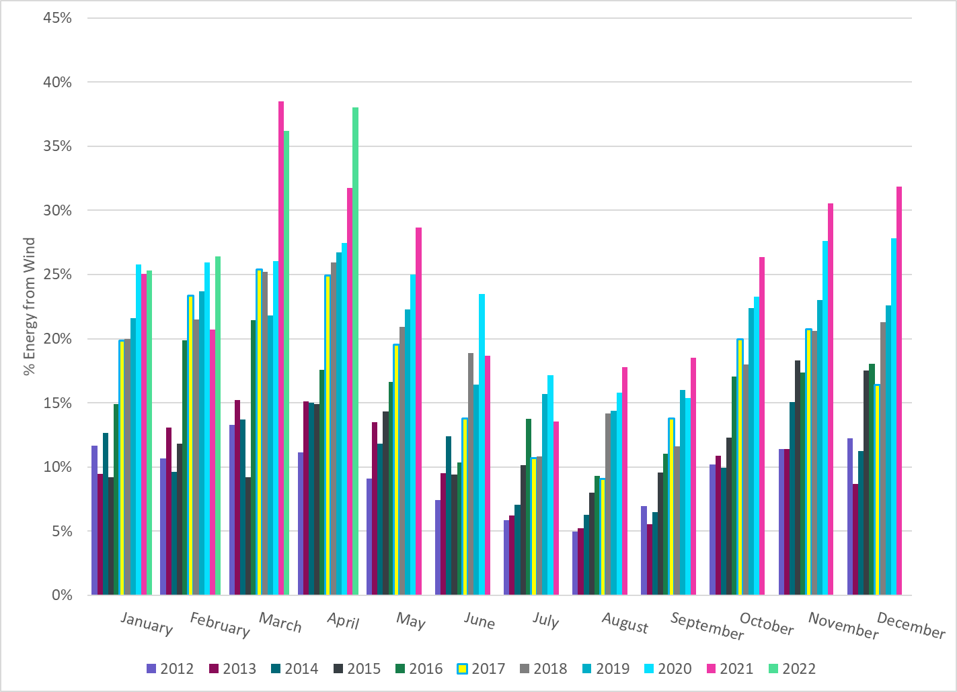
ERCOT % Energy from Wind Generation
Notes:
38.05%

Slide 18
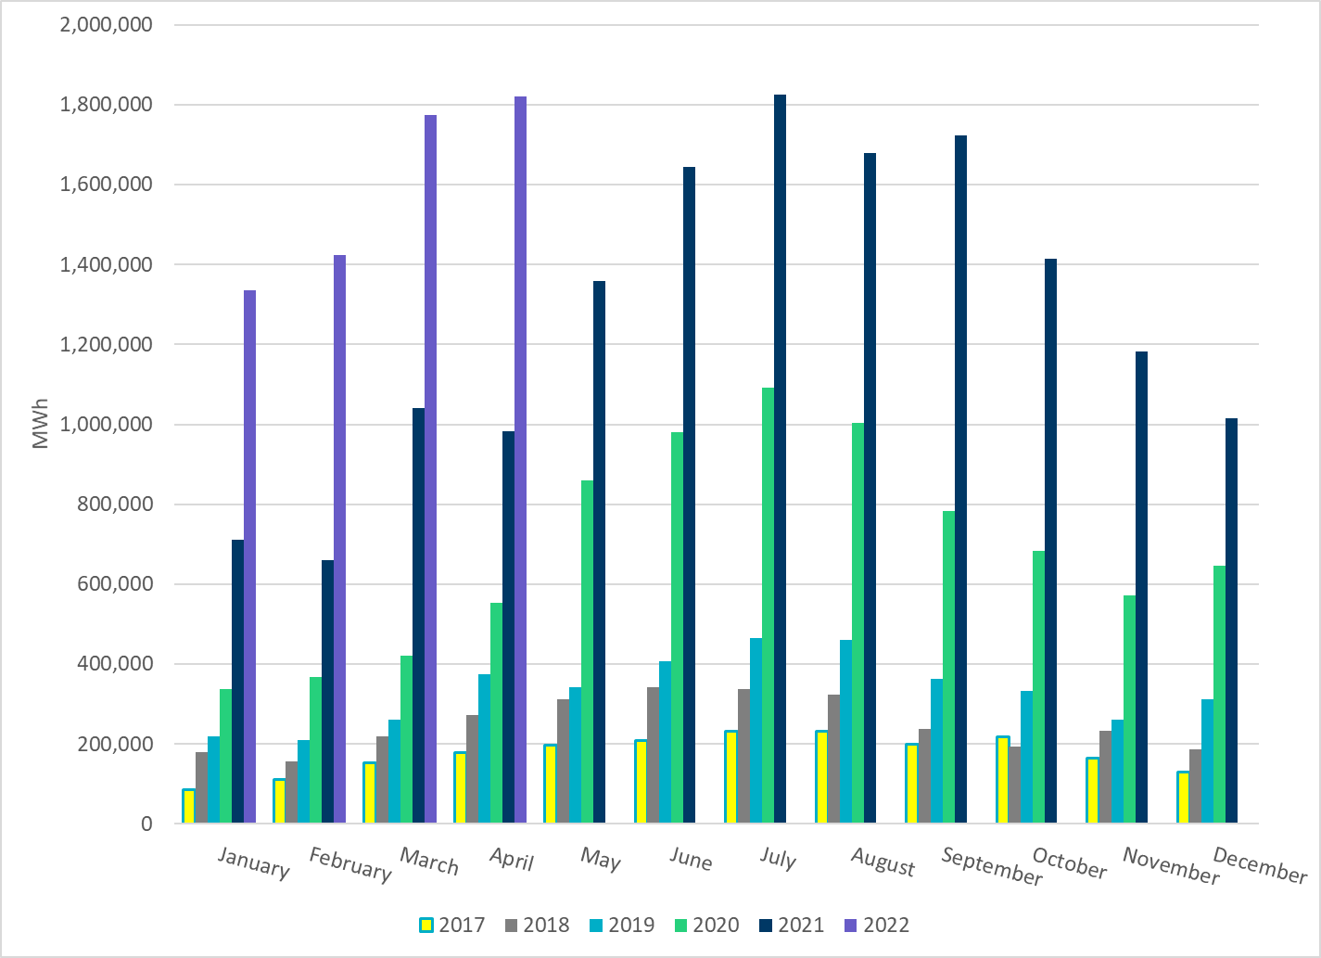
ERCOT Total Energy from Solar Generation
Notes:
1,820,140 MWh

Slide 19
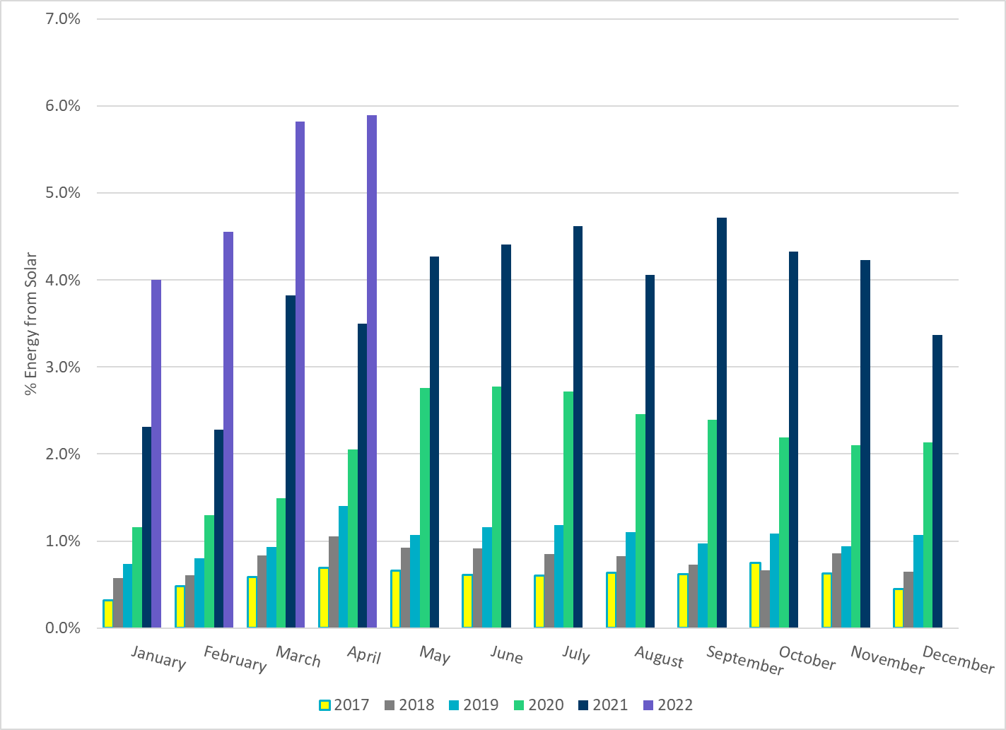
ERCOT % Energy from Solar Generation
Notes:
5.9 %

