Slide 1
Virtual Power Plants in Texas ASAP Refresh Rules for “Participation of Aggregate Load Resources”
ERCOT OBDRR041 Workshop
May 31, 2022

Slide 2
AGENDA
Policy motivators
Problem Statement
Refresh "Requirements for Aggregate Load Resource Participation" Other Binding Document so ERCOT can enable customers with DERs to provide dispatchable MWs + Ancillary Services in 2022
Tesla’s Voluntary Virtual Power Plant in Texas
What services customers provided in TX and what problems they solve
Components of the Other Binding Document Revision Request (OBDRR) 041
What is in the proposal
Long-term aggregation growth: ERCOT concerns, potential solutions
Appendix
Glossary
How to become an Aggregate Load Resource
Notes:
SCED, Nonspin & RRS, critical bridge service for the market
Regulation, keep demand and supply in balance in RT – service does the hardest work to keep everything in balance
Primary Frequency/Fast Frequency ?

Slide 3
Policy Motivators
Texas has thousands of Megawatts of assets on the distribution system, trending the acceleration in distributed energy resources (DERs) (behind-the-meter generation and storage)
FERC’s “Order 2222” does not apply in Texas – but Texas regulators recognize the need to mobilize this capacity

Slide 4
“DERs can hide in plain sight in our homes, businesses and communities, but their power is mighty…Projections indicate that from 65 gigawatts to more than 380 gigawatts of DERs could be added to the country’s power grids over the next four years” – FERC Chairman Neil Chatterjee, Opening Remarks at 9/24/20 FERC Open Meeting announcing FERC Order 2222
“FERC recently issued FERC Order 2222 that promotes eliminating barriers for DERs ..distributed energy resources from getting into the market .. We’re not subject to FERC jurisdiction, but I think the other markets are going to be evaluating these issues. What I mean by DERs is aggregations of customers and how they can participate in real time markets and ancillary services. I want to use this opportunity but also in continuing to innovate and enhancing reliability. ERCOT should have a workshop to get some momentum going. I don’t want to fall behind. We innovate at ERCOT, we lead. I would like to see a roadmap, a pathway.”​
-- Texas PUC Commissioner Lori Cobos, 12/02/21 Commission workshop ​

Slide 5
Problem Statement
Texas needs all available, affordable, dispatchable electric capacity/resources mobilized to address grid reliability challenges
Distributed energy resources are available today, but are unrealized dispatchable assets to ERCOT
Short-Term Solution
Minor changes to an existing, unutilized ERCOT market design concept developed 9 years ago, could immediately unlock grid reliability services from small distributed energy resources that can be dispatched as an "aggregation"
Notes:
A Virtual Power Plant is an aggregation of small, individual DERs, managed by a common software platform, to control those resources in response to signals from ERCOT – customers own their participation experience in a way that benefits everyone

Slide 6
https://pv-magazine-usa.com/2022/05/26/tesla-rallies-powerwall-owners-to-demonstrate-how-they-can-help-power-the-texas-grid/

Slide 7
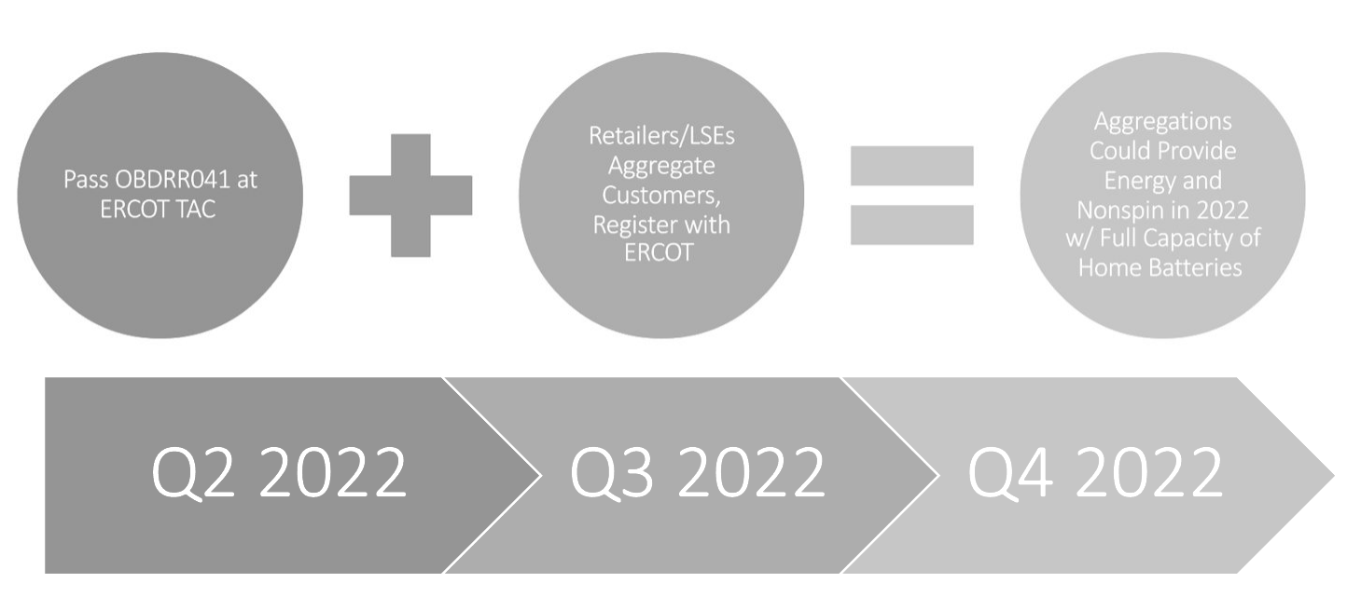
Short-Term Solution – OBDRR041 Clears Path for First ALRs in ERCOT in 2022

Slide 8
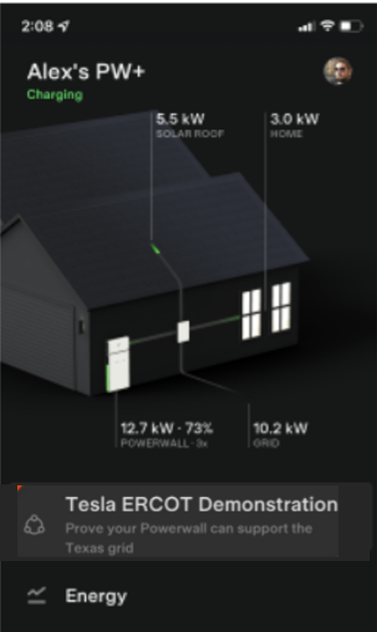
Virtual Power Plant Demo
Tesla has been proving that we can bring grid services value to ERCOT with volunteer customers
What is it:
Part of our effort with ERCOT to make additional grid services available (ancillary services)
An aggregation of ~60 customers in a single ERCOT load zone
What made this possible:
Aggregation building features and ancillary services capabilities used in other markets
Experience in other markets (ISO-NE, AEMO) delivering grid services
Collaboration with ERCOT staff to set parameters for VPP performance specific to ERCOT operations and dispatch rules
Results and Next Steps:
Demonstrated that there are zero technical blockers
OBDRR041 filed to update ALR Framework

Slide 9
Test Results
The behind-the-meter aggregation showed exceptional performance

Slide 10
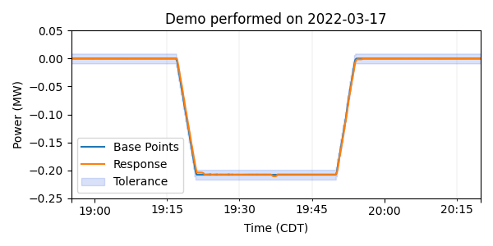
SCED Dispatch – Deployment of Reserve Capacity
ERCOT's pre-defined qualification test dispatch profile
Service Demonstrated
SCED dispatch for non-spin or PFR
Show that the aggregation can respond in minutes and follow ERCOT base point instructions
Service provides reserve capacity for when the grid operator has a near-term shortfall
Results
ALR could easily meet qualification standards
Responsive in seconds
Follows base points precisely, within a few kW
Takeaway
ERCOT could effectively deploy an aggregation of devices if reserves are needed to serve load.
Aggregation response follows dispatch exactly

Slide 11
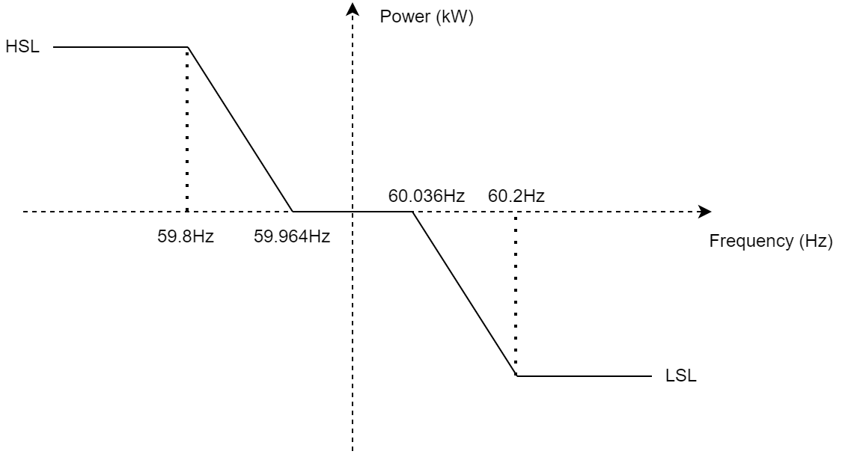
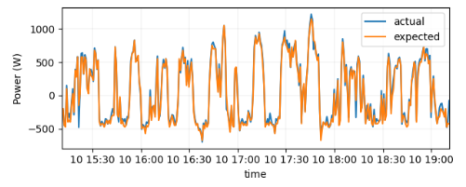
Primary Frequency Response (Required for SCED and Nonspin Reserve Service)
Set the fleet to automatically respond to grid conditions
Service Demonstrated
Droop response for non-spin or PFR
Show that the aggregation can provide fast, precise responses to grid frequency
This service is meant to respond immediately and automatically when Load and Gen get out of balance (e.g., sudden trip)
Results of technical demonstration
ALR could easily meet qualification standards
Devices instantaneous response time and fast control systems allow for an exceptional response
Takeaway
As required, an aggregation of devices can respond automatically to help 'catch' the grid if load and gen get out of balance.
Observe the devices in the field respond precisely

Slide 12
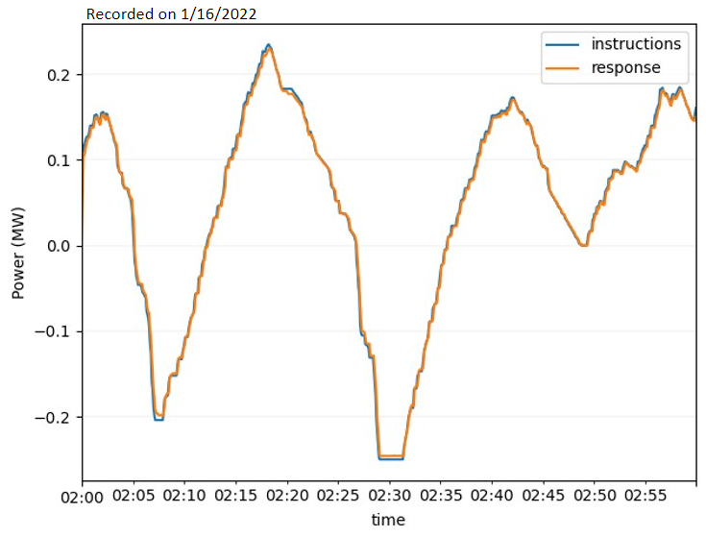
Regulation – Respond to ERCOT Second-by-Second
Future Opportunity
Send the aggregation a real regulation signal – both Reg-Up and Reg-Down
Service Demonstrated
Regulation: Reg-Up and Reg-Down
Prove that the aggregation can respond to second-by-second dispatches from ERCOT
This is the service that does the hard work of maintaining balance between load and gen
Results
ALR could easily meet qualification standards
Instantaneous ramp
Good performance of control and monitoring
Performance is exceptional compared to conventional resources
More thinking on validation of response
Takeaway
Looking forward, ALRs are capable of providing the most challenging Ancillary Services as well or better than conventional resources
Response plot traces exactly over the plot of the instruction

Slide 13
Tesla will File VPP Demo Results with TX PUC
“Our office has taken up what the most important issues, considerations, and policy parameters were to be considered on the topic of distributed generation, on distributed energy resources. I call it the holy grail issue. If we can crack the code on that then the grid has unlimited potential, in terms of segmentation, in terms of resiliency capability, in terms of resource adequacy. All the other grids are tackling this as well, FERC is keenly interested in it.”
Texas PUC Commissioner Will McAdams, 04/21/22 Commission Discussion of McAdams DER Memo ​

Slide 14
Elements of OBDRR041
"As we move from a supply sided system where it was just vertically integrated utilities, and now its generators and reps, gentailers as we call them, are providing resources, the lines between what a utility does and what consumer does are being blurred. The transmission and distribution systems are being blurred, as consumers become generators of power and put that back on the system. We have to account for that. […]The demand side are suppliers now. We want to push for them, we want their megawatts as part of their market.”​​
-- Texas PUC Commissioner Jimmy Glotfelty , 12/02/21 Commission workshop ​

Slide 15
OBDRR041
Tesla submitted OBDRR041 on May 18
Requires TAC approval; currently tabled at TAC
Key elements:
Clarifies that a ‘device’ can be any equipment under control
Clarifies that ‘some or all’ of the sites in an ALR can have devices under control
Intent is to allow ALR to consist of some sites that are not under control, but are there only to ensure that the ALR is always a Load
Any exports to the grid offset Load at the premise and at the Load not under control, thus allowing full capacity of storage/generation to be credited in a Load Resource.

Slide 16
OBDRR041
Key elements (cont.):
Telemetry:
Confirms that QSE can send two telemetry streams to ERCOT (premise-level and device-level) (This is allowed under Protocols 6.5.5.2)
Changes ‘Load’ to ‘MW’ to allow telemetry feed to include exports to the grid
Provides ERCOT with additional flexibility to manage congestion
May cap size of an ALR
May split an ALR into multiple ALRs (example: if sites are too concentrated to work under Load Zone shift factor dispatch)
May prevent ALR from adding sites in a concentrated area

Slide 17
OBDRR041
Key elements (cont.):
Performance Evaluation:
Aligns OBD with Protocols by confirming that ALR CLRs will be evaluated based on Controllable Load Resource Energy Deployment Performance (CLREDP) and Base Point deviations
Compliance to be based on telemetry values, which can be spot-validated against 15-minute interval metering
Further clarifies that ALR performance can be measured & verified using either Baseline or Meter Before/Meter After methodology

Slide 18
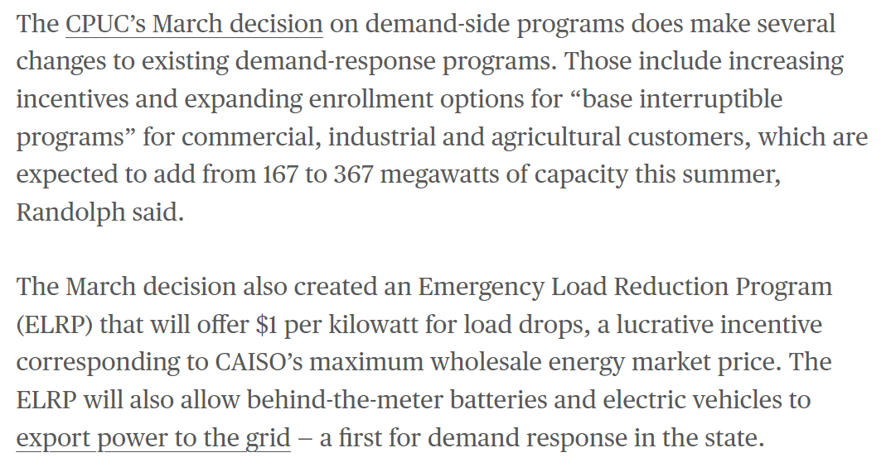
Equivalent Policy Fixes Being Made in High Grid- Risk States Load Resources Can Use Capacity of Devices that Export
https://www.canarymedia.com/articles/grid-edge/californias-race-to-secure-its-grid-against-summer-blackouts

Slide 19
Long Term Solution (Not Solved in OBDRR041)
ERCOT additional study/refresh of OBD + Unlock More Ancillary Services (RRS, Reg)
PUC Texas/ERCOT Sponsors Nodal Protocol Changes for Moving Aggregations to Nodal Settlement
Long-Term Policy Solution for Scaling Aggregated DERs Providing Grid Services
Experience of REPs/LSEs registered first ALRs in 2022 **OBDRR041 to Enable
2022
2023
Timeline could run 4 - 6 years
2022 +

Slide 20
Long Term Approach Considerations
Other grid operators have been working on mobilizing DER capacity for a few years now and have a model for sizing "congestion zones" or limiting aggregations at a congested transmission node
Texas has not yet worked on a solution for large DER aggregations - to grow this market, Texas will a creative solution that aligns with nodal dispatch
Large scale DER penetration will let ERCOT shift demand from interval to interval in the same way that they shift supply today

Slide 21
ERCOT Concerns about Load Resources
Under current rules, any CLR (aggregated or single site) is dispatched on the Load Zone shift factor and settled at Load Zone prices
That paradigm is not appropriate for large, single-site CLRs – can pose congestion management challenges (ERCOT described them here: "Zonal shift factors do not accurately reflect the impact that a change in the Load Resource's consumption would have on a specific transmission constraint.")
That is why Large Controllable Loads will begin receive Nodal Pricing
-- Large Flexible Load Task Force is exploring numerous other policy options
But an ALR that is widely dispersed across a Load Zone is a different story -- zonal dispatch is appropriate for now:
Tesla is proposing a conservative approach which allows ERCOT to decide where and when to limit aggregation growth under ALR rules

Slide 22
Appendix

Slide 23
Glossary
Term ​ | Definition ​ | Reference
Aggregate Load Resource (ALR)​ | A Load Resource that is an aggregation of individual metered sites, each of which has less than ten MW of Demand response capability and all of which are located within a single Load Zone.​ ​ | ERCOT Nodal Protocols, Section 2.1​
Controllable Load Resource | A Load Resource capable of controllably reducing or increasing consumption under Dispatch control by ERCOT. | ERCOT Nodal Protocols, Secition2.1
Devices​ | A “Device” refers to equipment under control or otherwise being used at some or all of the sites in an ALR to provide qualified services. A Device is always located behind a Premise-level meter.​ | Existing and proposed language in OBDRR 41, ERCOT Other Binding Document “Requirements For Aggregate Load Resource Participation in the ERCOT Markets”​
Distributed Energy Resources ​ | Generally refers to any resource that is distribution-connected and participating in grid operations or markets​ | SEE PUC Texas Project No. 51603, Utilicast Comment
Load Zone Price | A weighted average of the nodal prices at each electrical bus within each of the eight ERCOT load zones. | SEE PUC TX Project No. 52373, ERCOT Comments
Load Zone Shift Factor | A weighted average of the shift factors at electric buses within each load zone with respect to each transmission constraint, not specific to a given Load Resource and its location on the grid. | SEE PUC TX Project No. 52373, ERCOT Comments
Premise Level Telemetry | Data collected at the location of the revenue meter and communicated to ERCOT every 2 seconds via ICCP | Existing and proposed language in OBDRR041
Virtual Power Plant (VPP)​ | Typically refers to a combination of generation, storage and demand response under software control​ | SEE Australia Energy Market Operator VPP Home Page

Slide 24
How To: ERCOT Aggregate Load Resource Registration
ALR rules require a single Load-Serving Entity (Muni, Co-op, Retail Energy Provider) and must aggregate in a single Load Zone
Minimum Size of 100kW (maybe future cap on how big is too big)
With OBDRR041, any Load-Serving Entity/Retailer Can Aggregate Diverse Loads that Cannot Respond with Loads and Devices that Can Respond. Example: Injections from home batteries can be part of that load-reducing response as long combined with enough other Load so no "export" seen in the ERCOT system.
Every Customer does NOT have to have the same devices/loads
Some Customers can have NO devices (pure Load) and still benefit from lower electricity rates.
Must have the same Qualified Scheduling Entity for all Customers in the ALR
Must use ERCOT's existing process to Register an ALR (obtain Meter ESIDs for all customers, use published registration process)

