Slide 1
Market Credit Working Group update to the Wholesale Market Subcommittee
Brenden Sager, Austin Energy, Chair
Seth Cochran, Direct Energy, Vice Chair
1 June 2022

Slide 2
MCWG update to WMS
General Update
18 May 2022 Joint MCWG/CWG WEBEX Meeting
6 NPRRs reviewed for their credit impacts All considered operational without credit impacts
1131NPRR Controllable Load Resource Participation in Non-Spin
1110NPRR Black Start Requirements Update
1129NPRR Posting ESI IDs of Transmission-Voltage Customer Opt-Outs
1130NPRR Weatherization Inspection Fees Sunset Date Extension
1100NPRR Allow Generation Resources and Energy Storage Resources to Serve Customer Load When the Customer and the Resource are Disconnected from the ERCOT System
1127NPRR Clarification of ERCOT Hotline Uses

Slide 3
MCWG update to WMS
Data request update from the March CWG (from ERCOT)
Impact to QSEs and CRRAHs uplift exposure based on changes to the Default Uplift Methodology.
In the following slides:
The impact of removal of CRR Auction activity and multiplying CRRs owned (DAOPT & DAOBL) by a scalar with 50%, 60%, 70%, 80% and 90% multipliers at QSE/CRRAH and CP level.
The impact of removal of CRR Auction activity and multiplying CRRs and PTPs owned (DAOPT, DAOBL, RTOBL, RTOBLLO) by a scalar with 50%, 60%, 70%, 80% and 90% multipliers at QSE/CRRAH and CP level.

Slide 4
Maximum MWh activity ratio share (MMARS) adjustment
MMARS _{cp} = MMA _{cp} / MMATOT
MMA _{cp} = Max { ∑_{mp} (URTMG _{mp} + URTDCIMP _{mp}), → RTM Metered Generation and DC Tie Imports
∑_{mp} URTAML _{mp,} → RTM Adjusted Metered Load
∑_{mp} URTQQES _{mp,} → RTM QSE to QSE Energy Sales
∑_{mp} URTQQEP _{mp,} → RTM QSE to QSE Energy Purchases
∑_{mp} UDAES _{mp,} → DAM Energy Sales (TPO and Energy-Only)
∑_{mp} UDAEP _{mp,} → DAM Energy Purchases
∑_{mp} URTOBL _{mp,} → RTM PTP Obligations
∑_{mp} (UDAOPT _{mp} + UDAOBL _{mp} + UOPTS _{mp} + UOBLS _{mp}), → CRR Auction Sales & CRR Ownership in DAM
∑_{mp} (UOPTP _{mp} + UOBLP _{mp})} → CRR Auction Purchases

Slide 5
Real Time Metered Generation (MMARS) adjustment, option 1

Slide 6
Real Time Metered Generation (MMARS) adjustment, option 2
Real Time Obligation with Links to an Option Payment

Slide 7
Aug- 50%, 60%, 70%, 80% & 90% Scalar Scenarios
QSE/CRRAH Level
August 2021 UDAOPT, UDAOBL, RTOBL, RTOBLLO Adjustment
Segment | Original | Remove Auctions | 90 Percent adj. | 80 Percent adj. | 70 Percent adj. | 60 Percent adj. | 50 Percent adj.
Gen | 2.58% | 2.79% | 2.95% | 3.53% | 3.85% | 4.08% | 4.34%
Load | 16.67% | 18.04% | 18.66% | 19.09% | 19.73% | 20.90% | 22.21%
Load and Gen | 11.83% | 12.81% | 14.33% | 15.28% | 16.52% | 17.50% | 18.59%
Trader | 21.65% | 24.36% | 25.04% | 25.77% | 26.52% | 27.22% | 28.02%
CRRAH Only | 47.28% | 42.01% | 39.02% | 36.33% | 33.39% | 30.31% | 26.85%
Total | 100.00% | 100.00% | 100.00% | 100.00% | 100.00% | 100.00% | 100.00%
MMATOT | 222,159,396 | 205,270,370 | 194,010,691 | 182,977,832 | 172,423,362 | 162,784,960 | 153,164,681
Counter Party Level
August 2021 UDAOPT, UDAOBL, RTOBL, RTOBLLO Adjustment
Segment | Original | Remove Auctions | 90 Percent adj. | 80 Percent adj. | 70 Percent adj. | 60 Percent adj. | 50 Percent adj.
Gen | 3.52% | 3.20% | 3.18% | 3.19% | 3.19% | 3.18% | 3.17%
Load | 6.39% | 6.91% | 7.29% | 7.73% | 8.20% | 8.69% | 9.23%
Load and Gen | 47.01% | 50.64% | 51.46% | 52.38% | 53.54% | 55.10% | 56.85%
Trader | 38.59% | 34.82% | 33.86% | 32.73% | 31.38% | 29.69% | 27.79%
CRRAH Only | 4.49% | 4.42% | 4.21% | 3.97% | 3.69% | 3.35% | 2.96%
Total | 100.00% | 100.00% | 100.00% | 100.00% | 100.00% | 100.00% | 100.00%
MMATOT | 222,159,396 | 205,270,370 | 194,010,691 | 182,977,832 | 172,423,362 | 162,784,960 | 153,164,681
Maximum MWh Activity Total (MMATOT)

Slide 8
Benefits of NPRR 1126
Adjusts the default uplift allocation process to better balance the burden of a default across all market activity
Eliminating double counting and reducing the high concentration of default uplift risk to CRRs promotes market liquidity
Improves the ability of CRRs to work together with the energy market to hedge forward risk

Slide 9
Another credit calculation adjustment proposal
Example: DC tie transaction importing into ERCOT. URTA Unbilled Real-Time Amount drives credit requirements and when they’re importing power and ERCOT owes them money
EALt = Max [RFAF * Max {RTLE during the previous lrt days}, RTLF] + DFAF * DALE + Max [RTLCNS, Max {URTA during the previous lrt days}] + OUTt
Proposed EALt = Max [RFAF * Max {RTLE during the previous lrt days}, RTLF] + DFAF * DALE + RTLCS + OUTt
Proposal removes Unbilled Real-Time Amount max function
Due to Max functions, RTLF and RTLCNS, which capture recent positive RTM activity, is not taken into account at all. Rather RTLE and URTA, which lag behind by 7 days and have large M1=10 and M2=9 weights, set RTM exposure

Slide 10
Another credit calculation adjustment proposal
Proposal: To receive Trading Activity Only treatment, TAO-eligible entity would agree to suspend RTM activities immediately following receiving notice from ERCOT (simultaneously as when DAM activity is suspended) and not resume RTM activity until notified by ERCOT to do so (similar in concept to agreeing to special provisions to receive preferential “e” treatment in DAM)
DC Tie Load, even though allocated costs like other Load, is still a trading activity – i.e., there is no mass transition required for DC Tie Load. Currently, QSE engaging in trading activity only having no Load or generation but exporting over DC Ties (DC Tie Load) is not considered a TAO QSE. Change: Export (DC Tie Load) should be treated as trading activity in designation of TAO QSE.
From ERCOT: Not going to be manual monitoring by ERCOT; manual processes are difficult especially for RT activity

Slide 11
MCWG update to WMS
Monthly Highlights Mar 2022 – Apr 2022
Market-wide average TPE increased from $ 935.1 million in March to $ 1,145.7 million in April
TPE increased mainly due to
higher Forward Adjustment Factors and
higher Real-Time and Day-Ahead Settlement Point prices in April than in March
Discretionary Collateral is defined as Secured Collateral in excess of TPE,CRR Locked ACL and DAM Exposure
Average Discretionary Collateral decreased from $1,941.7 million to $1,875.6 million
The decrease in Discretionary Collateral is largely due to increase in TPE
No unusual collateral call activity

Slide 12
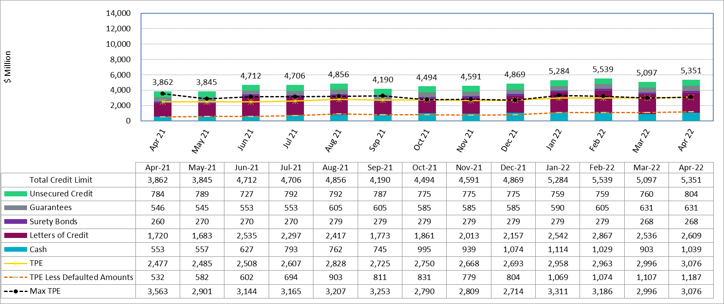
Available Credit by Type Compared to Total Potential Exposure (TPE) Feb 2021- Apr 2022
Numbers are as of month-end except for Max TPE
Max TPE is the highest TPE for the corresponding month
TPE less Defaulted Amounts: TPE – Short-Paid Invoices

Slide 13
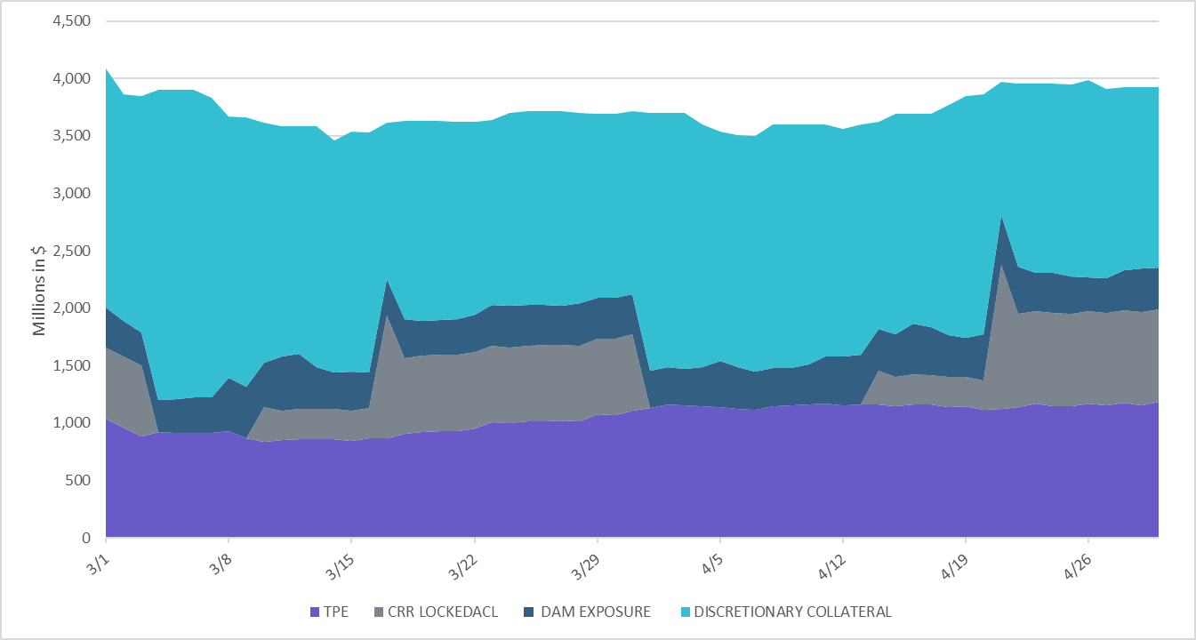
Discretionary Collateral Mar 2022 - Apr 2022
* Discretionary collateral doesn’t include Unsecured Credit Limit or parent guarantees
* TPE adjusted to exclude short pay entities eliminating data skew

