Slide 1
Firm Fuel Supply Service RFP Review
ERCOT Staff
May 26, 2022

Slide 2
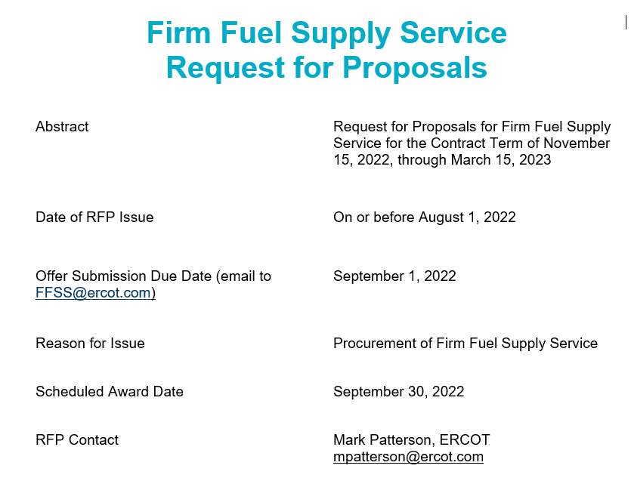

Slide 3
NPRR-1120 Establish Firm Fuel Supply Service (FFSS)
NPRR-1120 was approved by ERCOT BOD on 03/07/2022 and PUCT approved the NPRR-1120 on 03/31/2022.
Currently, ERCOT is working on the Project to implement NPRR-1120, stay tune to monthly Project Update at PRS.
At the time of the NPRR-1120 there were number of outstanding questions related to Firm Fuel Supply Service (FFSS) and ERCOT has since received guidance from the commission on those questions.
Feedback on, what Resources are Qualified in the first RFP?
Guidance on budget/quantities for the first RFP
Clearing the Service - Pay as bid versus single clearing price
Service duration requirement for Firm Fuel Supply Service (48, 72, other?)

Slide 4
Obligation Period, Single Clearing Price, and Service Duration
ERCOT seeks to procure 3000-4000 MWs of FFSS at a cost not to exceed $54 Million for the obligation period covered by this RFP. ERCOT may procure more or less than this range depending on the specific offers received.
Cost cap only applies to the cost of the standby payments.
Obligation period for this RFP will be the period starting with Hour Ending 01:00 on November 15, 2022 and ending with the conclusion of Hour Ending 24:00 on March 15, 2023.
ERCOT will procure FFSS using a single clearing price methodology for all capacity procured covering the obligation period ($/MW).
Only bids that include a specified amount of reserve fuel that is sufficient to sustain the operation of the Generation Resource at its offered MW level for 48 hours will be considered.

Slide 5
Eligibility
Only offers for natural gas Generation Resources with the following reserve fuel capabilities will be considered for the FFSS procurement addressed in this RFP:
On-site fuel, or
Off-site natural gas storage where the Resource Entity and/or QSE owns and controls the natural gas storage and pipeline to deliver the required amount of reserve natural gas to the Generation Resource from the storage facility.
Split Generation Resource (SGR)
Offers must be submitted by the QSE for each separate SGR.
Offers will be eligible for awards only if each QSE representing an SGR at the site offers at or below the clearing price and each offer qualifies to be awarded.

Slide 6
Offer Profile
The FFSS Standby price must be stated in U.S. dollars per MW for the capacity offered to provide FFSS. Operation at the offered MW level must be sustainable for a 48 hour duration.
The QSE, by offering FFSS MW for a duration of 48 hours, is offering reserve fuel for the offered Generation Resource to run for 48 hours at the offered MW.
Any FFSS offers above $18,000 per MW will not be considered in the auction.
The offered Generation Resource must have and maintain sufficient
emission credits or allowances for at least two 48-hour deployments at any level of output up to the offered MW, and
reserve fuel to deliver the offered MW for at least one 48-hour deployment
In the case of the reserve fuel being stored in an off-site natural gas storage facility the Resource Entity must own and control the natural gas storage facility and any equipment, including but not limited to pipelines, necessary to transport the natural gas from the storage facility to the Generation Resource.
The off-site natural gas storage and the associated infrastructure to transport natural gas to the FFSSR must be a critical natural gas facility, as defined in PUC Substantive Rule 25.52(c)(2).

Slide 7
Offer Profile (Cont’)
The QSE must acknowledge that the Generation Resource has, or will obtain, both the authority and emission credits or allowances to operate at the offered capacity for a duration of at least 96 hours to meet its obligation to provide FFSS.
Any Generation Resource offered to provide FFSS must have a startup time no greater than 6 hours with the reserve fuel and must be capable of providing the full amount of offered MW within 6 hours of receiving a Verbal Dispatch Instruction (VDI) from ERCOT.

Slide 8
Offer Submission Process and Award Notification
Offers for FFSS must be provided using the FFSS Offer Submission Form found on the FFSS webpage on ERCOT.com.
Only one Generation Resource offer per form.
FFSS Offer Submission form includes two tabs; Identification tab and offer tab. Both tabs must be completed for the offer to be considered.
An offer may not be withdrawn once submitted.
An offer is binding upon the QSE if ERCOT notifies the QSE that it has been awarded an FFSS Obligation.
ERCOT will post both awards and a notification of those offers not awarded to the MIS Certified Area for each QSE that submits a valid offer.

Slide 9
Bid Evaluation Criteria
Any proposals for FFSS in which the offered Generation Resource does not meet the minimum requirements of an FFSSR outlined in the ERCOT Protocols, Operating Guides, and this document will be excluded and not evaluated. Additionally, any proposals with an offer price that exceeds $18,000 per MW will be excluded and not evaluated.
The proposals for FFSS in which the offered Generation Resource meets the minimum requirements of an FFSSR will be evaluated based on, at a minimum, the following criteria:
Standby Price for FFSS for each obligation period.
Amount of capacity offered.
Reserve fuel type.
Fuel Storage capability sufficient for FFSSR to operate at its awarded MW value for at least 48 hours.

Slide 10
FFSS Offer Submission Form
A draft of the FFSS Offer Submission Form is posted to the May 26, 2022 FFSS RFP Stakeholder Review/Discussion Session on the ERCOT meeting calendar.

