Slide 1
IBR Ride-Thru Events
Monthly Update
IBRTF Meeting
May 23, 2022

Slide 2
January – March Events
All events resulted from fault/failure within the plants
Not deemed susceptible to trip for Odessa type event
No follow ups scheduled at this time
May return to some of these events at later date
Still following up with repeat unit trips/ MW swings
Curtailment, PFR issues

Slide 3
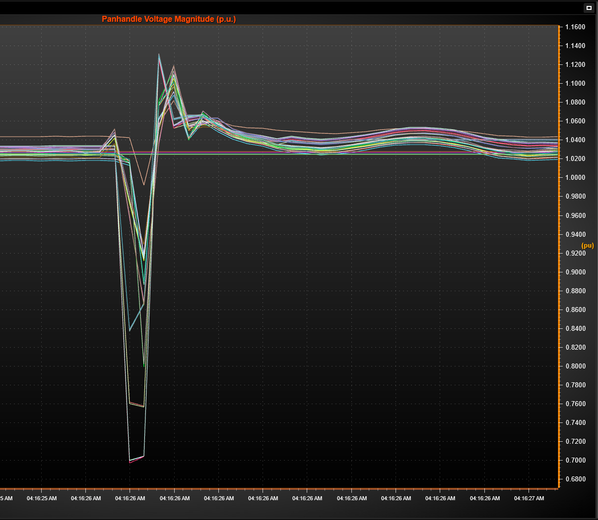
Panhandle Windfarm Event 3/22
Event #1 – 3/22 @ 4:16 AM
A-B phase fault lasting 3.38 cycles on transmission line from large Panhandle substation to windfarm (line owned by windfarm and tripped)
Windfarm was generating a combined 273 MW which was lost due to line trip
Voltage at substation dropped to 0.7pu (345kV) and highest voltage or 1.132pu recorded at nearby substation
Nearby windfarms (8 sites) lost combined ~385 MW following fault with varying recovery times
Total loss ~658 MW
Frequency dropped from 60.008 Hz to 59.904 Hz (PI)

Slide 4
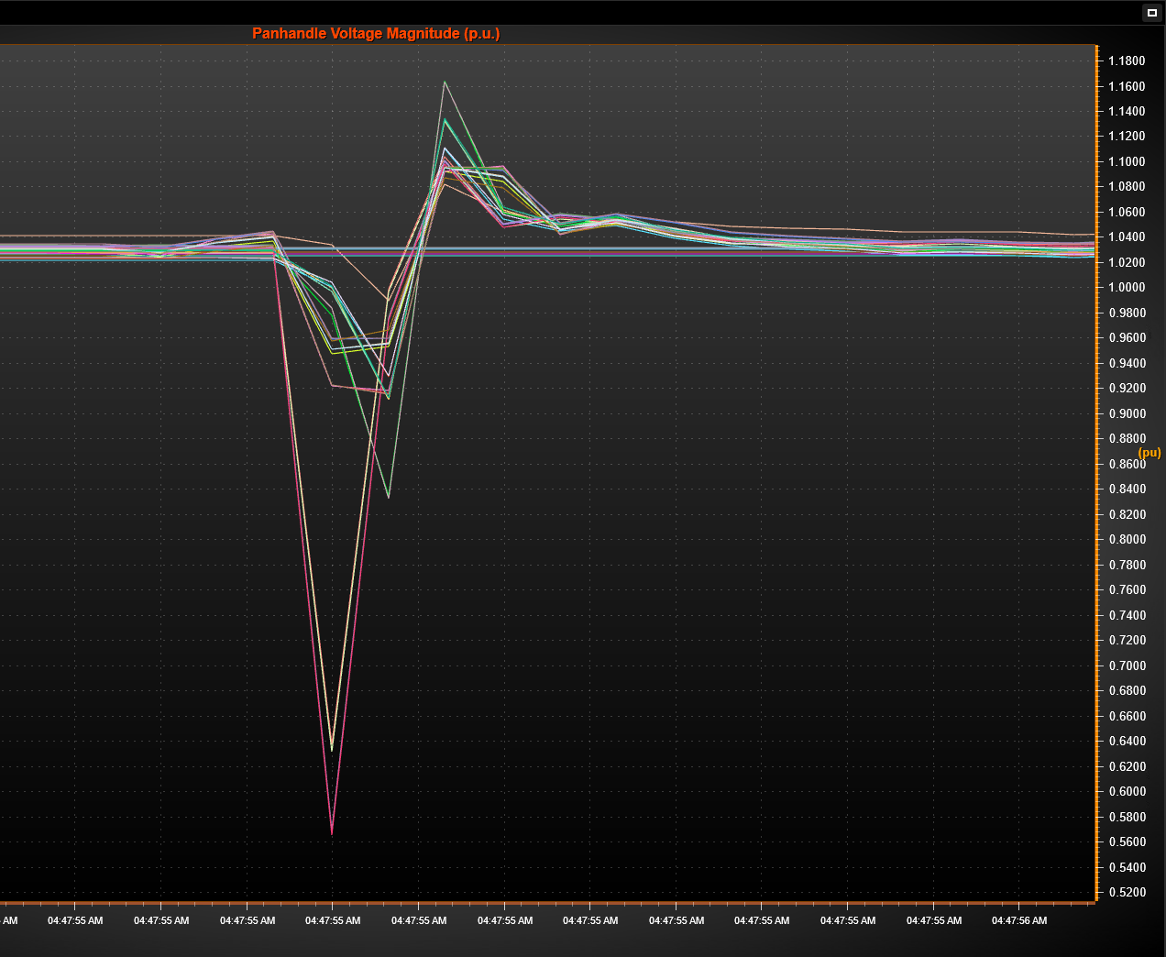
Panhandle Windfarm Event 3/22
Event #2 – 3/22 @ 4:48 AM
B-C phase fault lasting 2.88 cycles on transmission line between two large Panhandle substations (line trips)
Voltage at substation dropped to 0.567pu (345kV) and highest voltage or 1.163pu recorded at nearby substation
Nearby windfarms (same 8 sites) lost combined ~441 MW following fault with varying recovery times
Frequency dropped from 59.998 Hz to 59.942 Hz (PI)

Slide 5
Panhandle Windfarm Event 3/22
3 of 8 sites returned to pre-disturbance output within seconds
RFIs sent to remaining 5
Most common stated cause for MW reduction is pitch-system related turbine faults
Overvoltage tripping also stated in a couple responses
One response stated 23 of 27 turbines that faulted were due to SubSynchResonance fault code
One unit had very low output for a few minutes for undetermined reasons
Most plants stated they are still working with OEMs to perform additional analysis

Slide 6
NERC Event Report
Initial report finished and submitted to TRE on May 10
ERCOT to follow up with several windfarms in next couple weeks
Meeting with NERC this week to discuss additional questions
Possible collaboration with NERC/TRE for follow up discussions similar to Odessa Disturbance
Final report after follow up discussions
Redacted report to present to IBRTF

Slide 7
April – May Events
3 events in April/May in which possible system fault recorded by PMUs coincides with loss of solar generation
Event 1 on April 8 was site forced offline by TSP due to grid issues
Plant forced offline by TSP
Breakers at station were opened
No IBR performance issues identified
Two events in May were same plants and similar causes as events on 1/20 and 2/17
Plant having issues with catastrophic MVT failures
RE operates neighboring sites with same design issues
ERCOT has had conversations with RE and will monitor

Slide 8
Events of Interest Since August 2021
The following chart shows events with significant loss of IBR generation accompanied by a system fault shown in PMU data.
*273 MW of 658 MW due to line trip

Slide 9
General Comments
No longer sending RFIs for smaller events
Will send email with event description and request PMU/DFR data as well as answers to a few basic questions
Quicker response time and less extraneous information/work required
Emails coming from RFI@ERCOT.COM
ERCOT will follow up as needed

Slide 10
Questions?

