Slide 1
ERCOT IBRTF: NERC and Other Industry Updates
Julia Matevosyan
Chief Engineer
ESIG
5/23/2022

Slide 2
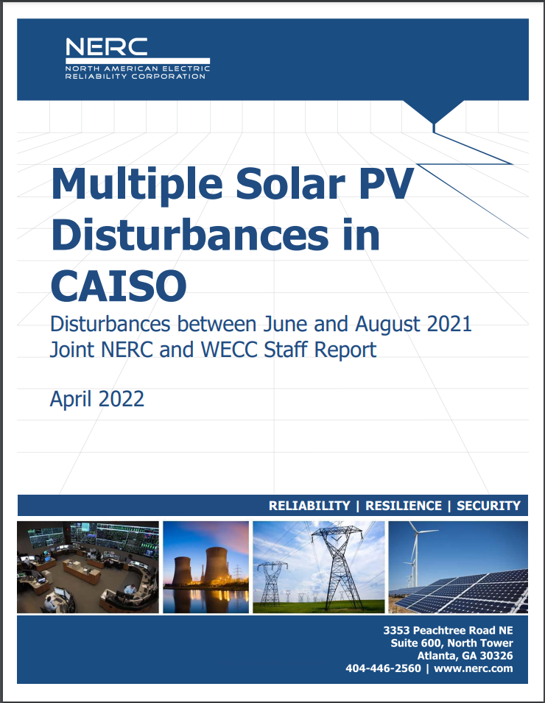
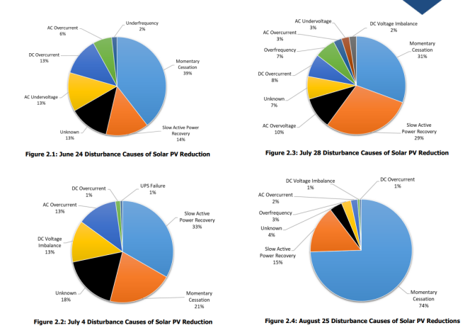
Four fault-induced (primarily) solar loss events in summer 2021 in CAISO
Solar MW loss ranging from 511 MW (30 plants) to 765 MW (27 plants)
Notes:
Three events are phase to phase fault on 500 kV line and one event single line to fault fault on 500 kV breaker.
Active power recovery extends many seconds (or minutes after fault clears)

Slide 3
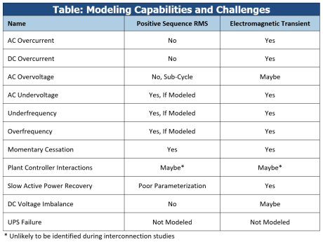
Modelling Challenges and Recommendations
Recommendations:
Establish clear, detailed, and necessary modeling requirements per FAC -001 and FAC -002 standards
Ensure sufficient model quality checks are in place
Enforce model quality reviews and checks throughout interconnection study process, planning studies, and operational planning assessments
Recognize that bad models lead to unnecessary or inaccurate studies, which lead to re -work and possible reliability risks

Slide 4
Recommendations
Recommendation #1: Adopt Reliability Guidelines
Recommendation #2: Improve Interconnection Process, including comprehensive requirements that must be met prior to commercial operation
Recommendation #3: Improve NERC Reliability Standards:
Performance validation standard needed,
PRC-024-3 needs to be replaced by ride-through standard,
Analysis and reporting for abnormal inverter operations
Monitoring Data Improvements,
Inverter-specific requirements
Requirement for accurate EMT models at time of interconnection (FAC-001, FAC-002)
Update NERC MOD-032 to include EMT Modelling
Updates to ensure model quality checks and model improvements
Recommendation #4 (CAISO-Specific): Adopting NERC Guidelines, Performance Validation and Follow-Ups, Event Analysis Improvements, Detailed Model Quality Review
Notes:
Event Analysis Improvements:
Understanding momentary cessation versus tripping
Analyzing smaller events
Proactively engaging plant owners

Slide 5
References
Multiple Solar PV Disturbances in CAISO Disturbances between June and August 2021: Joint NERC and WECC Staff Report Informational Webinar
Presentation: https://www.nerc.com/pa/rrm/ea/Documents/CA_Solar_PV_Disturbances_Webinar_May2022.pdf
Recording: https://nerc.webex.com/recordingservice/sites/nerc/recording/c92f63aab2b0103abf4d0050568110b2/playback
Report: https://www.nerc.com/pa/rrm/ea/Documents/NERC_2021_California_Solar_PV_Disturbances_Report.pdf

Slide 6
IEEE2800 Adoption Webinars
Joint NERC-NATF-NAGF-EPRI Webinar on IEEE 2800-2022: https://www.epri.com/events/621D26F1-00A5-4F90-8AA8-C68959393DBC
Joint IEEE–ESIG–PSERC–CURENT Webinar: https://sagroups.ieee.org/2800/resources/ (scroll down the page to find links to the webinar slide deck and recording)
Both webinars widely attended by the industry

Slide 7
NERC MOD-026 and MOD-027
In 2020, based on comprehensive NERC Standard Review IRPTF recommended revisions to NERC Reliability Standards MOD-026-1 and MOD-027-1. These standards require, among other things, Generator Owners to provide verified dynamic models to their Transmission Planner for the purposes of power system planning studies. Both standards contain language that is specific to synchronous generators that is not applicable to IBRs. The IRPTF recommended to clarify requirements related to IBRs and to require sufficient model verification to ensure accurate generator representation in dynamic simulations.
A formal comment period for draft Reliability Standard MOD-026-2 – Verification of Dynamic Models and Data for BES Connected Facilities, is open through 8 p.m. Eastern, Wednesday, July 6, 2022.
https://www.nerc.com/pa/Stand/Pages/Project-2020_06-Verifications-of-Models-and-Data-for-Generators.aspx
Next Steps: Initial ballots for the standard and implementation plan, as well as a non-binding poll of the associated Violation Risk Factors and Violation Severity Levels will be conducted June 27 – July 6, 2022.
Notes:
MOD-026: Verification of Models and Data for Generator Excitation Control System or Plant Volt/Var Control Functions
MOD-027: Verification of Models and Data for Turbine/Governor and Load Control or Active Power/Frequency Control Functions

Slide 8
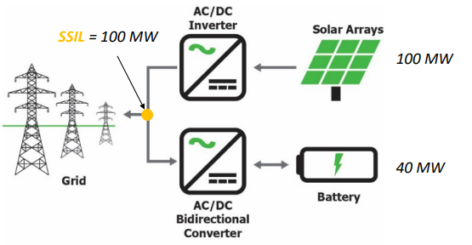
Utilizing Excess Capability of BPS-Connected IBRs for Frequency Support
Objective: Leverage PFR and FFR capabilities from inverter-based resources to the extent possible to support BPS frequency as an essential reliability service
Terminology:
Steady-State Interconnection Limit (SSIL)
Short-Term Interconnection Limit (STIL)
Industry webinar:
Overview of the white paper
Benefits for different stakeholders
OEM perspective (capabilities, field demo)
Planning perspective (models and studies)
IEEE2800-2022 perspective
White Paper: https://www.nerc.com/comm/RSTC_Reliability_Guidelines/White_Paper_IBR_Hybrid_Plant_Frequency_Response.pdf
Webinar: https://nerc.webex.com/recordingservice/sites/nerc/recording/6cd07f37a230103aaf5f00505681f098/playback
Presentation slides: https://www.nerc.com/comm/RSTC/IRPS/Webinar_Utilizing_Excess_IBR_Capability_FR.pdf

Slide 9
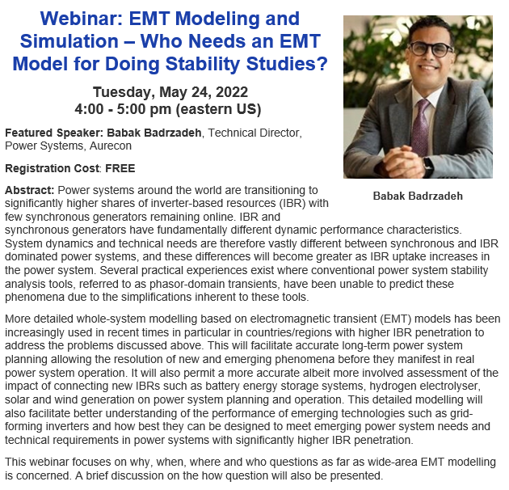
Upcoming ESIG Webinar: EMT Modelling and Simulation
Event Page: https://www.esig.energy/event/webinar-emt-modeling-and-simulation-who-needs-an-emt-model-for-doing-stability-studies/

Slide 10
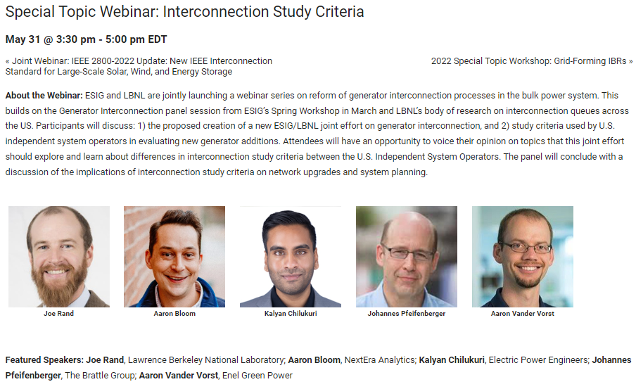
Upcoming ESIG Special Topic Webinar: Interconnection Study Criteria
Event Page: https://www.esig.energy/event/special-topic-webinar-interconnection-study-criteria/

Slide 11
Upcoming Workshops, June 6-9, Denver
https://www.esig.energy/event/2022-meteorology-and-market-design-for-grid-services-workshop/
https://www.esig.energy/event/2022-special-topic-workshop-grid-forming-ibrs/

Slide 12
Grid –Forming Technology in Energy Systems Integration
Julia Matevosyan
julia@esig.energy

