Slide 1
Update on SCR 800 and 809
Balancing Operations Planning Staff
WMWG
May 20, 2022

Slide 2
Discussion Outline
Update on SCR800
Predicted DC Tie ramp rate (PDCTRR) calculation methodology
PDCTRR Benefits and Performance
Summary & Next Steps
Reminder of SCR809

Slide 3
SCR800

Slide 4
Background on SCR800
SCR800 will incorporate a new component into ERCOT’s Generation To Be Dispatched (GTBD) which accounts for the five-minute predicted DC tie ramp rate (PDCTRR). The PDCTRR will be calculated using the latest available scheduled DC tie flows.
In absence of this today, SCED is does not have a way of accounting for the ramping of DC ties in Real-Time.
Adding the PDCTRR in the GTBD is anticipated to improve the ability of Security-Constrained Economic Dispatch (SCED) to calculate Five-minute Base Points and is anticipated to reduce the burden of Regulation Services to compensate for the ramping of DC ties. This is also expected to improve the frequency recovery duration during significant DC tie ramp events.
Equation
GTBD = Total Gen + K1*10*System Load Frequency Bias + K2*[(net non-conforming Load) – (net filtered non-conforming Load)] + K3*5*PLDRR + K4*Regulation Deployed + K5*ACE Integral – K6*5*PWRR + K7*5*PDCTRR – K8*5*PSRR
NEW ADDITIONS

Slide 5
SCR800 Update
As a part of implementing SCR800, ERCOT is in the process of integrating a five-minute predicted DC tie ramp rate into ERCOT’s Energy Management System (EMS)
ERCOT’s EMS is being setup to compute a Predicted DC Tie Ramp Rate using
Approved DC Tie Electronic Tags (e-Tags)
Note that a DC tie schedule is originally in 15m resolution and must be converted to 5m resolution
ERCOT is on track to complete the software changes associated with SCR800 in the 2022 R3 release.

Slide 6
Conversion from 15m to 5m Schedule
DC tie schedules are originally in 15m resolution. DC ties are expected to perform 10m ramps “across the interval” to the next scheduled value.
In the example above, the DC tie schedule changed from -100 MW at 00:45 to 200 MW at 01:00. DC Ties should start the 10-minute linear ramp at 00:55 and end at 01:05. The 5-minute schedule values are shown below:
00:55, -100 MW
01:00, 50 MW
01:05. 200 MW

Slide 7
Evaluated PDCTRR Calculation Methods
Direct Method
Sch(5)
Predicted Ramp
Current Time
Sch(0)
00:00
00:05
Sch(0): The scheduled DC tie flow at the nearest future 5 min clock interval
Sch(5): The scheduled DC tie flow 5 min after Sch0
Persistence Method: predicts a DC tie ramp of 0. This is essentially what is being done in absence of the PDCTRR component in GTBD.
Notes:
Maybe take out interpolated?

Slide 8
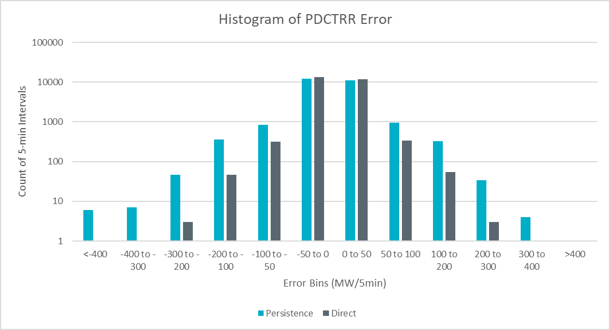
PDCTRR Error, 12/01/2021 to 03/01/2022
Performance Metric | Persistence | Direct
Mean Absolute Error | 13.7 | 7.1
Mean Absolute Error, Absolute Ramp > 100 | 142.9 | 37.4
Mean Absolute Error, Absolute Ramp > 250 | 299.3 | 78.4
Over Forecasted
Export
Under Forecasted Export

Slide 9
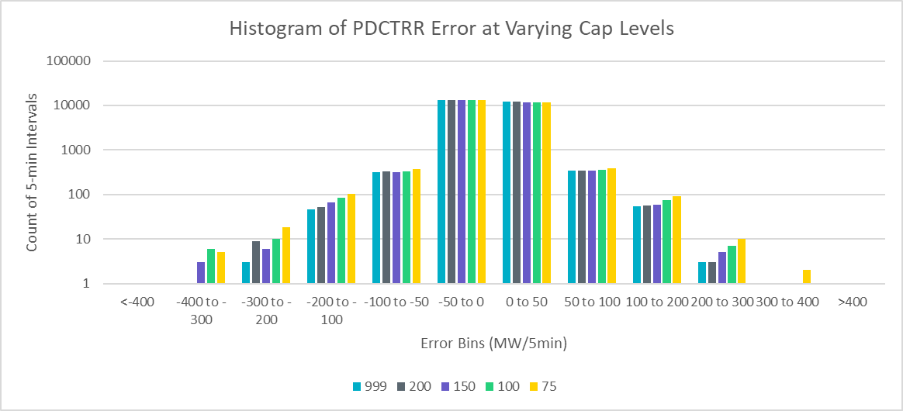
PDCTRR Cap Evaluation
The cap is a configurable parameter which limits the magnitude of PDCTRR.
Decreasing the cap tends to increase occurrence of larger errors. However, the cap will be initially set to 0 after implementation and increased gradually as confidence grows in the applied changes.

Slide 10
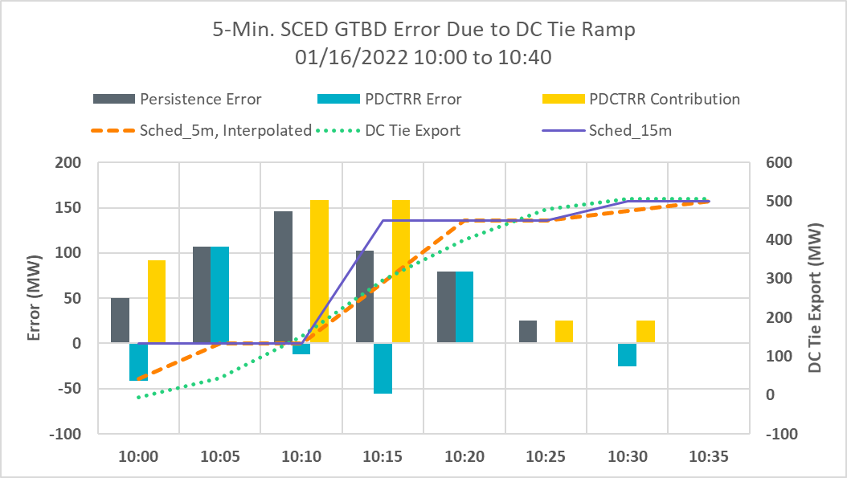
Potential Impact of PDCTRR in GTBD, 01/16/2022
Time | 10:00 | 10:05 | 10:10 | 10:15 | 10:20 | 10:25 | 10:30 | 10:35
Sched, 5m, Interpolated | 41.5 | 133 | 133 | 291.5 | 450 | 450 | 475 | 500
PDCTRR Contribution to GTBD (MW/5min) | 95.1 | 0 | 158.5 | 158.5 | 0 | 25 | 25 | 0
Notes:
10:20 will be at 450
10:10 we are at 133
Ramp will be 317
158.5 of PDCTRR per SCED interval

Slide 11
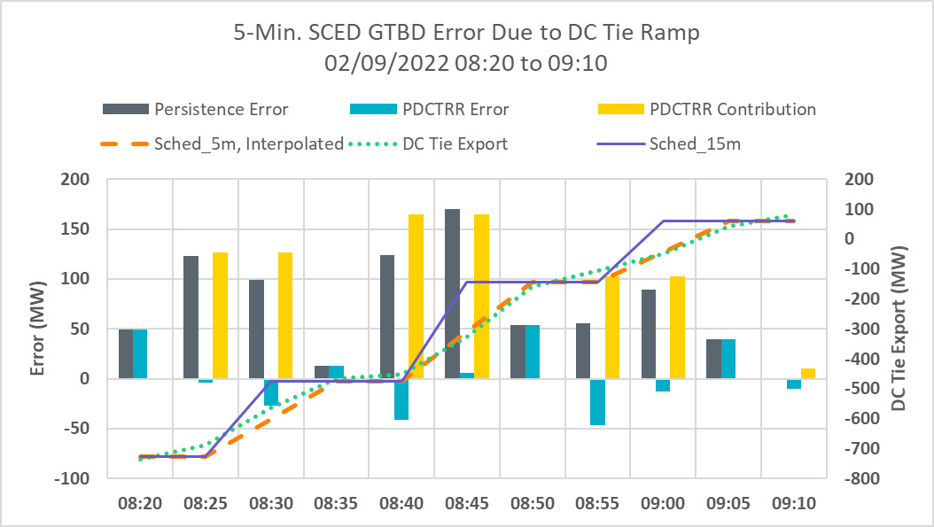
Potential Impact of PDCTRR in GTBD, 02/09/2022
Time | 08:20 | 08:25 | 08:30 | 08:35 | 08:40 | 08:45 | 08:50 | 08:55 | 09:00 | 09:05 | 09:10
Sched, 5m, Interpolated | -728 | -728 | -601.5 | -475 | -475 | -310 | -145 | -145 | -42.5 | 60 | 60
PDCTRR Contribution to GTBD (MW/5min) | 0 | 126.6 | 126.5 | 0 | 165 | 165 | 0 | 102.5 | 102.5 | 0 | 10
Notes:
8:35 will be -475
8:25 we are at -728
Ramp of 253 over 10 mins
126.5 of PDCTRR per SCED interval

Slide 12
Impact of K7 and Cap on 02/09/2022, 08:40
Time | 08:20 | 08:25 | 08:30 | 08:35 | 08:40 | 08:45 | 08:50 | 08:55 | 09:00 | 09:05 | 09:10
Sched, 5m, Interpolated | -728 | -728 | -601.5 | -475 | -475 | -310 | -145 | -145 | -42.5 | 60 | 60
PDCTRR Contribution to GTBD (MW/5min) | 0 | 126.6 | 126.5 | 0 | 165 | 165 | 0 | 102.5 | 102.5 | 0 | 10
K7 | Cap (MW/5min) | Calculated PDCTRR (MW/5min) | SCED PDCTRR (MW/5min)
0 | 0 | 165 | 0
0.25 | 50 | 165 | 41.25
0.5 | 50 | 165 | 50
0.5 | 100 | 165 | 82.5
0.75 | 100 | 165 | 100
0.75 | 150 | 165 | 123.75
1.0 | 200 | 165 | 165
Notes:
Limiting either on K7 factor or the cap

Slide 13
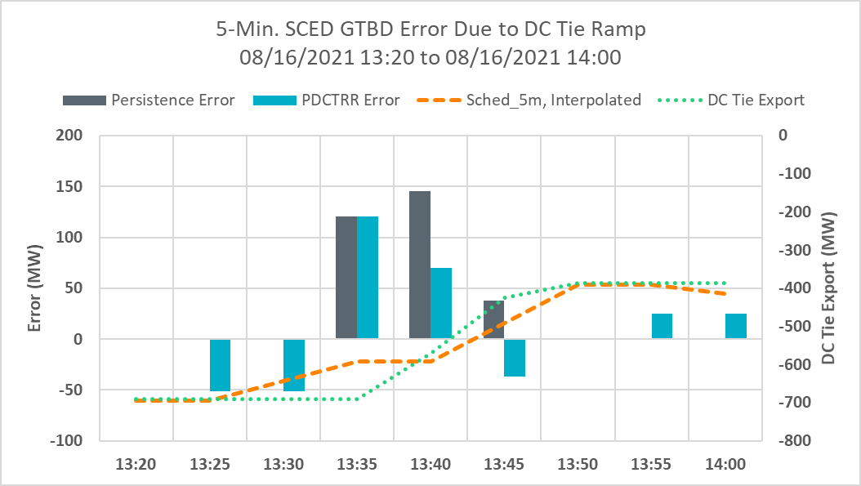
DC Tie Ramp During Frequency Event

Slide 14
Summary & Next Steps
ERCOT will implement SCR800 during a 2022 R3 release.
Initially, K7 will be set to 0 so that it will not impact GTBD calculation.
ERCOT is planning to tune K7 (K7 becomes non-zero) and potentially other GTBD parameters in the first week of June.
A market notice will be sent out prior to activation of K7 to a non-zero value.

Slide 15
SCR809

Slide 16
Summary of the Changes proposed in SCR809
SCR 809 proposes four changes
When suspect data quality is detected for normal/emergency ramp rate telemetry, change RLC validations to retain the last telemetered value that had good quality
To improve situational awareness, raise alarms when sudden “large” changes in System level markers like HDL-GEN, HASL-GEN etc. are detected.
Enhance the RLC actions when a resource operating above 90% of its LSL telemeters an offline resource status.
Make changes that promote resources to follow proper startup/shutdown sequence i.e. Off – Startup – ON or ON – Shutdown – OFF in the telemetered Resource Status(RST).

Slide 17
Summary of the Changes proposed in SCR809
ERCOT is in the process of implementing SCR809 and expects to implement changes associated with it in 2022-R3 release (~end of May).
The changes that detect the inconsistent telemetry and promote resources to follow proper startup/shutdown sequence i.e. Off – Startup – ON or ON – Shutdown – OFF in the telemetered resource status will be implemented in two phases.
Phase changes have been setup such that RLC will record instances when inconsistent telemetry is detected for post-hoc analysis. No changes will be made to dispatch during this phase.
Phase 1 will be effective upon implementation of SCR809.
ERCOT engineers may reach out to resources for issue resolution.
ERCOT expects to keep running in phase 1 mode for a couple months, to allow time for outreach and issue resolution.
Phase 2 changes have been setup such that when inconsistent telemetry is detected High/Low Dispatch Limits will be set equal to the unit’s current output.
ERCOT expects to coordinate with QSEs before implementing Phase 2.
All other rules changes will be effective upon implementation of SCR809.

Slide 18
Questions

