Slide 1
NPRR 1128 On FFR Procurement
Balancing Operations Planning
WMWG
May 20, 2022

Slide 2
Some points for consideration
NPRR 1128, proposes that Fast Frequency Response* (FFR) Ancillary Service Offer price may not be less than -$0.01 per MW. This will allow FFR procurement up to the current FFR limit without proration. When assessing this NPRR a few things that are worth noting,
During low inertia conditions, with FFR participation, ERCOT’s Critical Inertia will reduce and the amount of RRS needed in those hours will also reduce. Under today’s setup, if 450 MW of FFR is available,
Critical Inertia during hours with low inertia conditions will reduce by around 8-10 GW.s.
ERCOT’s critical inertia is 100 GW.s Lowest inertia the grid has experienced so far is approximately 116 GW.s and in 2021 there were 15 hours wherein inertia was lower than 120 GW.s.
Average RRS reduction for 2022 would be around 50 MW – 75 MW.
During tight operating conditions and long drawn events like URI, due to duration limited nature of ESRs, FFR if deployed, may not be available after some time. During similar conditions, Load Resources providing RRS using under frequency relays (RRS-UFR) if deployed, are required to stay deployed till recalled.
Also, worth noting is that there are couple projects that are slated to be implemented between now and mid-2023 that will affect Ancillary Services. Specifically,
When FFR Advancement project is implemented (~early October 2022), several changes will be made to ERCOT systems to make offering and carrying FFR more efficient.
Resources will be able to offer FFR across their full range (charging + discharging).
Resources will simultaneously be able provide FFR with other ancillary services
ERCOT is in the process of implementing ERCOT Contingency Reserve Service (ECRS) (target mid 2023).
Up to 50% of ECRS can come from Non-Controllable Load Resources
*FFR triggers at 59.85 Hz, provides response within 15 cycles and for a single event, resource providing FFR must be capable of sustaining response for at least 15 minutes.

Slide 3
Questions from WMWG
How many resources have qualified for FFR?
How many ESR’s have not qualified for FFR?
Qualified for FRRS but not FFR?
What is the level of participation this year?
Compared to participation in RRS-PFR
Review of the FFR qualification criteria
Any other relevant information that would help the discussion.

Slide 4
Responses to WMWG questions (Slide 1)
(Question 1, Question 2 and Question 2a)
79 Energy Storage Resources (ESRs) with a total capacity of 2,734 MW are modeled in ERCOT’s CIM.
Note that this count includes 22 ESRs with a total capacity of 938 MW that have not been energized or synchronized yet.
From Ancillary Service (AS) qualification perspective to date approximately,
8 ESRs with total capacity of
83 MW are qualified to provide Fast Responding Regulation Service Up (FRRS-Up);
101 MW is qualified to provide FRRS-Down
19 ESRs with total capacity of 423 MW are qualified to provide RRS-FFR.
No other resource type have requested qualification for RRS-FFR.
35 ESRs with total capacity of 1,555 MW (815 MW on discharge and 740 MW on charge) are qualified to provide RRS-PFR
(Question 3 and Question 3a)
From AS provision in Real Time perspective,
Since implementation in Mar 2020, FFR has not been provided in Real Time;
There has been very little activity related to FFR offers in the Day-Ahead Market.
No FFR offers in 2022, 1 hour in 2021, and 150 hours in 2020
In 2022, approximately 10% to 15% of RRS was provided by ESRs using Primary Frequency Response.

Slide 5
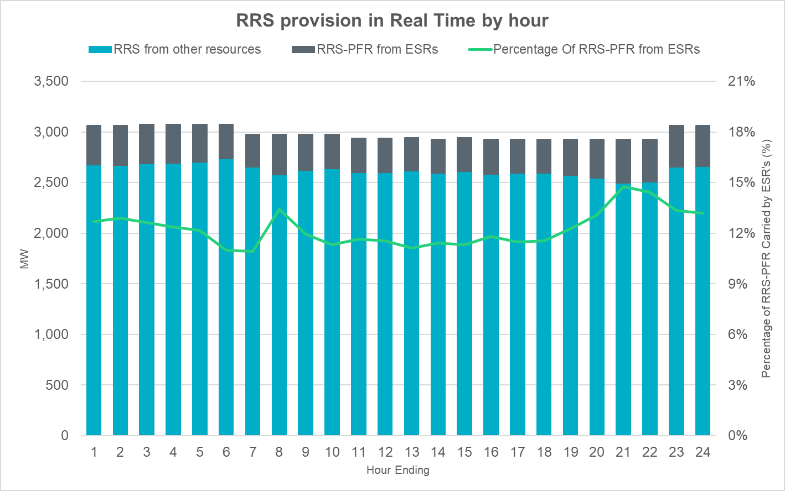
Responses to WMWG questions (Slide 2)

Slide 6
Responses to WMWG questions (Slide 3)
(Question 4)
FFR qualification test is a two-pronged test
a self test that demonstrates the Resource’s ability to deploy within 15 cycles of when the frequency trigger is met and to sustain response for at least 15 minutes; and
a coordinated test that demonstrates the Resource’s ability to change Ancillary Service Schedule for RRS-FFR telemetry in response within 15s to an ERCOT deployment.
The following are some more details on the self test for FFR
The total time from the time frequency first decays to a value low enough to initiate action up to the time when full Ancillary Service Resource Responsibility for RRS is delivered should be no more than 15 cycles, including all relay and breaker operating times;
The resource must demonstrate its ability to sustain the scheduled level of deployment for at least 15 minutes at a minimum level of 95% but not more than a maximum level of 110% of the MW capacity for which the Resource seeks qualification for FFR.

Slide 7
References
Whitepaper, Inertia: Basic Concepts and Impacts on the ERCOT Grid
PDCWG | Aug 11, 2021 | Winter Event 2021 PDCWG 08112021 v2
FFR Advancement Workshop | Oct 27, 2021 | Link

