Slide 1
ERCOT Technology Working Group (TWG)
May 19, 2022

Slide 2
ERCOT TWG – Venkat Tirupati
WELCOME

Slide 3
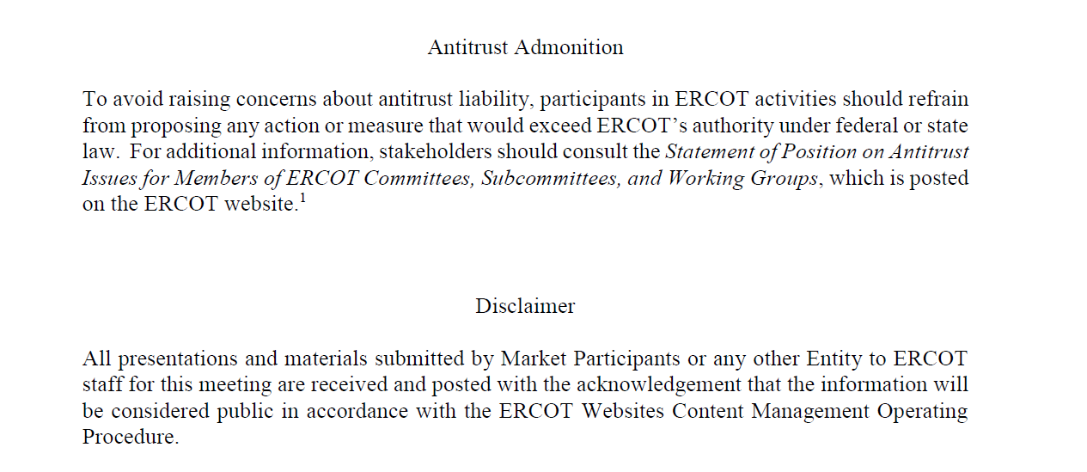
ERCOT TWG

Slide 4
ERCOT TWG Agenda
Item # | Item Description | Presenter
1 | Antitrust admonition | Venkat Tirupati
2 | Project Update | Troy Anderson
3 | Discussion of Projects with Interface Change Requirements NPRR1093 Loads in Non-Spin NPRR863/FFRA scope delivery NPRR1120 Create Firm Fuel Service NPRR863/ECRS scope delivery | Matt Mereness
4 | CIM 16 Project Update | Joel Koepke
5 | PVGR Forecasts - Reports | Pengwei Du
6 | NERC EMSWG Update | Wei Qiu - NERC
7 | Retiring Legacy MIS public report functionality | Leo Angele
8 | ERCOT WAN Infrastructure Update | Todd Jaksch
9 | Information Only Topics Operator Real-Time Messaging SCR820 - Badri, Sreenivas Public API and API improvements - Soberanis, Omar TLS 1.2 Certification - Soberanis, Omar IE11 EOL and multiple cert workaround in Chromium browsers - Blackard, Jr, Bob MarkeTrak system Updates - Gupta, Vikram Retail API Redesign - Brandaw, Brian TEXAS SET 5.0 Project - Gupta, Vikram | ERCOT Staff
10 | Future topics of interest | Venkat Tirupati
11 | Adjourn | Venkat Tirupati

Slide 5
ERCOT TWG – Troy Anderson
Project Update

Slide 6
ERCOT TWG – Matt Mereness
Projects with Interface Change Requirements
  NPRR1093 Loads in Non-Spin
  NPRR863/FFRA scope delivery
  NPRR1120 Create Firm Fuel Service
  NPRR863/ECRS scope delivery

Slide 7
ERCOT TWG – Venkat Tirupati
Response to questions received

Slide 8
ERCOT TWG – Joel Koepke
CIM 16 Upgrade Project - Update

Slide 9
ERCOT TWG – Pengwei Du
PVGR Forecasts - Reports

Slide 10
ERCOT TWG – Wei Qiu
NERC Update

Slide 11
ERCOT TWG – Leo Angele
Retiring Legacy MIS Public Report Functionality

Slide 12
ERCOT TWG – Todd Jaksch
ERCOT WAN Infrastructure Update

Slide 13
ERCOT TWG – Sreenivas Badri
Operator Real-Time Messaging SCR820

Slide 14
ERCOT TWG – Omar Soberanis
Public API and API improvements
TLS 1.2 Certification

Slide 15
ERCOT TWG – Bob Blackard Jr.
IE11 EOL and multiple cert workaround in Chromium browsers

Slide 16
ERCOT TWG – Vikram Gupta
MarkeTrak system Updates
TEXAS SET 5.0 Project

Slide 17
ERCOT TWG – Brian Brandaw
Retail API Redesign

Slide 18
ERCOT TWG – Open Forum
Q & A

Slide 19
ERCOT TWG
Thank You

