Slide 1
NPRR 1085
Ensuring Continuous Validity of Physical Responsive Capability (PRC) and Dispatch through Timely Changes to Resource Telemetry and Current Operating Plans (COPs)
Summary of ERCOT May 10, 2022 Comments
ERCOT Staff
ERCOT Balancing Operations Planning
18 May 2022
PDCWG
Notes:
NPRR 1085 had originally proposed that telemetry updates be sent as soon as practicable but no longer than 5mins after event occurs and COP updates be sent as soon as practicable but no longer than 30mins after event occurs. However..

Slide 2
Outline
Summary of ERCOT’s May 10, 2022 Comments
What-If Analysis on Physical Responsive Capacity (PRC) for Feb 15, 2021
Examples of impact of erroneous telemetry on operations

Slide 3
NPRR1085 May 10, 2022 ERCOT Comment Summary
Recognizing that QSEs may have to make several concurrent updates, which could present a challenge in meeting the originally proposed timelines, ERCOT’s comments propose to balance ERCOT’s real time operational needs and the rare circumstances where multiple, simultaneous Resource issues justify taking additional time to provide this information to ERCOT. Specifically,
  Resource Status (RST) telemetry changes for Forced Outages must be made as soon as practicable but no longer than 10 minutes after the event;
  Any other RST change must be made as soon as practicable but no longer than 15 minutes after the change in status;
  New RST ONHOLD may be used in Real Time to inform ERCOT that a Resource is On-Line but temporarily unavailable for SCED Dispatch or reserve provision. QSE may switch to ONHOLD within 10 minutes of experiencing an event;
  Telemetry changes related to a Forced Derate, must occur as soon as practicable but no longer than 15 minutes after
    the beginning of the forced derate if the derate is greater than ten MW and more than 5% of the Seasonal net max sustainable rating of the Resource and its expected or actual duration is greater than 30 minutes. OR
    Changing RST to ONHOLD
  Current Operating Plan (COP) updates including updates for Forced Outages and Forced Derates that are greater than 10 MW and expected to last more than 120 minutes, must be made as soon as practicable but no longer than 60 minutes after the triggering event for the change.

Slide 4
ERCOT Notes…
The proposal to require RST telemetry updates for Forced Outages and ONHOLD status changes within 10 minutes of an event should not place Resource owners or QSEs in a position of having to choose between ensuring safety or plant or personnel or violating a Protocol, as these circumstances can be either automated to minimize human interaction or prioritized over Forced Derates, which allow for 15 minutes instead of 10 minutes.
Forced Outages are less frequent than Forced Derates and are more impactful which aligns with the higher priority over a Forced Derate.
Lastly, PUC Rule 25.503 (f)(2)(c) provides excusal from compliance with ERCOT Protocols if compliance would jeopardize public health and safety or risk of damage to equipment.
  PUC Rule 25.503. Oversight of Wholesale Market Participants.
  (f) Duties of market entities.
  A market participant must comply with ERCOT procedures and any official interpretation of the Protocols issued by ERCOT or the commission.
    If a market participant disagrees with any provision of the Protocols or any official interpretation of the Protocols, it may seek an amendment of the Protocols as provided for in the Protocols, appeal an ERCOT official interpretation to the commission, or both.
    A market participant appealing an official interpretation of the Protocols or seeking an amendment to the Protocols must comply with the Protocols unless and until the interpretation is officially changed or the amendment is officially adopted.
    A market participant may be excused from compliance with ERCOT instructions or Protocol requirements only if such non-compliance is due to communication or equipment failure beyond the reasonable control of the market participant; if compliance would jeopardize public health and safety or the reliability of the ERCOT transmission grid, or create risk of bodily harm or damage to the equipment; if compliance would be inconsistent with facility licensing, environmental, or legal requirements; if required by applicable law; or for other good cause. A market participant is excused under this subparagraph only for so long as the condition continues.

Slide 5
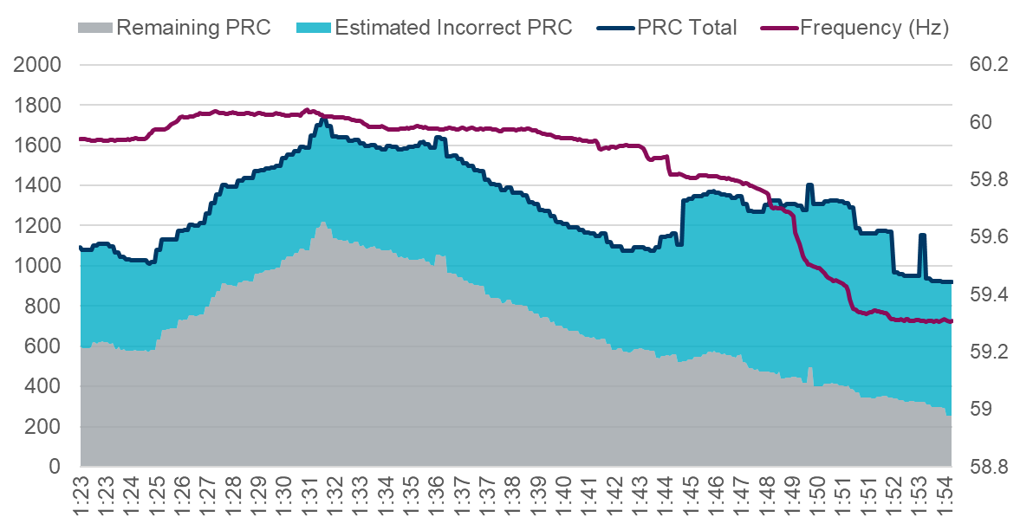
What if on Feb 15, 2021 timely updates were sent?
Recap:
ERCOT’s analysis of the timeframe between 1:23 and 1:55 on Feb 15, 2021 had noted that out of 20 Generation Resources that were on an average contributing more than 10 MW to ERCOT’s Physical Responsive Capacity (PRC), 14 resources had incorrect telemetry that resulted in approximately 430 MW to 870 MW in PRC that were incorrect/unavailable during that time.
Methodology:
To recreate PRC for the early morning hours on Feb 15, 2021, the following two steps were taken
  PRC contribution from each of the 14 resources that were identified as having operational issues early morning of February 15, 2021 was set to 0 MW X minutes after an event occurred.
    X was set to 1min, 5min, 8min, 10min, 15min and 30min.
  PRC from NCLRs providing RRS-UFR was set to 0 MW 12 minutes after updated PRC in each scenario reached 1,750 MW.
    During the February Winter storm event more than 95% of the response occurred within 8 minutes of NCLR RRS deployment. A 4-min delay was included to account for Operator action.

Slide 6
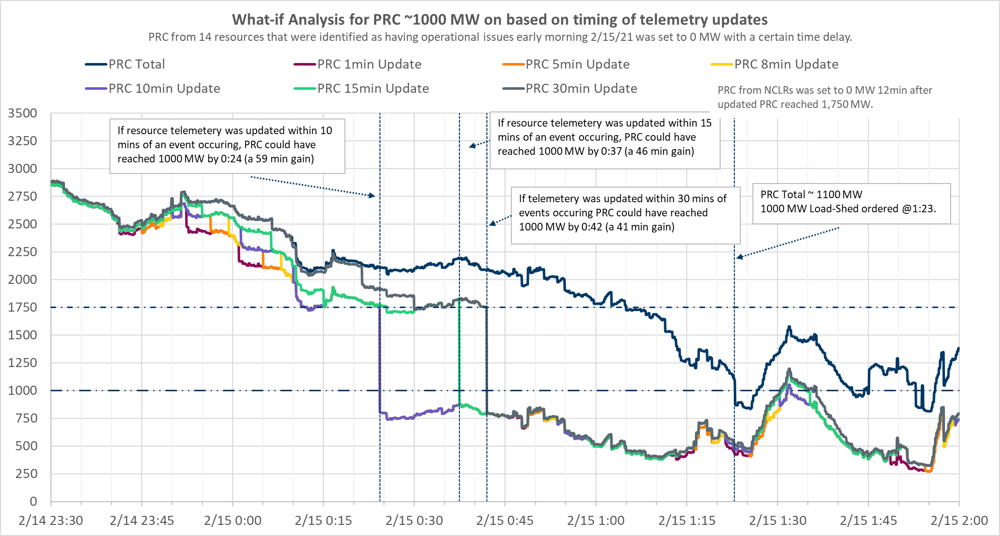
What-If analysis for PRC based on timing of telemetry updates
PRC Level | Actual | 1 Min Delay | 5 Min Delay | 8 Min Delay | 10 Min Delay | 15 Min Delay | 30 Min Delay
1000 MW | 02/15 01:23 | 02/15 00:24 (-59min) | 02/15 00:24 (-59min) | 02/15 00:24 (-59min) | 02/15 00:24 (-59min) | 02/15 00:37 (-46min) | 02/15 00:42 (-41min)

Slide 7
So, what if on Feb 15, 2021 timely telemetry updates were sent?
Summary potential impact of timely telemetry updates on PRC on Feb 15, 2021 between 1:23 and 1:55.
PRC Level | Actual | 1min Delay | 5min Delay | 8 Min Delay | 10 Min Delay | 15 Min Delay | 30 Min Delay
Minimum PRC (MW) | 813 | 272 | 272 | 324 | 324 | 324 | 324
2300 MW | 02/15 00:10 | 02/15 00:01 (-9min) | 02/15 00:01 (-9min) | 02/15 00:01 (-9min) | 02/15 00:01 (-9min) | 02/15 00:06 (-4min) | 02/15 00:10 (0 min)
1750 MW | 02/15 01:05 | 02/15 00:12 (-53min) | 02/15 00:12 (-53min) | 02/15 00:12 (-53min) | 02/15 00:12 (-53min) | 02/15 00:25 (-40min) | 02/15 00:30 (-35min)
1000 MW | 02/15 01:23 | 02/15 00:24 (-59min) | 02/15 00:24 (-59min) | 02/15 00:24 (-59min) | 02/15 00:24 (-59min) | 02/15 00:37 (-46min) | 02/15 00:42 (-41min)
As Resources started experiencing winter weather related equipment failures, if telemetry updates had been made within ten minutes of an event occurring, calculated PRC would have reached 1,000 MW approximately 59 minutes earlier, giving Operators more appropriate situational awareness and time to make critical decisions and give instructions, including those related to Load shed.

Slide 8
Example: Impact of incorrect telemetry on PRC
Issue: A resource that was operating close to its HSL started experiencing issues, while telemetering an ON status its MW output declined to 0 MW over the course of 25 minutes. As the resource’s output decreased its contribution to PRC increased – but the unit really had no ability to respond to frequency or BPs.
With NPRR1085: When a resource is experiencing a runback type event or an operator is manually controlling it, setting its RST to ONHOLD will ensure ERCOT’s tools do not count on the resource for SCED dispatch or for provision of reserves.

Slide 9
Example: Impact of incorrect telemetry on frequency recovery
Issue: A group of 3 IRR units tripped offline causing frequency to drop to 59.926 Hz.
MW telemetry of one of the units dropped to 0 MW and RST telemetry changed to OFF immediately following the event.
However, the MW telemetry on the other two units remained a non-zero value up to 10 minutes after the start of the event and the RST telemetry for the units stayed ON up to 15 minutes after the event.
Frequency took almost 9 minutes and 36 seconds to recover to pre disturbance value. A combination of regulation deployment, reduction in load and SCED redispatch were relied upon to recover frequency during this event.
With NPRR 1085: The focus of NPRR1085 is to promote the use of automation at resource’s end to detect events like forced outages and use it to update the resource’s RST to an offline status in a timely manner.

Slide 10
Appendix

Slide 11
Physically Responsive Capacity (PRC)
PRC is a representation of the total amount of frequency responsive Resource capability On-Line in Real-Time. Per Nodal Protocol Section 6.5.7.5, PRC is the sum of 7 components
PRC = PRC₁ + PRC₂ + PRC₃ + PRC₄ + PRC₅ + PRC₆ + PRC₇
  PRC₁: maximum of 20% of an On-Line Generation Resource’s
  frequency responsive headroom.
  PRC₂: maximum of 20% of an On-Line Wind Generation Resource’s (WGR)
  headroom. Only WGRs with PFR capability are included.
  PRC₃: hydro-synchronous condenser headroom
  PRC₄: RRS supplied from Load Resources controlled by high-set
  under-frequency relay
  PRC₅: capacity from Controllable Load Resources active in SCED and
  carrying Ancillary Service Resource Responsibility
  PRC₆: capacity from Controllable Load Resources active in SCED and
  carrying Ancillary Service Resource Responsibility
  PRC₇: capacity from Resources providing FFR
PRC from Generation
PRC from Hydro
PRC from Load Resource

