Slide 1
MarkeTrak Work Center
Dashboard Set-up Tutorial
May, 2022

Slide 2
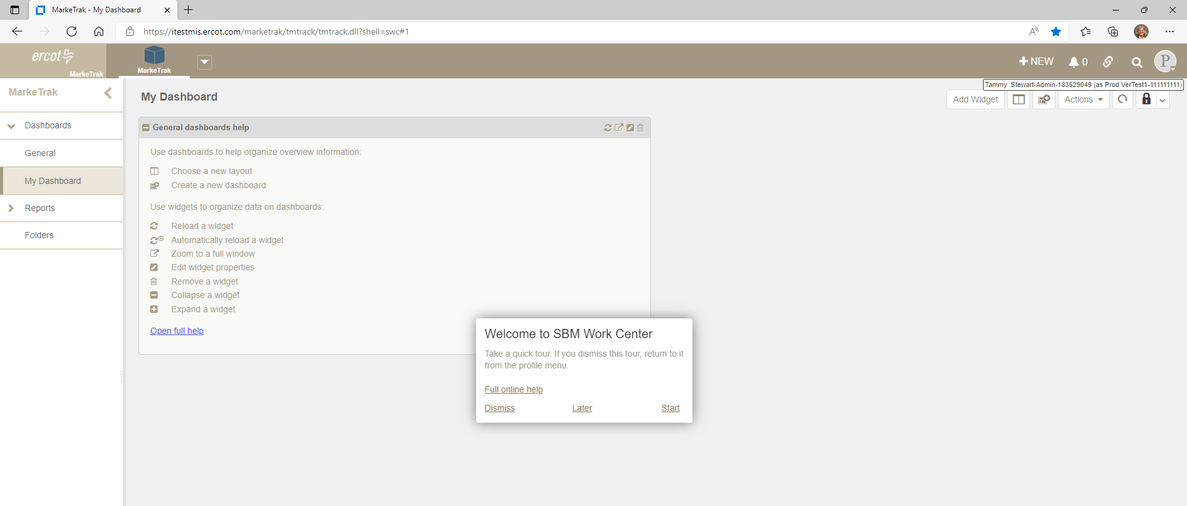
You are viewing the new MarkeTrak interface. Dashboards now replace the former ‘Home Page’ view. This presentation will illustrate how you can replicate your current Home Page on your new ‘My Dashboard’.

Slide 3
“Welcome to SBM Work Center” will display to all users upon initial login. Click ‘Dismiss’ to remove the prompt, ‘Later’ to receive the prompt at a later time, or ‘Start’ to take a quick tour of the new interface. Full online help link is also available.

Slide 4
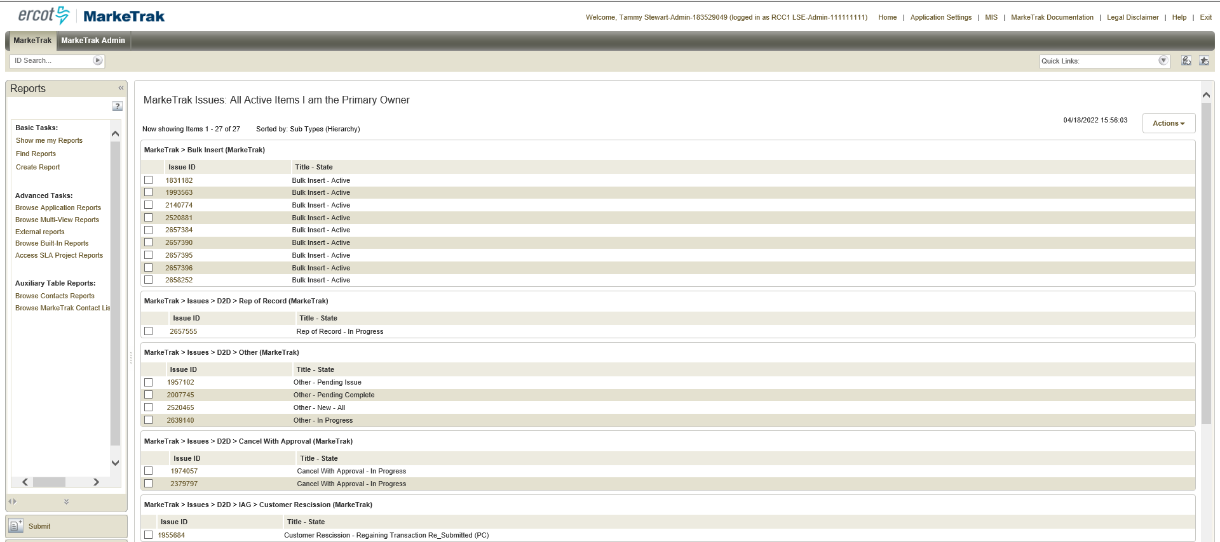
Most MarkeTrak users have one of two types of Home page reports – either a single report or a Multi-View report. Below is a sample of a single Home page report. This is a Built-In system report that the user selected for their home page.

Slide 5
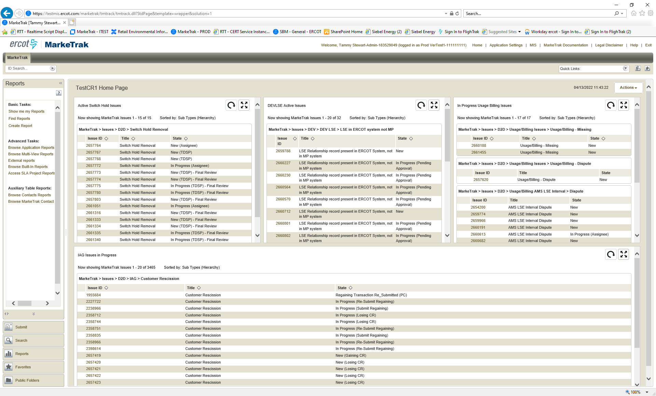
This is a sample of Multi-View Home page report. This Multi-View report is comprised of four individual reports created by the user or someone within their organization:

Slide 6

The first step to recreating your Home page report on your new ‘My Dashboard’ is to identify the reports currently in use. This MUST BE DONE BEFORE THE UPGRADE GO LIVE WEEKEND OF JUNE 4TH. Your Home page reports will NOT transition over to the new interface. The following slides illustrate how to recreate a current Home Page report that uses a system Built-In report:
Before June 4th, document the report name on your current Home Page. You will need to know the name of the Built-In report to recreate your ‘My Dashboard’ in the new version.

Slide 7
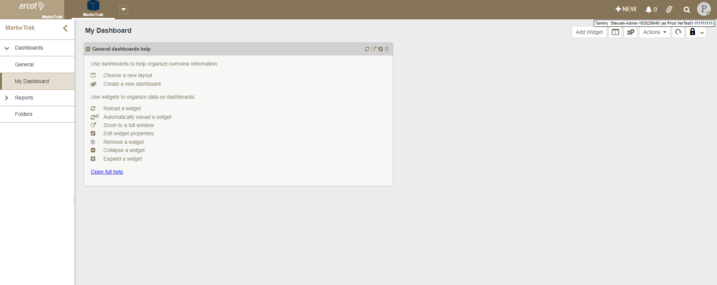
Customizing My Dashboard in the new MarkeTrak interface – Built-In reports cont.
From the new interface after go live, click on My Dashboard and select ‘Add Widget’

Slide 8
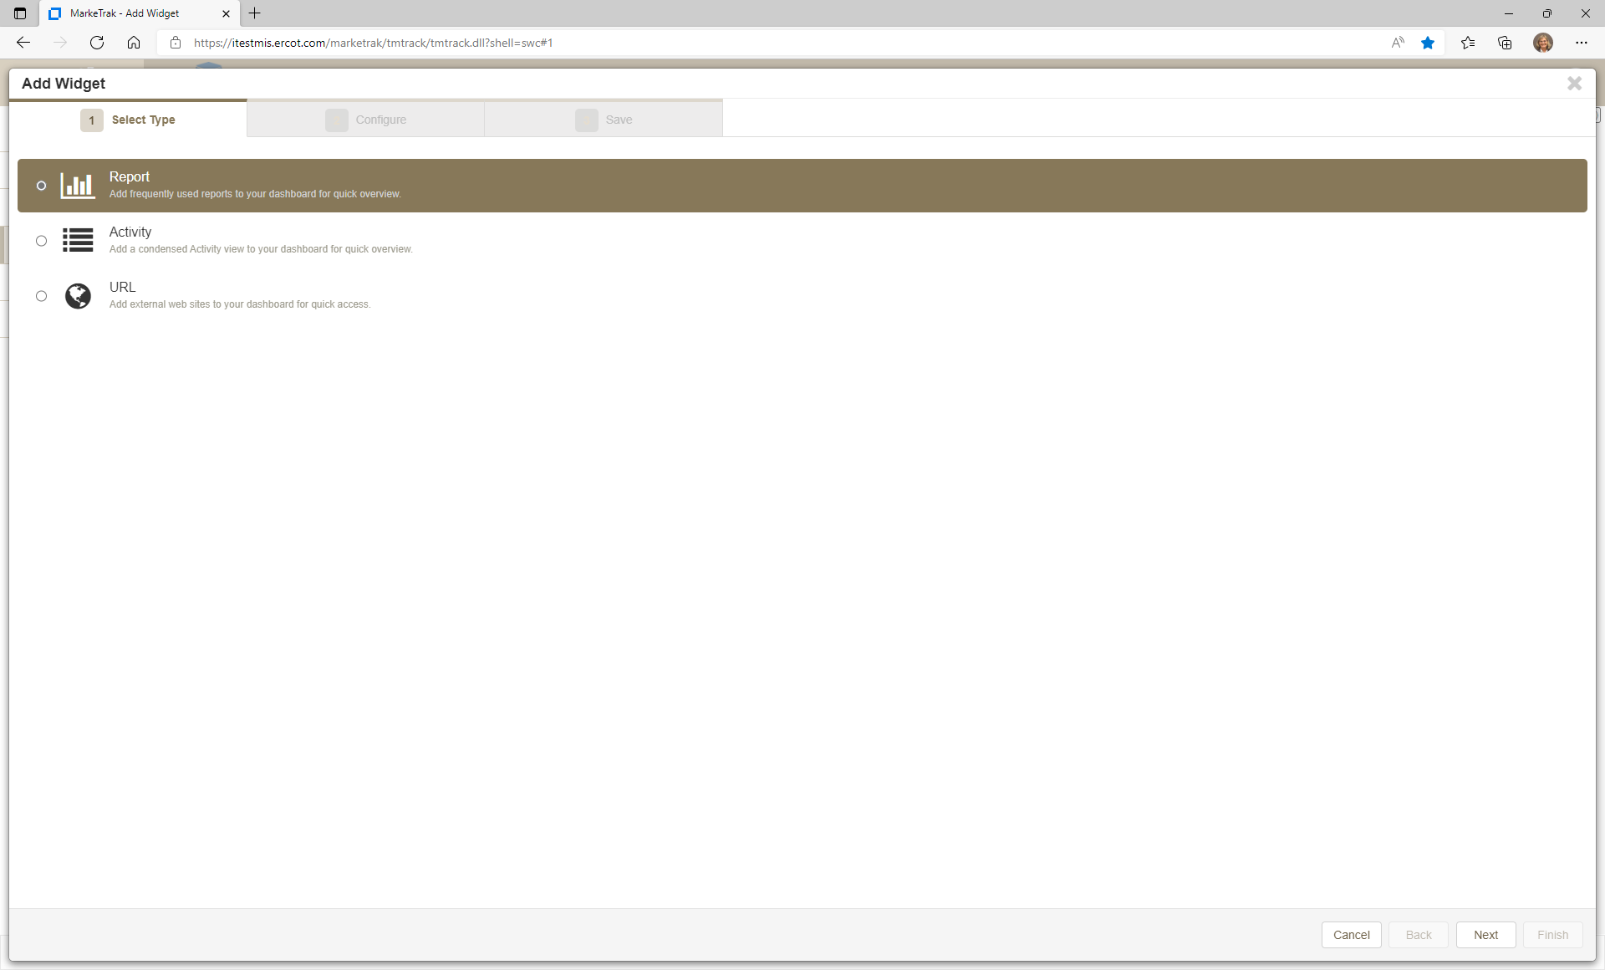
Customizing My Dashboard in the new MarkeTrak interface – Built-In reports cont.
Select ‘Report’

Slide 9
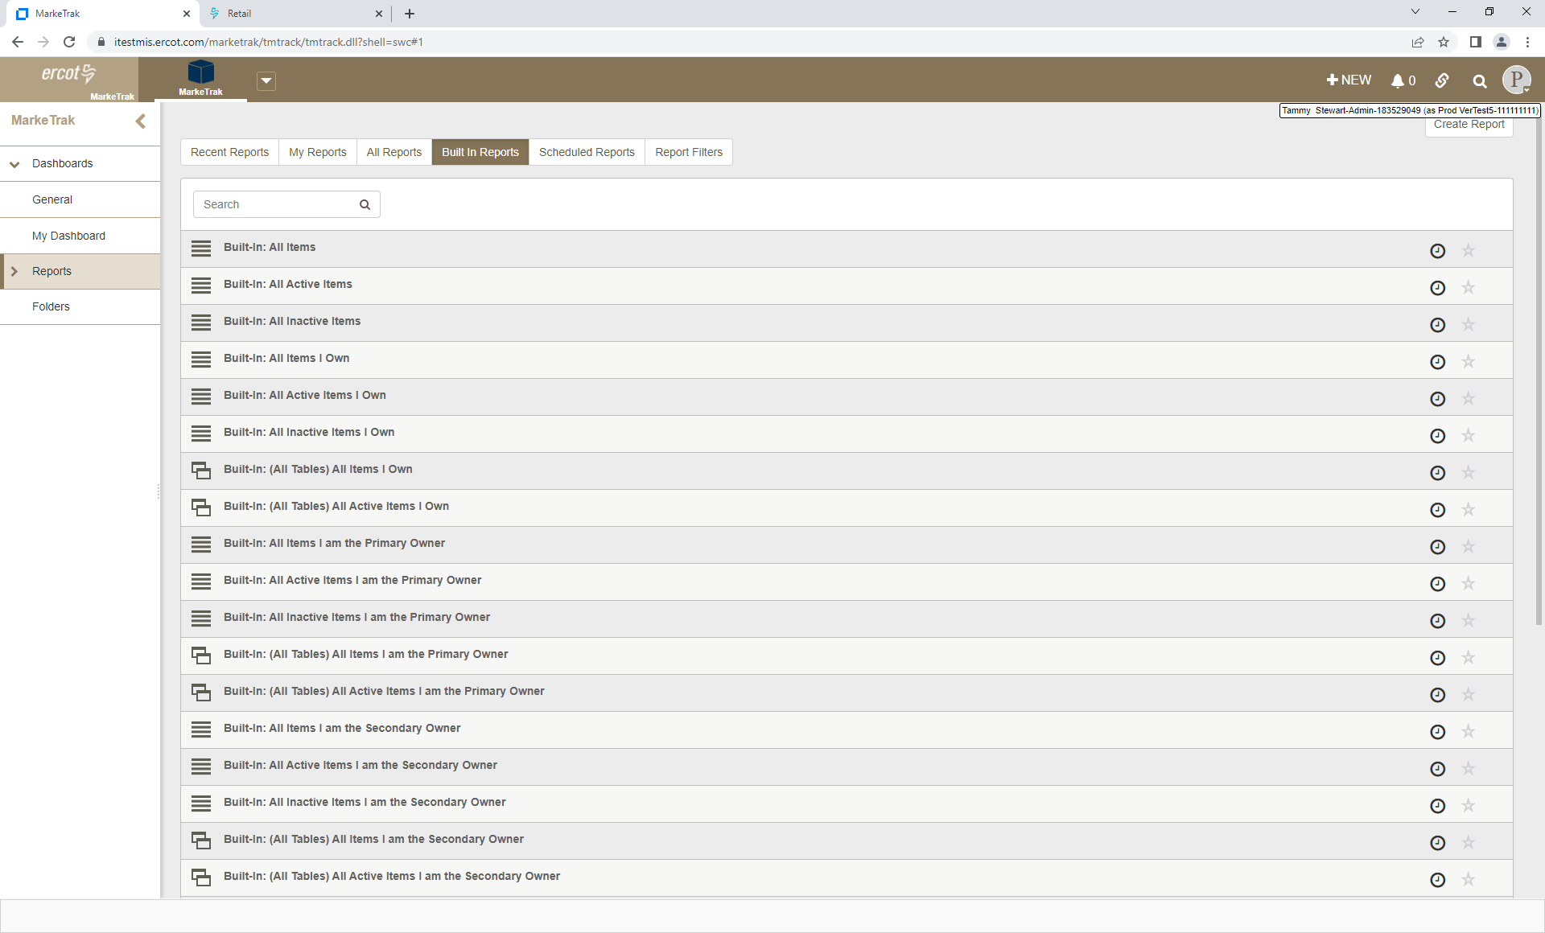
Customizing My Dashboard in the new MarkeTrak interface – Built-In reports cont.
Click on the Built In Reports tab and select the report name.

Slide 10
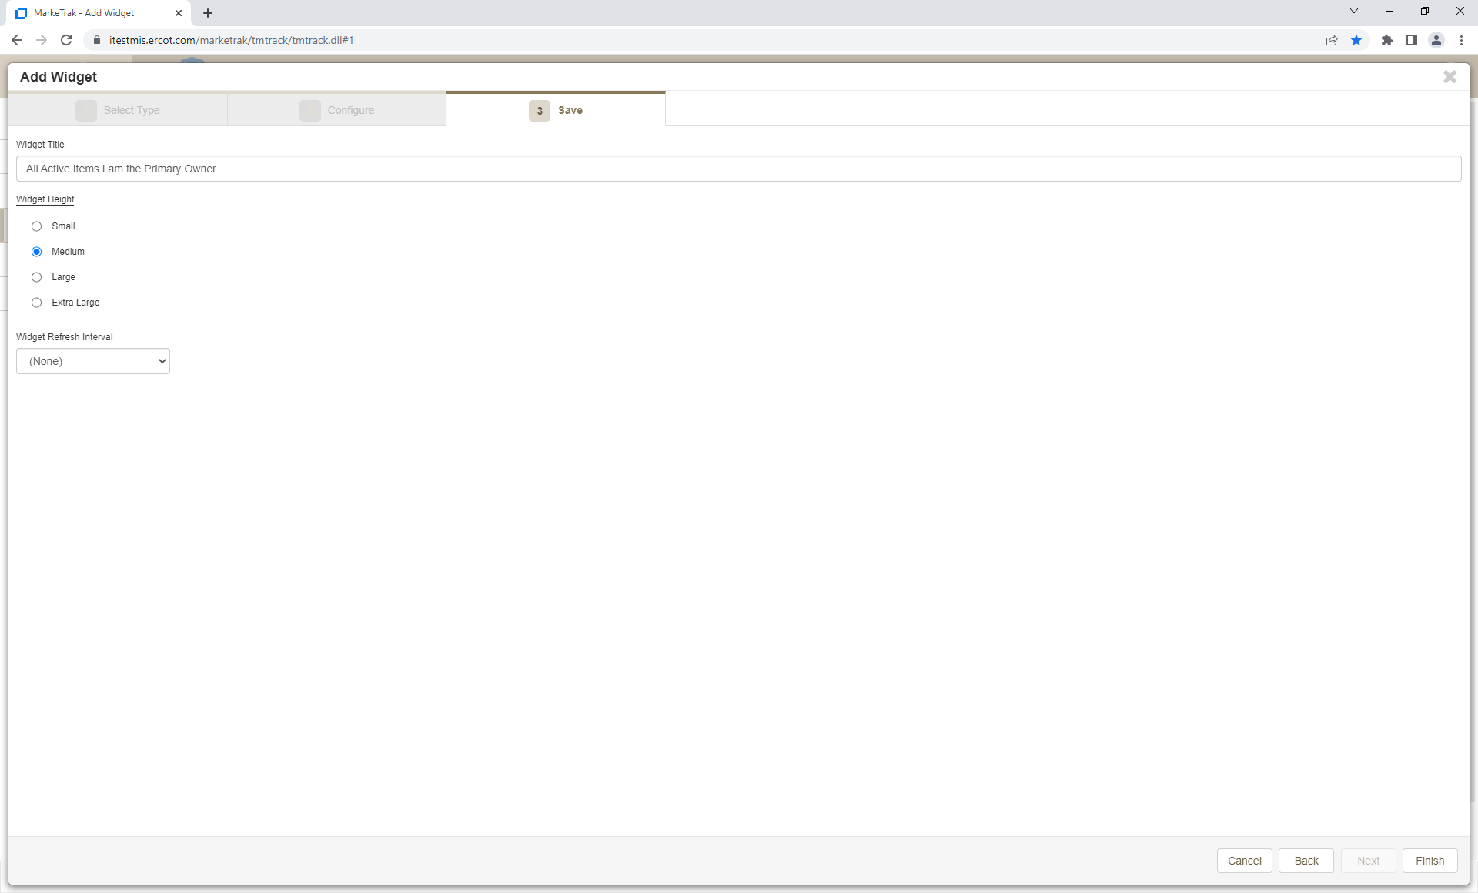
Customizing My Dashboard in the new MarkeTrak interface – Built-In reports cont.
Name your widget in the Widget Title field and then select the Widget display size of your choice. Click Finish.

Slide 11
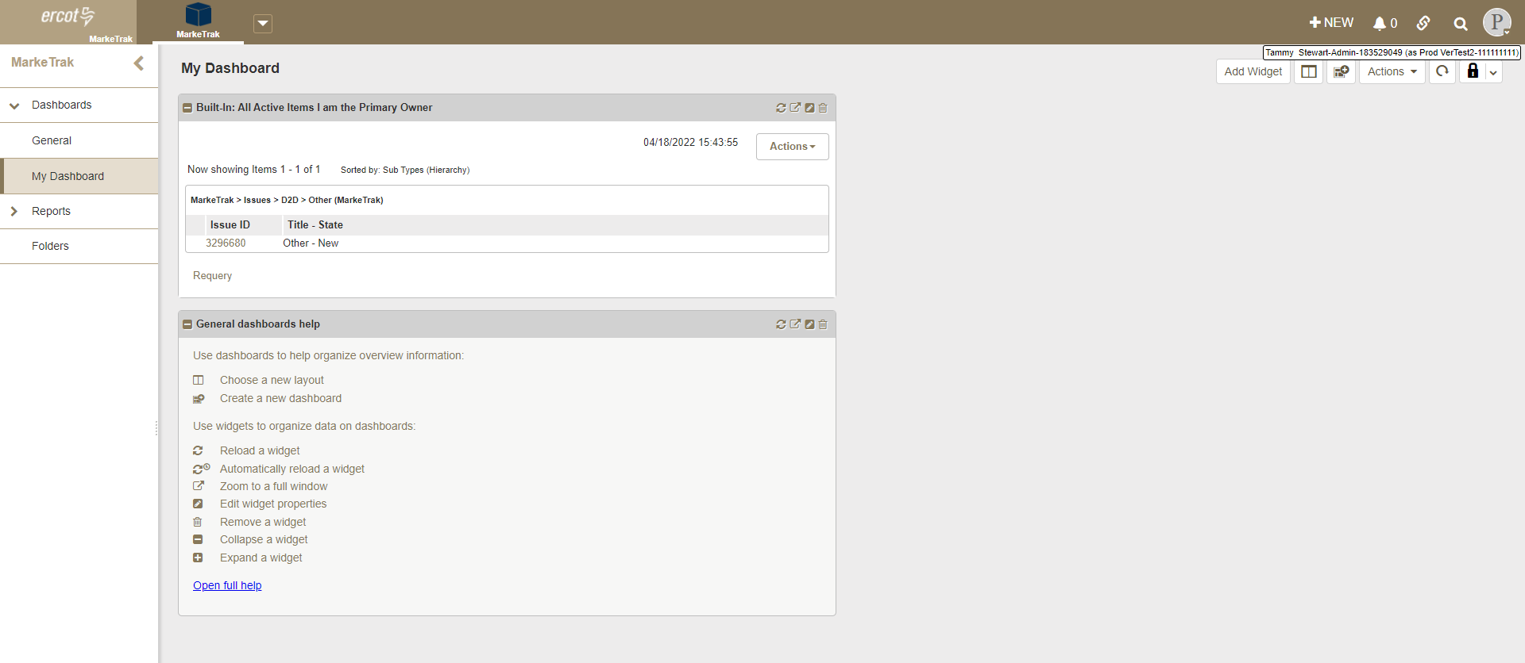
Customizing My Dashboard in the new MarkeTrak interface – Built-In reports cont.
The first report now appears on My Dashboard. Repeat these steps for each report.
The General dashboards help widget can be deleted if not needed by clicking the delete icon.

Slide 12
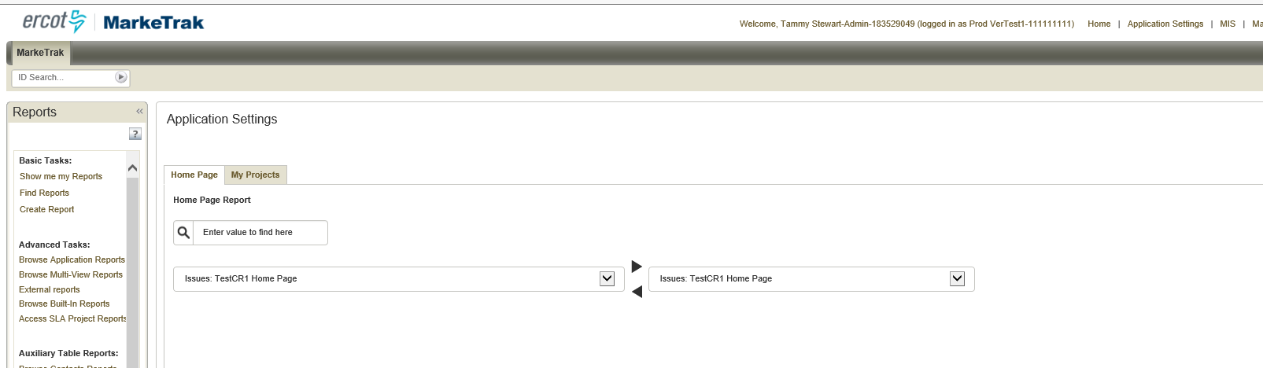
The following slides illustrate how to recreate a current Home Page report that is set as a Multi-View report:
Before June 4th, click the Application Settings link to view current Home Page report settings
Note the report name

Slide 13
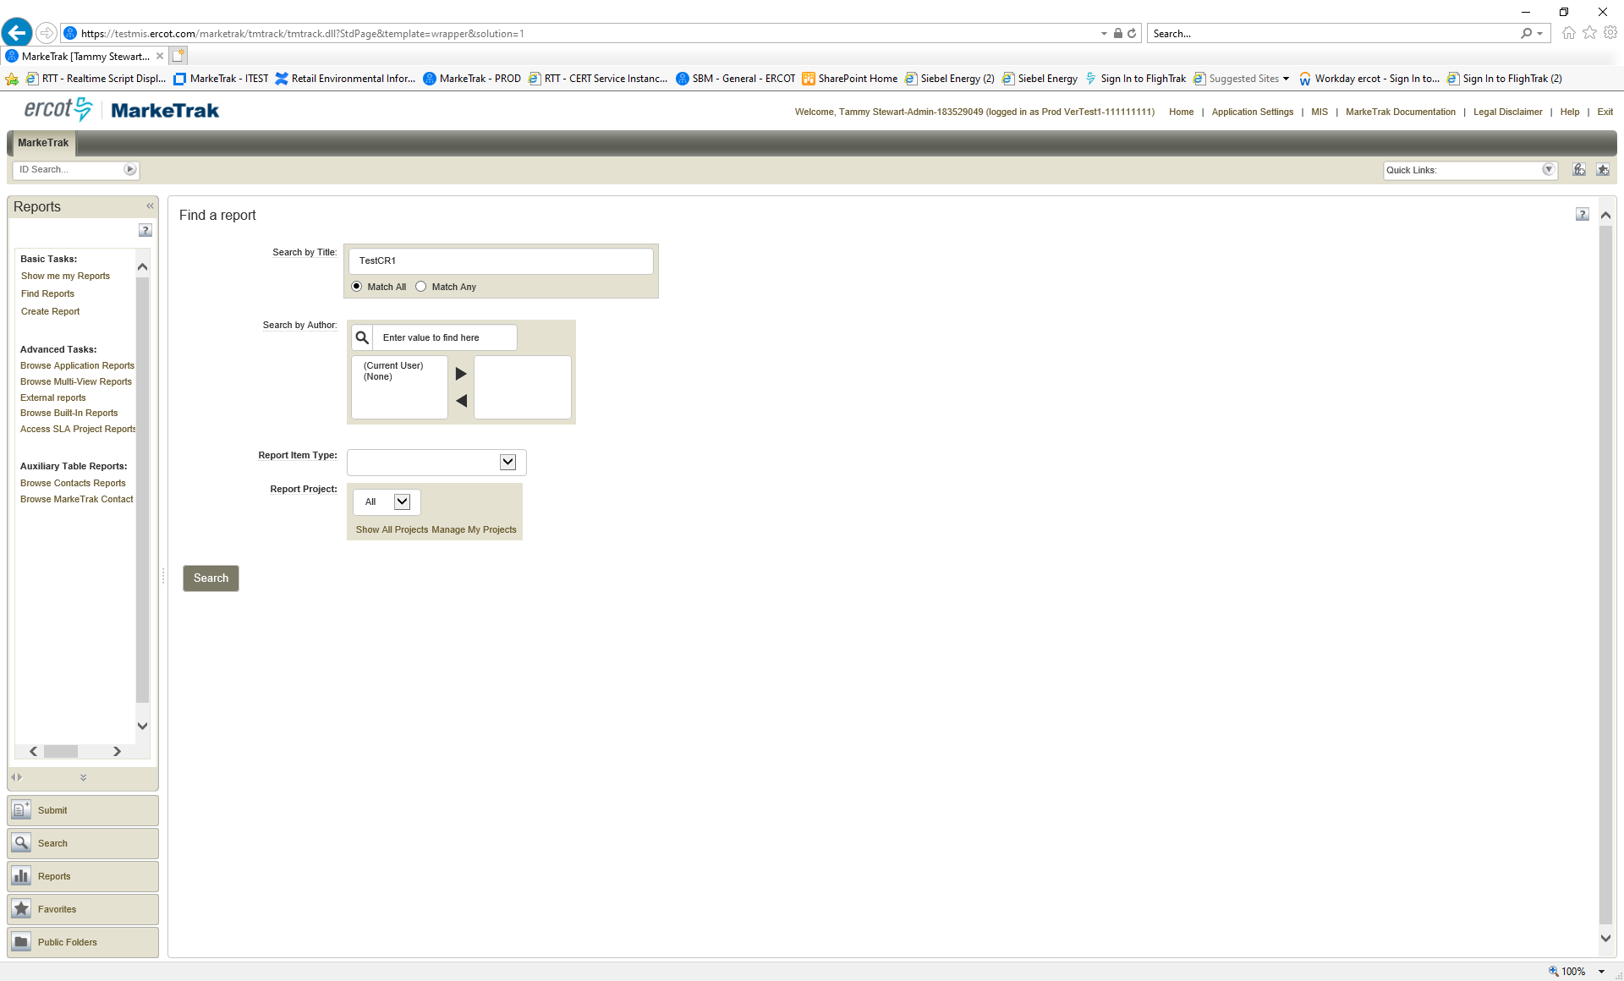
Customizing My Dashboard in the new MarkeTrak interface – Multi-View reports cont.
Select ‘Find Reports’ from the Report menu and search by report name

Slide 14
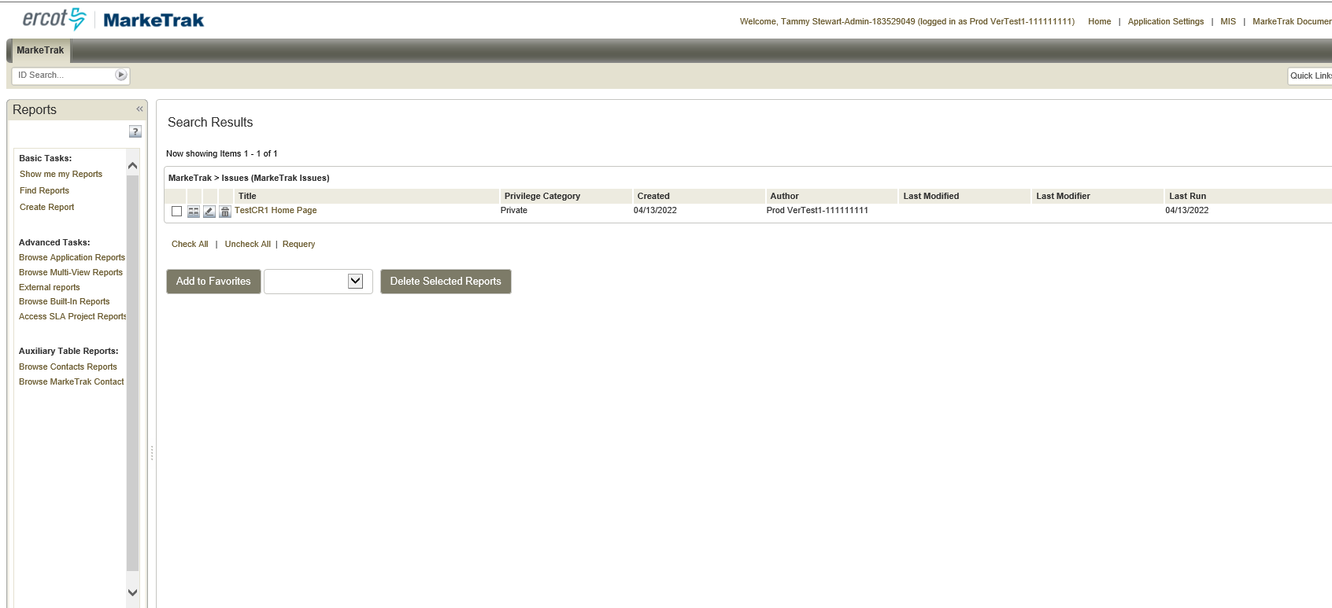
Customizing My Dashboard in the new MarkeTrak interface – Multi-View reports cont.
Click the ‘Edit’ icon next to the report name

Slide 15
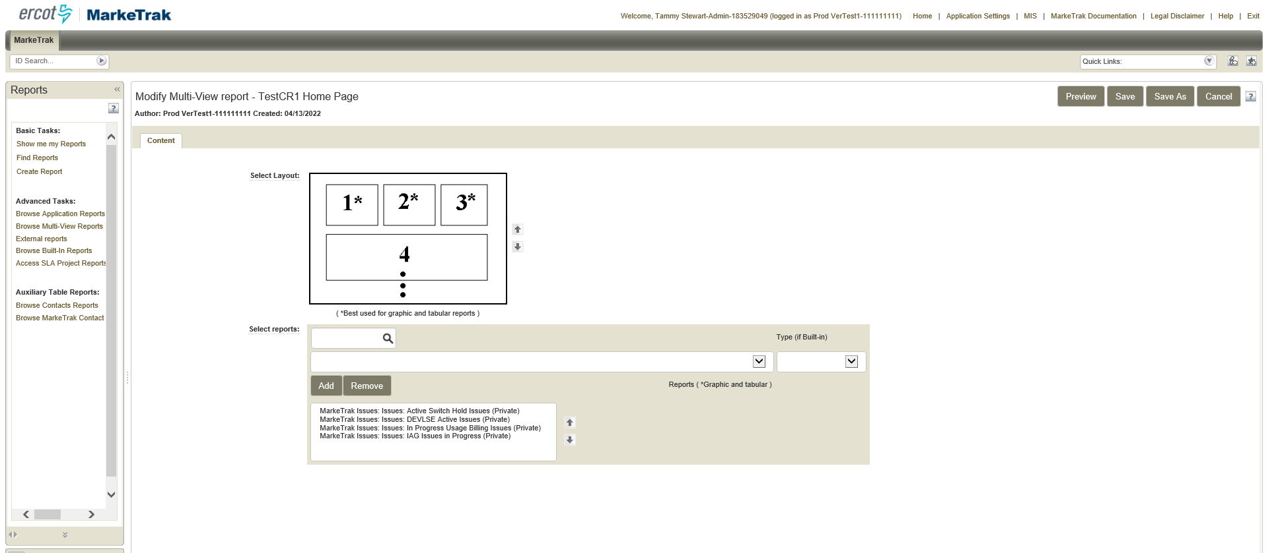
Customizing My Dashboard in the new MarkeTrak interface – Multi-View reports cont.
Document the report names that are included in the multi-view Home Page report. You will need to know the names of these reports to recreate your ‘My Dashboard’ in the new version.

Slide 16
Customizing My Dashboard in the new MarkeTrak interface – Multi-View reports cont.
From the new interface after go live, click on My Dashboard and select ‘Add Widget’

Slide 17
Customizing My Dashboard in the new MarkeTrak interface – Multi-View reports cont.
Select ‘Report’

Slide 18
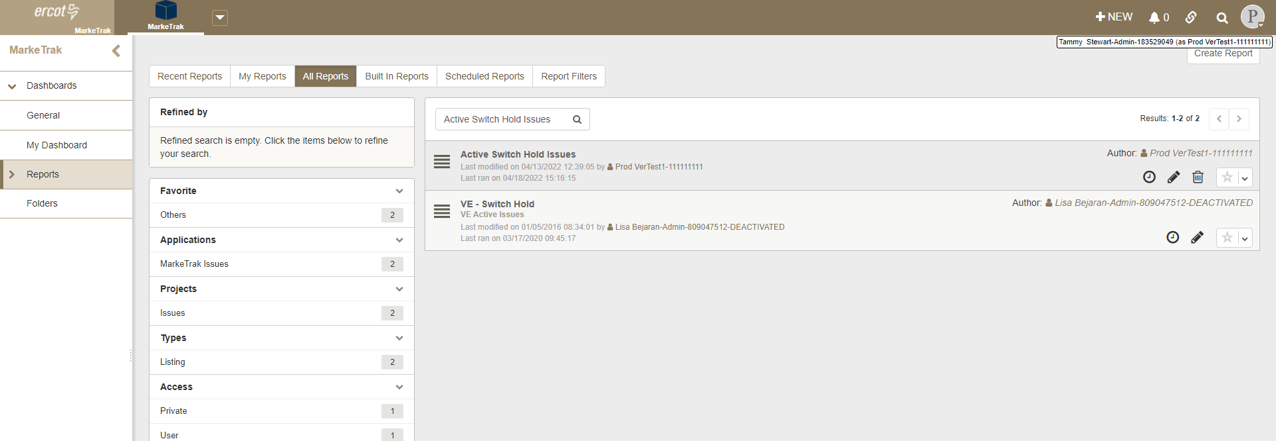
Customizing My Dashboard in the new MarkeTrak interface – Multi-View reports cont.
Click on the ‘All Reports’ tab. Type in the first report name and click the search icon. Click on the report in the search results. You can also search in the ‘My Reports’ tab if you were the author of the report.

Slide 19
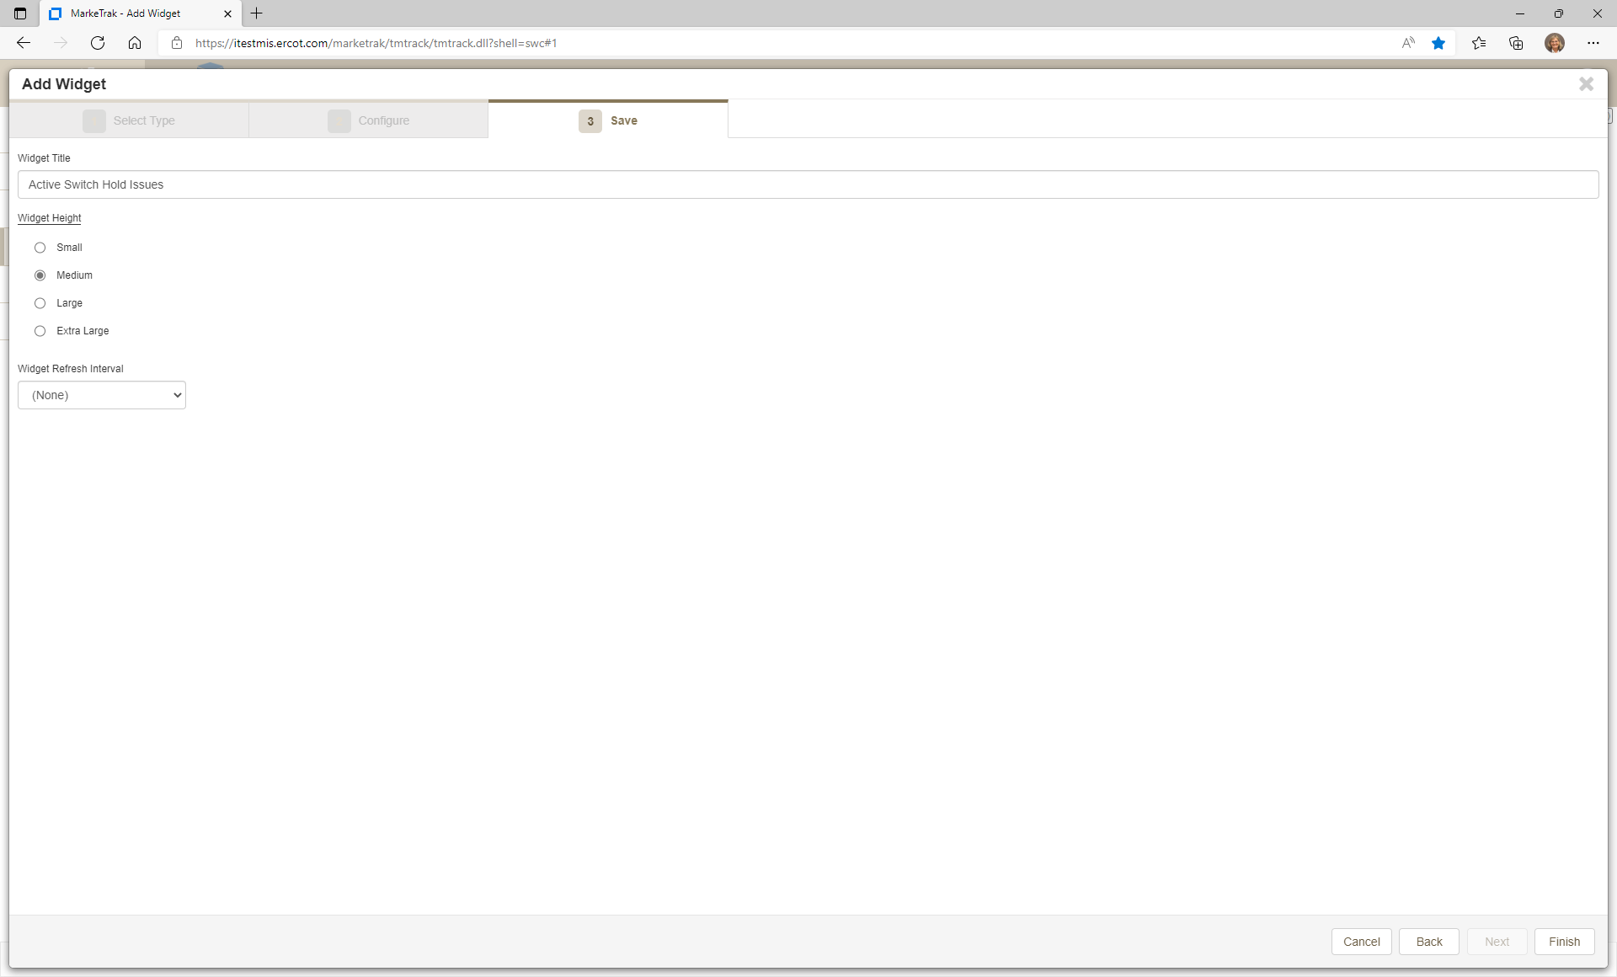
Customizing My Dashboard in the new MarkeTrak interface – Multi-View reports cont.
Name your widget in the Widget Title field and then select the report display size of your choice. Click Finish.

Slide 20
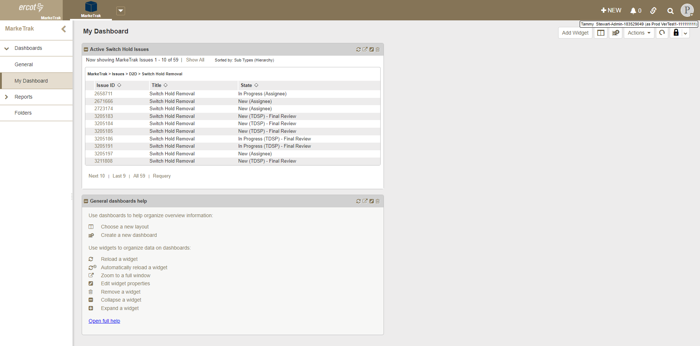
Customizing My Dashboard in the new MarkeTrak interface – Multi-View reports cont.
The first report now appears on My Dashboard. Repeat these steps for each report.
The General dashboards help widget can be deleted if not needed by clicking the delete icon.

Slide 21
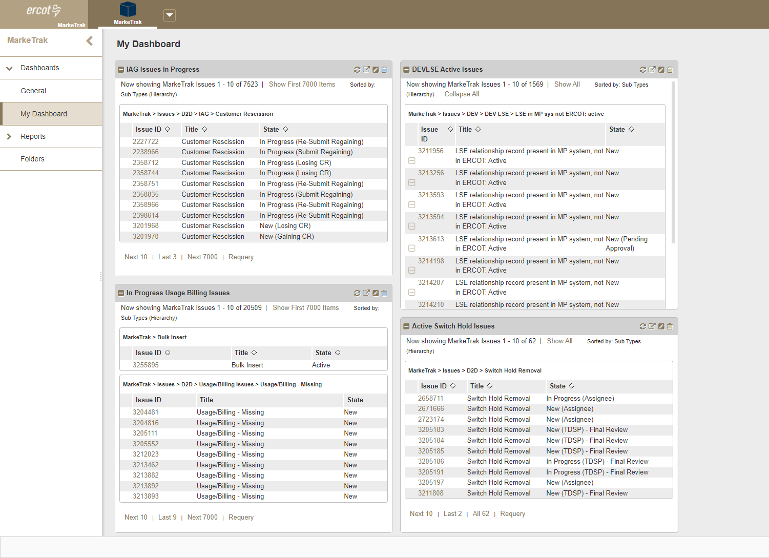
Customizing My Dashboard in the new MarkeTrak interface – Multi-View reports concluded.

