Slide 1
ERCOT Frequency Control Report
April 2022
ERCOT
Operations Planning
PDCWG | May 18th, 2022

Slide 2
Summary of April 2022
CPS1: 172.06%
Current CPS1 12-Month Rolling Average: 172.25%
0 BAAL Exceedance(s)
2 hourly CPS1 score below 100%
BAAL-003 Events have updated through 2020
2020 BAAL-003 FRM Performance: -789.34
2022 RMS1 Statistics
  Mean: 15.33 mHz
  Min: 12.43 mHz
  Max: 19.20 mHz
Energy Statistics
  Total Energy: 30,866,082 MWh
  Wind Energy: 11,743,813 MWh
  Percent Energy from Wind: 38.05 %
  Solar Energy: 1,820,140 MWh
  Percent Energy from Solar: 5.90%
Minimum System Inertia
  Mean: 148,287 MW*s
  Max: 193,300 MW*s on April 17th
  Min: 118,023 MW*s on April 9th

Slide 3
Frequency Control
CPS1, BAAL, & RMS1

Slide 4
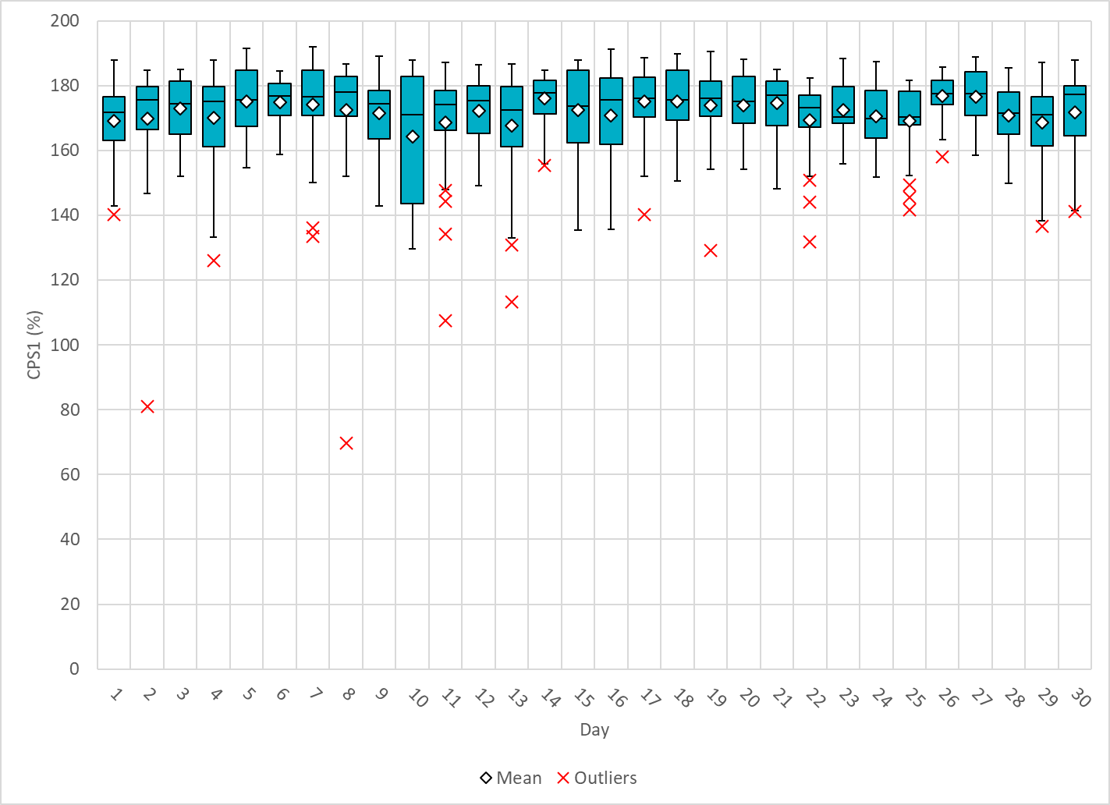
Hourly CPS1 by Day
Apr-22 CPS1 (%): 172.06
Notes:
1. 81.1%@ 4/2/2022 HE 01:00
Expected Generation Deviation
Between 00:00-01:00am the Expected gen dev remained negative. The largest expected gen dev was -1701 MW @ 00:59am with signification contribution from wind generation.
IRR Ramps
Between 00:40-01:00am wind ramped down by ~1000MW
Regulation: Regulation up was exhausted during the last quarter of the hour.
2. 69.8% @ 4/8/2022 HE 20:00
Expected Generation Deviation
Expected gen dev remained negative for the hour. The largest expected gen dev was -2790 MW @ 7:30pm with signification contribution from thermal, solar, and wind resources.
IRR Ramps
Between 7:00pm to 8:00pm wind ramped down by ~2550 MW and solar ramped down by 4300 MW.
Regulation: Regulation up was exhausted during the first half of the hour. Multiple SCED offsets were applied, the largest being a 450 MW SCED manual offset.

Slide 5
BAAL Exceedances & Violations
There are 0 BAAL exceedance(s) in April

Slide 6
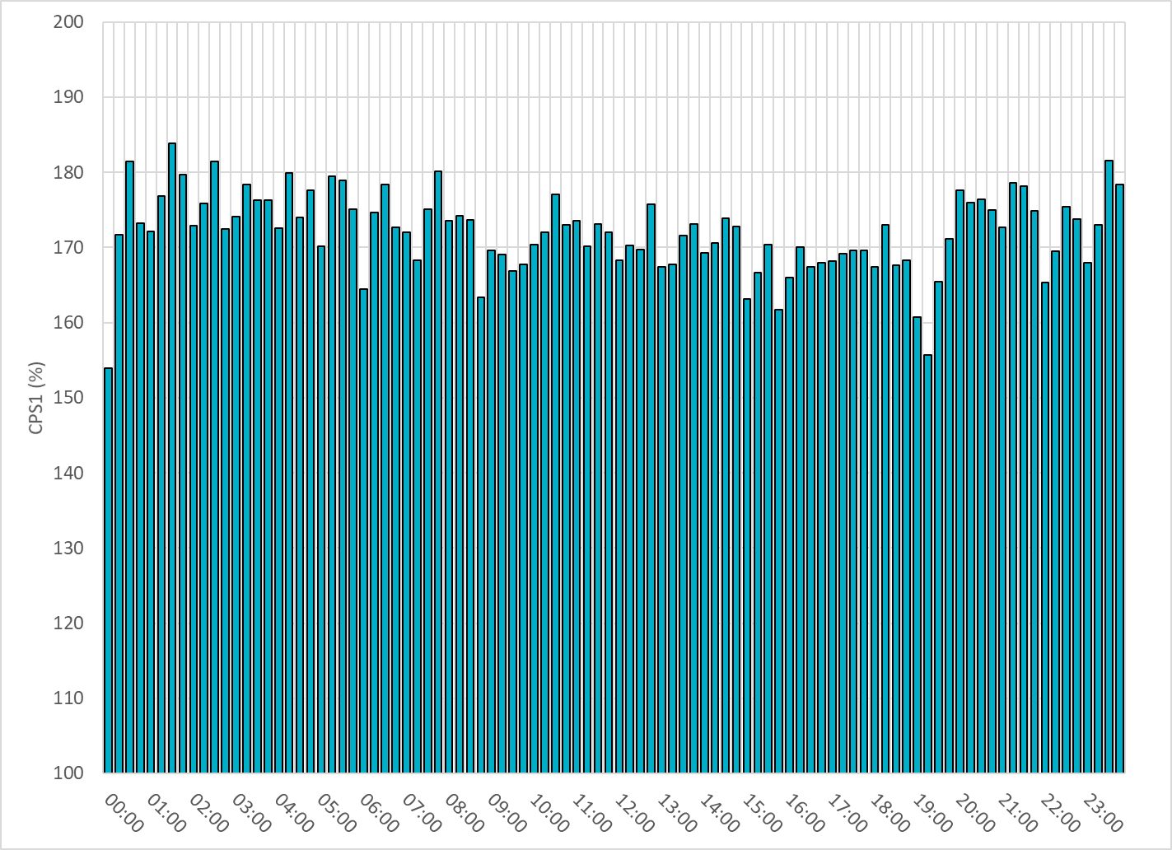
15-Minute Average CPS1%
Apr-22 CPS1 (%): 172.06

Slide 7
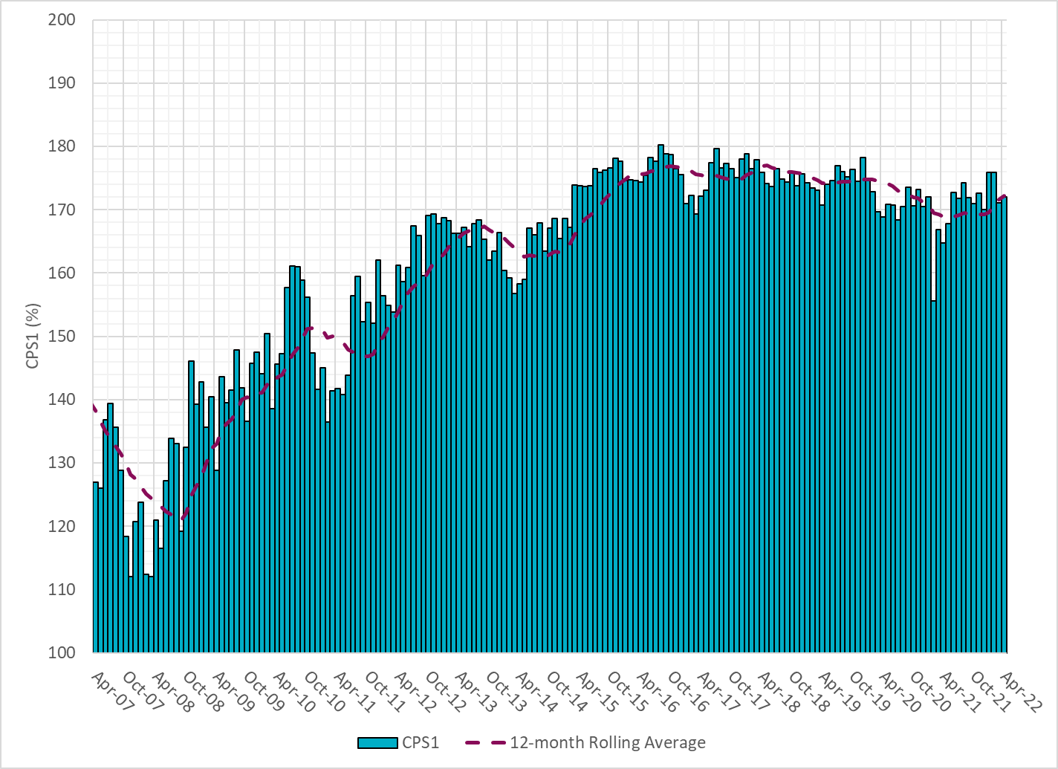
12-Month Rolling Average CPS1
Current 12-Month Rolling Average: 172.25%

Slide 8
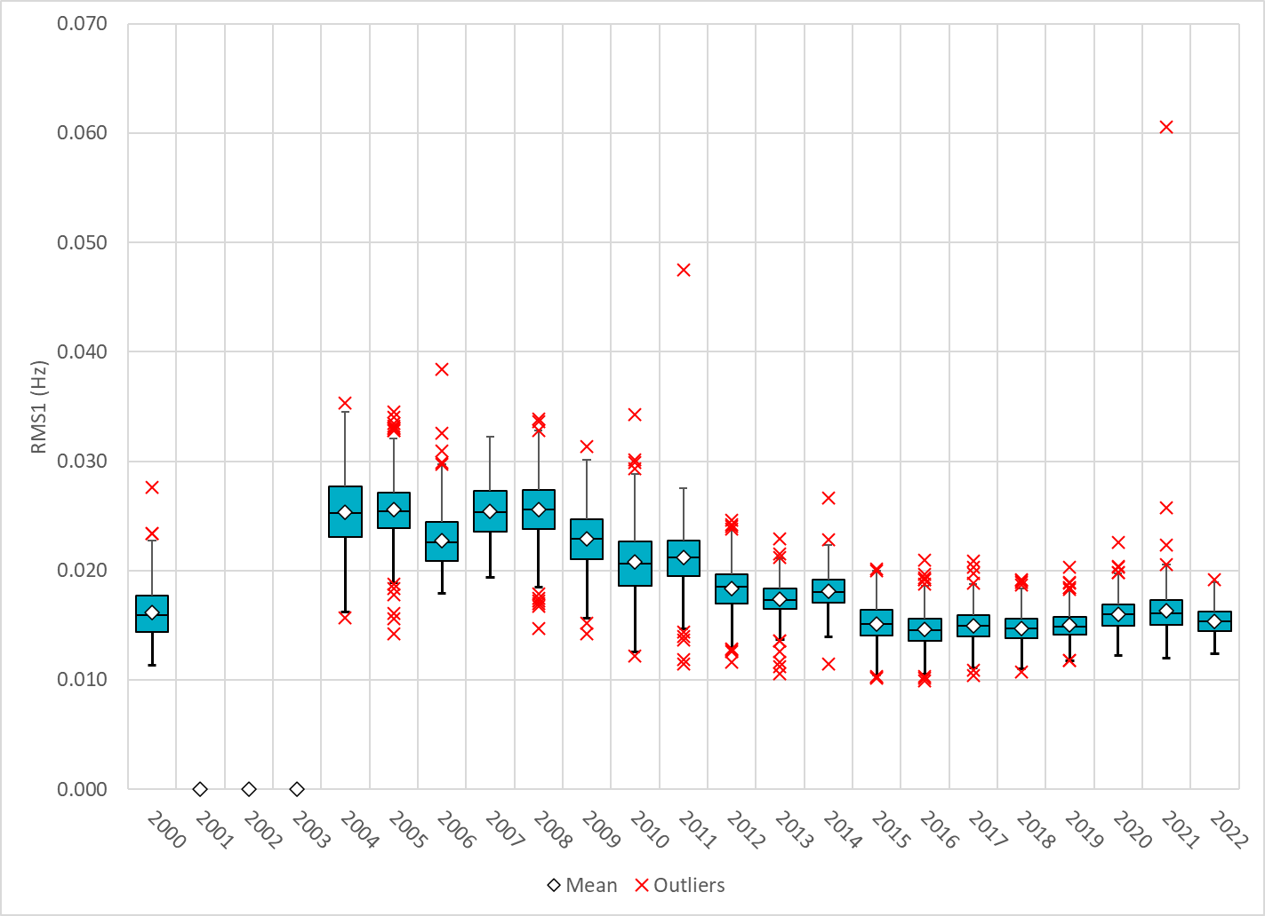
Daily RMS1 of ERCOT Frequency by Year
Notes:
Mean: 15.33 mHz
Min: 12.43 mHz
Max: 19.20 mHz

Slide 9
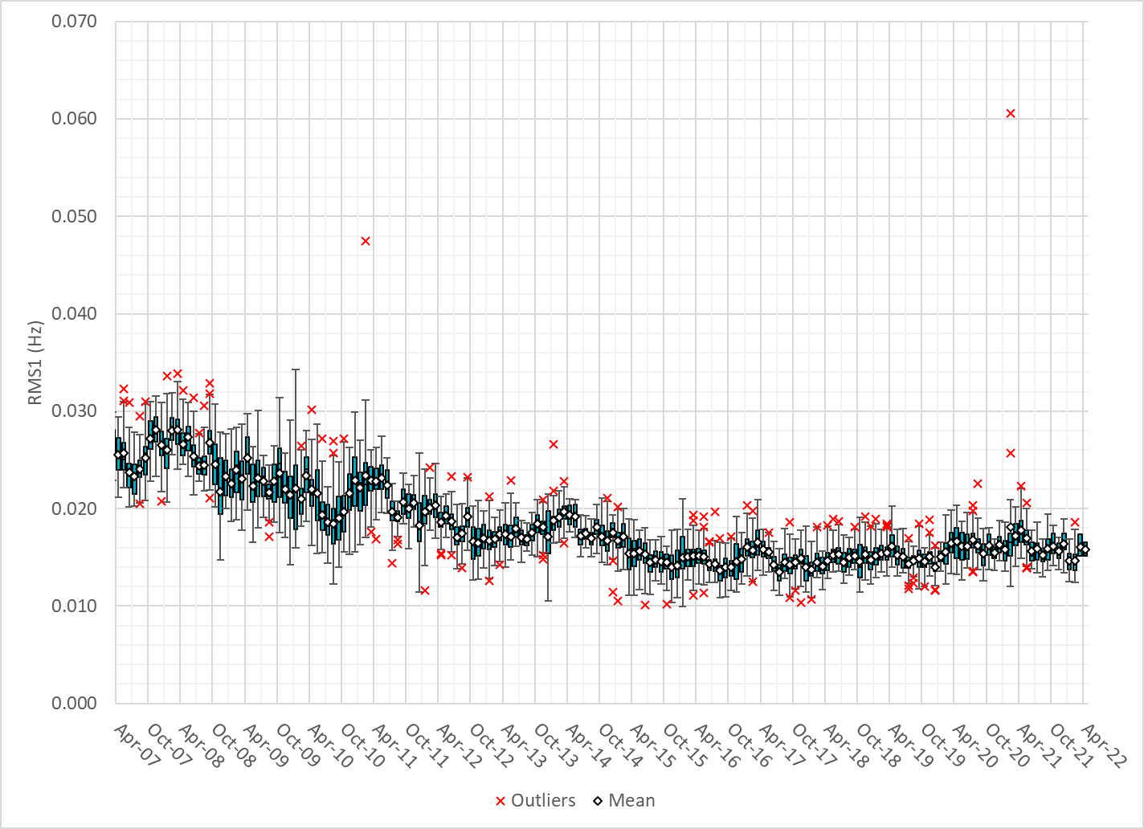
Daily RMS1 of ERCOT Frequency by Month

Slide 10
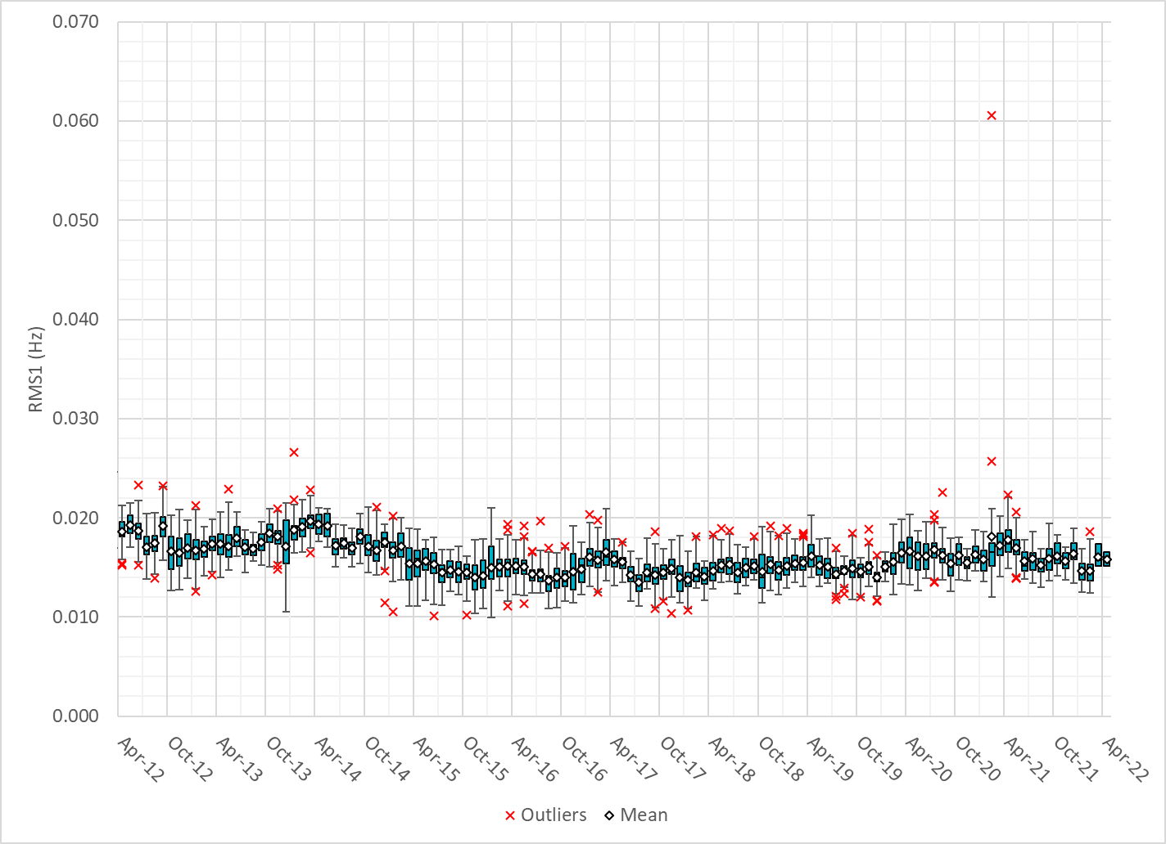
Daily RMS1 of ERCOT Frequency by Month
Notes:
15.8mHz on avg

Slide 11
Frequency Profile Comparison

Slide 12
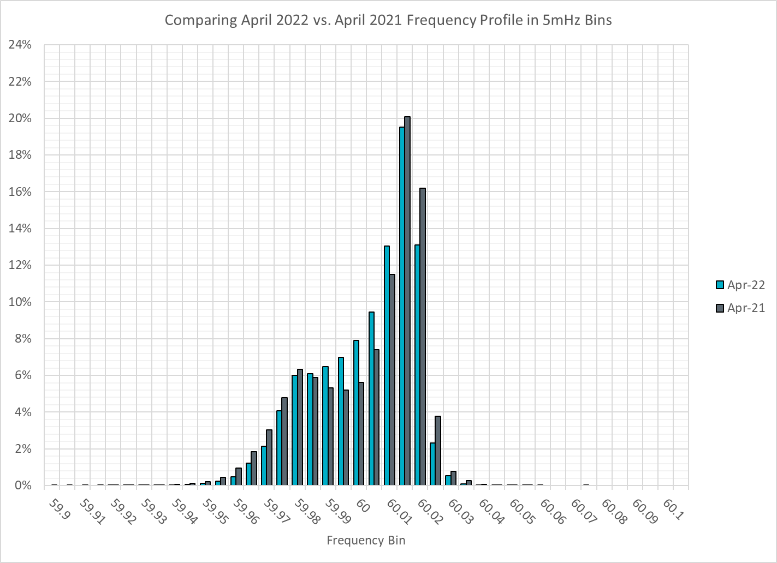
Frequency Profile Comparison

Slide 13
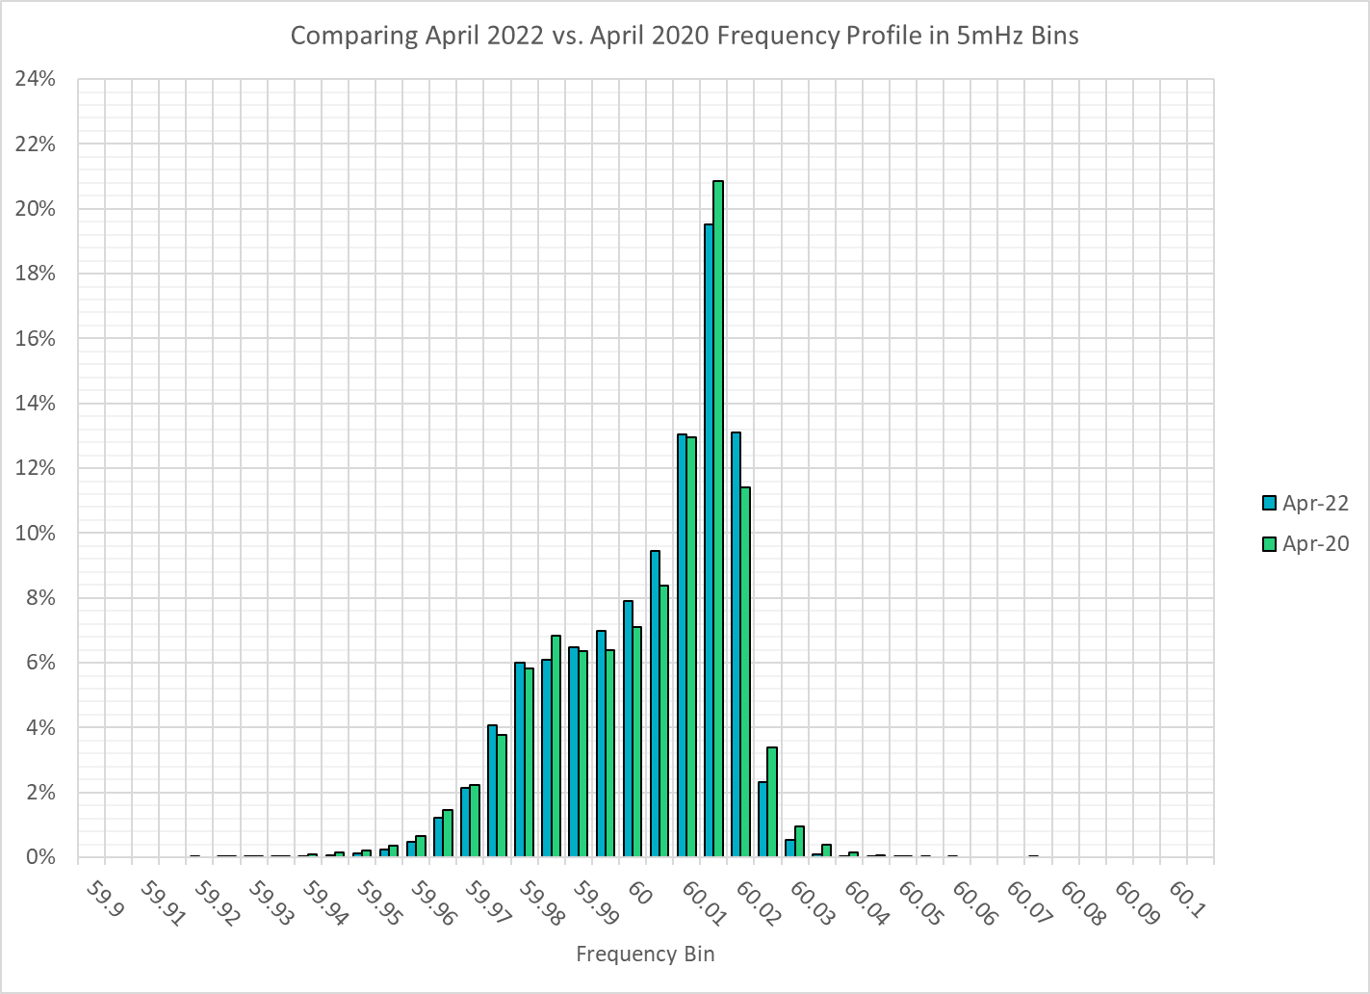
Frequency Profile Comparison

Slide 14
Time Error Correction

Slide 15
ERCOT Daily Time Error

Slide 16
Time Error Corrections Log Summary
There have been no time error corrections since December 2016

Slide 17
BAL-003 Performance

Slide 18
Op. Year 2020 BAL-003 Selected Events – Update
Notes:
BAL-003

Slide 19
Op. Year 2020 BAL-003 FRM Performance - Update
Notes:
OP2018: FRO = -381.0, FRM_median = -843.17, FRM_average = -959.7
OP2019: FRO = -381.0, FRM_median = -811.14, FRM_average = -892.5
OP2020: FRO = -425.0, FRM median = -789.34, FRM average = -879.0
OP2021: FRO =

Slide 20
ERCOT Energy Statistics

Slide 21
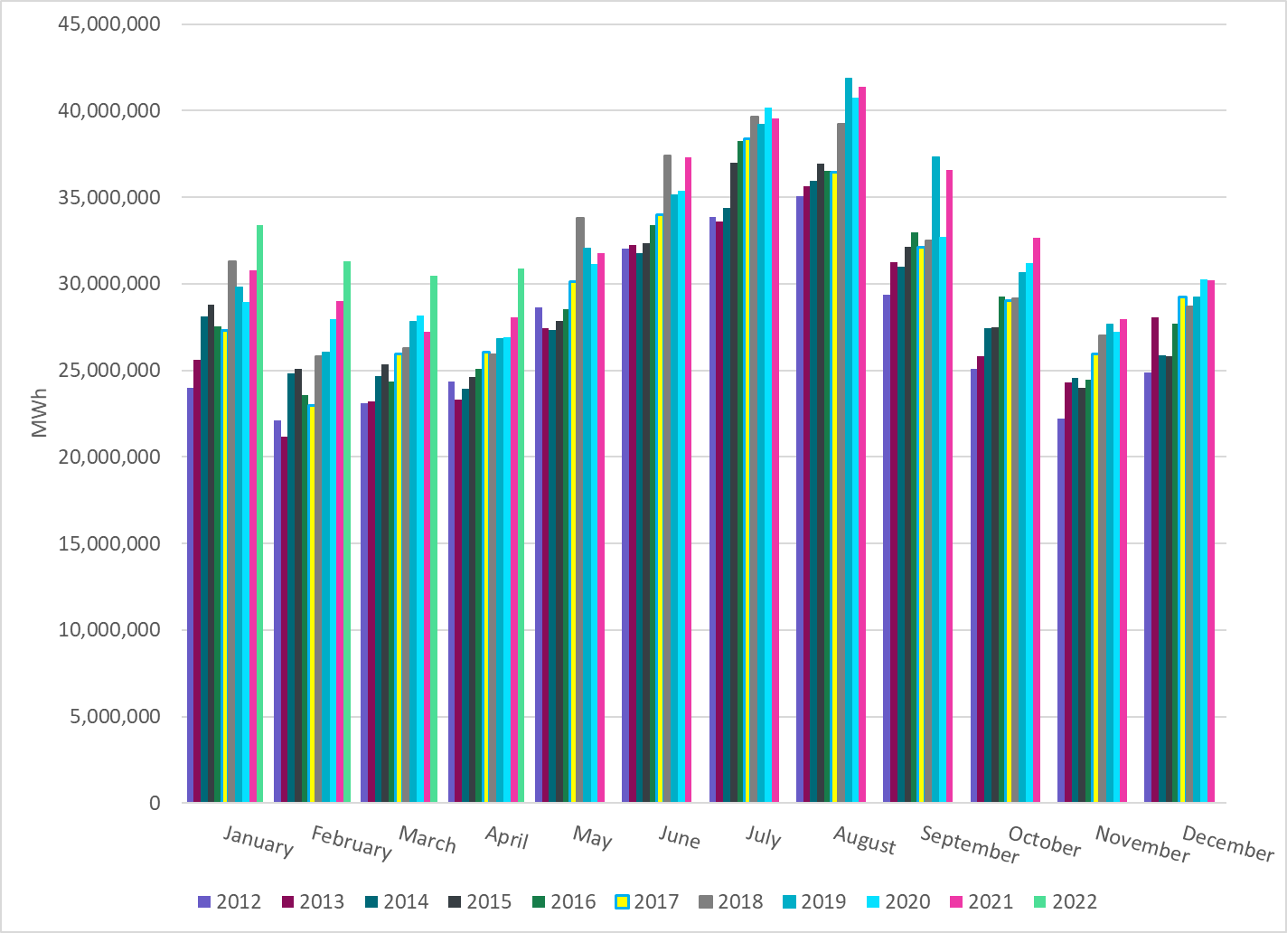
Total Energy
Notes:
30,866,082 MWh

Slide 22
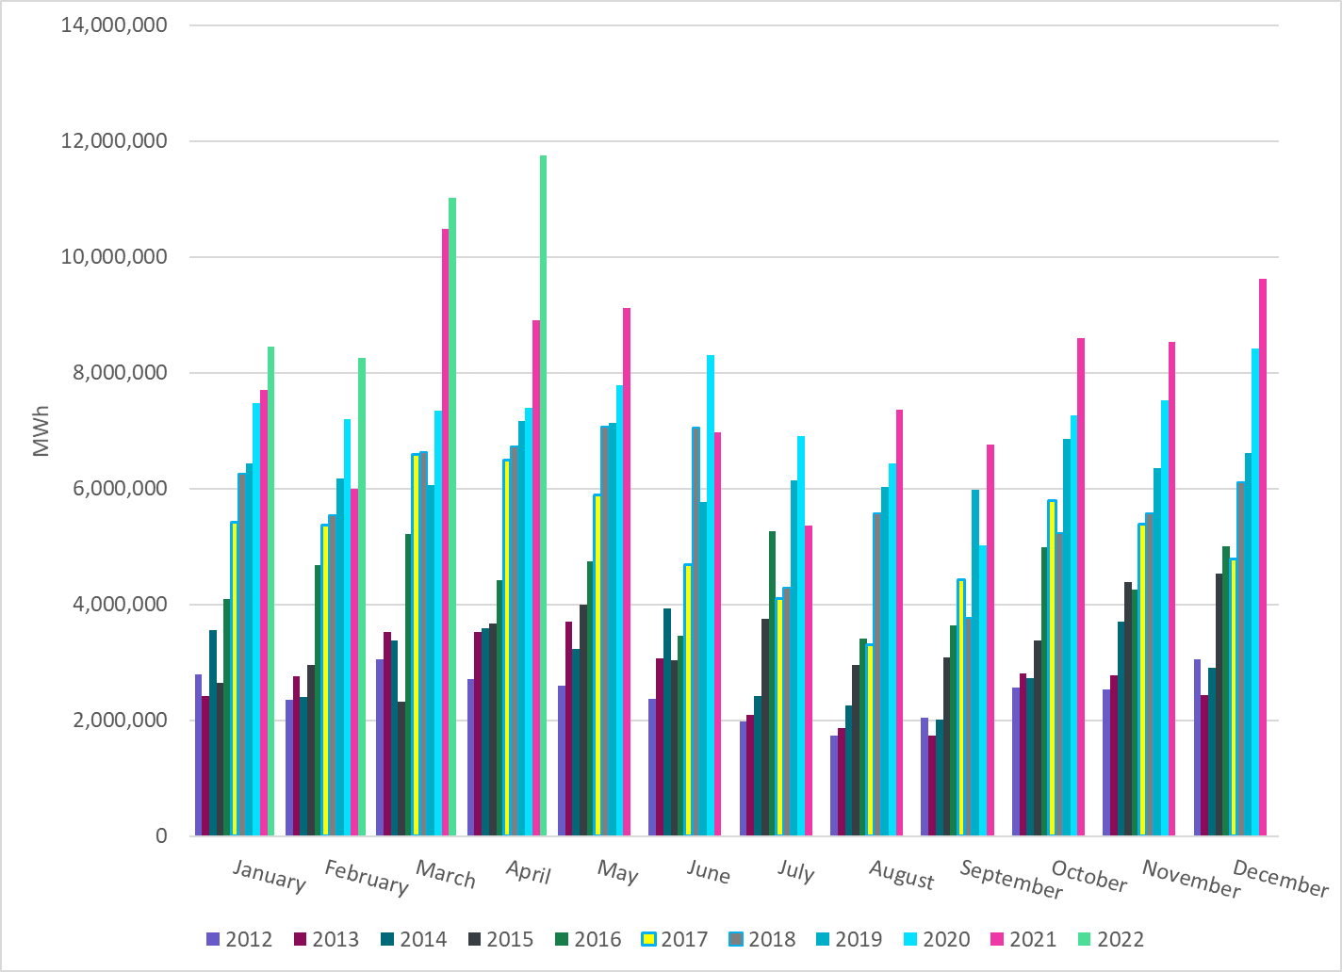
Total Energy from Wind Generation
Notes:
11,743,813 MWh

Slide 23
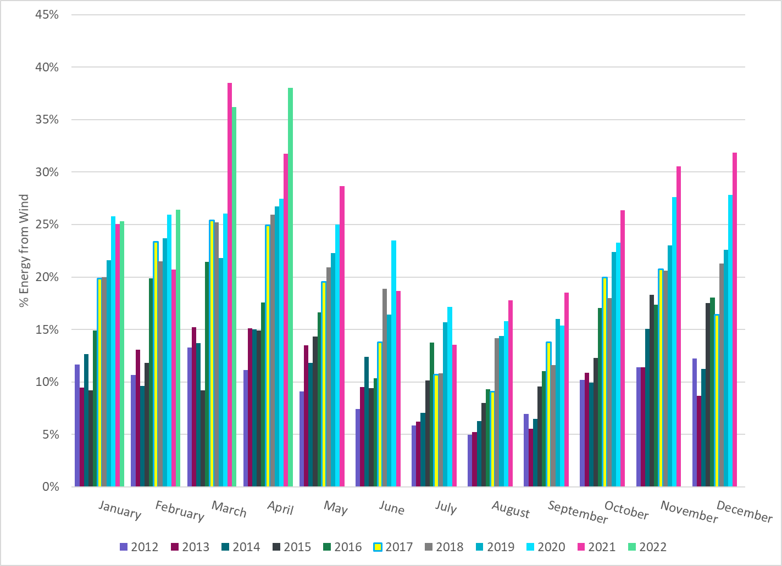
% Energy from Wind Generation
Notes:
38.05%

Slide 24
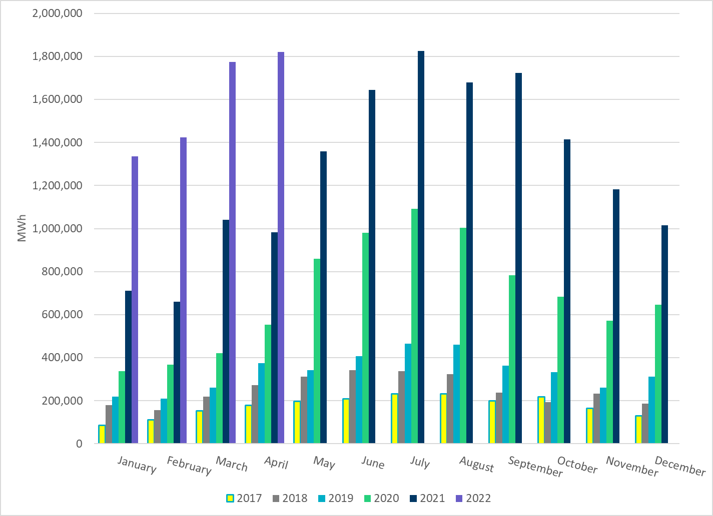
Total Energy From Solar Generation
Notes:
1,820,140 MWh

Slide 25
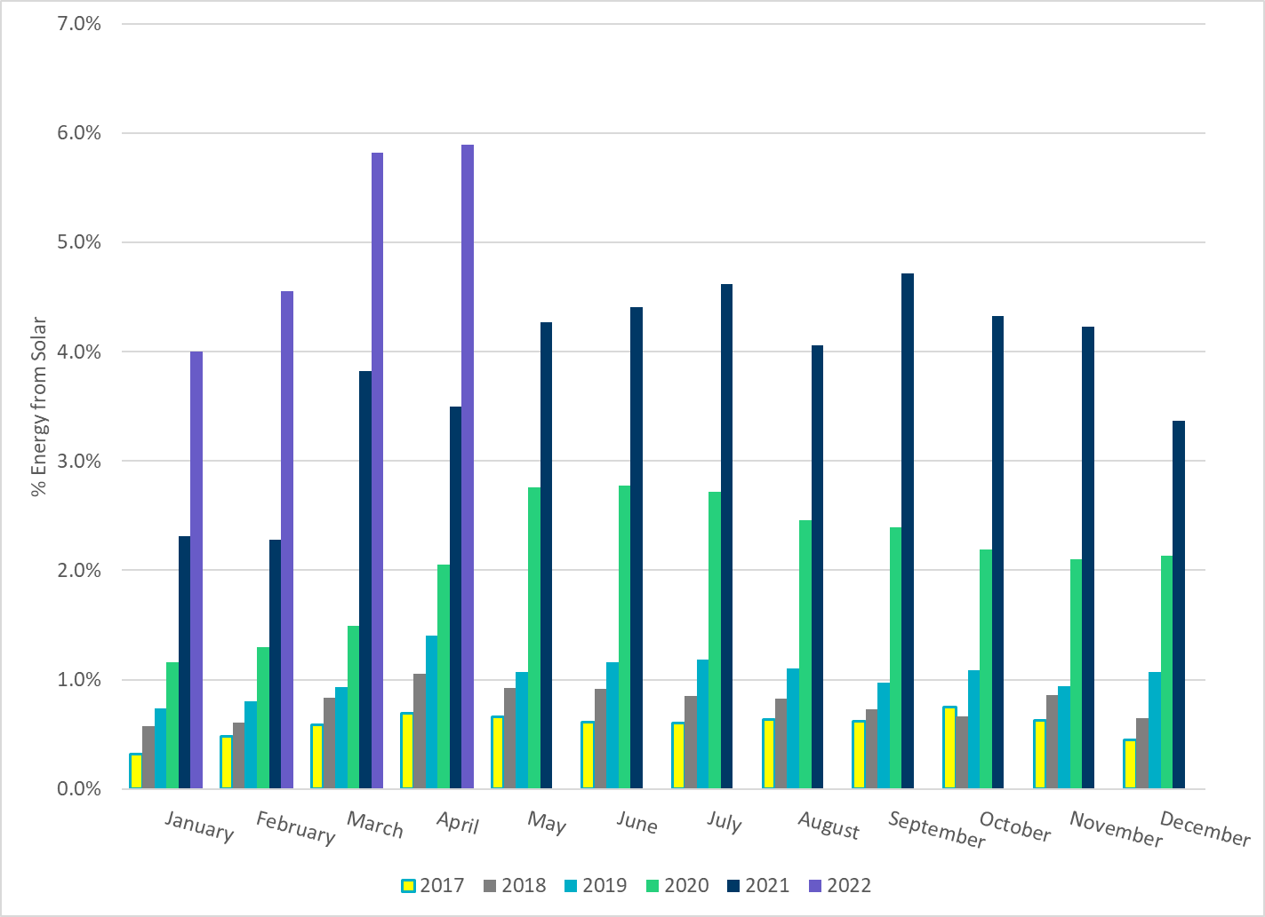
% Energy from Solar Generation
Notes:
5.90%

Slide 26
ERCOT System Inertia

Slide 27
Daily Minimum System Inertia
Notes:
Minimum Inertia =118,023 MW*s on 04/09/2022
Previous Minimum was 109,029 MW*s on 3/22/2021
Data:
Mean: 148,287 MW*s
Max: 193,300 MW*s on April 17th
Min: 118,023 MW*s on April 9th

Slide 28
Questions?
Thank you!

