Slide 1
May 2022 NDSWG - ERCOT Updates
May 17, 2022

Slide 2
Contents
Model correction for mismatched voltage associations (verbal)
LFLTF
Resource Node management for DESR and DGRs
ICR usage for contingency DPCs

Slide 3
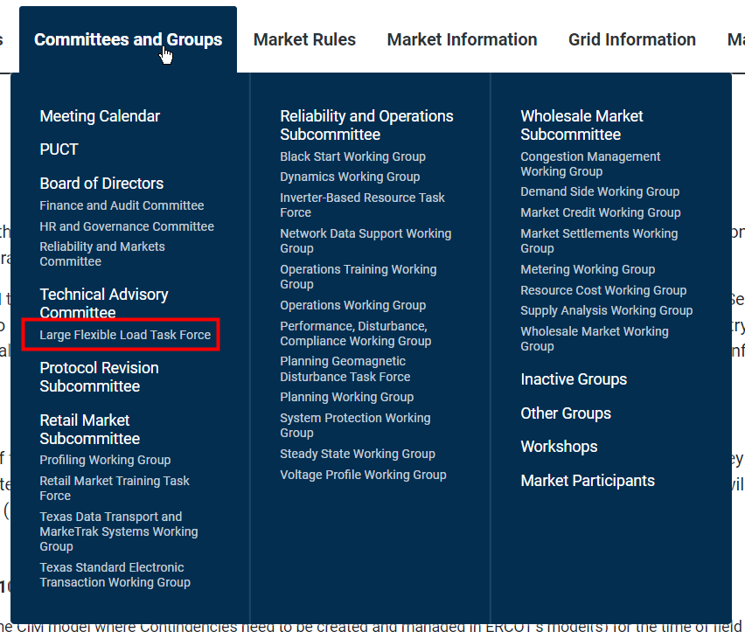
Large Flexible Loads - Update
Large Flexible Load Task Force created:
  https://www.ercot.com/committees/tac/lfltf
  Next meeting on 5/18 (tomorrow)
New email address for LFL process:
  LargeLoadInterconnection@ercot.com
Interim thresholds described in Market Notice (W-A032522-01)
  TSP stations: >75MW demand increase over 2 years
  Co-located generation sites: >20MW demand increase over 2 years

Slide 4
Resource Node Movement for DGR/DESR

Slide 5
DGR/DESR Resource Node Management – Post-Conversion
If a DGR/DESR is modeled in the “new-style” protocols provide some flexibility to relocate Resource Nodes of DGRs and DESRs

Slide 6
DGR/DESR Resource Node Management – Post-Conversion
Resource Nodes of DGR/DESRs can move to a new location if they are electrically the same

Slide 7
DGR/DESR Resource Node Management – Post-Conversion
<0.0005 X
Resource Nodes of DGR/DESRs can move to a new location if they are electrically the same or the impedance is less that the 0.0005 pu reactance threshold

Slide 8
DGR/DESR Resource Node Management – Post-Conversion
Resource Nodes of DGR/DESRs cannot be moved across impedances greater that 0.0005 reactance.
>0.0005 X
The “old” Resource Node must stay in the model until all CRR activities have concluded (Up to 3 years)

Slide 9
Contingency Management – Informational Change Requests

Slide 10
ICR – Informational Change Request
Informational Change Requests (ICRs) are submissions to ERCOT that will not have an associated modeling change.
  Example: Ratings Methodology Submissions
ERCOT requests ICRs be submitted when a valid change request cannot be accommodated due to modeling nuances
  Example: Disabling an auto-traced contingency via DPC on the first model load

Slide 11
Submission of Auto-Traced Contingencies
Auto-traced contingencies are added at the end of the model week
CRs are submitted throughout the first day of the model week
The model provided downstream represents the end of the model week

Slide 12
Submission of Auto-Traced Contingencies
Contingency is not present in the model at this time. ICR requested since CAMR would not have any changes

