Slide 1
Large Flexible Load Issues
Summary by area of LFL issues
LFL Taskforce
Date 05-18-2022

Slide 2
Interconnection /Planning Issues
Champion/Owner
Process for efficient Interconnection of Large Loads (LFL1)
Define LFL *
Define Interruptible Load *
Long term threshold for LFL *
Responsibilities during Interconnection (LFL3)
Tracking and reporting of Large Loads (LFL3)
How should BTM loads be considered for Resource Adequacy reports Milestone for incorporating Large Loads in Planning cases
Incorporation of LFL into GTC and GTL
Impacts on Frequency for tripping of Large Loads
Voltage Control impacts of LFL ramping
Forecasting of LFL in studies
RMR considerations for LFL *
______________
______________
______________
______________
______________
______________
______________
______________
______________
______________
______________
______________
______________

Slide 3
Operations
Champion/Owner
Evaluate rules and process changes that may be necessary for considering LFLs, particularly those modeled as CLRs/SCED dispatchable, in near-term reliability studies, including the Reliability Unit Commitment (RUC) process.*
RUC system changes
What forecasting in studies for LFL
What processes to use for LFL(AAN)
CLR/Interruptible Load on firm load shed obligations
BTM Load treatment
TSP LFL treatment
Outage coordination impacts for LFL
UFLS impacts of LFL
BTM Load treatment
LFL treatment
Ramp limits of LFL
Use of regulation due to Load switching up and down
RAS and CMP impacts of LFL
LFL Shed prior to/during EEA *
1. ______________
2. ______________
3. ______________
4. ______________
5. ______________
6. ______________
7. ______________
8. ______________

Slide 4
Operations continued
Champion/Owner
Forecasting of LFL in day ahead and real-time
Load forecast
Resource Forecasting
AS methodology impacts of LFL
Possibly requiring CLR participation in SCED
Study the value of lost load and diversity of response across different LFLs.*
Should SCED be run more frequently to address increased response and fluctuations from LFLs
Evaluate processes for AS and other Resource awards for LFLs, specifically BTM LFLs*
Evaluate telemetry, metering, COP, and other market submission requirements for LFLs*
Any corresponding Business Practice Manual updates
1. ______________
2. ______________
3. ______________
4. ______________
5. ______________
6. ______________

Slide 5
Load Shed Table
CLR/Interruptible Load on firm load shed obligations
1. BTM Load treatment
Champion ___________________
2. TSP LFL treatment
Champion ___________________

Slide 6
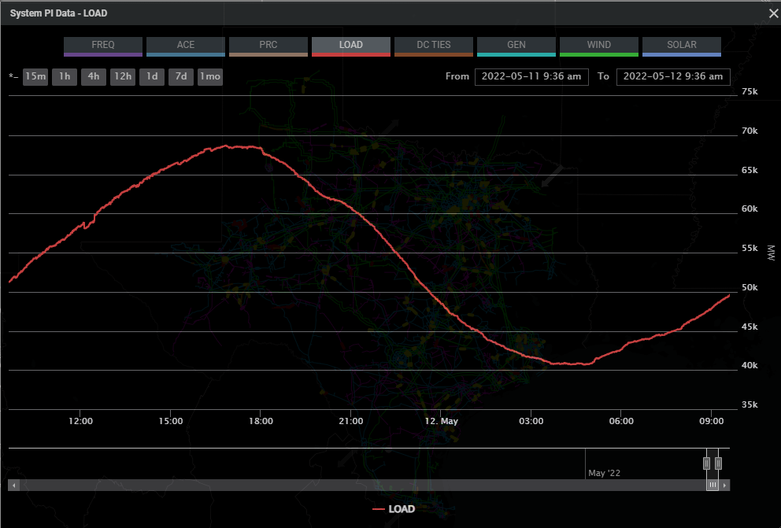
Day Ahead and Outage Coordination
Evaluate rules and process changes that may be necessary for considering LFLs, particularly those modeled as CLRs/SCED dispatchable, in near-term reliability studies, including the Reliability Unit Commitment (RUC) process.*
1. Outage coordination impacts for LFL
Champion ____________
2. RAS and CMP impacts of LFL
Champion ____________
3. Forecasting of LFL in day ahead and real-time
Load forecast
Resource Forecasting
Champion ____________

Slide 7
Frequency Support
Ramp limits of LFL
Champion ____________
Use of regulation due to Load swing
Champion ____________
UFLS impacts of LFL
BTM Load treatment
LFL treatment
Champion ____________
AS methodology impacts of LFL
Champion ____________

Slide 8
Operational Market tools impacts
Possibly requiring CLR participation in SCED*
Champion ____________
Study the value of Lost load and diversity.
Champion ____________
Should SCED be run more frequently after LR deployment
Champion ____________
AS awards where BTM LFL and Resources are awarded
Champion ____________
LFL telemetry, metering and COP submission requirements for LFL
Champion ____________
Business Practice Manual updates to account for LFL
Champion ____________
How could CLR be something other than SCED dispatchable. *

Slide 9
Markets Issues
Champion/Owner
Evaluate the need for rules prohibiting the switching between CLR and non-CLR participation and/or nodal and Load Zone settlement*
Identify any needs for metering requirements, specifically as it related to nodal vs. Load Zone settlement*
Evaluate the need for any mitigating measure needs to price oscillations or other related concerns due to fast LFL responses*
Determine if or how LFLs, specifically those modeled as CLRs, should be considered in constraint competitiveness test and Resource mitigation processes*
Study the value of lost load and diversity of response across different LFLs.*
Should SCED be run more frequently to address increased response and fluctuations from LFLs
Consider adjust energy settlement from current 15-minute process and weighting
______________
2. ______________
3. ______________
4. ______________
5. ______________

Slide 10
Markets Issues continued
Champion/Owner
AS methodology impacts of LFL
Evaluate processes for AS and other Resource awards for LFLs, specifically BTM LFLs*
Evaluate telemetry, metering, COP, and other market submission requirements for LFLs*
Any corresponding Business Practice Manual updates
Evaluate the need for changes in the treatment/modeling of LFLs in the DAM*
Evaluate the need for changes in the treatment/modeling of LFLs in the RUC*
If LFLs not required to be CLRs/dispatched by SCED, identify other potential process or tools for deployment of the LFLs*
______________
7. ______________
8. ______________
9. ______________
10. ______________
11. ______________

Slide 11
Policy
Are LFL firm Load
Transmission Allocation Cost for LFL
Provisions for Standby Service
Requiring to register as CLRs
Evaluate the pros and cons of LFLs* participating in SCED vs. responding passively
Should LFLs be required to register as CLRs
Should there by rules requiring CLRs to be available for SCED distpatch
Evaluate the need for rules prohibiting the switching between CLR and non-CLR participation and/or nodal and Load Zone settlement
Evaluate need for nodal settlement of LFLs not participating in SCED
If LFLs not required to be CLRs/dispatched by SCED, identify other potential process or tools for deployment of the LFLs

