Slide 1
Projects with Interface Change Requirements
NPRR1093, FFRA, Firm-Fuel, ECRS
Matt Mereness
March 19, 2022

Slide 2
Outline
Purpose
Protocol Projects with Upcoming Market Facing Changes
NPRR1093 Loads in Non-Spin
NPRR863/FFRA delivery
NPRR1120 Firm Fuel Supply Service
NPRR863/ECRS delivery
Discussion of Market Readiness concepts
Feedback for next TWG Meeting
Appendix
NPRR1093 Details

Slide 3
Purpose for interface change discussion
Quick reminder:
Leveraging TWG forum to communicate Protocol project changes where MPs will be required to change their ERCOT interfaces.
Target audience is Market Participant staff and/or vendors responsible for developing and deploying systems to adapt to market interface changes with ERCOT.
ERCOT publishing interface changes earlier in project process and using this forum to share technical details, listen to feedback, and provide estimated project dates including MOTE availability and Go-Live dates.
Note that this will not be the forum for project business details (will be in project readiness workshops).
3

Slide 4
NPRR1093 Load Resource Participation in Non-Spinning Reserve
High-priority PUCT project
Expands procurement of Non-Spin to include Load Resources
“Allow Load Resources that are not Controllable Load Resources to participate in Non-Spinning Reserve so that additional capacity is available to ERCOT Operators for the upcoming winter and summer 2022.” excerpt from NPRR
Go-Live next week
ERCOT worked to minimize interface changes
Relatively minor changes to Market MMS XML submission
Changes limited to new values with AS Self-Arrangement and AS Trades for Non-Spin from Load
Backward compatible (traditional Non-Spin AS type remains the same)
No changes to Telemetry/ICCP
Changes to Reports

Slide 5
Library of NPRR1093 Requirement Changes
Technical Specification Changes:
Posted at prior TWG (https://www.ercot.com/calendar/event?id=1643307467620)
External_Web_Services_XSD_V1.22_NPRR1093
EIP_External_Interfaces_Specification_v1_22
Note the word doc leverages “gray boxed” language to capture multiple protocol changes.
MarketSubmissionValidationRules_NP4-450-NPRR1093
Transaction Changes (more detail in Appendix):
AS Trades (new type of Non-Spin, NSPNM)
AS Self-Arrangement (new type of Non-Spin, NSPNM)
Changes to market facing reports on next slide
Key Dates (in Market Notices also):
Project/Business workshop date: April 25, 2022 1-3pm
MOTE availability date May 5, 2022
MOTE support calls May 12, 2022
Go-Live date: May 26, 2022

Slide 6
FFRA (in NPRR863) Fast-Frequency Response Advancement Project
High-priority PUCT project
Incorporates Fast-Frequency Response into Response Reserves
Project scheduled for October 2022 Go-Live in R5
Originally was planned for go-live Dec 2021
Project in re-planning stages
Interface specifications previously published are still valid for FFRA changes
See detailed content from 12/7/2021 workshop
Creates 3 sub-types of RRS products
Structural changes to XML and telemetry additions
Changes affect all QSEs that schedule/sell/buy AS (not backward compatible)
Planning for extending time in MOTE (time for QSE break/fix)
ERCOT piloting technical market readiness options to mitigate risk

Slide 7
Library of FFRA Requirement Changes
Reminder of specs posted in library zip file at 12/7/2021 workshop
MarketSubmissionValidationRules_NP4-450
External Web Services XSD V1.21
EIP External Interfaces Specification v1.21 (FFR & DGR)
ERCOT_Nodal_ICCP_Communications_Handbook_v3_11_Change_Upd
Current Day Reports XSD v6.xx –Excerpt for workshop
Disclosure Reports Column Definitions Guide
Estimated Key Dates (will be in future Market Notices also):
Project/Business workshop dates and cutover details: TBD- Late-July
MOTE availability dates: mid-Aug through Sep2022
Market notice this week describes MOTE expectations for AS Qualified QSEs
Weeks 1 & 2 - No submission summary published
Weeks 3 & 4 - Publish submission summary by QSE (target 50% success)
Weeks 5 & 6 - Publish submission summary by QSE (target 75% success)
Week 7 - Publish submission summary by QSE (target 95% success)
Go-Live date: R5/October 2022

Slide 8
Firm Fuel Supply Service NPRR1120
High-priority PUCT project
Firm Fuel Supply will be procured outside of ERCOT systems (via RFP)
Deliver in late 2022
Market Interface Impacts
Daily submissions will be required for awarded QSEs
Plan to leverage “Availability Plan” XML Transaction
Adds another type to Availability Plan submission
Current types for Black Start, RMR, and Synchronous Condenser Resources)
ERCOT will share specifications as soon as Business Requirements completed by ERCOT.

Slide 9
ECRS (in NPRR863) ERCOT Contingency Reserve Service
High-priority PUCT project
Incorporates new 10-minute Ancillary Service (ERCOT Contingency Reserve Service).
Project initiated and targeting 2023 Go-Live in first half of year.
Project Impacts
Similar to FFRA in terms of level of changes as this new Ancillary Service will impact all AS-related submissions and not be backward compatible.
ERCOT sharing high-level schedule and impacts so MPs can plan for development resources and budget as needed.

Slide 10
Discussion of Confirming Market Readiness (FFRA/ECRS)
ERCOT is piloting improvements in communication and the MP feedback loop with FFRA since not backward compatible and creates reliability risk if not successful:
Early Market Notice to increase awareness of risks (not backward compatible) and MOTE testing activities that will be required and publicly posted (details in forthcoming market notice on May 20).
Longer MOTE Duration (extended from 4 weeks to 7 weeks)
Publication of successful submissions by QSEs
Weeks 1 & 2 - No submission summary published
Weeks 3 & 4 - Publish submission summary by QSE (target 50% success)
Weeks 5 & 6 - Publish submission summary by QSE (target 75% success)
Week 7 - Publish submission summary by QSE (target 95% success)

Slide 11
Feedback for next TWG Meeting
Current plan for next TWG meeting:
Continue discuss of changes and/or additional details for:
NPRR1093 (R3-May 2022 release)- post-launch update
NPRR863/FFRA (R5-Oct 2022 release)
NPRR1120 Firm Fuel Supply Service (late 2022)
NPRR863/ECRS (first half 2023 release)
Continue Discussion of Market Readiness concepts for FFRA & ECRS
Any new projects on horizon
ERCOT open to feedback/questions for next TWG meeting
Feedback can be directed to Matt.Mereness@ercot.com

Slide 12
Appendix
NPRR 1093 Details

Slide 13
NPRR 1093 XSD changes
External Web Services XSD V1.22_NPRR1093
ERCOTCommonTypes

Slide 14
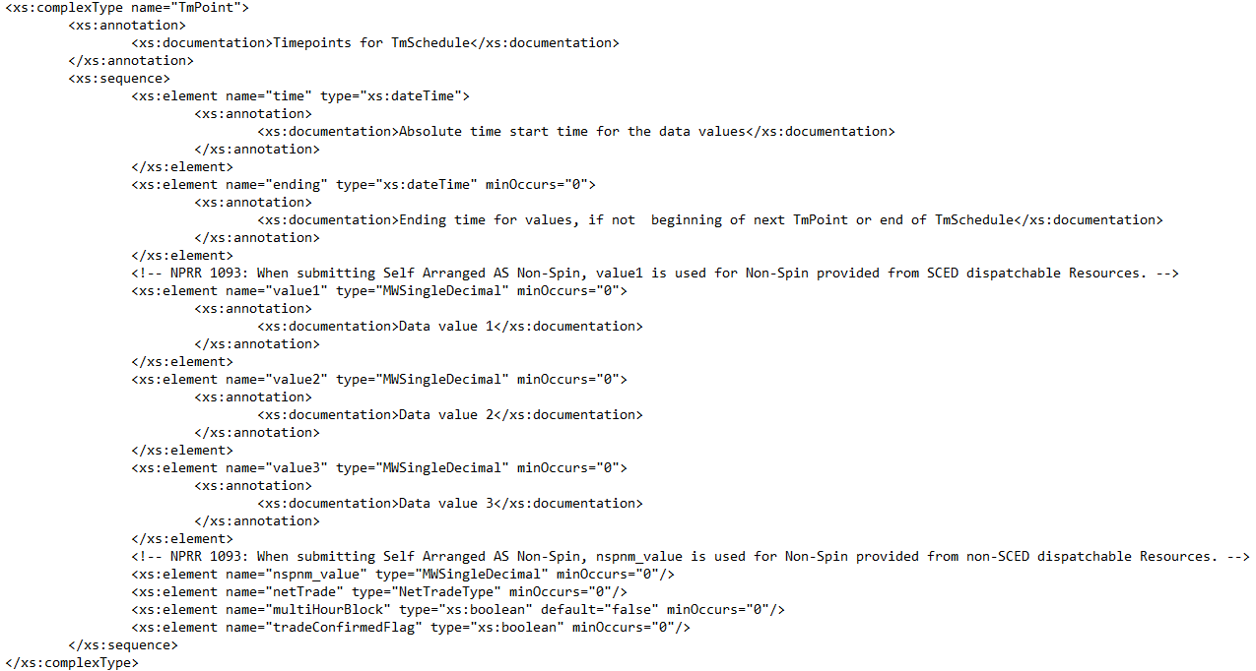
NPRR 1093 XSD changes
ERCOTCommonTypes

Slide 15
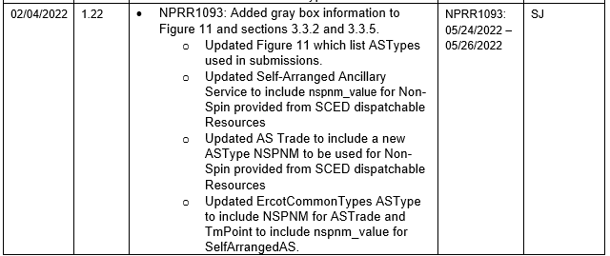
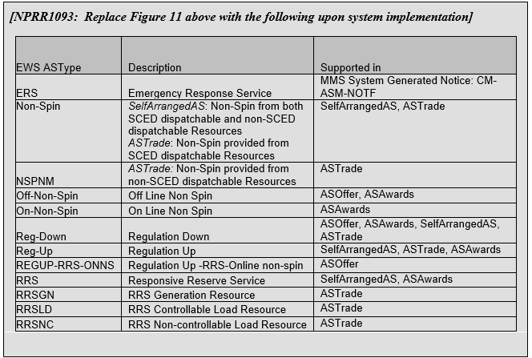
NPRR 1093 Interface changes
EIP_External_Interface_Specifications_v1_22

Slide 16
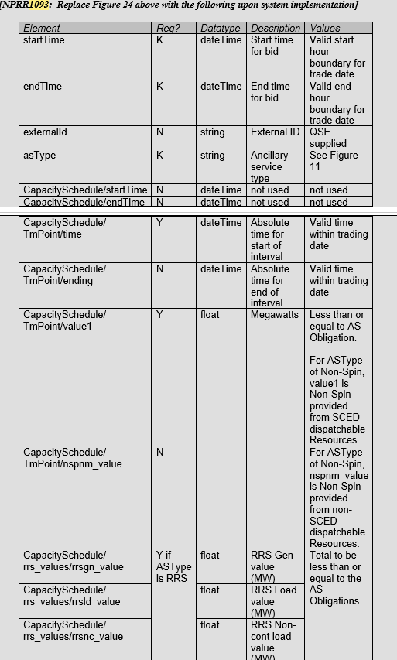
NPRR 1093 Interface changes
EIP_External_Interface_Specifications_v1_22

Slide 17
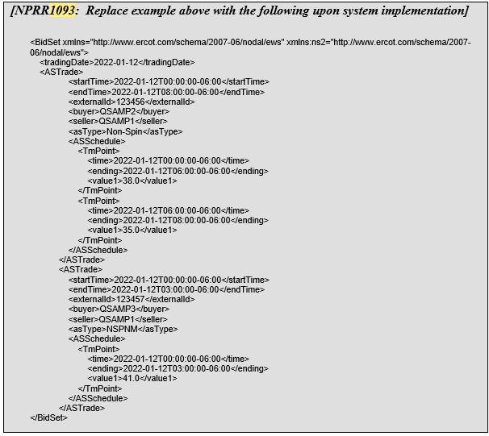
NPRR 1093 Interface changes
EIP_External_Interface_Specifications_v1_22

Slide 18
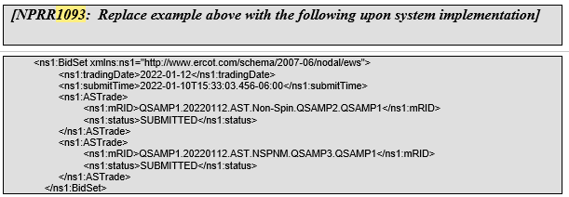
NPRR 1093 Interface changes
EIP_External_Interface_Specifications_v1_22

Slide 19
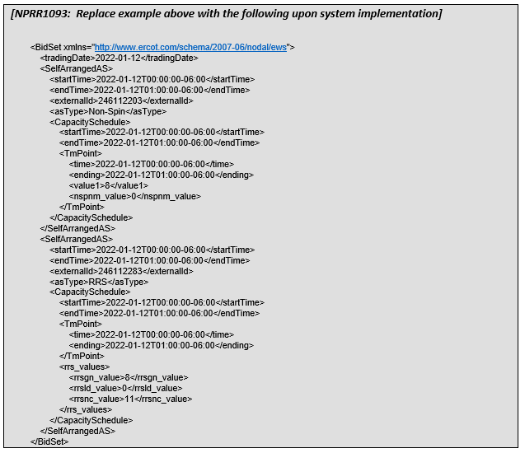
NPRR 1093 Interface changes
EIP_External_Interface_Specifications_v1_22

Slide 20
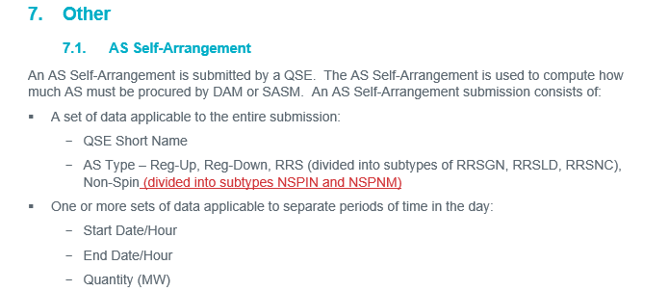
NPRR 1093 Market Validation Changes
MarketSubmissionValidationRules_NP4-450-NPRR1093

Slide 21
Report Impact Summary – NPRR1093
Report | Change Summary
NP6-557-CD Group Assignments for NCLRs and Off-Line Generation Resources participating in NSRS | New Report - Daily Certified for QSEs Rpt ID: 21939
NP6-323-CD Real-Time ORDC and Reliability Deployment Price Adders and Reserves by SCED Interval | Report Modification Rpt ID: 13221 Change: Addition of new column ‘RTNCLRNSCAP’
NP6-792-ER Historical Real Time ORDC and Reliability Deployment Price Adders and Reserves | Report Modification Rpt ID: 13231 Change: Addition of new column ‘RTNCLRNSCAP’
NP8-385-ER Monthly Non-Spin NCLR Performance Report | New Report - Monthly Certified for QSEs Rpt ID: 22069
NP3-911 2-Day Ancillary Services Disclosure Output File: 2d_Self_Arranged_AS_NSPNM | Report Modification Rpt ID: 13057 Change: New CSV output file within the 2-Day Self-Arranged AS ‘2d_Self_Arranged_AS_NSPNM’ due to new NSPNM subtype
NP3-966-ER 60D DAM Disclosure Report Output file: 60-Day QSE-Specific Self-Arranged AS in DAM | Report Modification Rpt ID: 13051 Change: Current NSPIN Column to be split out to account for new subtype of NSPNM
NP3-965-ER 60D SCED Disclosure Report Output file: 60-Day QSE-Specific Self-Arranged AS in DAM | Report Modification Rpt ID: 13052 Change: Current NSPIN Column to be split out to account for new subtype of NSPNM

