Slide 1
Monitoring and Control
Wei Qiu
ERCOT TWG
May 19, 2022

Slide 2
Challenges
“Loss of Monitoring and/or Control”
Lack of definitions
Different understanding

Slide 3
Monitoring
The ability to accurately receive relevant information about the BES in Real Time and evaluate system conditions using Real-time data to assess existing (pre-Contingency) and potential (post-Contingency) operating conditions to maintain reliability of the BES. This could include, but not be limited to, the ability to evaluate:
the current frequency
the current status and capabilities of the generators
the availability of generating operating reserves in real time
the current status (open or closed) and real and reactive power flows on the BES tie-lines and facilities
the current voltage profile
resource balance in real time

Slide 4
Control
The ability to take and/or direct actions to maintain the reliability of the BES in Real Time via entity actions or by issuing Operating Instructions. This could include, but not be limited to, the ability to maintain and/or adjust:
ACE
Current BES voltage profile using available reactive resources
BES facility line flows and voltages within IROLs, SOLs and facility ratings using available generation dispatch, re-dispatch or load shedding as necessary
Facility output and adjust in accordance to agree upon schedules
Planned transmission facility outages based on current transmission system conditions and any unplanned element losses (generation or transmission) that could affect the reliability of the current plan

Slide 5
Status
Draft -- Done
Comments -- ongoing
Approval --- NERC Event Analysis Subcommittee (EAS)
ERO Event Analysis Process Document

Slide 6
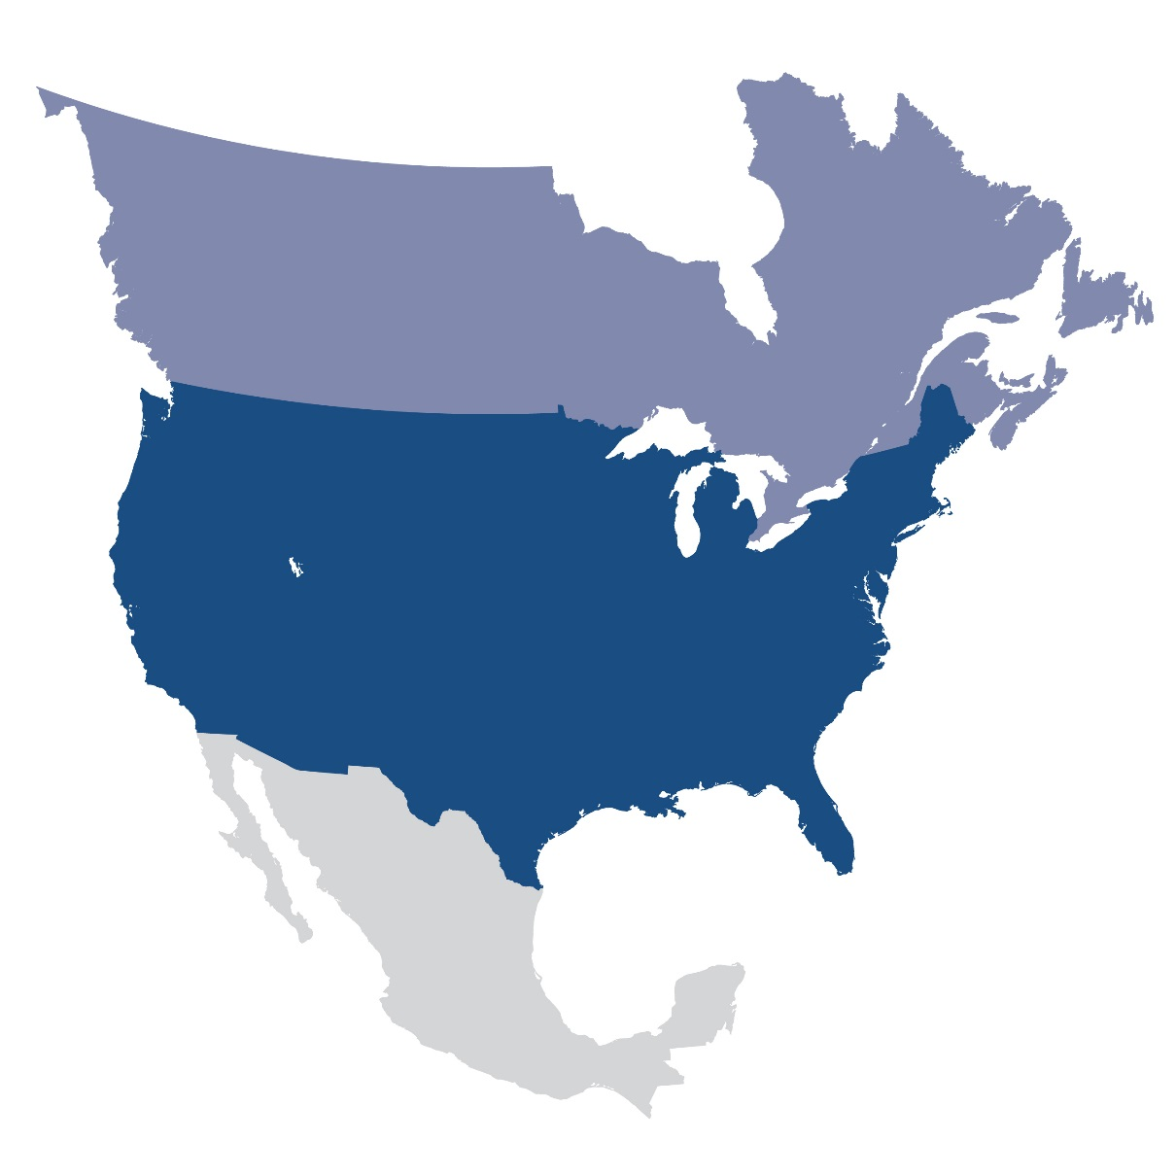
Questions and Answers
Contact Information:
wei.qiu@nerc.net

