Slide 1

Recent GIC Research at
Texas A&M University
Thomas J. Overbye
Department of Electrical and Computer Engineering
ERCOT Planning Geomagnetic
Disturbance Task Force
May 10, 2022

Slide 2
Acknowledgments
Work presented here has been supported by a variety of sources including PSERC, the TEES Smart Grid Center, DOE, ARPA-E, NSF, EPRI, BPA, PowerWorld, and others. Their support is gratefully acknowledged!
Slides also include contributions from many of my students, postdocs, staff and colleagues at TAMU, UIUC, other PSERC schools, and PowerWorld
Simulation results presented here are based on synthetic electric grids, and contain no Critical Electricity/Energy Infrastructure Information (CEII)
  Simulations done using PowerWorld Simulator ver. 22

Slide 3
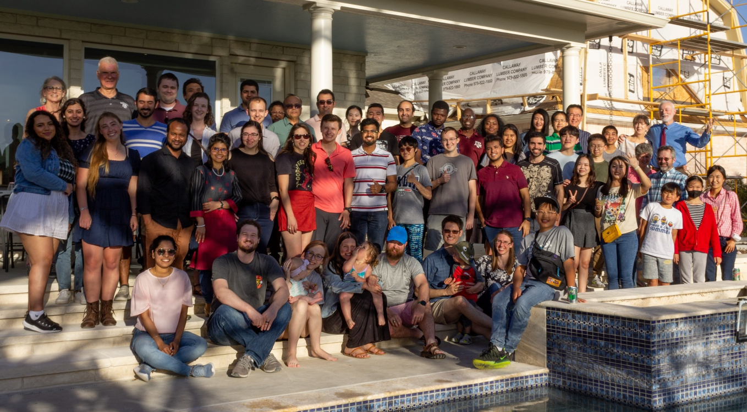
Greetings from the TAMU Energy and Power Group and the Smart Grid Center (SGC)

Slide 4
A Little on My Background in GMD
Overall research focus is power system analysis and visualization, including power flow and stability
  Original developer of PowerWorld Simulator
Started getting interested in GMD in 2010 based on my attending a JASON event
  Started implementing GMD in the PowerWorld power flow in summer 2010; did lots of utility studies
  Added EMP E3 into PowerWorld stability starting in 2015
Involved in the NERC/EPRI GMD and EMP groups
Recently TAMU is partnering with PNNL and EPRI on a DOE GMD project, and with Sandia, LANL and others on a DOE EMP E3 project

Slide 5
Introduction
Goal of the presentation is to update the task force on recent work that has been taking place at TAMU in this area, and to identify more areas for collaboration
Our ultimate goals are to do the research and to help develop tools for utilities to mitigate the impacts of GMD and EMPs (and other high-impact, low frequency events [HILFs]) on their systems in a cost conscious manner
A key question I ask my students is, “If a large GMD were to occur in the near future, what should we be doing now to prepare

Slide 6
Current DOE Projects in GMD/EMP
In 2021 the DOE Office of Cybersecurity, Energy Security and Emergency Response (CESER) funded four national lab led projects looking at reducing the risks caused by GMDs and EMPs
  Lab leads are PNNL, Sandia, Los
  Alamos and Idaho National lab
  Other partners include EPRI, TAMU, Air Force Research Lab, BPA and WAPA
  The announcement is at www.energy.gov/ceser/articles/us-department-energy-awards-4-million-projects-elevate-grid-security-and-resilience
TAMU has also used other funding sources to work in this area
We’d like a Texas utility person on our advisory board

Slide 7
Specific TAMU GIC Research Areas
Performing specific GMD studies associated with NERC TPL-007-4
Develop and run the Texas Magnetometer network
Create realistic GMD scenarios including severe ones
Develop better solution algorithms, particularly for the voltage-stressed conditions associated with heavy GICs; also develop better sensitivity techniques and couple with harmonic analysis
Develop interactive simulations of GIC events
Develop improved algorithms for GIC mitigation
Develop better visualization techniques

Slide 8
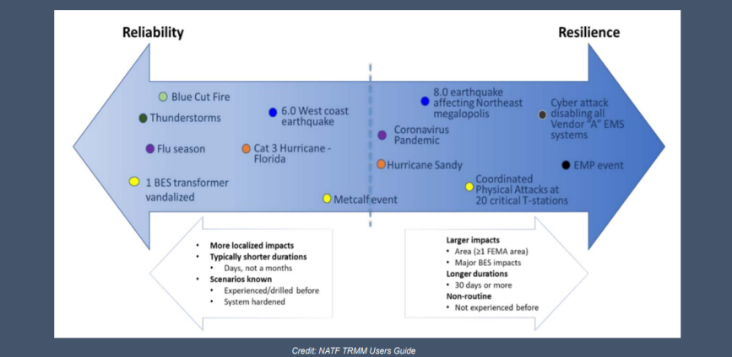
Reliability – Resilience Continuum
Slide is from the 53rd North American Power Symposium keynote address by Dan Smith of Lower Colorado River Authority, November 2021; credit NATF

Slide 9
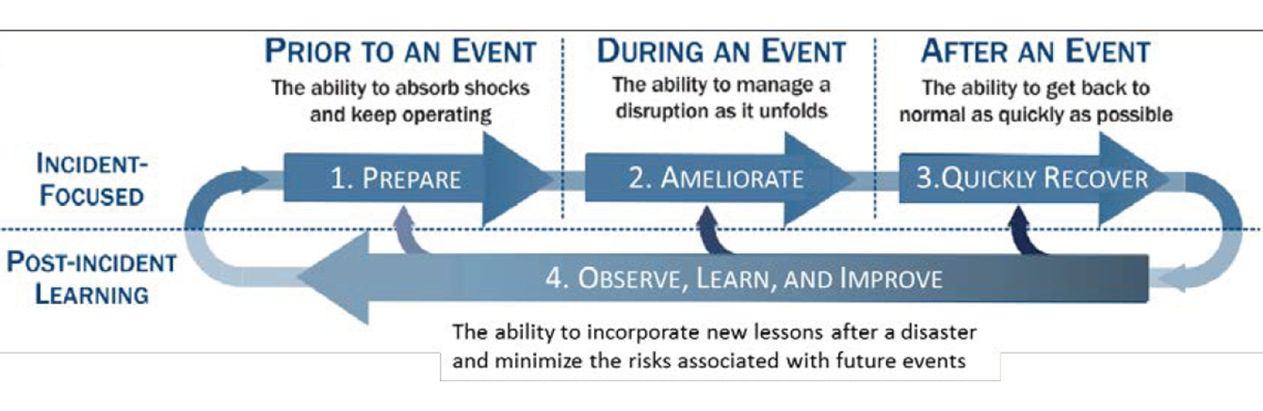
Four Stage Resilience Process
This is presented as Figure 1.2a in the National Academies’ Enhancing the Resilience of the Nation’s Electricity System report (2017), and is originally from
S.E. Flynn, “America the resilient: Defying terrorism and mitigating
natural disasters.” Foreign Affairs, vol. 87: 2–8 (2008) and as illustrated by the National Infrastructure Advisory Council (NIAC) in 2010.

Slide 10
How to Approach HILF Events from a Research Perspective
The goal in studying HILFs is seldom to replicate a specific event
  Many have not occurred, and within each class there can be great variability (e.g., a physical attack)
Nor is it to ensure there is no loss of service
Rather, it is to be broadly prepared, and to be able to do at least a reasonable cost/benefit analysis
HILF simulations can help in preparing for the unexpected
Several techniques, such as improved control room rare event situational awareness and better black start procedures, are generally applicable

Slide 11
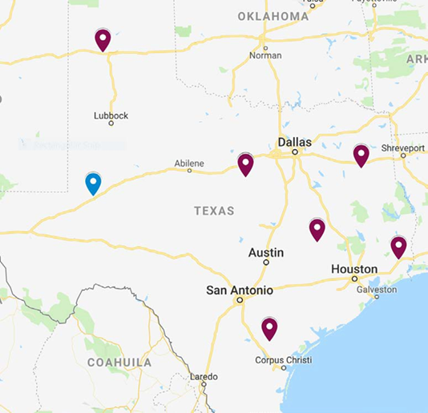
Texas Magnetometer Network
Using funding provided by a Governor’s University Research Initiative (GURI) award, we have deployed a network of six magnetometer’s around the state
  This network was setup by
  Computational Physics
  Inc. (CPI)
  Data is supplemented
  with an another
  magnetometer in Odessa
Data is available in real-
time to all Texas utilities;
measured every second

Slide 12
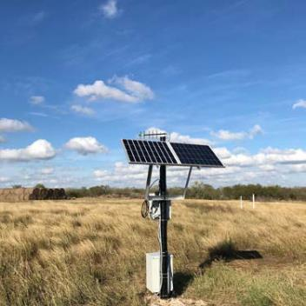
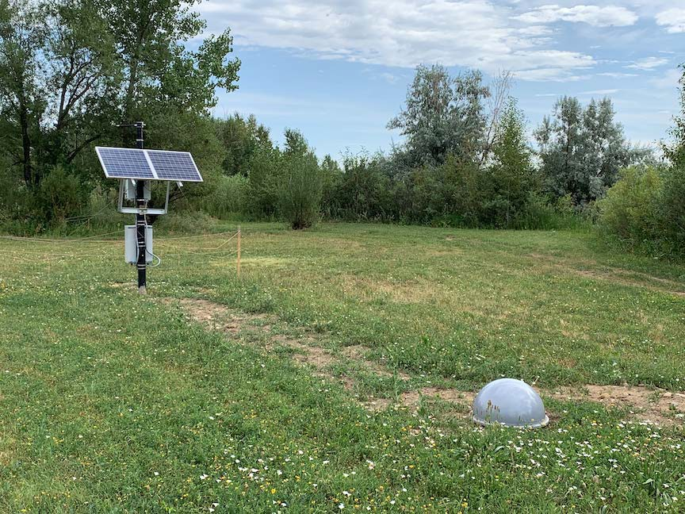
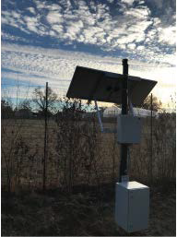
Magnetometer Setup
They are located on A&M property, are set for autonomous operation (solar), and connect through wireless via a secure communication.

Slide 13
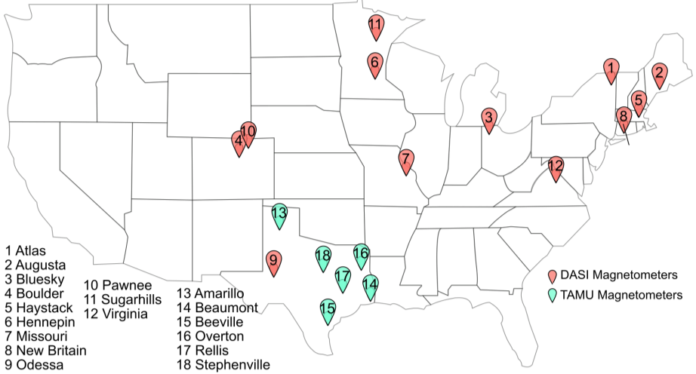
Using the Magnetometer Data
In addition to providing real-time data to utilities, the magnetometer data is being used to better understand the expected wide-area behavior of GMDs
We’re combining our data with data from other sources to
develop
better models
for the type
of GMD
behavior that
could be
expected

Slide 14
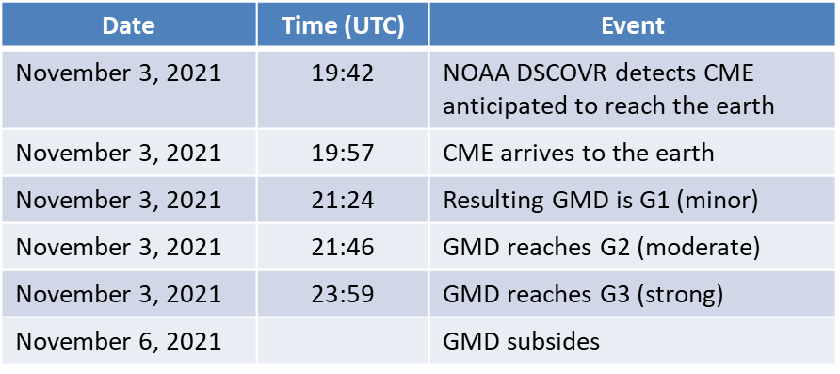
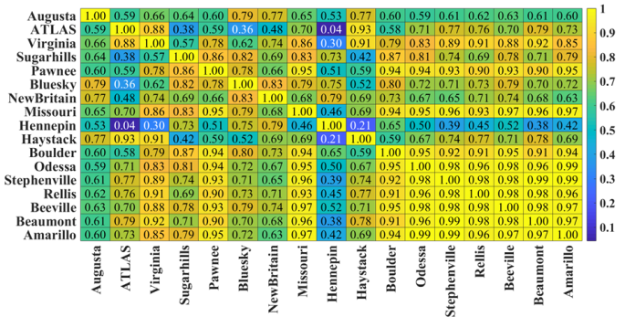
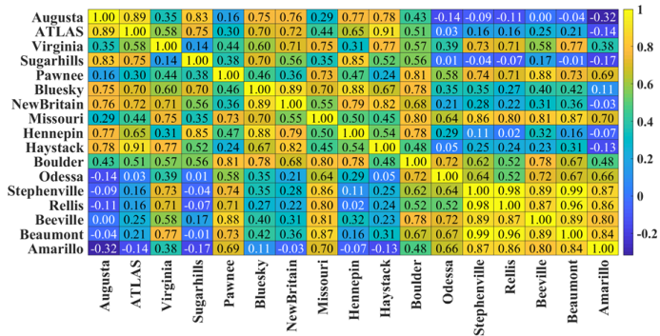
Example: 11/3/21 GMD Event
During the GMD the
magnetometers across the US became less
correlated

Slide 15
Developing Realistic Synthetic
GMD Scenarios
In order to develop GMD electric grid simulations and ultimately mitigation strategies, we need storm scenarios
Fortunately (from an operations perspective), but unfortunately from a scenario generation perspective, there are not many strong GMDs and no severe GMDs with large sets of measurements
Hence we need to use data extrapolation techniques to develop these synthetic storms.
There are two approaches for doing this: 1) data-only, 2) physics-based using coupled with data

Slide 16
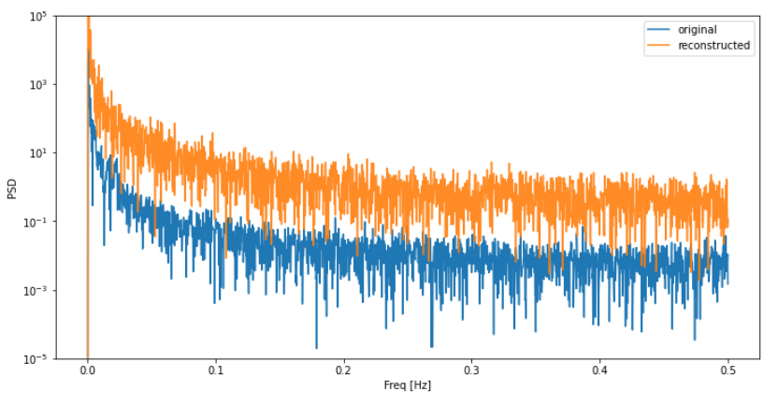
Developing Realistic Synthetic
GMD Scenarios
The data-only approach uses historical data to develop alternative, but similar storms
  We’ve looked at using an autoregressive model and a time-series generative adversarial network (GAN), a class of machine learning frameworks
  The problem with this
  approach is we have
  essentially no data
  associated with the
  largest GMDs
We are currently
researching physics-based approaches (including the electrojet) coupled with data

Slide 17

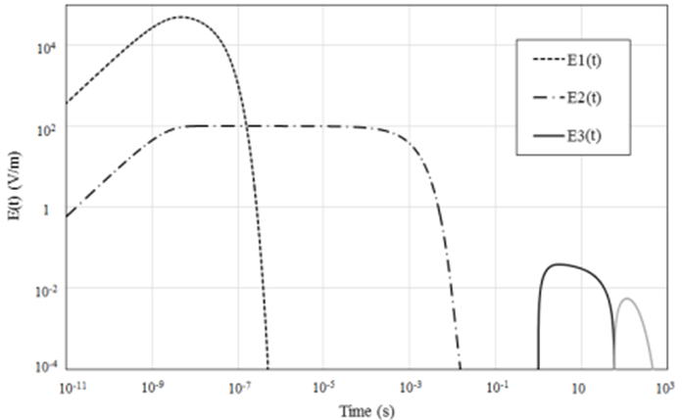
Quick Aside: HEMP E3 Impacts
GICs can also be generated by high-altitude electromagnetic pulses (HEMPs)
  Their response on the surface is typically divided into three waveforms: E1, E2 and E3; the E3 can look like a minutes long severe GMD
The 1.44 megaton, 400 kM Starfish Prime explosion observed on Maui in 1962, Source US EMP Commission
Report from July 2017

Slide 18
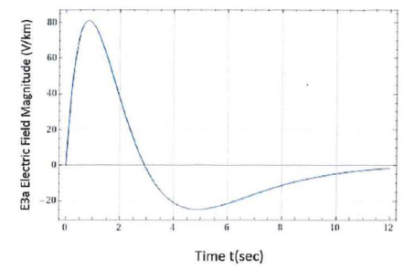
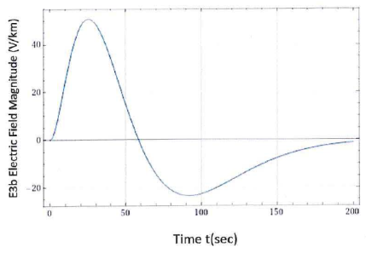
Quick Aside: DOE E3 Waveform
The E3 waveform is considered as two separate waveforms that are summed together
  E3a (blast waveform), E3b (heave waveform)
The electric field is impacted by the ground conductivity (10⁻³ S/m here);
with a smaller value (less conductive) giving higher electric fields; note the time scale difference for E3a (12 seconds) versus E3b (200 seconds)

Slide 19
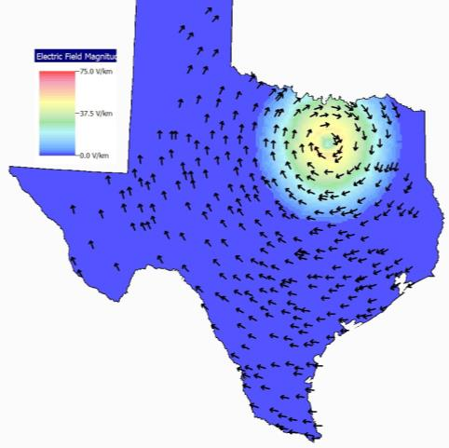
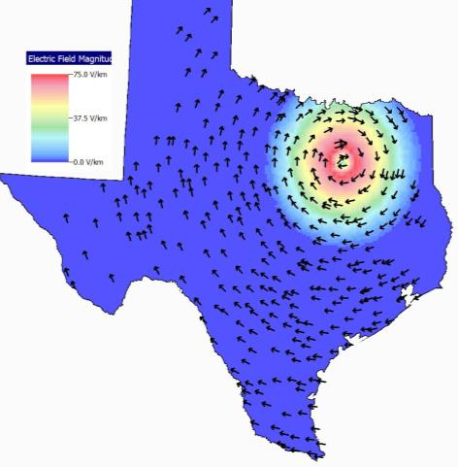
Quick Aside: The E3 Causes a Spatially and Time-Varying Field on the Ground
Non-classified versions of these waveforms have been developed
PowerWorld Simulator can directly read time-varying electric fields saved in the B3D format
The two images are synthetic electric fields at 15 and 25 second respectively; they are only intended for illustrative and testing purposes

Slide 20
Develop Better Solution Algorithms
A challenge with doing power flow and stability simulations in systems with high GICs is the reactive power consumption can be high, resulting in low voltages
  This can stress the solution algorithms
  The power flow can converge to alternative solutions
  The load models tend to break-down at low voltages
We are looking at several methods for improved solutions including more use of the power flow optimal multiplier approach
We’re also looking at better coupling with EPRI’s harmonic analysis tool (based on OpenDSS)

Slide 21
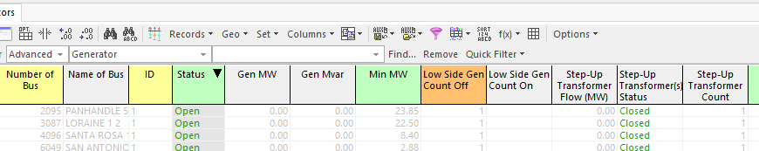
Key Modeling Insight: Make Sure the GSU Statuses are Correct
An important, but sometimes overlooked aspect of the case setup is that the GSUs should have correct statuses
  Usually a GSU is out-of-service when its generator is out-of-service, but there can be exceptions
Software now has fields to show and change the generator GSU statuses

Slide 22
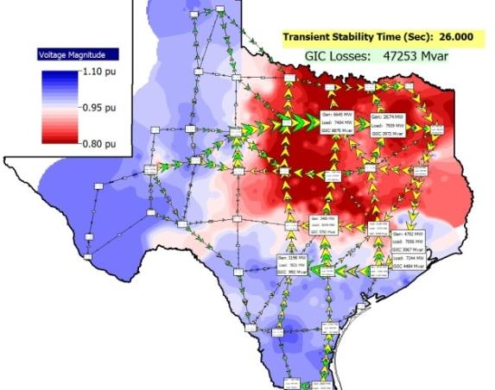
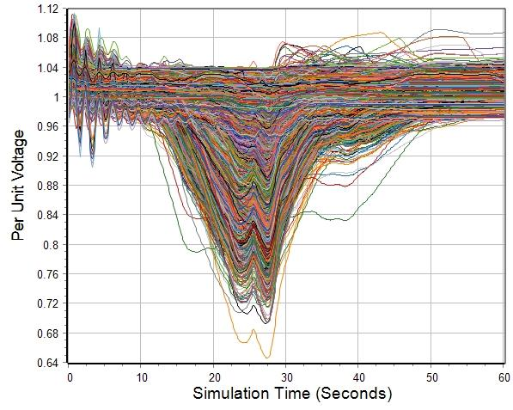
Example of Voltage Variation for a Severe GIC Scenario
Simulation was done using the Texas 2000-bus synthetic grid

Slide 23
TAMU EMS Simulation Environment
We are developing a simulation environment that includes a commercial EMS that will allow in-depth simulation of GMD or EMP events
Simulated Power System Including GMD and EMP Events
(PowerWorld DS)
Communication uses DNP3
Measurements
SCADA System
Measurements
State
Estimator
Power System Model and State (Dynamic)
Controls
Measurements
Automatic
Generator
Control (AGC)
Power
System
Electric
Model
(Static)
Advanced Applications (Online Power Flow, Contingency Analysis, SCOPF, Voltage Stability,
Dynamics)
Controls

Slide 24
Develop Improved Algorithms for GIC Mitigation
The ability to simulate severe events in power flow and stability programs allows for the development of mitigation approaches
We are currently doing research in this area, including the development of better sensitivity algorithms
Mitigation includes what could be done before an event and what can be done during an event

Slide 25
GIC Visualization and Storytelling
GICs present special visualization challenges
  The information associated with the standard power grid needs to be presented along with information associated with the GICs
  The GICs could cause the grid to be in a very unfamiliar operating configuration
Because the GICs are time-varying, there is a need to tell the story
of the entire
event

Slide 26
Some Example Visualizations

Slide 27
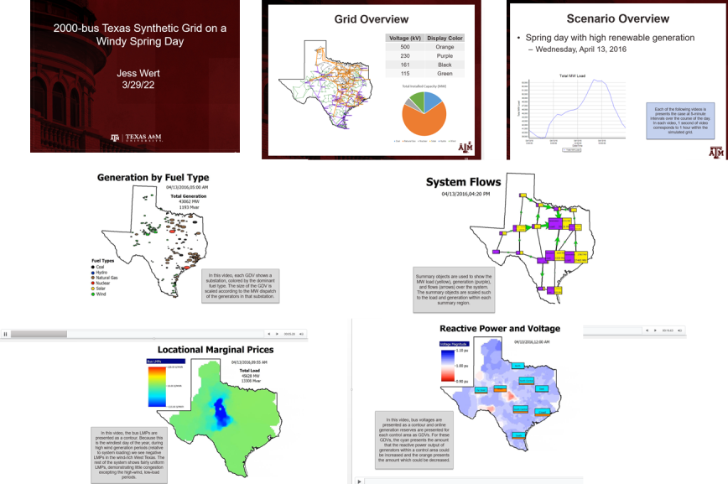
GMDs and Storytelling
A newer visualization approach we are pursuing is using storytelling techniques to show can could happen to the grid during a severe GIC event

Slide 28
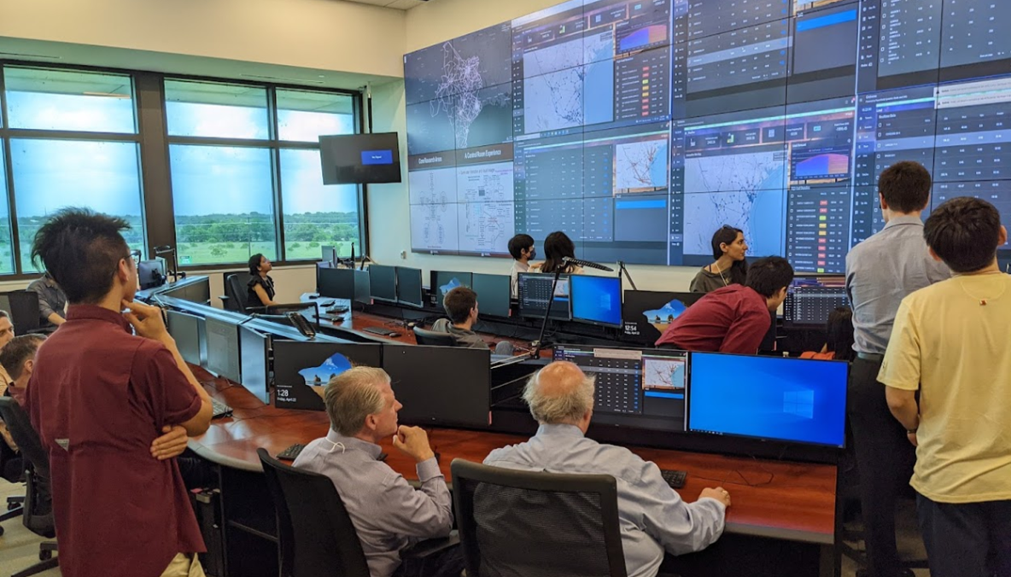
Questions? overbye@tamu.edu
All my recent papers (with several on GMD and EMP) are available for free download at overbye.engr.tamu.edu/publications/

