Slide 1
NPRR 1126 Default Uplift Allocation Design
May 2022

Slide 2
Disclaimer
DC Energy is not soliciting commodity pool business or investors or providing any advice via these materials or the related presentation. These materials and the related presentation are not an advertisement for investors or prospective investors or to the public generally. These materials are only for general information and discussion. The information included in these materials is not investment, trading or financial product advice.
The presentation may contain forward looking statements or statements of opinion. No representation or warranty is made regarding the accuracy, completeness or reliability of the forward looking statements or opinion, or the assumptions on which either is based. All such information is, by its nature, subject to significant uncertainties outside of the control of the presenter and DC Energy and also may become quickly outdated. These materials and the related presentation are not intended to be, and should not be, relied upon by the recipient in making decisions of a commercial, investment or other nature with respect to the issues discussed herein or by the presenter. To the maximum extent permitted by law, DC Energy and its officers, owners, affiliates and representatives do not accept any liability for any loss arising from the use of the information contained in these materials.

Slide 3
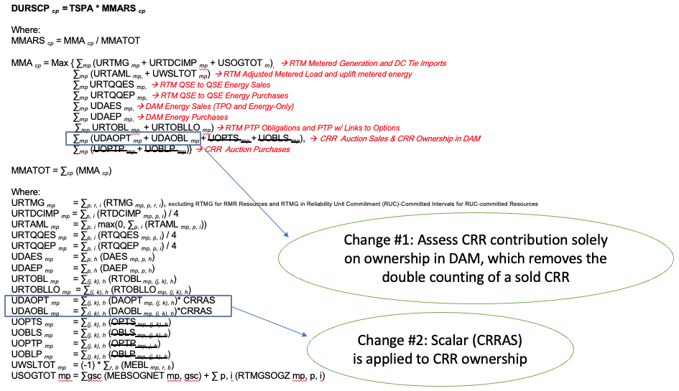
NPRR 1126 seeks two changes to the current ERCOT default uplift allocation process
NPRR 1126 Default Uplift Allocation Enhancement
–Changes to Protocol Formula (9.19.1 (2)) –

Slide 4
NPRR 1126 revises the current default uplift framework to address deficiencies with the current MW based allocation
Benefits of NPRR 1126
Adjusts the default uplift allocation process to better balance the burden of a default across all market activity
This helps avoid a high concentration of default uplift risk to a single product type, which lowers the risk of second order defaults
The allocation of 50% of a $2.9B default to CRR holders who participate in a market with an average annual value < $1B [measured by market-wide auction revenue or settlement] is unreasonable compared to the greater energy market value of ~$50B during the week of Storm Uri
Eliminating double counting and reducing the high concentration of default uplift risk to CRRs promotes market liquidity
Lowers the liquidity gap between buyers and sellers
Increased auction activity promotes robust forward price discovery
Improves the ability of CRRs to work together with the energy market to hedge forward risk
Allocating a disproportionate amount of default uplift to CRRs effectively penalizes hedging activity that is essential for managing basis risk and avoiding defaults in the first place

