Slide 1
PDCWG Report to ROS
Chair: Jimmy Jackson, CPS
Vice Chair: Vacant
ROS
May 5, 2022

Slide 2
Report Overview & Notes
Report Overview
Meeting Minutes
BAL-001-TRE-2 FMEs and IMFR
3 FMEs in the month of March
Frequency Control Report

Slide 3
Meeting Minutes
PDCWG Meeting 4/20/2022
SCR809 Presentation
Introduction of Analysis of High Wind Penetration Events
ERCOT Reports
TRE Report

Slide 4
Frequency Measurable Events Performance

Slide 5
Frequency Measurable Events
There were 3 FMEs in March
3/12/2022 10:21:03
Loss of 747 MW of generation
Interconnection Frequency Response: 1,737 MW/0.1 Hz
53 Resources were evaluated. These includes,
51 Generation Resources
2 Controllable Load Resources
0 Energy Storage Resources
5 of 51 Evaluated Generation Resources had less than 75% of their expected Initial Primary Frequency Response.
6 of 51 Evaluated Generation Resources had less than 75% of their expected Sustained Primary Frequency Response.

Slide 6
Frequency Measurable Events
There were 3 FMEs in March
3/14/2022 21:41:14
Loss of 440 MW of generation
Interconnection Frequency Response: 1,073 MW/0.1 Hz
41 Resources were evaluated. These includes,
39 Generation Resources
2 Controllable Load Resources
0 Energy Storage Resources
9 of 41 Evaluated Generation Resources had less than 75% of their expected Initial Primary Frequency Response.
15 of 41 Evaluated Generation Resources had less than 75% of their expected Sustained Primary Frequency Response.

Slide 7
Frequency Measurable Events
There were 3 FMEs in March
3/22/22 04:16:26
Loss of 703 MW of generation
Interconnection Frequency Response: 1,192 MW/0.1 Hz
46 Resources were evaluated. These includes,
44 Generation Resources
2 Controllable Load Resources
0 Energy Storage Resources
8 of 46 Evaluated Generation Resources had less than 75% of their expected Initial Primary Frequency Response.
6 of 46 Evaluated Generation Resources had less than 75% of their expected Sustained Primary Frequency Response.

Slide 8
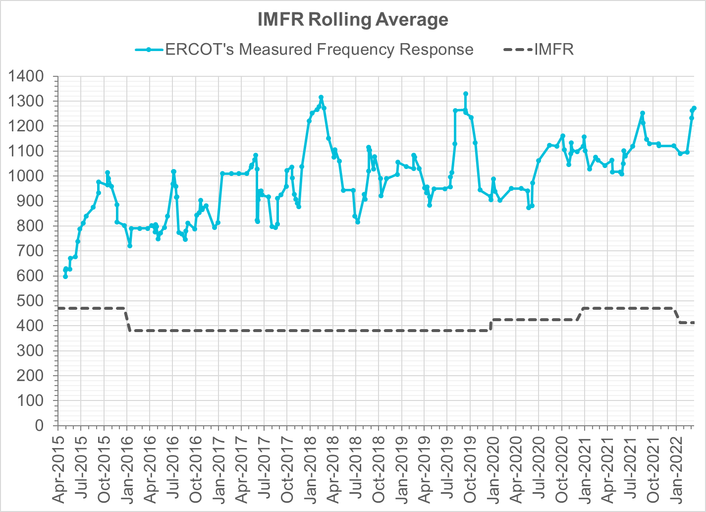
Interconnection Minimum Frequency Response (IMFR) Performance
IMFR Performance currently
1271.49 MW/0.1HZ
Frequency Response Obligation (FRO): 412 MW/0.1 Hz

Slide 9
Questions?

Slide 10
Frequency Control Report
March 2022

Slide 11
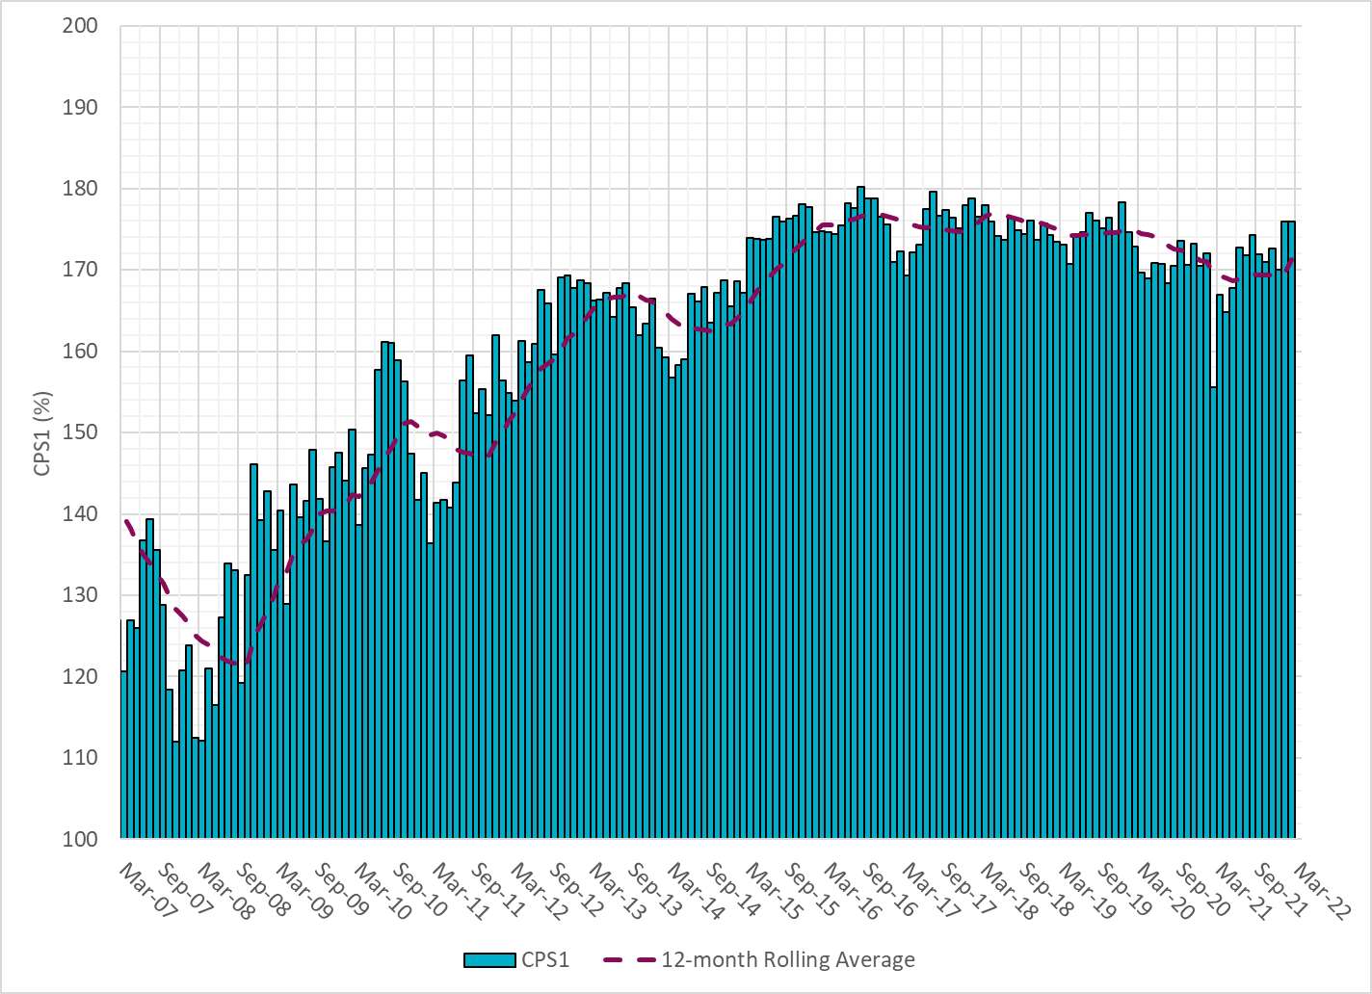
CPS1 Performance

Slide 12
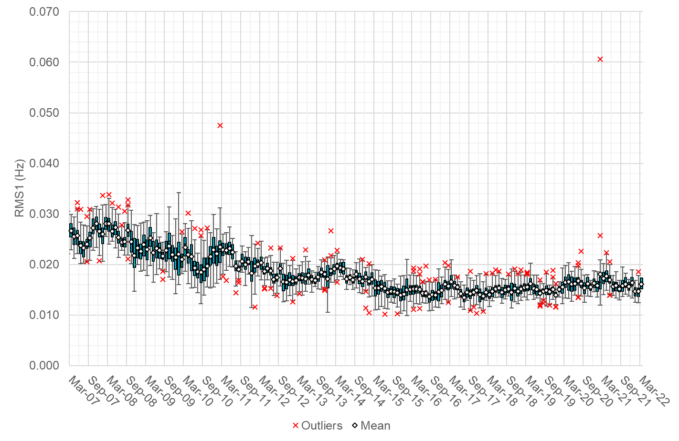
RMS1 Performance of ERCOT Frequency

Slide 13
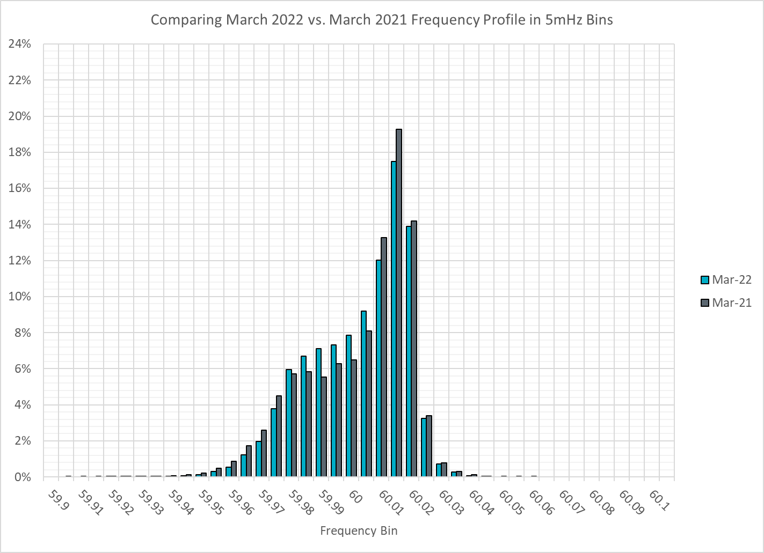
Frequency Profile Analysis

Slide 14
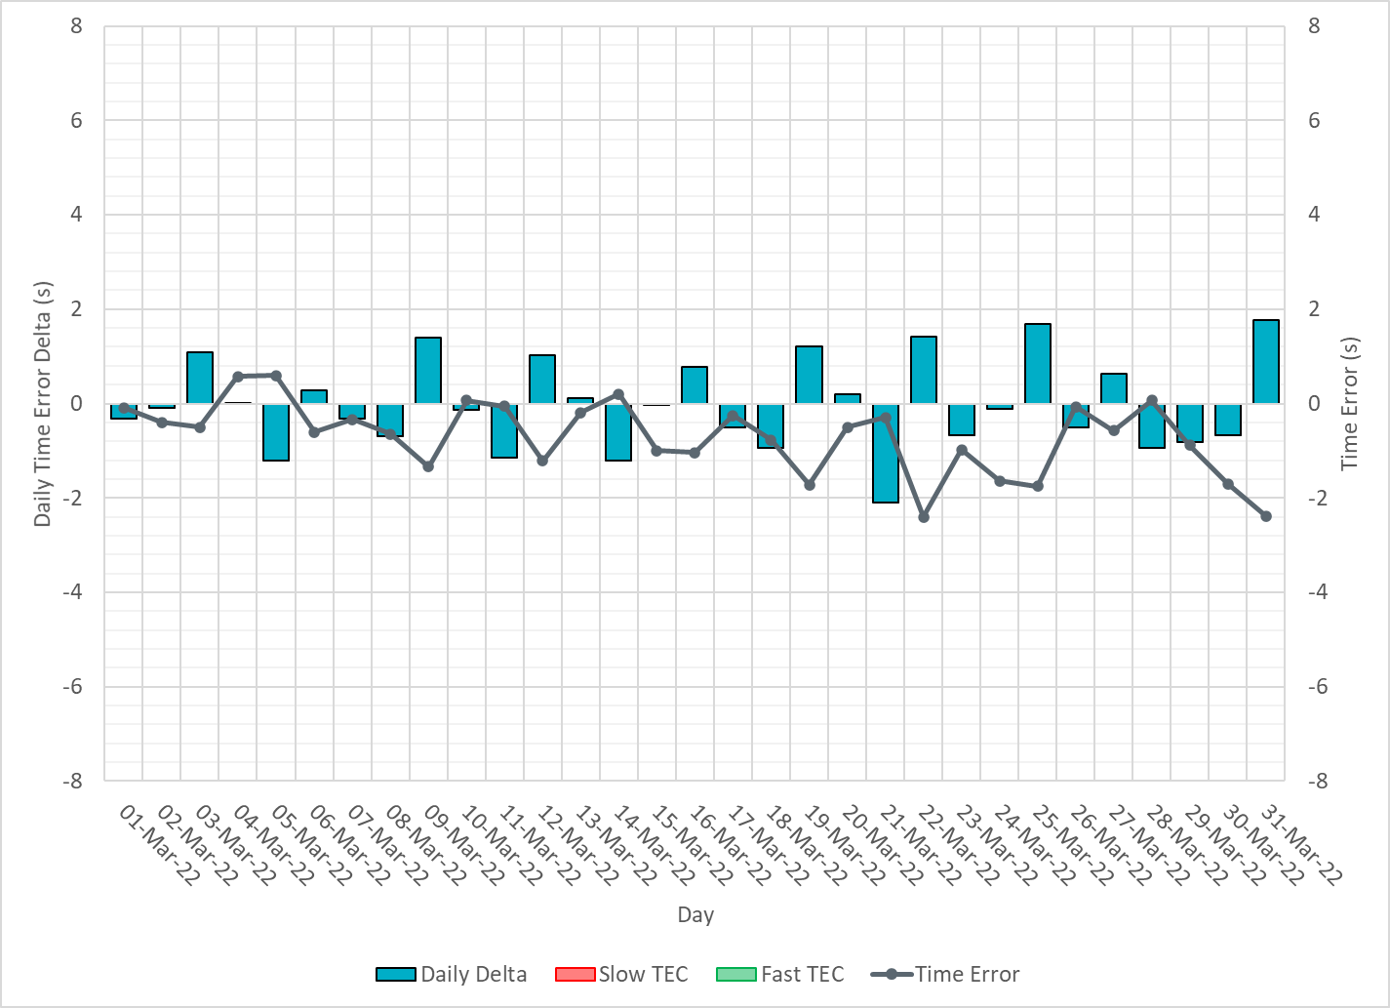
Time Error Corrections

Slide 15
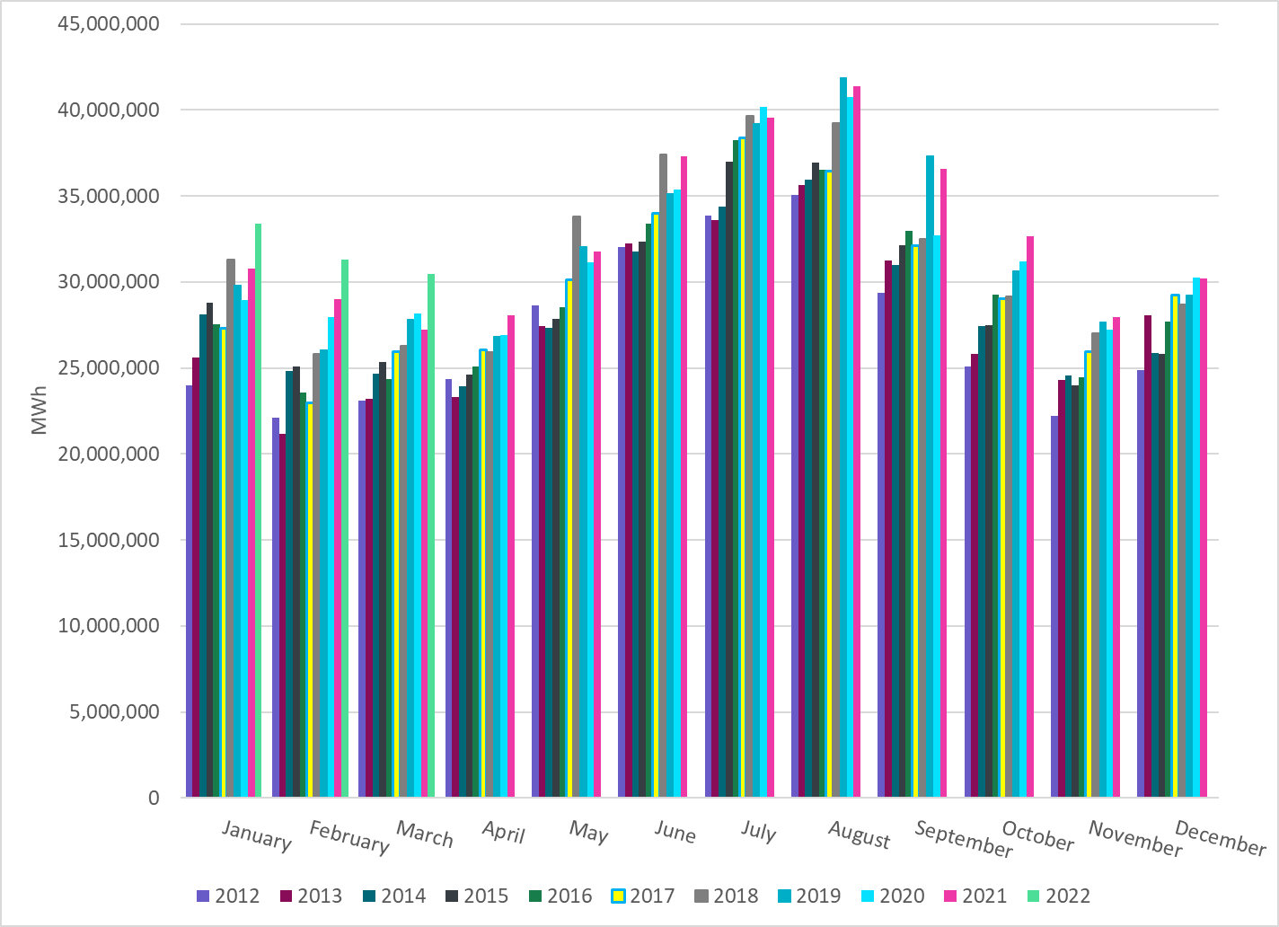
ERCOT Total Energy
Notes:
31,284,898 MWh

Slide 16
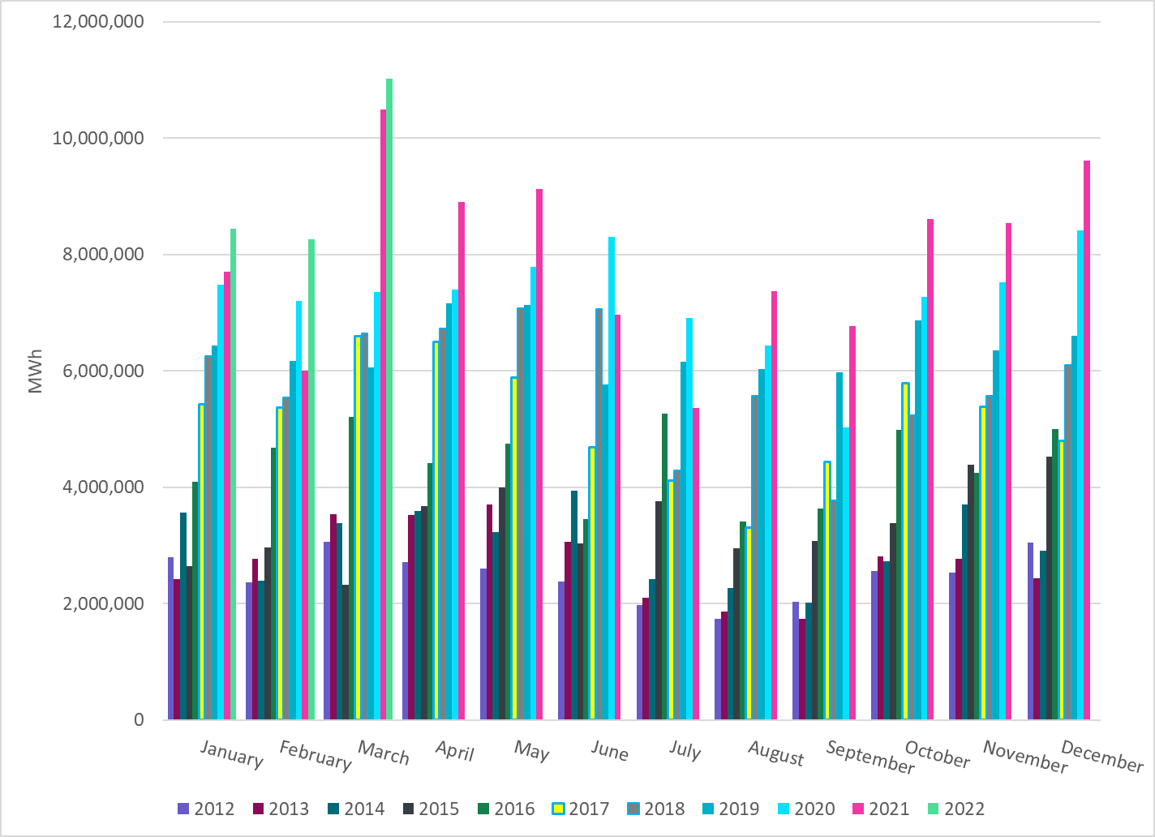
ERCOT Total Energy from Wind Generation
Notes:
8,261,666 MWh

Slide 17
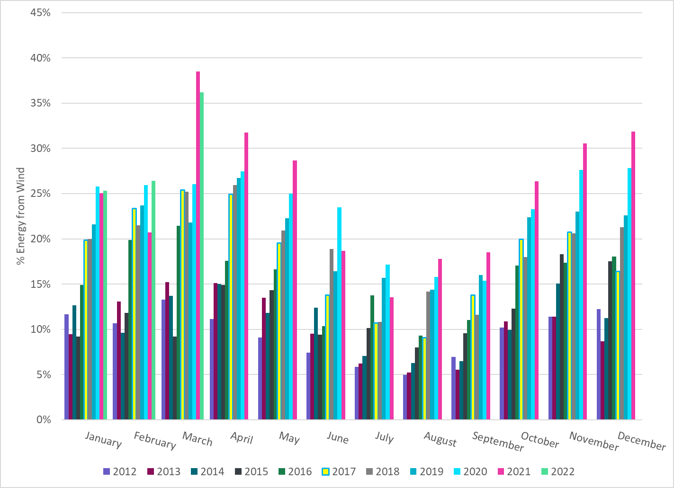
ERCOT % Energy from Wind Generation
Notes:
26.41%

Slide 18
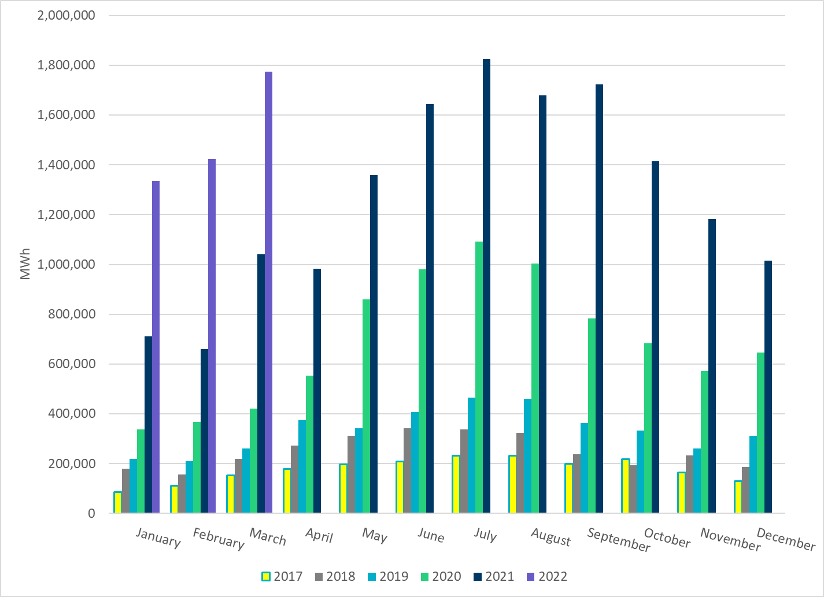
ERCOT Total Energy from Solar Generation
Notes:
1,423,230 MWh

Slide 19
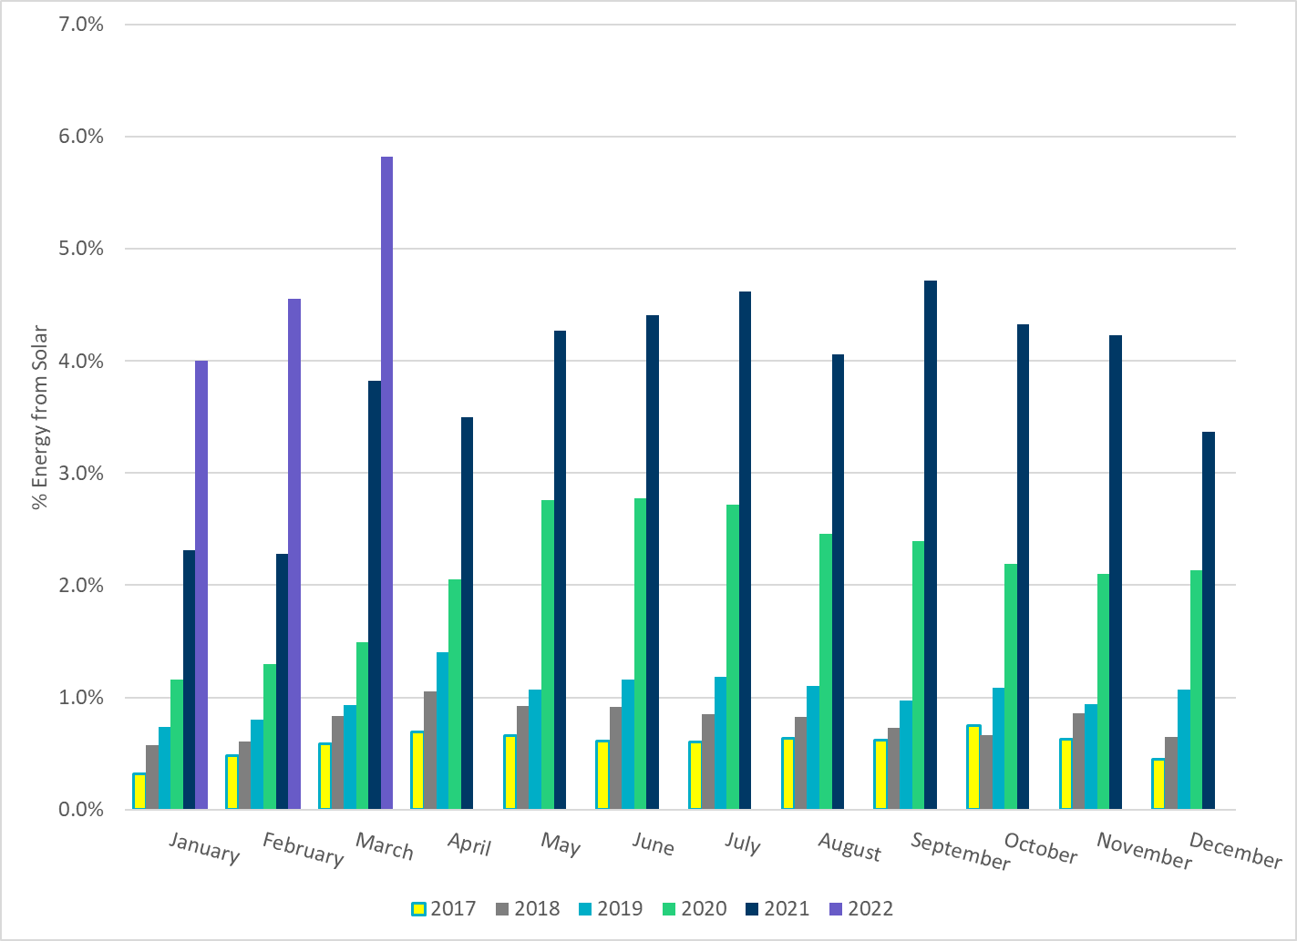
ERCOT % Energy from Solar Generation
Notes:
4.55 %

