Slide 1
2021 Voltage Reduction RFI
OWG
March 2022

Slide 2
Disclaimer
Of the 172 RFIs sent to TDSPs, 54 responses were received. All TOs responded, but many small local TSPs and DSPs (municipalities and co-ops) did not respond.
  Some TOs responded that they do not provide service at distribution voltage and have no Distribution Voltage Reduction (DVR) while their member TSPs and DSPs responded that they do have DVR.
  All values are slightly higher than values in February 2022 OWG meeting slides due to additional responses and clarifications.

Slide 3
ERCOT Distribution Voltage Reduction (DVR) Capability
 | Summer | Summer |  |  | Winter
ERCOT System Load (MW) | 60,000 | 70,000 | 80,000 | 55,000 | 65,000 | 75,000
1. Loads with DVR Capability (MW) | 17,538 | 20,715 | 23,958 | 16,903 | 20,214 | 23,596
i) SCADA Controlled (MW) | 7,183 | 8,459 | 9,752 | 8,278 | 9,882 | 11,514
2. Estimated Total MW Reduction From DVR | 453 | 551 | 655 | 459 | 564 | 674
i) SCADA Controlled (MW) | 193 | 243 | 298 | 238 | 298 | 363
ii) Manual (MW) | 260 | 308 | 357 | 222 | 266 | 311
Many entities have defined voltage reduction percentages. Most DVR programs starts at 2.5%.
  Examples:
    TO1 only has 1% voltage reduction.
    TO2 only has 2.5% voltage reduction.
    TO3 only has 2.5% and 5.0% voltage reduction.
At 5% Voltage Reduction, estimated MW reduction is less than 1% of ERCOT System Load.
Benefit of DVR is slightly higher in winter than summer. Better response from resistive load.

Slide 4
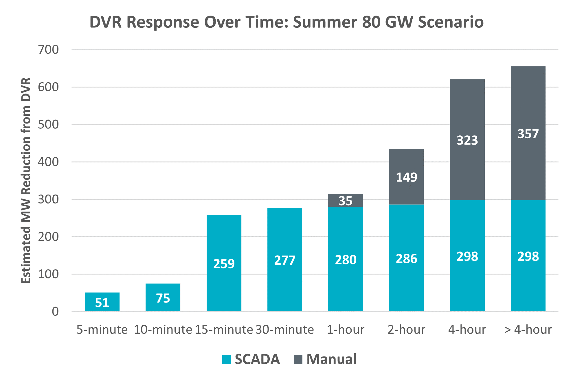
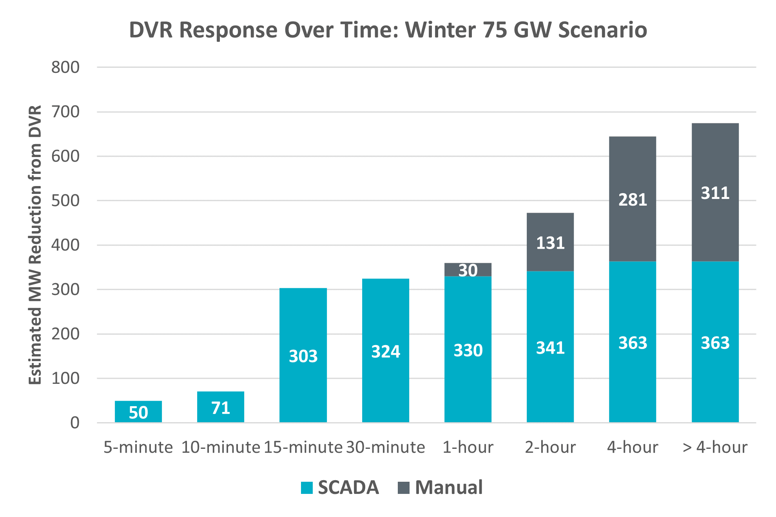
DVR Response Over Time
Most of the SCADA-controlled DVR can respond within 15 minutes, but a small portion may take close to 4 hours to respond.
Majority of Manual DVR requires 2 hours or longer to implement.
More DVR are SCADA-controllable during winter than summer due to changes in load composition.

Slide 5
Distribution Voltage Reduction (DVR)
7 out of 21 Transmission Operators (TOs) have DVR.
Some TOs do not have DVR to implement in response to ERCOT instruction, but continuously uses the Volt/Var optimization program.
One TO implements DVR only during summer.
Maximum DVR duration typically ranges from 15 minutes to 4 hours.
Typical response for TOs with the DVR program:
Voltage Reduction Percentage | DVR Response (Load Reduction %)
At 1% | <1%
At 2.5% | 1-2%
At 5.0% | 2-3%

Slide 6
Distribution Voltage Reduction Implementation Factors
Load Composition. DVR Capability may increase as the portion of:
  Resistive Load (lights, heaters) increases
  Industrial and Transmission Load decreases. Most of these loads are excluded from the DVR program.
System Topology: Long radial lines reduce DVR Capability.
Distributed Generation (DG) Penetration: Currently, TDSPs require DGs to operate at a unity power factor which decreases DGs’ MW output when voltage decreases. Some entities are working toward setting voltage setpoint instructions for DGs.

Slide 7
Barriers to Increase DVR with SCADA Control
Requires additional communication equipment and control updates.
  Multi-year, multi-million-dollar investment.
Some RFI responses questioned the estimated benefits vs. cost.
Physical Limitations:
  Existing Transformers’ Capability.
  Maintaining Voltage Limits especially for long radial circuits to prevent equipment damage.

