Slide 1
IBR Ride-Thru Failure Events
Monthly Update
IBRTF Meeting
April 8, 2022

Slide 2
Jan/Feb IBR Ride-Thru Failure Events
The following events were identified as loss of solar generation after a system fault or voltage disturbance seen in RT PMU data. RFIs were sent on 3/10 with due date of 4/1.
Event #1 – 1/20 @ 9:40 AM
Event Description:
2 units at same plant lost a combined 123 MW (Unit 1 – 110 MW; Unit 2 – 13 MW)
Unit 1 fell to 0MW and began ramp up in 15 sec. and reached ½ output in 1.5 min.
Unit 2 reduced 15% output and came back to full in 15 sec.
Same inverters as other plants tripping on AC overvoltage
No identified forced outages in FOD during event
RFI Response and Follow Up Actions:
Failed MV transformer at site caused one feeder breaker to open
All other inverters entered momentary cessation after transformer failure, of which the RE was unaware until receiving RFI
Still in process collecting information on applicable inverter fault codes, momentary cessation settings, and oscillography records
Potential changes to inverter protection settings are being evaluated with OEM; no changes made yet

Slide 3
Jan/Feb IBR Ride-Thru Failure Events
Event #2 – 2/9 @ 2:14 PM
Event Description:
Single unit trip while generating 116 MW
Began ramping up 3 min. later but only reached 35% output. Full output following day.
Unit tripped during 6/26/2021 event while in commissioning process. Inverter type not found in any other events.
RFI Response and Follow Up Actions:
Granted extension on RFI until 4/8

Slide 4
Jan/Feb IBR Ride-Thru Failure Events
Event #3 – 2/11 @ 2:33 PM
Event Description:
Single unit run back and trip over ~25 sec. while generating 98.6 MW
Unit began ramping 3 min. later and full output reached < 4 min. after fault
Unit came online in Jan. 2022 and inverter type not seen in other events
RFI Response and Follow Up Actions:
Voltage disturbance recorded at time of event inconsequential
Unit not yet commercial and loss of generation occurred during reactive testing when Cap bank switched in service but MPT load tap changer did not adjust in timely manner
All 33 inverters tripped on overvoltage as a result
Inverter overvoltage protection settings and LTC controller settings were changed to prevent repeat of condition
No ERCOT follow up actions at this time

Slide 5
Jan/Feb IBR Ride-Thru Failure Events
Event #4 – 2/12 @ 9:07 AM
Event Description:
Single unit trip while generating 123 MW; did not generate until next day
Plant E from NERC table of 5/9 unit reductions that had feeder breakers trip on underfrequency
Same inverter as other plants tripping on AC overvoltage
RFI Response and Follow Up Actions:
Failure of MW transformer caused a SLG fault and tripped a feeder breaker
Feeder breaker trip caused an undervoltage event within the site, causing the rest of the feeder breakers to trip
3 feeder breakers were closed that night and the last the following day
Evaluation of potential changes to inverter protection settings are being discussed with OEMs

Slide 6
Jan/Feb IBR Ride-Thru Failure Events
Event #5 – 2/17 @ 4:52 PM
Event Description:
3 units at 2 different sites with same POI
Single unit in Site #1 tripped while generating 180.5 MW. Began ramping 10 sec. later and reached 78% output 1.5 min. after trip.
Two units at Site #2 lost a combined 28 MW and returned to full output ~10 seconds later. Site #2 same as Event #1
All three units same inverter type as other plants tripping on AC overvoltage
RFI Response and Follow Up Actions:
MV transformer failure at Site #1 caused feeder breaker to open.
All other inverter at Site #1 entered momentary cessation, of which RE was not aware until receiving RFI.
33 inverters (of 372) at neighboring Site #2 entered momentary cessation; RE unaware
Site #1 recorded fault code records for Phase Jump, Under Freq., and Under Voltage
Both sites still in process of retrieving momentary cessation settings and oscillography records
Both sites are evaluating potential changes to inverter protection settings with OEM

Slide 7
March Events
No solar events in which a fault or significant voltage disturbance detected at time of loss of generation
Several events in which single site lost >100 MW
Seeing some solar farms with multiple events and will start sending RFIs for these
One such RFI due on 4/1 but granted extension
Most significant event was several windfarms in Panhandle either tripping or reducing output after system fault on 3/22

Slide 8
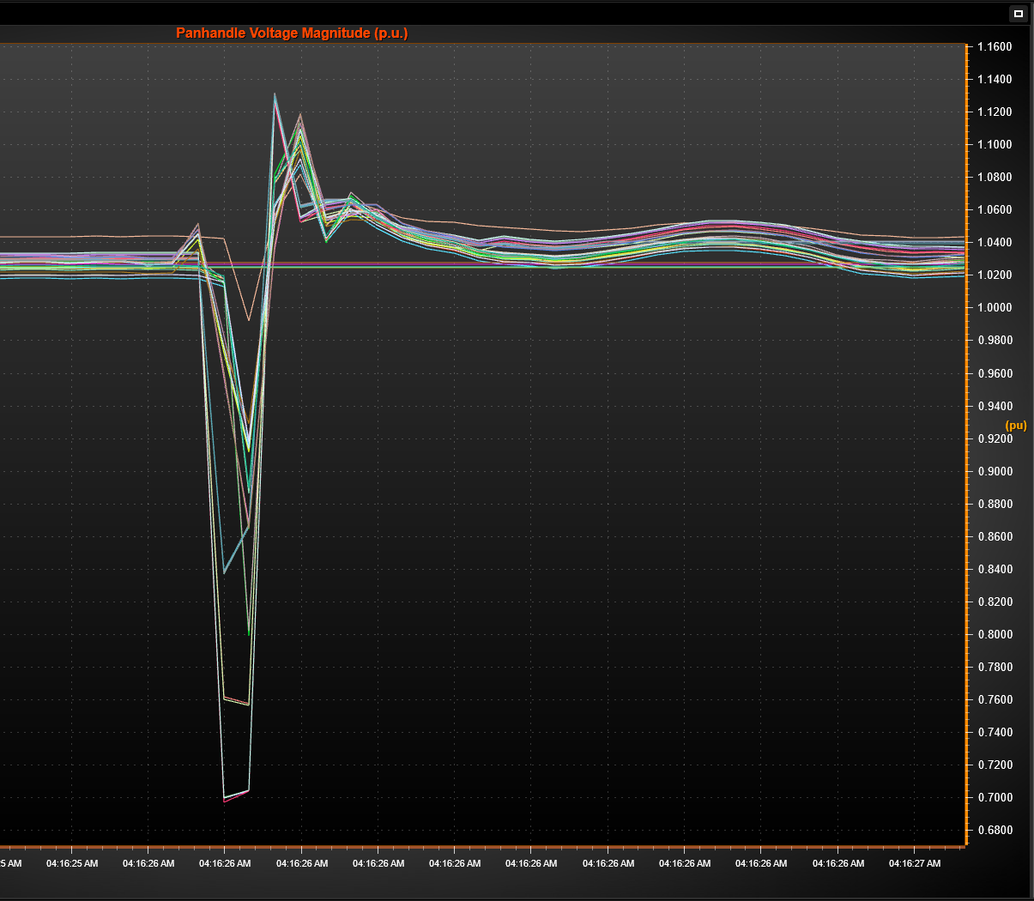
Panhandle Windfarm Event 3/22
Event #1 – 3/22 @ 4:16 AM
A-B phase fault lasting 3.38 cycles on transmission line from large Panhandle substation to windfarm (line owned by windfarm and tripped)
Windfarm was generating a combined 273 MW which was lost due to line trip
Voltage at substation dropped to 0.7pu (345kV) and highest voltage or 1.132pu recorded at nearby substation
Nearby windfarms lost combined ~410 MW following fault with varying recovery times
Total loss ~680 MW
Frequency dropped from 60.008 Hz to 59.904 Hz (PI)

Slide 9
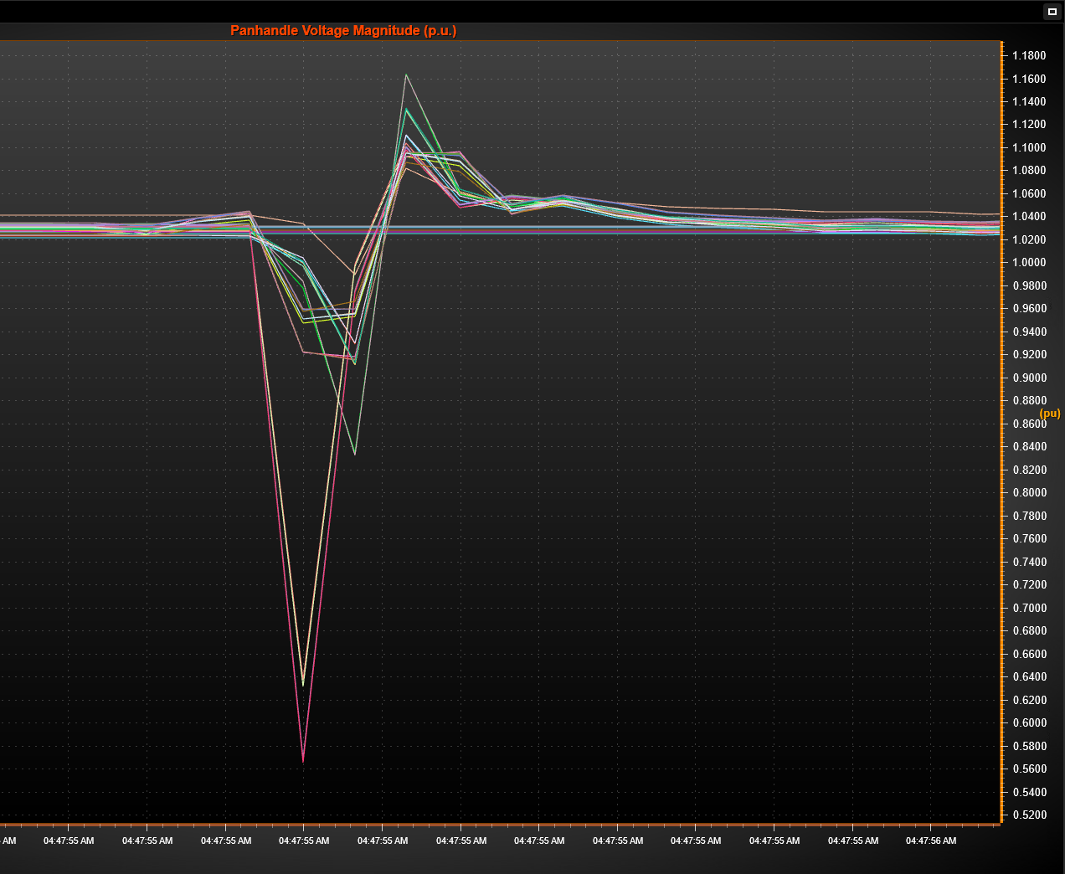
Panhandle Windfarm Event 3/22
Event #2 – 3/22 @ 4:48 AM
B-C phase fault lasting 2.88 cycles on transmission line between two large Panhandle substations (line trips)
Voltage at substation dropped to 0.567pu (345kV) and highest voltage or 1.163pu recorded at nearby substation
Nearby windfarms lost combined ~440 MW following fault with varying recovery times
Frequency dropped from 59.998 Hz to 59.942 Hz (PI)

Slide 10
Event 1 Generation Loss
Plant* | Pre-Disturbance MW | Lowest MW (SCADA) | MW Reduction | Recovery Time | RFI
Plant A | 133 | 119 | 14 | Sub-second | No
Plant B | 181 | 157 | 24 | Minutes | Yes
Plant C** | 273 | 0 | 273 | Hours | No
Plant D | 456 | 412 | 44 | Minutes | Yes
Plant E | 188 | 152 | 36 | Seconds/ Sub-second? | Not Yet
Plant F | 260 | 165 | 95 | Minutes | Yes
Plant G | 156 | 120 | 36 | Minutes | Yes
Plant H | 54 | 43 | 11 | Sub-second | No
Plant I | 165 | 104 | 61 | Minutes | Yes
Plant J | 183 | 97 | 86 | Seconds/ Sub-second? | Not Yet
*Units at each site aggregated; 10 MW combined reduction minimum
**Tripped off with transmission line

Slide 11
Event 2 Generation Loss
Plant* | Pre-Disturbance MW | Lowest MW (SCADA) | MW Reduction | Recovery Time | RFI
Plant B | 178 | 147 | 31 | Seconds | Yes
Plant D | 462 | 349 | 113 | Units vary | Yes
Plant E | 190 | 159 | 31 | Seconds/ Sub-second? | Not Yet
Plant F | 247 | 201 | 46 | Minutes | Yes
Plant G | 154 | 43 | 111 | Minutes | Yes
Plant H | 47 | 27 | 20 | Sub-second | No
Plant I | 154 | 100 | 54 | Minutes | Yes
Plant J | 171 | 135 | 36 | Seconds/ Sub-second? | Not Yet
*Units at each site aggregated; 10 MW combined reduction minimum

Slide 12
PMU vs SCADA for Analysis
*Plant A from previous slide

Slide 13
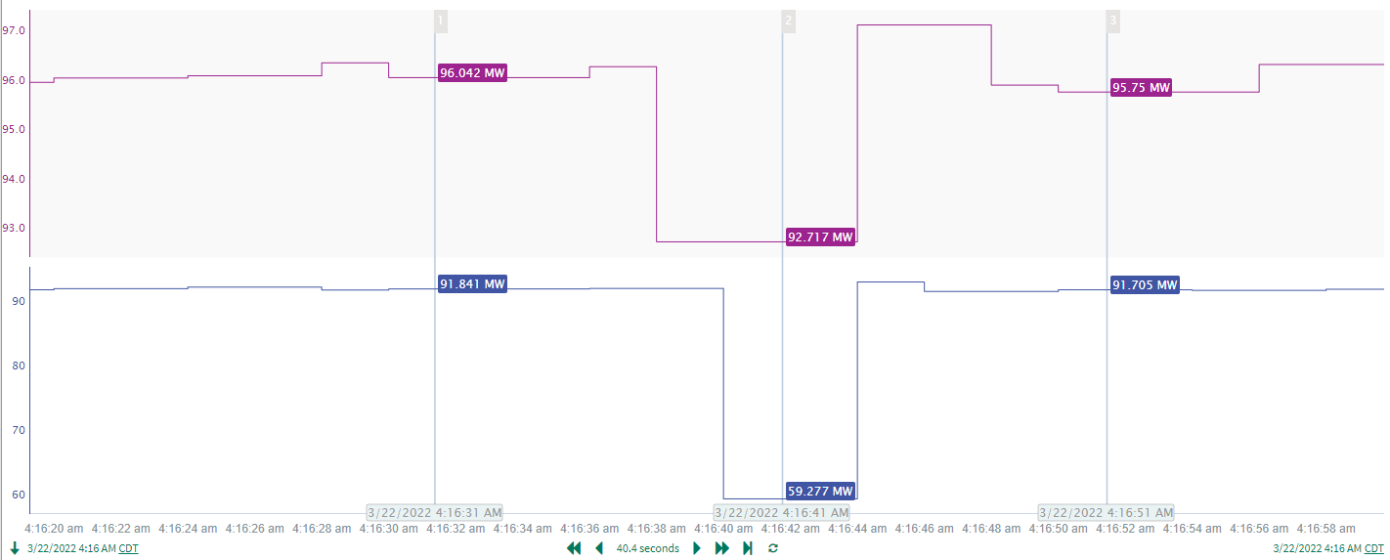
PMU vs SCADA for Analysis
*Plant E from previous slide

Slide 14
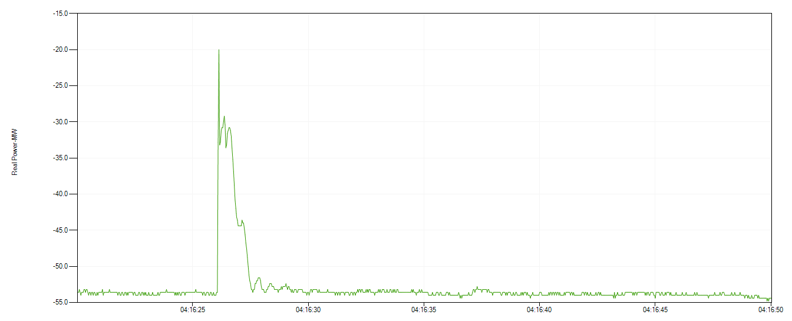
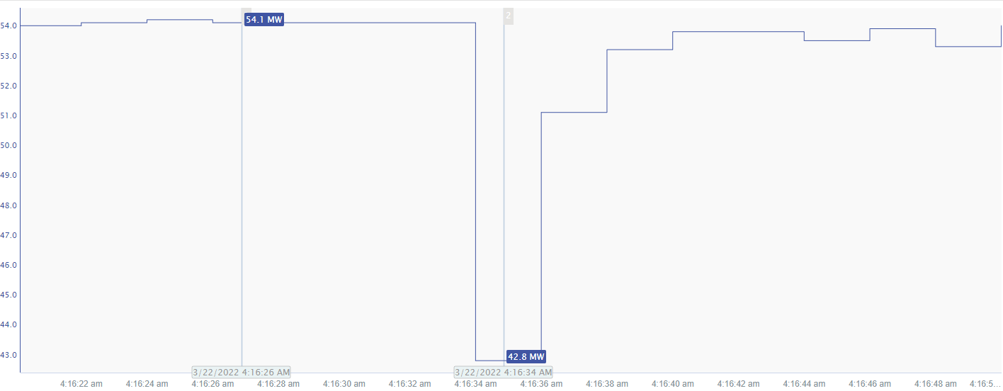
PMU vs SCADA for Analysis
*Plant H from previous slide

Slide 15
Misc. Notes from Panhandle Events
Have not received any usable PMU data; only have access to RT PMU data being streamed from ONCOR
Windfarms commissioned pre-2017; PMU data not required
Have received DFR event files from 5 plants; time consuming going through files and calculating power flows
Difficult to determine actual losses from SCADA data
RFIs due 4/12
Could possibly be Category 1j NERC event
A non-consequential interruption of inverter type resources aggregated to 500MW or more not caused by a fault on its inverters, or its ac terminal equipment.

Slide 16
Questions?

