Slide 1
Status Update for Odessa Disturbance
IBRTF Meeting
April 8, 2022

Slide 2
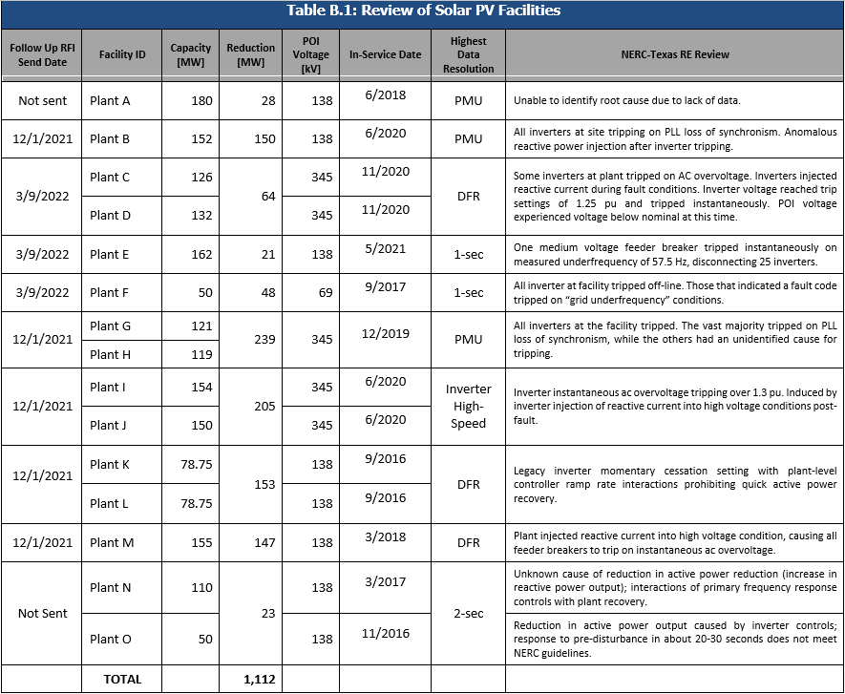
Plants Identified in NERC Odessa Disturbance Report
Table B.1 from NERC’s Odessa Disturbance Report

Slide 3
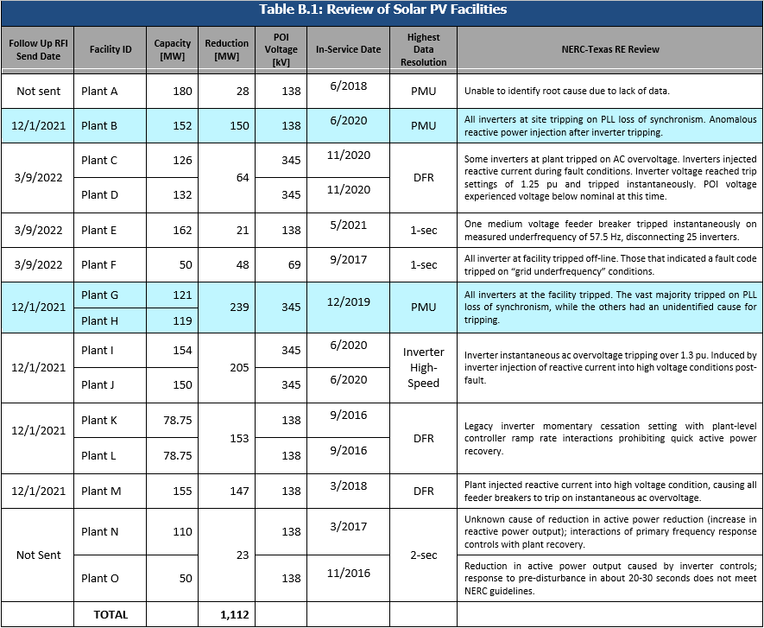
Plant Trips Due to Loss of Synchronization

Slide 4
Plant Trips Due to Loss of Synchronization
Both plants have TMEIC PVH-L3360 inverters
Loss of synchronization protection setting disabled for both plants
Additional plant with TMEIC PVH-L3360 inverters also disabled loss of synchronization setting
No other plants in ERCOT with TMEIC L3360 model inverters
Waiting for confirmation if other TMEIC inverter types are at risk for tripping on loss of synchronization
Need to follow up about potential model changes and resubmittal

Slide 5
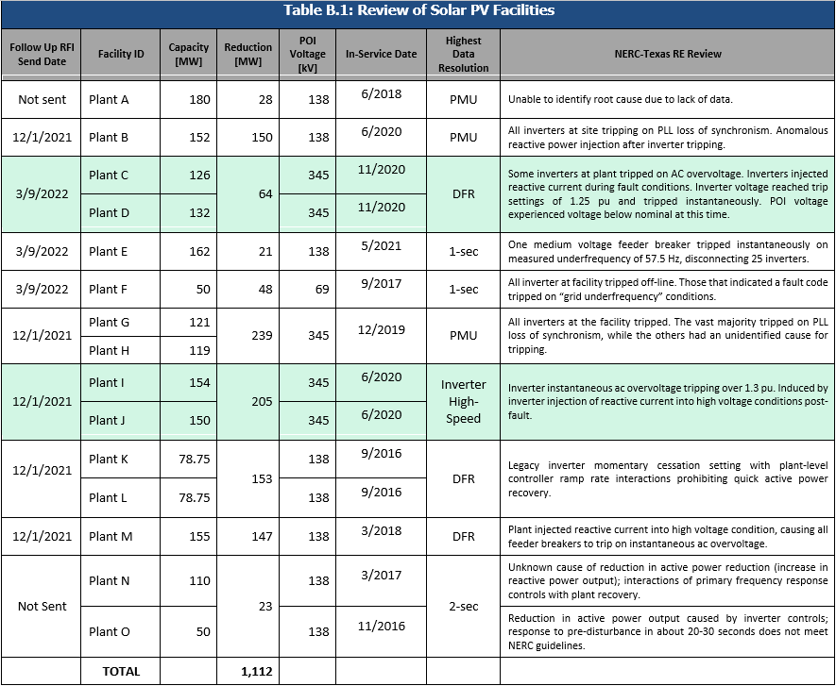
Plant Trips on Inverter Terminal Overvoltage

Slide 6
Plant Trips on Inverter Terminal Overvoltage
Both plants have TMEIC PVU-L0840 inverters
Both plants had inverters trip on instantaneous overvoltage above 1.25 pu at inverter terminals (POI voltage was in the 1.1 pu range)
Plant I/J stated they cannot relax overvoltage protection settings but would be amendable to evaluating reactive injection in response to low voltage events to better ride through
TMEIC has agreed with assessment and willing to work with RE about possible k-factor adjustment on DVC
ERCOT facilitating discussions and will use similar methods with Plant C/D and other plants with TMEIC L0840 inverters (20 plants in ERCOT with similar inverters)
ERCOT to conduct study comparing Short Circuit Ratios of POIs

Slide 7

Plant Trips with OEM#2 Inverters

Slide 8
Plant Trips with OEM#2 Inverters
ERCOT to schedule meeting with OEM#2 reps to discuss these two plant inverter trips
Plant K/L has legacy inverters with momentary cessation that cannot be disabled
Plant level controller prohibiting inverter ramp rate from recovering within 1 second
Plant M disabled feeder overvoltage protection and verified inverter terminal VRT requirements outside “No Trip Zone”
Plant M still may be susceptible to inverter overvoltage tripping
ERCOT to follow up with both plants after meeting with OEM#2

Slide 9
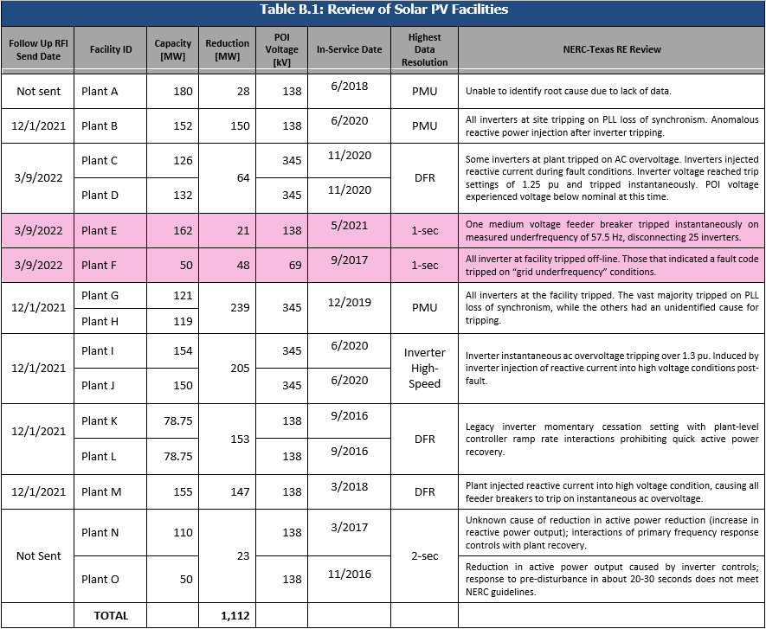
Plant Trips Due to Underfrequency

Slide 10
Plant Trips Due to Underfrequency
Follow up RFIs went out to both plants on 3/11
Plant E response stated they don’t believe frequency measurement that caused feeder breaker trip for < 57.5 Hz was erroneous
ERCOT may need to reach out to relay manufacturer to resolve issue
Plant E still evaluating potential changes to voltage/frequency settings for PRC-024-3 curves
Still waiting on response for Plant F

Slide 11
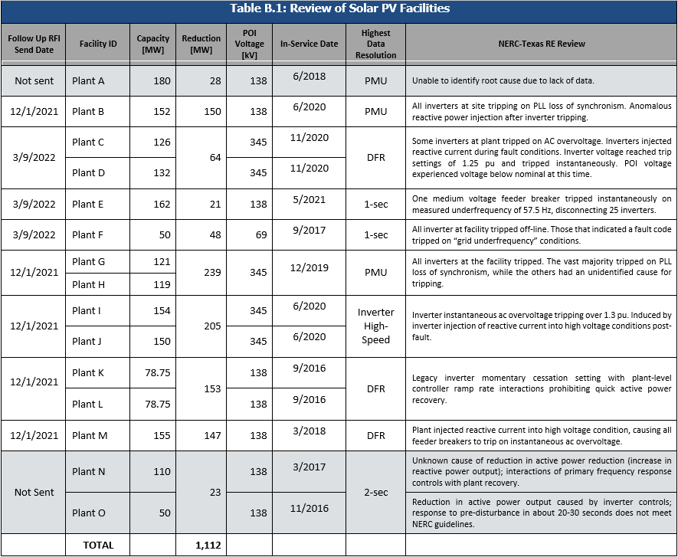
Plant Trips for Undetermined Reasons

Slide 12
Plant Trips for Undetermined Reasons
Both plants have OEM#3 inverters
OEM#3 no longer in business; ERCOT needs to find contacts for current service contract providers
Both plants had limited availability to data and troubleshooting capabilities
Unlikely to receive new information from additional RFIs
ERCOT will need to schedule meetings to discuss capabilities for retrieving data for new events

Slide 13
Questions?

