Slide 1

ERCOT Large Flexible Load Task Force Meeting
April 22nd 2022
Steve Kinard
steve@texasblockchaincouncil.org

Slide 2
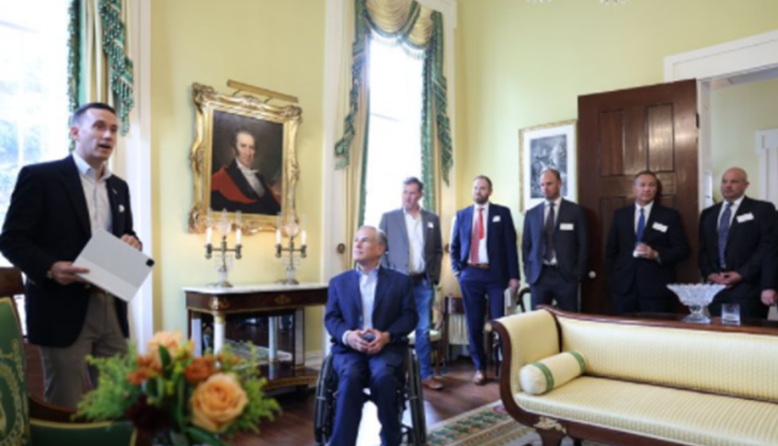
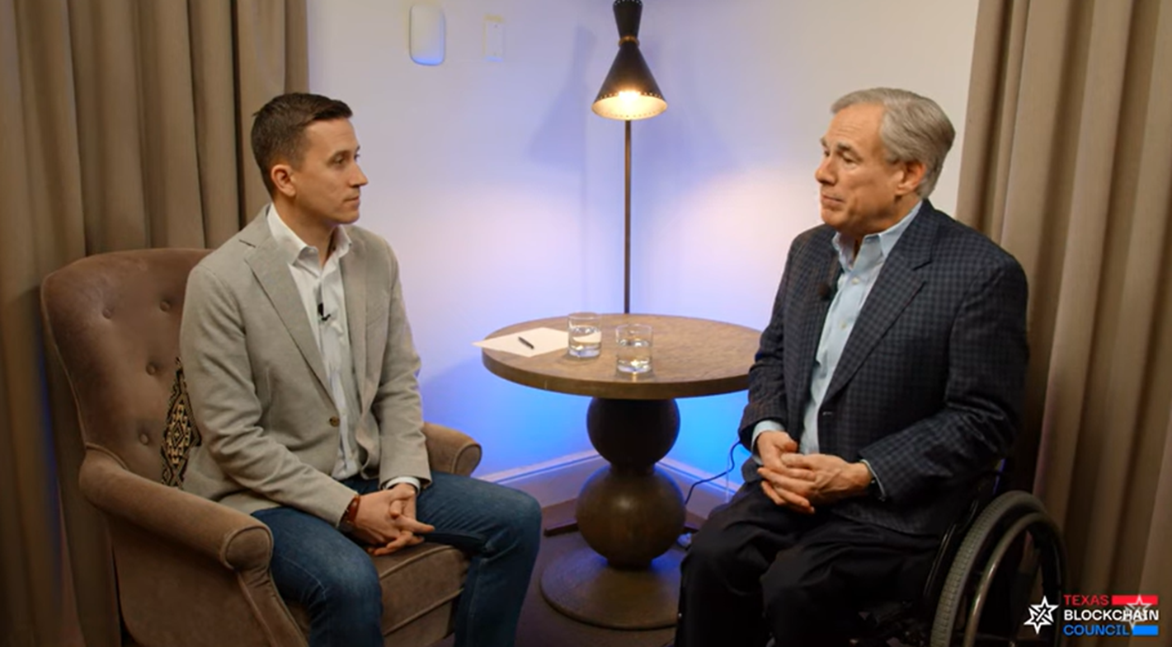
Who We Are
The Texas Blockchain Council is a nonprofit industry association that serves as the unified voice of the bitcoin mining and blockchain industry in the Texas Legislature.
Thanks to the recent efforts of the TBC, elected leaders, industry partners and bitcoin and blockchain community, Texas has been elevated to a position of global leadership in our industry (HB 4474, HB 1576, Texas Dept. Of Banking Guidance).

Slide 3
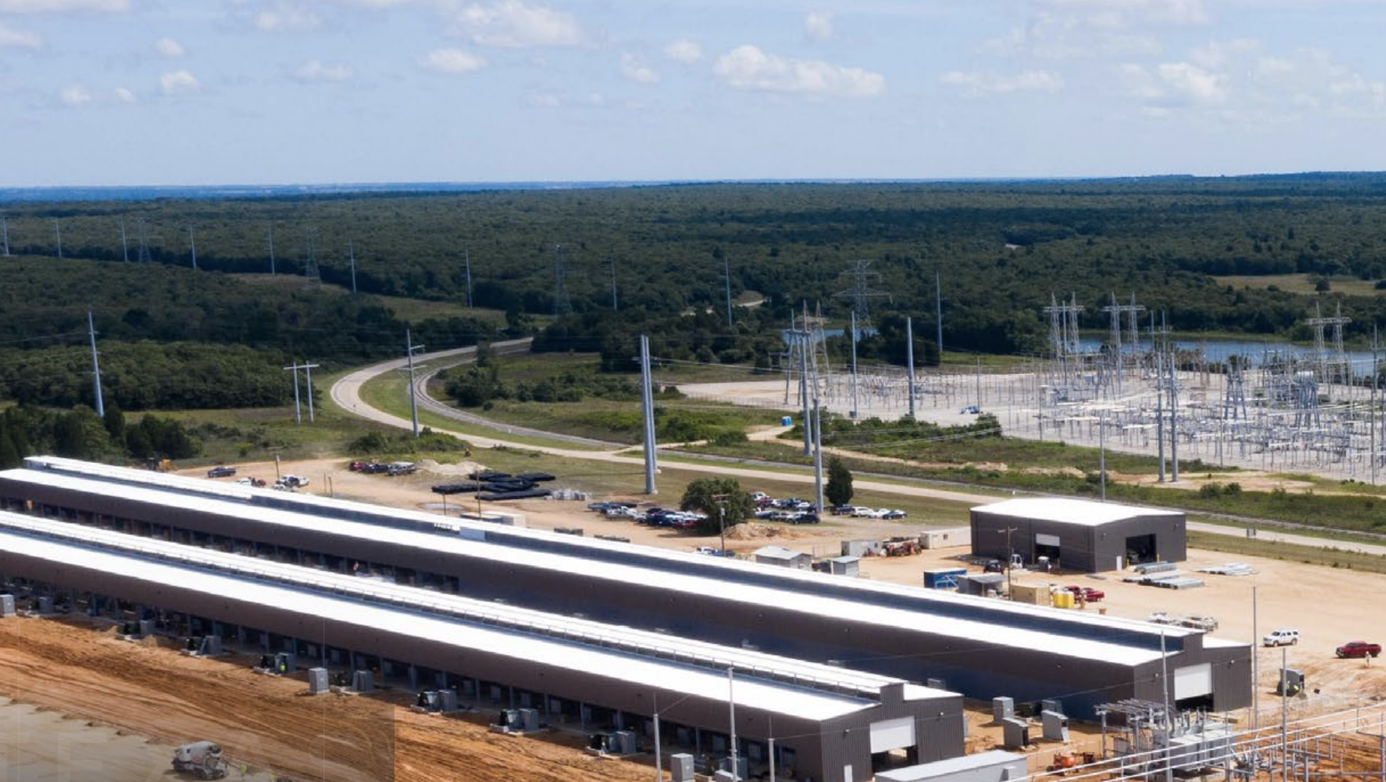
Texas Is A Leader In Bitcoin Mining
Texas has a long history of being a global leader in the energy industry. We are the jurisdiction of choice for bitcoin miners that bring investment in critical electrical infrastructure and provide ancillary services to strengthen the grid by being a source of flexible demand that can be reduced.
As an energy consumer of first and last resort, with an ability to flexibly deploy anywhere, bitcoin mining has an inherent incentive to seek out intermittent, stranded or underutilized energy sources.
Proof-of-Work
A piece of data that requires significant computation (energy) to find. In bitcoin, miners must find a numeric solution, which is determined by a difficulty target, in order to earn the right to validate transactions.

Slide 4

The Future Is Bright
The Texas Blockchain Council estimates the current electricity consumption of the entire global bitcoin network to be between 16 GW and 25 GW.
The TBC is working to increase the sophistication of forecasting bitcoin energy consumption through deeper partnerships with ERCOT, the industry and research institutions.
Texas is attracting approximately 2 GW per year of additional bitcoin mining capacity.
There is approximately 1.5 GW of current institutional bitcoin mining active in the State of Texas as well as approximately 500 MW of small-scale mining, which represents a ~ 8% – 12.5% market share of the bitcoin network.

Slide 5

Process for becoming a Load Resource
A new end-use customer signs a Facility Extension Agreement (FEA) with the utility, outlining the construction of electrical infrastructure, timing, capacity, and payment obligations of between the utility and the end-user. This is necessary to ensure future interconnection is possible.
ESI IDs
Modeling Details
Resource Acronyms
Registration
Request ESI IDs from the TDSP.
Timing varies between utilities.
  Request modeling details from utility and submit to ERCOT.
  Timing can take 1-3 weeks.
  Request resource acronym from ERCOT.
QSE submits resource registration form and ICCP points to ERCOT.
A resource cannot register as both a NCLR and CLR. To switch, they must go through LRARF process again

Slide 6
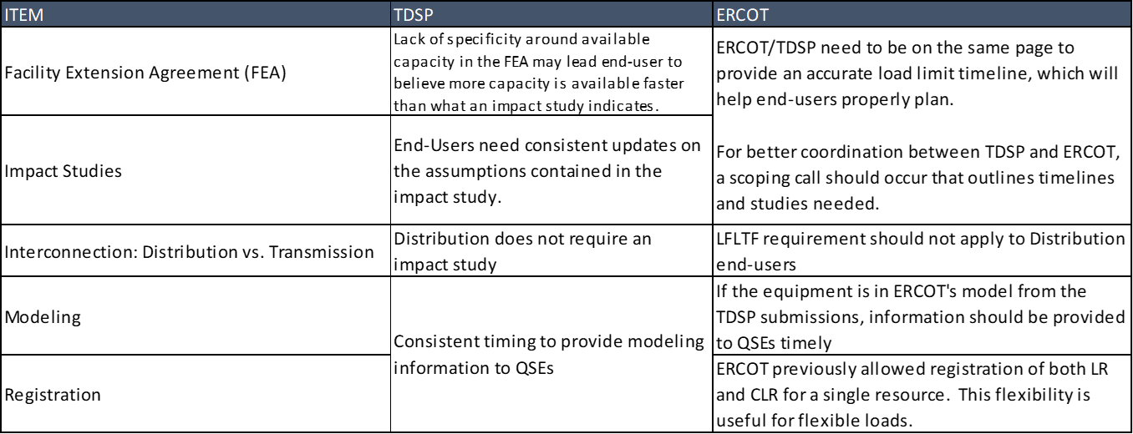
Interconnection – Registration & Qualification Challenges

Slide 7
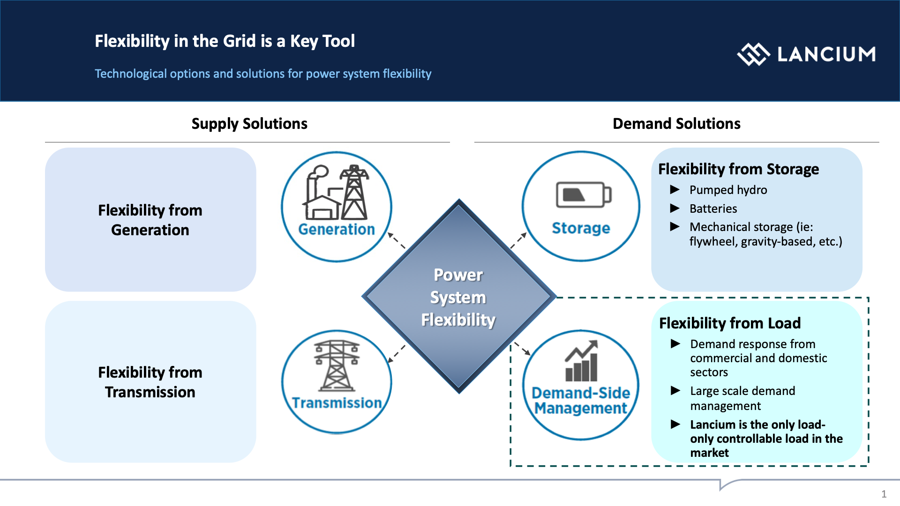

Slide 8
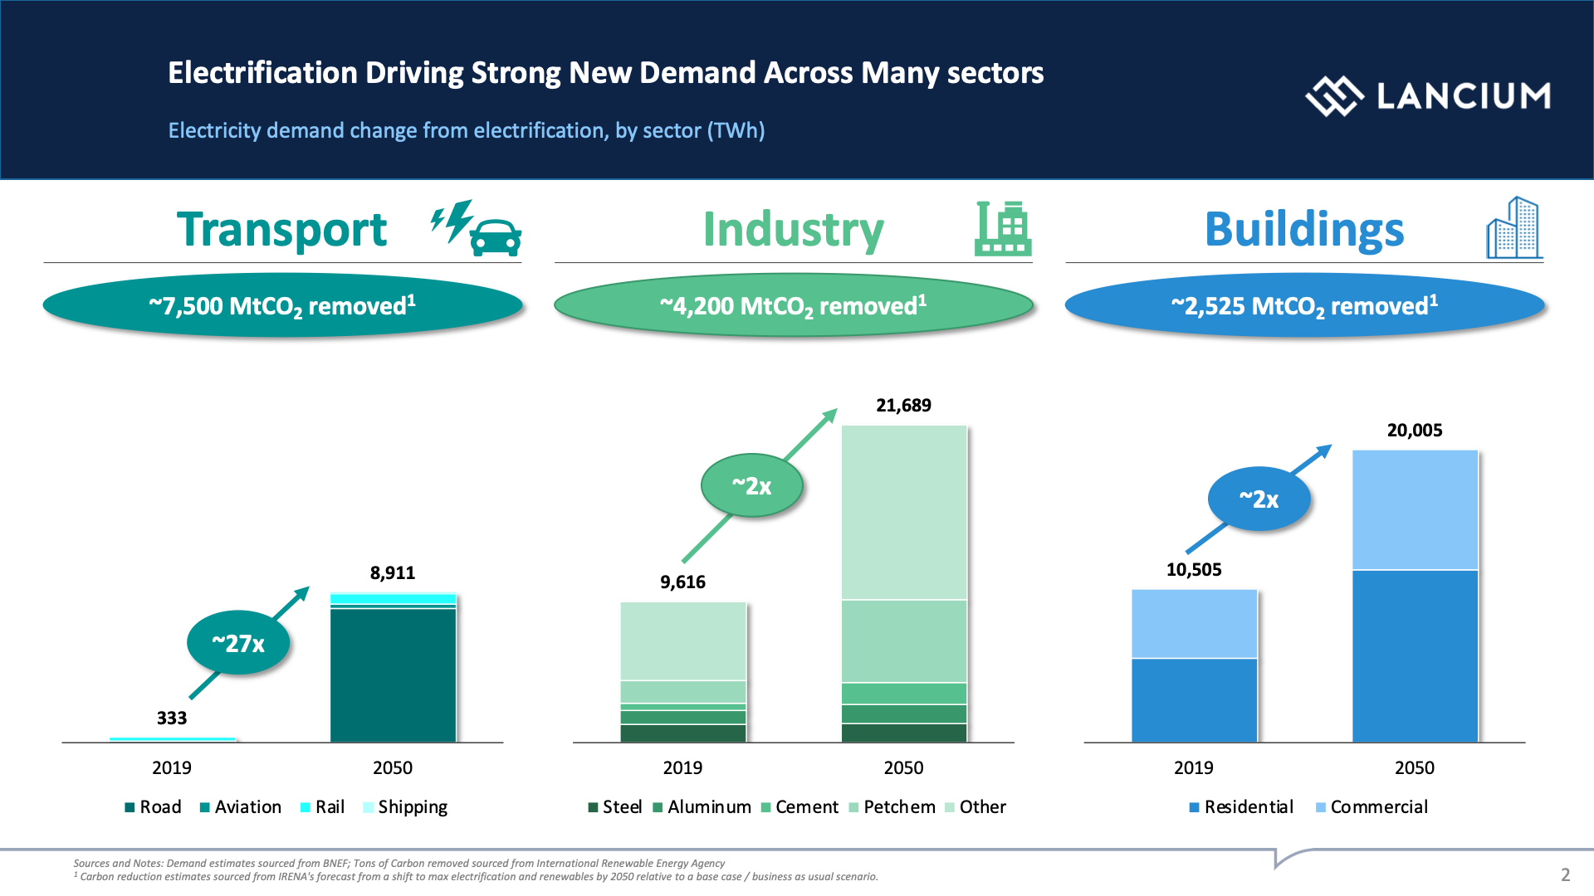

Slide 9
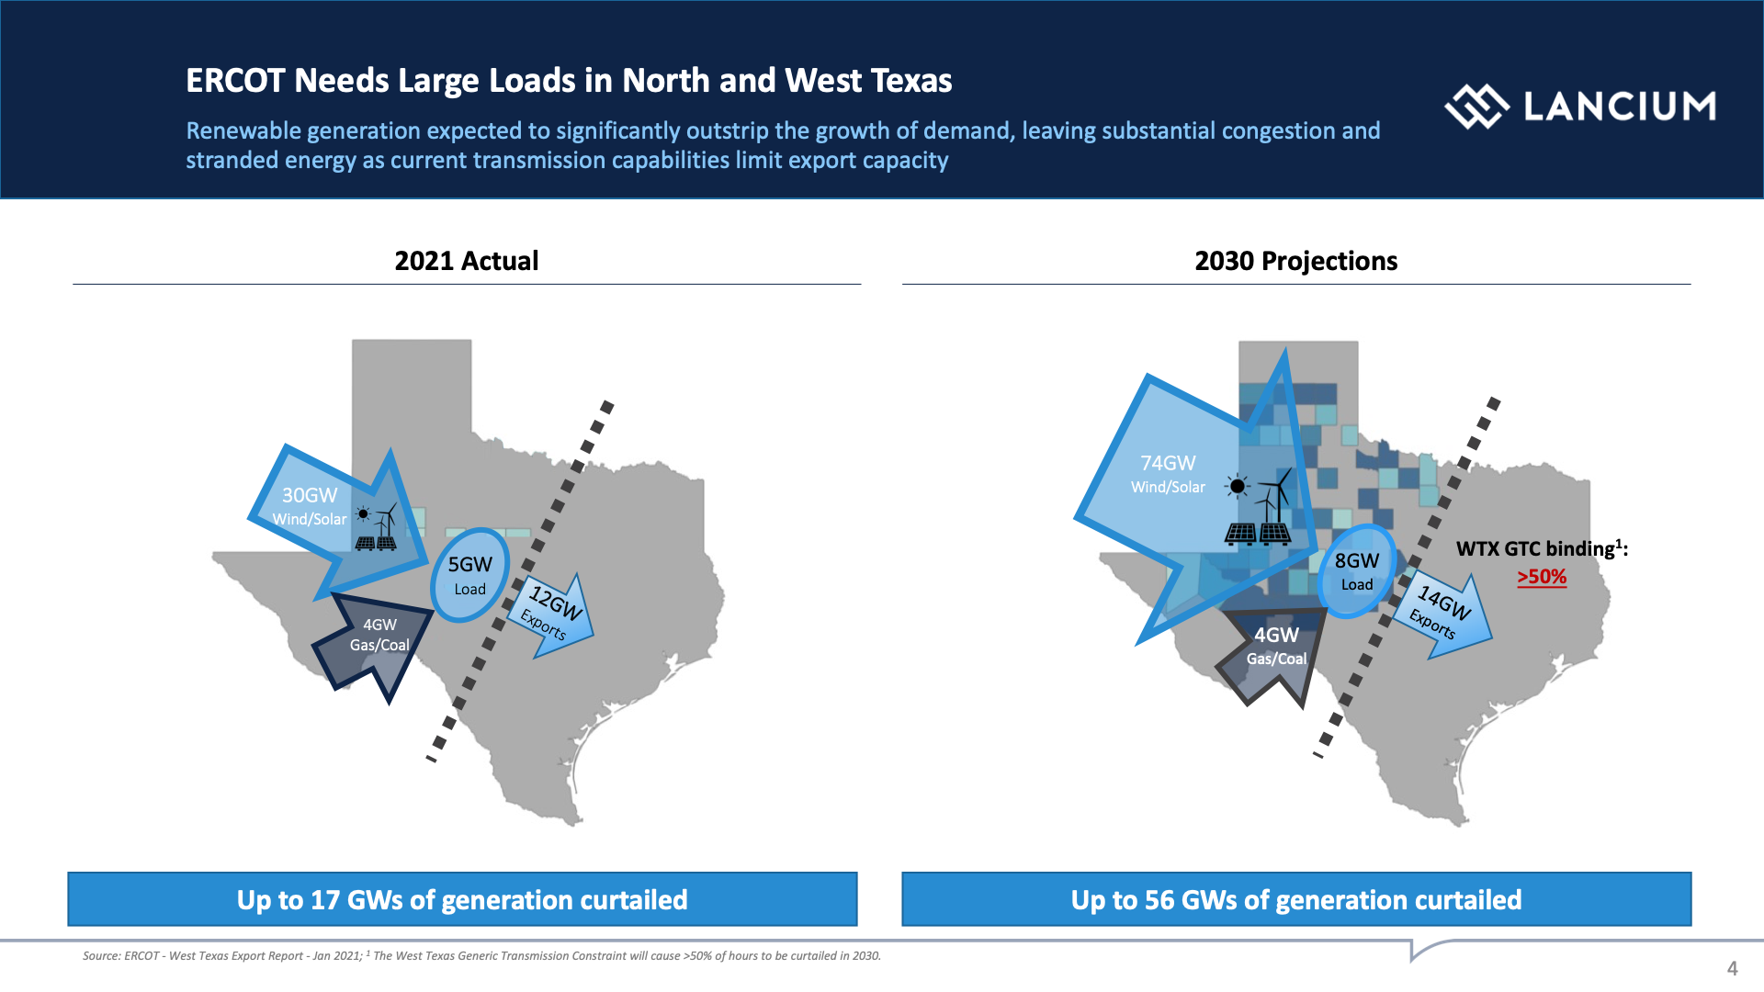

Slide 10
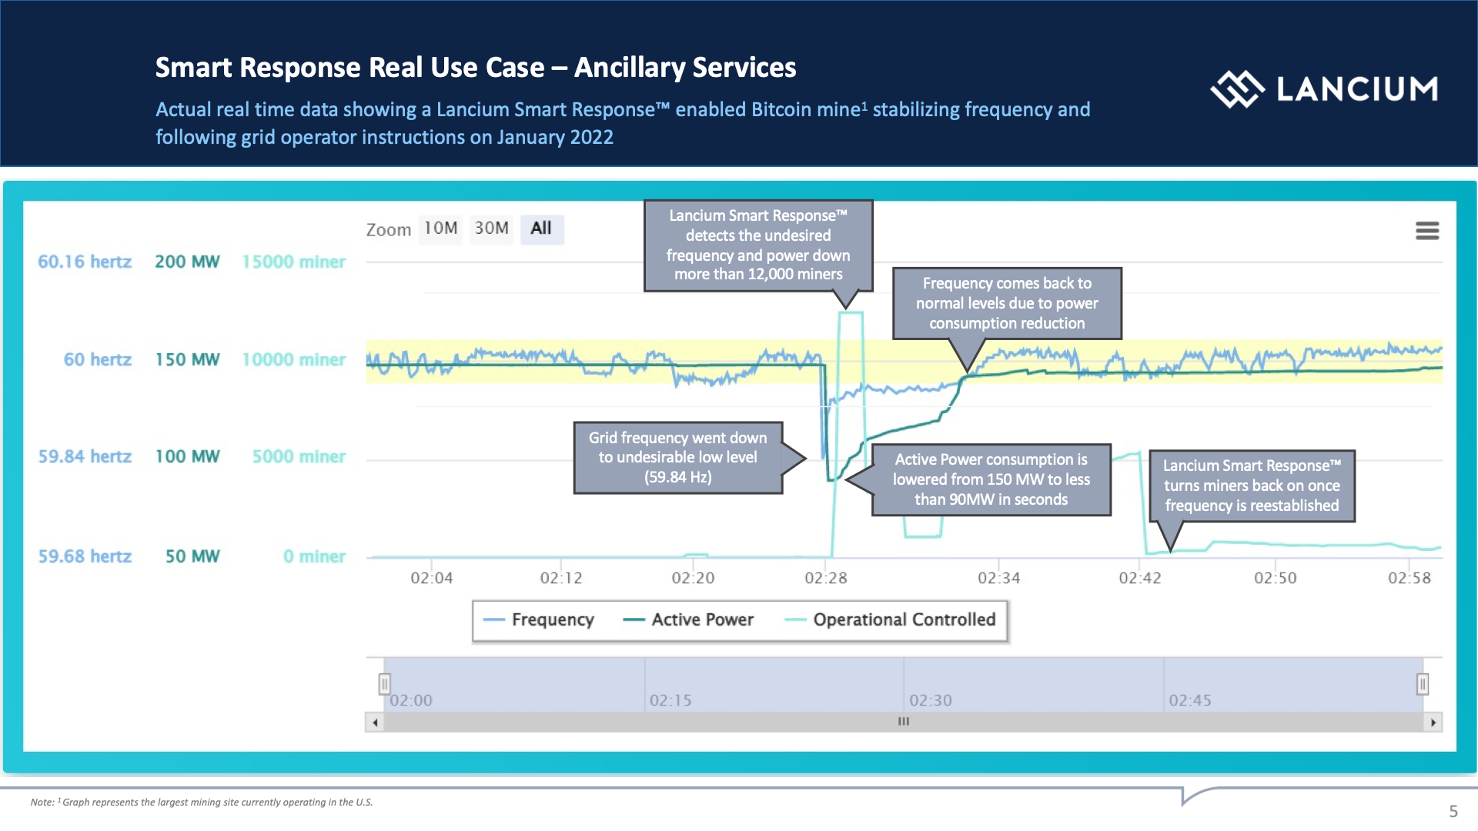

Slide 11
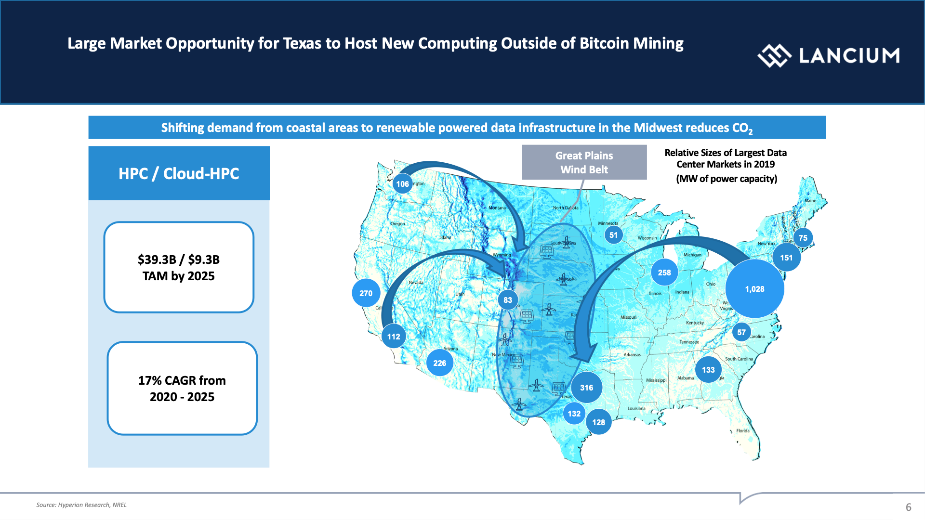

Slide 12


The Symbiotic Relationship Between ERCOT &
Texas Bitcoin Mining
Jesse Peltan
Chief Technology Officer, HODL Ranch Limited
jesse@hodlranch.com
April 2022

Slide 13
The United States & Texas: Evolution Into Bitcoin Mining Dominance
Global Bitcoin Network Hash Rate Market Share
The Texas Advantage: Why miners are flocking to ERCOT
China
Texas is a global energy powerhouse: #1 in US wind, #2 in US solar
Deep-rooted culture of energy production & consumption
Competitive, deregulated approach to power markets
Mutually beneficial grid stabilization capabilities in scale
Robust real-time demand response market opportunities
Encouragement of bottom-up innovation and market-based solutions
Strong state government support for energy-related projects
Clear regulatory framework promotes resource development
United States
Russia
Kazakhstan
Other
Canada
Malaysia
Germany
Ireland
Iran
United States: 35% market share as of Aug 2021 & growing into 2022
China: China bans bitcoin mining in Jun 2021
Kazakhstan: forcing miners out in 2022 due to grid blackouts & civil unrest
Canada: Quebec limiting hydropower availability for bitcoin mining
Norway: removed previous tax subsidies to miners
Iceland: refusing power to new bitcoin mining operations
Source: Cambridge Center for Alternative Finance
13

Slide 14
Bitcoin Mining: Market-Based Solution to Increase Electrical Grid Capacity
Illustrative Electrical Grid Supply/Demand: Without Bitcoin Mining
Illustrative Electrical Grid Supply/Demand: With Bitcoin Mining
Power
Power
Bitcoin Mining / Interruptible Load
Reduced demand during critical stress events from bitcoin mining facilities curtailing operations
Grid Stress Event:
Consumption > Grid Capacity
Grid Stress Event:
Consumption > Grid Capacity
2
1
Increased grid capacity from new bitcoin mining demand
Electrical grid capacity
3
Lower required power during stress events
Electrical grid capacity
Required Power
Spare capacity
  Gas Peaker Plants
  Batteries
  Flywheels
  Pumped Hydro
  Gravitational
  Thermal Energy
Spare capacity
Local Power Consumption
Local Power Consumption
Power consumption
Time
Time
Peak hours
Peak hours
High volatility during grid stress events
Reliance on peaker plants, batteries & other less efficient sources when grid capacity exceeded
Increased vulnerability to outages and rolling blackouts
Bitcoin mining increases utilization rates & balances volatility across the grid
Bitcoin mining fosters low-cost renewable energy generation & transmission
Miners can curtail demand or shut completely during supply scarcity to free up power as the Texas market requires
Bitcoin Mining provides clear economic incentives to energy producers, entrepreneurs & grid operators
14

Slide 15
Bitcoin Mining / ERCOT Benefits: Load Factor Improvement
ERCOT Hourly Load: 2021 Case Study
ERCOT Considerations
GW
Encourage and incentivize new GW-scale bitcoin mining operations to enhance grid stabilization
Consider a more tailored approach to current load studies by offering tiered categories of load requests based on capacity and uptime requirements (example at 90%, 95%, 99.99% or 100%)
Bitcoin mining in scale can increase ERCOT’s load factor, reduce the reserve margin and lower system-wide volatility
Unlike residential, commercial and industrial demand, bitcoin mining represents a large responsive load that can be curtailed during supply scarcity events
Adding 10 GW of new Texas bitcoin mining load could potentially enhance ERCOT’s load factor by 22%
Bitcoin mining allows for incubation of incremental renewable resources and future large uses of load
Bitcoin mining enables incremental revenue opportunities from renewable power generators, lowering costs for all users on ERCOT’s system
Improved load factors would provide ERCOT enhanced control over system frequency and stability
2021 Reserve Margin: Peak Demand + 13.75% Margin = 83,778 MW
2021 Peak Demand: 73,651 MW (8/24/21)
Potential Average Demand with 10 GW of Bitcoin Mining: 54,829 MW
1
2021 Average Demand: 44,829 MW
2021
Load Factor
53.5%
2
Potential Load Factor
with 10 GW of Bitcoin Mining
65.4%
Adding 10 GW of responsive bitcoin mining load would increase average demand & enable incremental renewable generation resources
Higher demand may improve ERCOT load factor by over 22% to 65.4%, lowering system volatility and increasing stability
1
2
15
Source: ERCOT

Slide 16
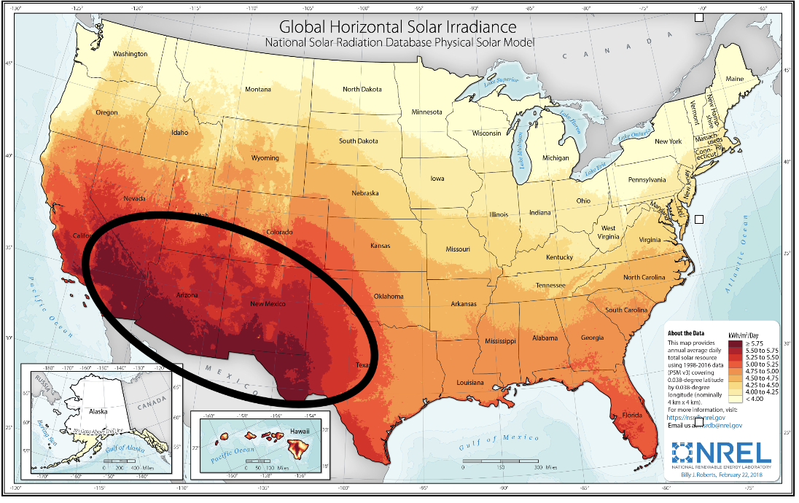
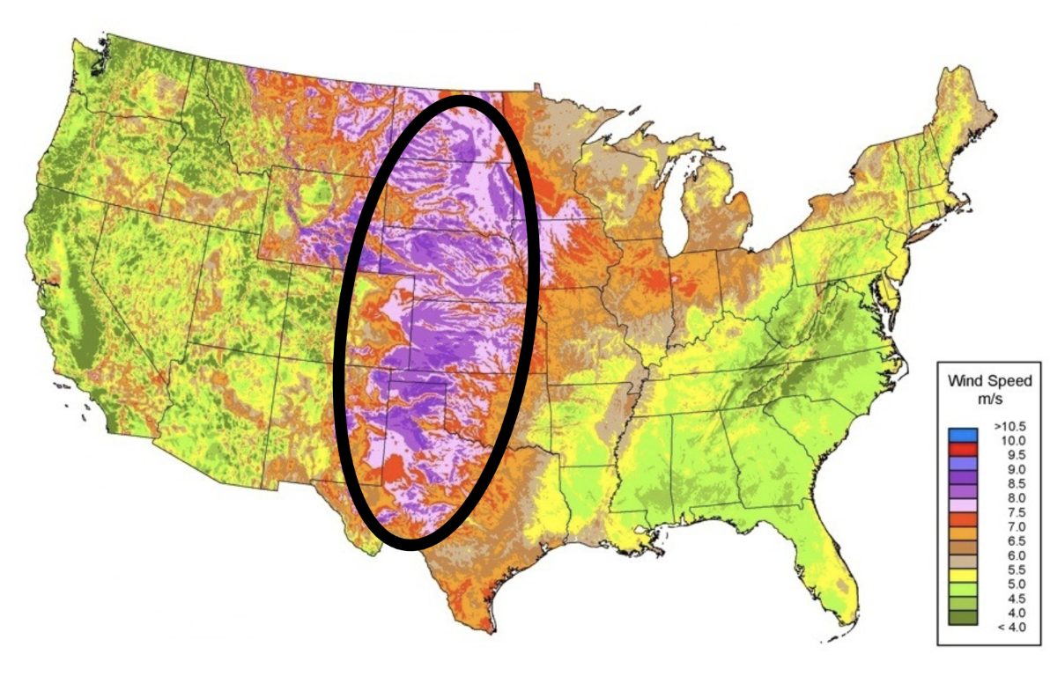
Bitcoin Mining / ERCOT Benefits: Accelerate & Stabilize West Texas Renewables
Texas Electrical Grid: The Largest Renewable Energy Market In The World
ERCOT Considerations
US Solar Resource
US Wind Speed
Bitcoin mining is actively moving to West Texas where the best renewable resources are located
Consider allowing access to nodal pricing to incentivize more selective locating of mining facilities to optimal regions for grid stability and cost
Bitcoin miners provide offtake and new revenue opportunities for renewables, enabling projects that do not need to wait for new transmission capacity
During grid stress events, bitcoin miners curtail capacity and release new power for availability to the rest of the grid
Bitcoin mining positioned to unlock the significant surplus renewables generating capacity in West Texas ²⁾
West Texas
The Intersection of the US Solar & Wind Corridors
Texas has over 2.5x more estimated recoverable renewables potential than the entire world’s 2019 electricity consumption
West Texas: the unique confluence of the US solar & wind renewable corridors
Transmission constraints result in stranded, surplus renewable energy & low electricity prices
Developing bitcoin mining campuses spurs West Texas renewable power generation
Bitcoin mining’s responsive load assists in stabilizing grid intermittency
Bitcoin mining positions Texas to unlock future renewable power for new industrial utility
¹⁾ Assumes 20% efficiency
²⁾ West Texas region includes ERCOT West & Panhandle Zones, renewable power generation includes wind & solar
Source: ERCOT, AWEA, NREL, IEA, EIA, Duke Energy
16

Slide 17
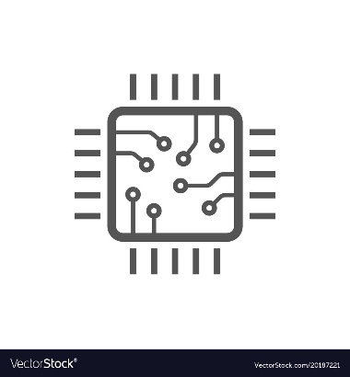


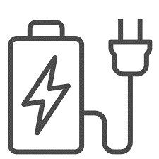

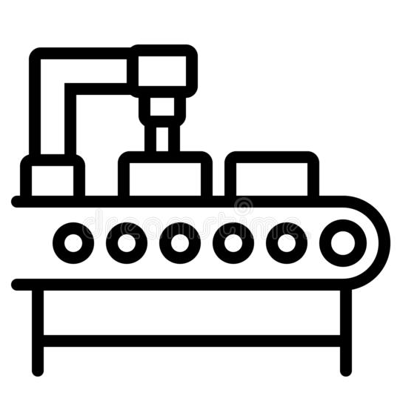
Long-Term Vision: Developing the West Texas Clean Energy Arbitrage
West Texas
Bitcoin Mining
ERCOT West Texas
Renewable Power
West Texas
Electricity Demand
West Texas
Sustainable Industrial Development
New Digital Technology Innovation
Residential
High Performance
Computing
Natural Gas
Cloud Computing
West Texas
Wind Generation
Artificial Intelligence
Bitcoin Mining
Campus Platforms
Sustainable
Industrial
Consumption
Sustainable American Manufacturing
West Texas
Solar Generation
1
Develop bitcoin mining campuses at institutional scale to unlock GWs of new, interruptible West Texas renewable power demand
Battery Gigafactories
2
Revitalize stranded West Texas renewable power generation, assist in stabilizing grid intermittency by shifting volatility from thermal generation to bitcoin miner computer banks
Semiconductor Foundries
3
Position Texas as the premier location to develop sustainable, energy-intensive technology industrial applications
Steel & Aluminum
Manufacturing
4
Establish West Texas as the global hub of zero-carbon, high-performance digital computing and sustainable American industrial innovation
Bitcoin mining is an efficient solution to stabilize grids, revitalize renewable power growth & catalyze sustainable US industrial development
17

Slide 18

Miners & ERCOT: What's the rush?
Bitcoin Halving
  What? The amount of new bitcoin entering the network cuts in half
  When? May 2024 – approximately every four years

Slide 19
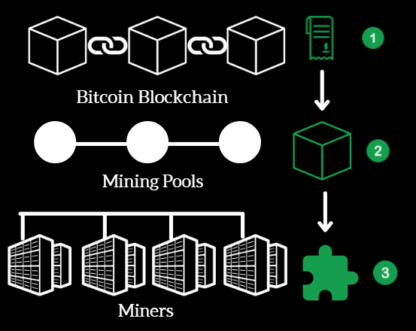
Miners & ERCOT: What's the rush?

Slide 20
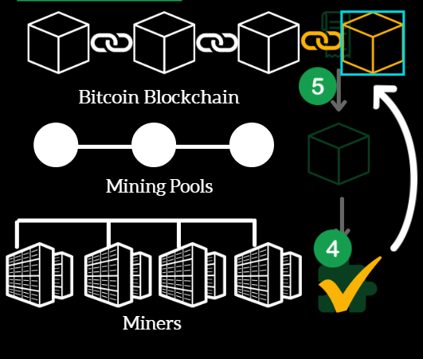
Miners & ERCOT: What's the rush?

Slide 21
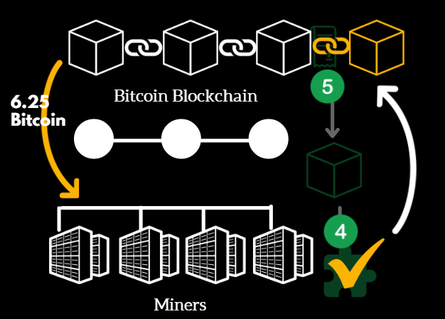
Miners & ERCOT: What's the rush?

Slide 22
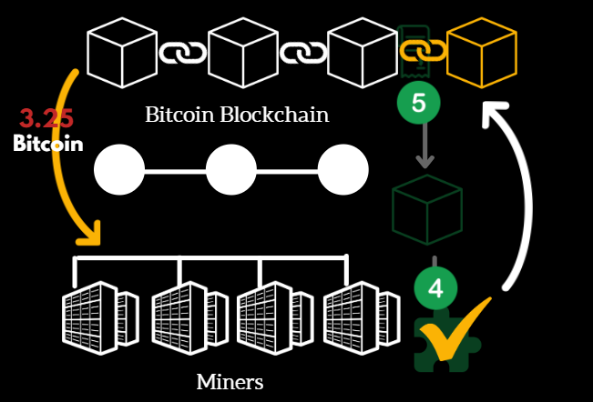
Miners & ERCOT: What's the rush?

Slide 23
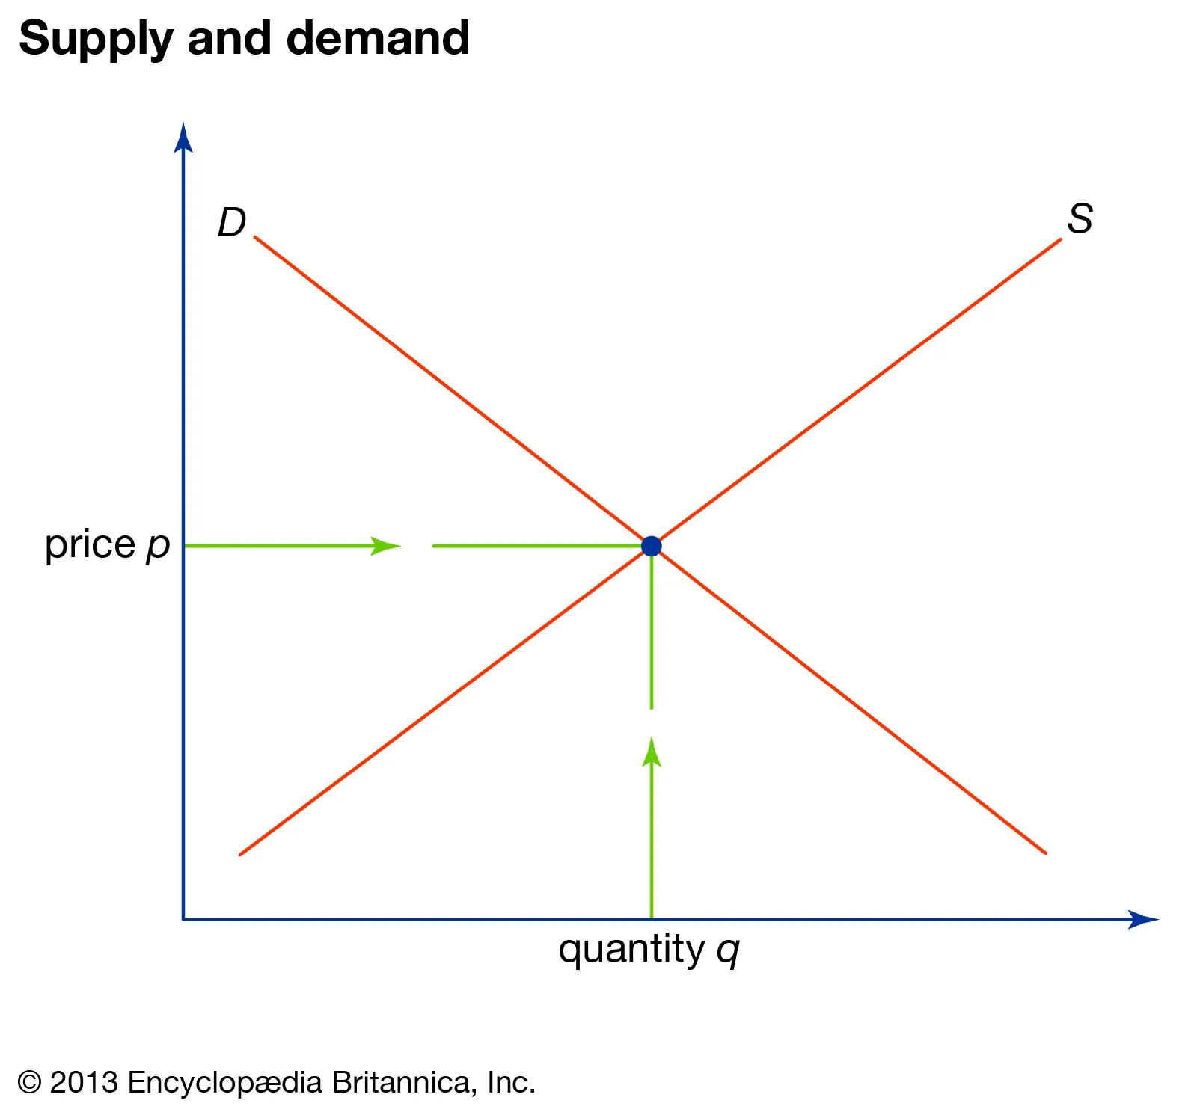
Miners & ERCOT: What's the rush?
Bitcoin Halving
  Why? Reduce Inflation, increase demand

Slide 24
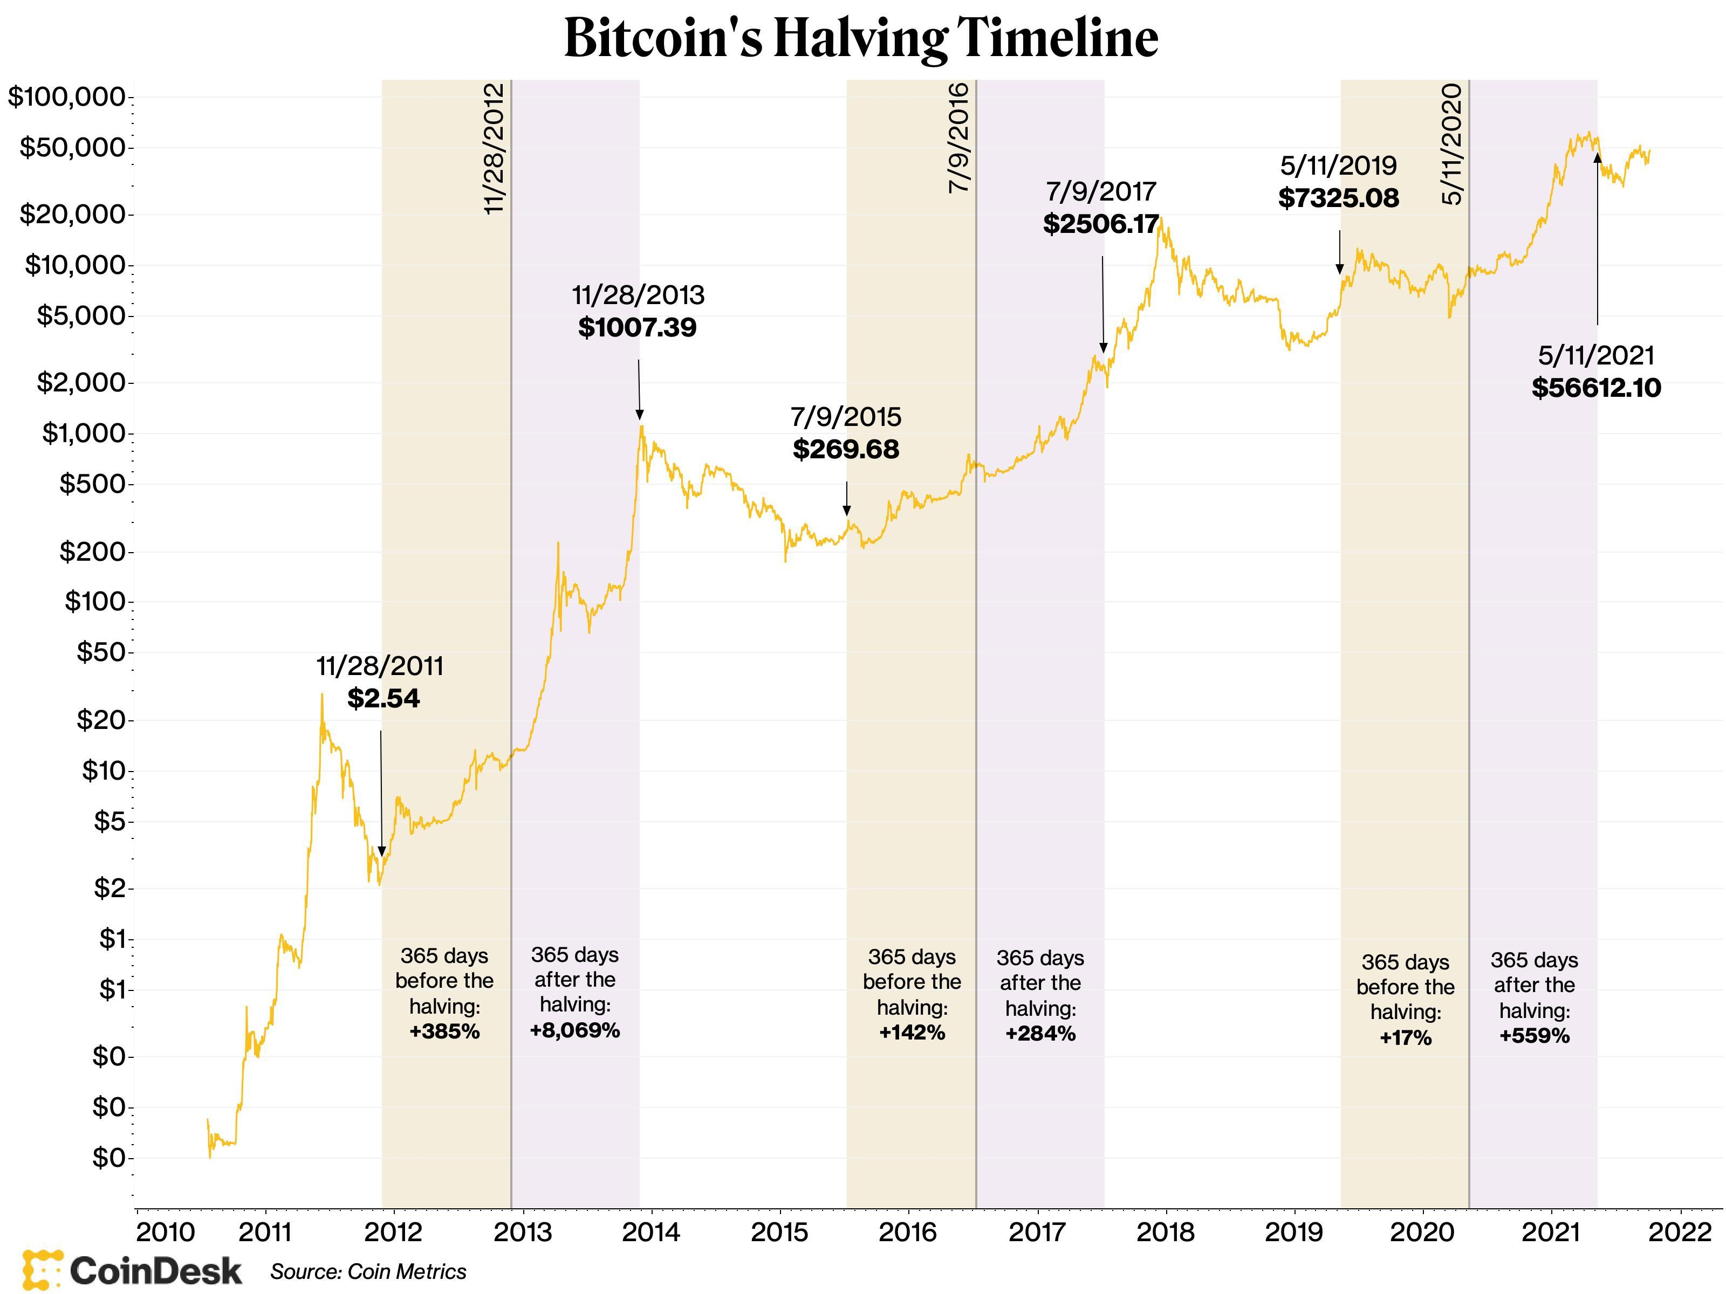
Miners & ERCOT: What's the rush?

