Slide 1
Large Flexible Load Resource Participation in the ERCOT Region

Slide 2
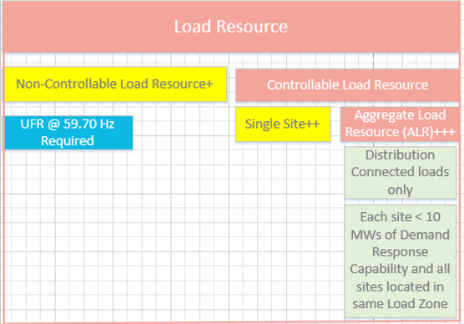
ERCOT Demand Response Services
Load Resource
A Load capable of providing Ancillary Service to the ERCOT System and/or energy in the form of Demand response and registered with ERCOT as a Load Resource.
Non-Controllable Load Resource (aka Load Resource other than Controllable Load Resource, Load Resource controlled by high-set under frequency relay)
Controllable Load Resource
A Load Resource capable of controllably reducing or increasing consumption under Dispatch control by ERCOT.
Aggregate Load Resource (ALR)
A Load Resource that is an aggregation of individual metered sites, each of which has less than ten MW of Demand response capability and all of which are located within a single Load Zone.

Slide 3
Types of Load Resources and Characteristics
Controllable Load Resources
Must be capable of following SCED or LFC basepoints
Must have frequency response similar to the governor for a GR
When qualified can provide RRS, Reg-Up, Reg-Down, Non-Spin
CLR must be represented by the same QSE that represents the Load Serving Entity.
QSE submits a “Bid to Buy” which represents the energy price above which the CLR will drop Load.
The CLR then gets dispatched economically by the Market Management System.
Non-Controllable Load Resources
Currently consist of blocky loads that deploy by opening a breaker
May or may not be required to have UFR depending upon AS participation
To provide RRS must have UFR set to trip when frequency drops to 59.7 hz
When providing RRS may be deployed manually by ERCOT instruction or automatically by UFR
Will also be able to participate in Non-Spin at the end of May
Will also be able to participate in ECRS when implemented in 2023

Slide 4
Registration and Modeling of Load Resources
ERCOT works with the TDSP and Resource Entity to get the modeling parameters necessary to register the CLR
Resource Entity submits Asset Registration Form (RARF) to ERCOT
Load Resources are mapped to an existing transmission load point in the Network Operations Model
Growth of LRs can be significant over short periods requiring registration and significant modeling changes
Rules are underway to limit registration capacity based on studies done by the TDSP (more on this during subsequent presentations)

Slide 5
Load Resource Qualification
Need to be qualified to provide AS in ERCOT
Can have a provisional qualification for 90 days but must eventually pass a test that demonstrates their ability to provide the AS
Subject to annual unannounced testing
Qualifications can be revoked and then suspended for failure to perform during events or tests
Telemetry must be validated annually.

Slide 6
Load Participation in ERCOT
Controllable Load Resource
8 data mining loads ~ 750 MWs of controllable load
Several of these existing CLRs are proposing an additional 2600 MWs pending additional studies by TDSP and ERCOT
7 additional sites have initiated registration (not clear yet if CLR or NCLR)
No ALRs registered and qualified since service was developed
Large data mining facilities with sophisticated control systems
Non-Controllable Load Resource
600+ NCLRs w/ registered maximum interruptible load of 7600+ MWs (4Q 2021)
14 of which are Data Mining loads with ~ 650 MWs
Large industrial/commercial loads with less sophisticated control systems that simply turn off or reduce consumption in blocks (gas separation, gas compression, large data mining facilities, etc.)
Emergency Response Service
Typically 20-30K sites
~ 1000 MWs procured in each of the 8 Time Periods
Typically smaller industrial/commercial loads but also residential aggregations

Slide 7
Questions?

