Slide 1




ERCOT LFLTF Meeting
04-26-2022
TDSP Load Interconnection Processes
Robert Knowles
Customer Services
Manager
Wes Woitt
Manager | Transmission
Studies and Modeling
Cris Ureña
Manager, Transmission
Interconnections
Robert Holt
Director, Transmission
Services

Slide 2
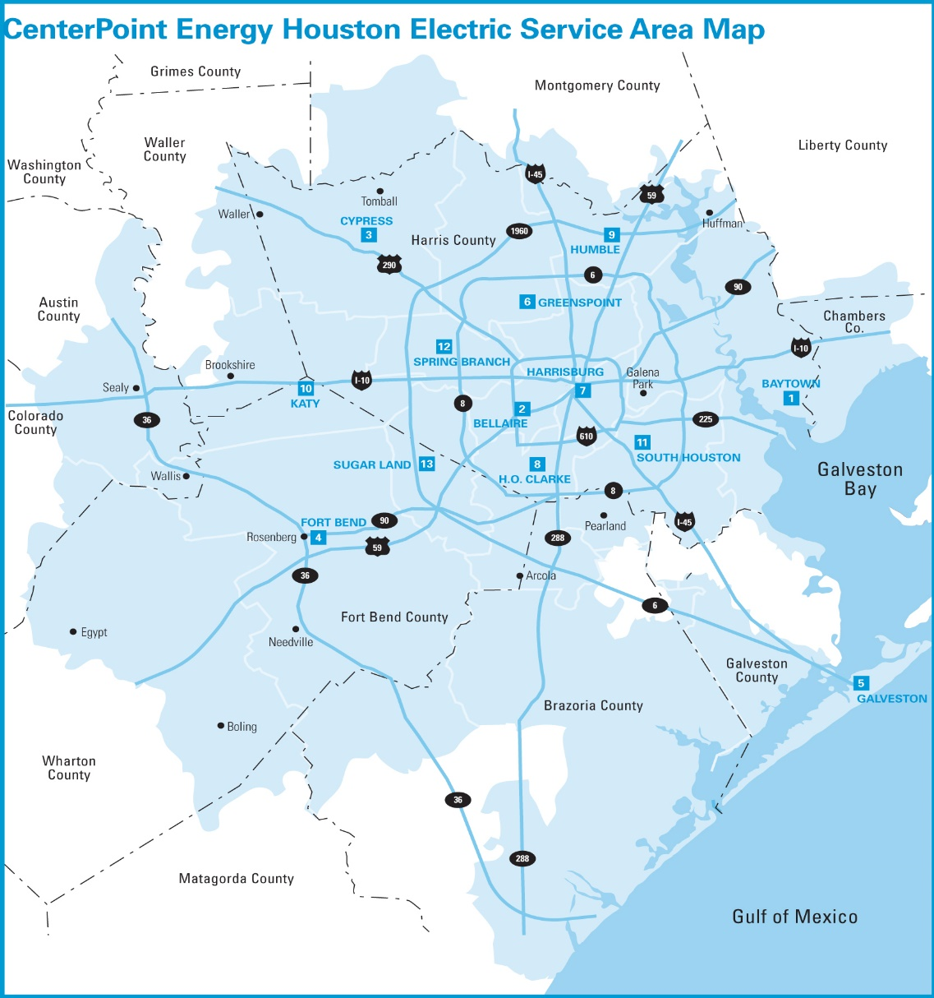
CenterPoint Energy
Transmission Load Interconnections:
Transmission service delivered through customer-owned stations; requires “loop” configuration
Highly industrialized 5,000 square mile service territory
163 customer-owned stations with non-coincident peak total load of 4,996 MW
129 load customer studies completed over the last 10 years
Historically 37% of load customer studies eventually move forward with project

Slide 3
Oncor
Company Snapshot
~16,000 miles of transmission lines; ~121,000 miles of distribution lines⁽¹⁾
    --(256) 345 kV circuits totaling (7,441) circuit miles
    --(578) 138 kV circuits totaling (8,277) circuit miles
    --(336) transmission stations and (806) distribution stations
    --(203) autotransformers
    --(1,666) distribution station power transformers
Panhandle
Metro
West
Central
Transmission Services
Initiation/Manage Points of Interconnection to Transmission Grid
Generation, Retail, and Utility Interactions
  --Intake and Project Coordination with Customer
  --Acts as liaison between Internal and External Clients
  --Contracts/Agreements Negotiation and Execution
  --Schedule Administration
Represent Company to Client
¹End of year 2020.

Slide 4
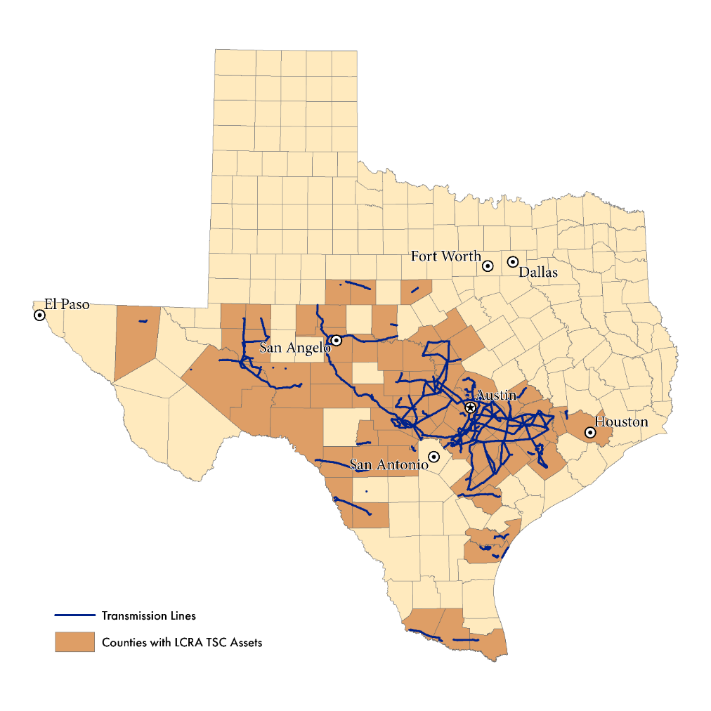
LCRA Transmission Services Corporation
LCRA TSC owns approximately 4,455 miles of transmission and facilities at 330 substations across the state of Texas.
LCRA TSC is a wholesale transmission and transformation service provider but not a distribution service provider. We work with area distribution service providers (ECs, IOUs, and MOUs) on load interconnection requests and are interconnected with 52+ wires utilities.
LCRA TSC’s load interconnection requirements are publicly available in LCRA TSC’s Facility Interconnection Requirements document (lcra.org)

Slide 5
AEP Texas
Coordinate Interconnections to the AEP Transmission and Distribution System
  Slightly over 1 million meters
  97,000 square mile service territory
  8,400 miles of transmission line

Slide 6
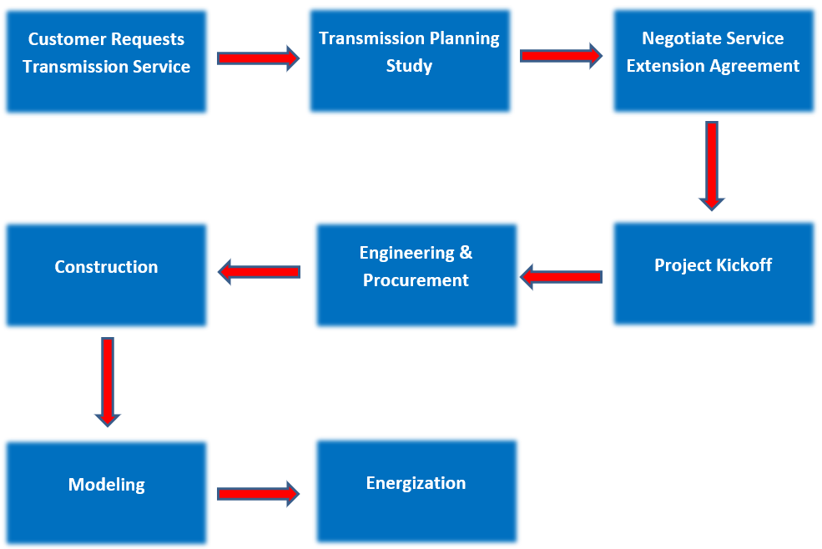
Interconnection Process Flow

Slide 7
Load Interconnection Request Intake
Provides Transmission Planning team information needed to perform reliability studies (FAC-002 compliance) for the Customer Load request:
Location (POI)
Request Status with Distribution Service Provider (DSP)
Requested In-Service Date
Load (MW) and Power Factor
Ramp Rate Schedule
Load Transfer (Y/N)
Type (Residential, Commercial, Industrial)
Point(s) of Contact

Slide 8
Load Interconnection Study
Interconnection Study agreement not required
Coordination on the study parameters per Load Interconnection Intake
Studies Performed:
  Steady-state analysis uses summer on-peak cases to model and study the forecasted load. Analysis compares performance in the base case (w/o new load) and study case (w/ new load) to identify new or worse voltage and thermal criteria violations.
  Stability analysis is performed as needed based on steady state results and historical knowledge of the study area.
  Other studies maybe applicable based on the area (SSR, harmonic analysis, etc.)
Study report is provided to ERCOT for review and feedback but no formal study report to the Customer (ECEII considerations).
Collaboration with neighboring TSPs on corrective action plans and transmission upgrades

Slide 9
Transmission Interconnection Facilities
Inputs to evaluation of scope for the Transmission Interconnection Facilities (TIF):
New Transmission Interconnection (TIF project)
  Proof of Site Control
  Site Control Boundaries (kmz)
  One-line and layout of DSP and Load Facilities
  Power Transformer owner (DSP or Customer)
Collocated with Generation (TIF project typically not required)
  One-line and layout of Generation Resource and Load Facilities
No formal study report as a deliverable

Slide 10
Interconnection Agreement
Transmission Interconnection (New Points of Interconnection)
  Agreements (either TDSP & Customer or TSP to DSP & DSP to Customer)
  Interconnection Facility Scope
  Real Property Rights
  Project Schedule
  Financial Security
Generation Collocated (Existing Points of Interconnection)
  MW of Load behind the POI (EPS Meter Proposal)
  Shared Facilities Agreement between Generator and Load

Slide 11



ERCOT Modeling Requirements
  Network Operations Model
  Energy MS
  Market MS
  Steady State Analysis
  State Estimator
  Day Ahead
  Outage Coordination
  RT Voltage Stability
  Planning Model
  Future Year Steady State Analysis
  Production Cost Analysis
  Voltage Stability
  Generation Interconnection screening studies
  Dynamics
  Model
  Derived from Steady State Model
  Future Stability Analysis
Courtesy - ERCOT

Slide 12
ERCOT Modeling Requirements
Any element change, move, addition, or deletion to the Transmission system must be provided to ERCOT so “the TSP’s control center operational model and ERCOT’s Network Operations Model are consistent”. Examples of an element include:
Lines | Reactors
Buses | Capacitors
Breakers | Resources
Switches | Loads
Transformers | Other such devices

Slide 13
ERCOT Modeling Requirements
ERCOT Protocols, Sec 3.10.1: Time Line for Network Operations Model Changes
(1) ERCOT shall perform periodic updates to the Network Operations Model. Market Participants may provide Network Operations Model updates to ERCOT to implement planned transmission and Resource construction one year before the required submittal date below. TSPs and Resource Entities must timely submit Network Operations Model changes pursuant to the schedule in this Section to be included in the updates.

Slide 14
ERCOT Modeling Requirements
Deadline to Submit Information to ERCOT Prior to: | Model Complete and Available for Test | Updated Network Operations Model Testing Complete | Update Network Operations Model Production Environment | Target Physical Equipment included in Production Model
Jan 1 | Feb 15 | March 15 | April 1 | Month of April
Feb 1 | March 15 | April 15 | May 1 | Month of May
March 1 | April 15 | May 15 | June 1 | Month of June
April 1 | May 15 | June 15 | July 1 | Month of July
May 1 | June 15 | July 15 | August 1 | Month of August
June 1 | July 15 | August 15 | September 1 | Month of September
July 1 | August 15 | September 15 | October 1 | Month of October
August 1 | September 15 | October 15 | November 1 | Month of November
September 1 | October 15 | November 15 | December 1 | Month of December
October 1 | November 15 | December 15 | January 1 | Month of January (the next year)
November 1 | December 15 | January 15 | February 1 | Month of February (the next year)
December 1 | January 15 | February 15 | March 1 | Month of March (the next year)
TSPs must submit Model updates at least three months prior to the physical equipment change.

Slide 15
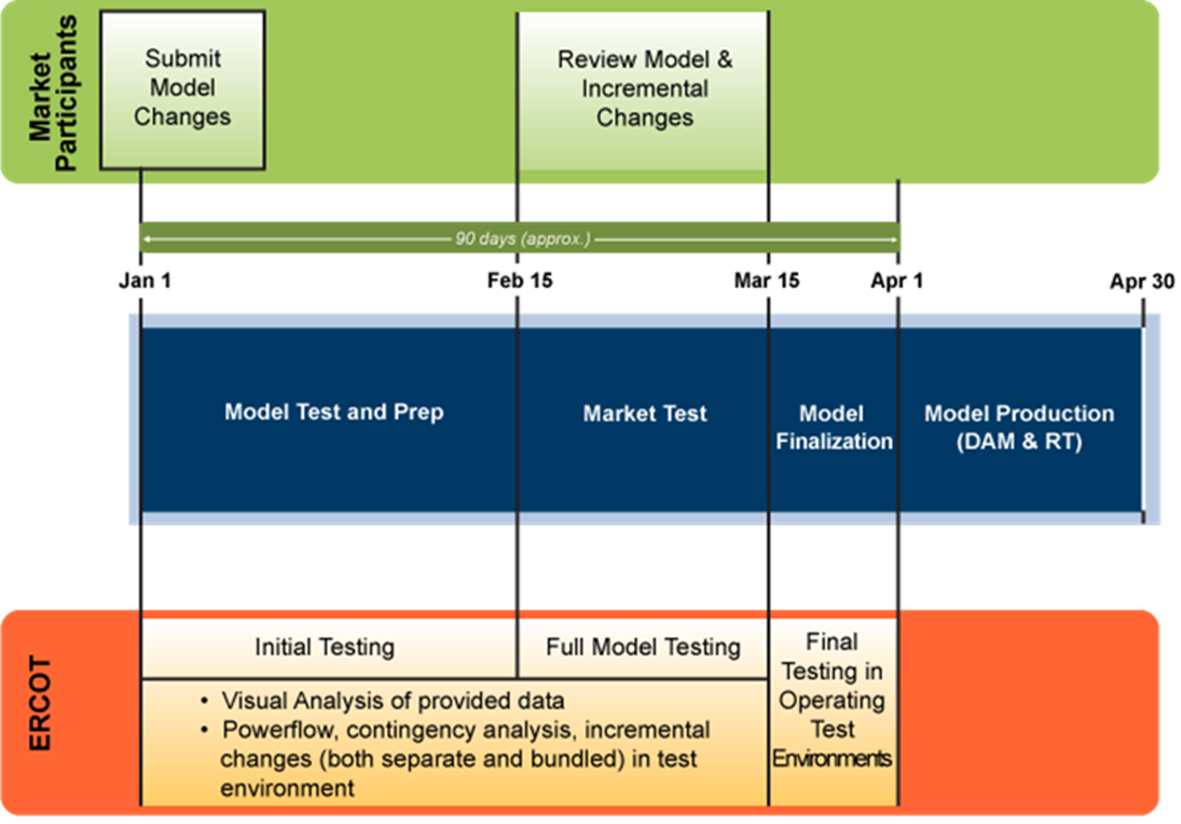
ERCOT Modeling Requirements
Courtesy - ERCOT

Slide 16

ERCOT Modeling Requirements
October | November | December | January | February | March | April
6 to 9 months
before
 | 5 months before
Notify Transmission Operations Modeling of in-service date
 | Provide Tran Ops Modeling dispatch drawings
 |  | 4 months before
Develop one lines assign equipment numbers |  | Confirm project is on track
 | Provide Tran Ops Modeling with device specifics |  | 3 months before
 |  | Submit NOMCR to ERCOT for April 1 in- service | ERCOT model validation
Develop outage plan |  |  |  | 2 months before
 | Provide earliest possible in-service date for equipment
 |  |  |  | ERCOT full model test
 |  |  |  |  | 1 month before
 |  |  |  |  | ERCOT final test
 |  |  |  |  |  | Project in service April 1

Slide 17
Schedule Considerations
Schedule Considerations
Project timelines are highly dependent upon the ultimate plan for service:
  Location
  Customer needs, including redundancy requirements such as dual feed, type of load, BTM
  Alternatives and configurations to address customer needs
  System upgrades to support load, etc.
The need for regulatory permitting (CCN) will noticeably extend the interconnection schedule.
Typical construction timelines may be affected by unanticipated interruptions or delays in some project activities, including: the acquisition of property; outage and clearance approvals; potential environmental requirements; and other unexpected variables (weather, for example).
All outage clearance requests are approved or rejected by ERCOT, and ERCOT may reject a previously-approved clearance based on system conditions.
ERCOT summer outage restriction window (historically, May 15 to Sept 15) should be allowed for in establishing a requested in-service.
Schedule Risk Mitigation
Partnership in property and right of way acquisition
SB1281: CCN exemptions up to 3 miles with qualifications
Use of the Discretionary Services Agreement
  Initiating Regulatory/CCN permitting activities
  Initiating detailed Distribution (construction power) and Transmission Engineering and Design activities
  Procurement and acquisition of long lead time Materials and Equipment
  Acquisition of right of way

Slide 18
Standard POI Configuration with HV Breakers
ROM Schedule: 18-24 Months
©2021 Oncor Electric Delivery Company LLC. All rights reserved.
Oncor | Process Example Timeline
Customer Request/Intake
Evaluate: RIA,
One Line, $Eng Estimates;
Start Contracts
FEA Finalized/NTP
Build Phase Starts¹
Construction Activities²
In Service
0
4
8
12
16
20
24
28
32
36
40
44
48
52
56
60
64
68
72
76
80
84
88
92
96
100
104
108
112
LQ
Planning Study
RIA, OneLine:8
FEA Negotiation
Security/NTP:8
Pre-Design Coord w/Customer:12
Detailed Engineering:40
Material Procurement:52
Permission and Ground Survey: 16
Land Acq:24
Const Activities:24
Summer Outage Restrct Buffer (as req):24
InSvc
Ext As Required
ROW Cleanup:6
Ext As Required
¹Indicated construction timelines may vary due to unanticipated interruptions in certain project activities including the acquisition of property, approvals for outages and clearances, potential environmental requirements, and other unexpected variables.
²All outage clearance requests approved or rejected by ERCOT; ERCOT may reject a previously-approved clearance based on system conditions. Note that ERCOT summer outage restriction window (historically, May 15 to Sept 15) should be allowed for in establishing requested in-service.
InSvc

Slide 19
Interconnection Challenges
Timelines for transmission upgrades needed to maintain system reliability and ensure compliance with NERC and ERCOT planning criteria
Condensed interconnection timelines make key regulatory and compliance milestones critical path:
  Studies
  Reporting
  Modeling
Single Load project requesting multiple TSP site evaluations

