Slide 1
Update on Implementation of SCR800 and SCR809
ERCOT Balancing Operations Planning Staff
April 22, 2022
WMWG

Slide 2
Agenda
SCR 809
  Introduction
  RLC Overview
  SCR809 RLC Validation Rule changes
  Summary
SCR 800
  Background
  Update

Slide 3
SCR809

Slide 4
SCR 809 Introduction
ERCOT protocols require QSE’s and TSP’s to send accurate telemetry. On occasion, however, QSE’s and TSP’s may send inaccurate telemetry to ERCOT in error
When telemetry sent in error is utilized by the Resource Limit Calculator (RLC), it can have unintended impacts on the ERCOT Grid and market operations.
In late 2019, in consultation with stakeholders, ERCOT had undertaken a holistic review of the validation rules imposed on external telemetry received in RLC. SCR809 was subsequently filed on January 10, 2020.
SCR809 will make changes to the validation rules imposed on the external telemetry ERCOT receives and will help better identify invalid telemetry and reduce the likelihood of RLC utilizing erroneous data.
ERCOT is in the process of implementing SCR809 and expects to implement changes associated with it in 2022-R3 release (~ end of May)
Notes:
At the Jun 24, 2019, WMWG meeting ERCOT provided an overview of the current telemetry validations in the Resource Limit Calculator (RLC).
Slide Deck: Link
In consultation with stakeholders ERCOT had undertaken a holistic review of the validation rules imposed on the external telemetry received in RLC and provided an overview of the validation rules at the Sept 16, 2019, WMWG meeting.
Slide Deck: Link

Slide 5
RLC Overview
Resource Limit Calculator
SCED BP/LMP Data To QSE via SCADA/ICCP
Telemetry from QSE via SCADA/ICCP
Ancillary Service Calcs.
ex. HASL, LASL
Calculated and telemetered Data To MMS/SCED
Dispatch Data from MMS
Resource Limit Calcs.
ex. SURAMP, SDRAMP, HDL, LDL
GTBD Calculation
Includes PLDRR, PWRR
Data For Settlements
Operator Initiated Data
Other Calcs.
Ex. SCED Trigger following RRS release
Data For Reports and Compliance
RLC executes every 4 seconds.
RLC uses telemetry from QSEs to compute limits such as HDL, LDL, HASL and LASL. These limits are then sent to MMS/SCED.
  RLC runs several sanity checks against input telemetry data and weeds out inconsistencies in telemetered data using pre-established business rules.

Slide 6
Summary of the Changes proposed in SCR809
SCR 809 proposes four changes
  When suspect data quality is detected for normal/emergency ramp rate telemetry, change RLC validations to retain the last telemetered value that had good quality
  To improve situational awareness, raise alarms when sudden “large” changes in System level markers like HDL-GEN, HASL-GEN etc. are detected.
  Enhance the RLC actions when a resource operating above 90% of its LSL telemeters an offline resource status.
  Make changes that promote resources to follow proper startup/shutdown sequence i.e. Off – Startup – ON or ON – Shutdown – OFF in the telemetered Resource Status(RST).

Slide 7
Issue 1: Normal/Emergency Ramp Rate Telemetry
Current
If Suspect data quality is detected for Generation Resources Normal/Emergency ramp rate telemetry, then effective ramp rate is computed using the resource specific ramp rate curves as submitted in the resource’s Market Manager Generation Resource Parameters or Resource Asset Registration Form (RARF) if there was no Market Manager Submission
For all other telemetry received from Generation Resources, when suspect data quality is detected, the RLC will default to last telemetered value with good data quality.
SCR 809 Change
When suspect data quality is detected for resource Normal/Emergency ramp rates ( NURR,EURR, NDRR and EDRR), RLC will be changed to retain the last telemetered value which had good data quality. With this change the logic of switching to market ramp rates will be removed.

Slide 8
Issue 2: New Alarm to detect potential fleet-wide invalid telemetry
In recent past, ERCOT identified sudden change in certain system level markers (e.g., HDL-GEN/HASL-GEN computed using external telemetry in RLC). However, no reliability issues were observed during this time which suggests that such events were related to submission of invalid telemetry.
An alarm will be raised in ERCOT’s EMS when over a rolling time window* HDL-GEN or HASL-GEN reduce by an amount greater than or equal to a predetermined threshold* AND no significant frequency deviation* is detected over the same period.
  An alarm raised may indicate that invalid telemetry is being received and will trigger further investigations to determine if a fleet of resources may be experiencing a systemic issue in telemetering information to ERCOT.
  ERCOT is in the process of analyzing past events to identify appropriate seed values for the parameters that will trigger this new alarm.
Note that, as the detection of invalid data using this logic becomes more robust, functionality maybe extended and other actions may be included as a part of this logic.
*Configurable parameter

Slide 9
Issues 3 and 4: Approach
Currently, RLC will ramp down a Generation Resource per its SCED Down ramp rate (SDRAMP) when telemetered Net MW > 0.9*LSL and Resource Status is OFF,OUT,EMR, OFFNS and EMRSWGR.
To enhance this check in RLC and to promote the use of Startup/Shutdown sequence, i.e. Off – Startup – ON or ON – Shutdown – OFF in the telemetered Resource Status (RST), ERCOT will implement new validation rules that utilize a combination of the following telemetered values received from supply-side resources (including wind, solar and ESR-Gen).
  Resource Status
  Net MW
  Unit/Transmission Connectivity Status
ERCOT is planning to use a two phased approach to implement the validation changes associated to Issues 3 and 4.
  In Phase 1 – Instances when inconsistent telemetry is detected will be “recorded” for post-hoc analysis. ERCOT engineers may reach out to QSEs during this phase and work with them on potential corrective actions.
  In Phase 2 – When inconsistent telemetry is detected High/Low Dispatch Limits in most cases will be set equal to the unit’s current output.

Slide 10
Issues 3 and 4: Approach
For a resource that is connected to the grid, High/Low Dispatch Limits will be set equal to the unit’s current output when
  Telemetered net output > 0.9 MW and an offline Resource Status (i.e. OFF,OUT,EMR, OFFNS and EMRSWGR) are received.
  Telemetered net output is greater than 0.9 MW but less than 0.9 * LSL and an online resource status (i.e. ON* excluding OFFQS and ONTEST) is received
For a resource that is not connected to the grid, High/Low Dispatch Limits will be set to DISPATCH the unit per its SCED down ramp rate when
  Telemetered net output > 0.9 MW and an offline Resource Status (i.e. OFF,OUT,EMR, OFFNS and EMRSWGR) are received.
  Telemetered net output is greater than 0.9 MW but less than 0.9 * LSL and an online resource status (i.e. ON* excluding OFFQS and ONTEST) OR STARTUP/SHUTDOWN resource status is received

Slide 11
Summary
ERCOT is in the process of implementing SCR809 and expects to implement changes associated with it in 2022-R3 release (~end of May).
The changes that detect the inconsistent telemetry and promote resources to follow startup/shutdown sequence i.e. Off – Startup – ON or ON – Shutdown – OFF in the telemetered resource status will be implemented in two phases.
  Phase changes have been setup such that RLC will record instances when inconsistent telemetry is detected for post-hoc analysis. No changes will be made to dispatch during this phase.
    Phase 1 will be effective upon implementation of SCR809.
    ERCOT engineers may reach out to resources for potential corrective actions. ERCOT expects to keep running in phase 1 mode for a couple months, to allow time for outreach and issue resolution.
  Phase 2 changes have been setup such that when inconsistent telemetry is detected High/Low Dispatch Limits will be set equal to the unit’s current output.
    ERCOT expects to coordinate with QSEs before implementing Phase 2.
All other rules changes will be effective upon implementation of SCR809.

Slide 12
SCR800

Slide 13
Background on SCR800
SCR800 will incorporate a new component into ERCOT’s Generation To Be Dispatched (GTBD) which accounts for the five-minute predicted DC tie ramp rate (PDCTRR). The PDCTRR will be calculated using the latest available scheduled DC tie flows.
In absence of this today, SCED is does not have a way of accounting for the ramping of DC ties in Real-Time.
Adding the PDCTRR in the GTBD is anticipated to improve the ability of Security-Constrained Economic Dispatch (SCED) to calculate Five-minute Base Points and is anticipated to reduce the burden of Regulation Services to compensate for the ramping of DC ties. This is also expected to improve the frequency recovery duration during significant DC tie ramp events.
Equation
GTBD = Total Gen + K1*10*System Load Frequency Bias + K2*[(net non-conforming Load) – (net filtered non-conforming Load)] + K3*5*PLDRR + K4*Regulation Deployed + K5*ACE Integral – K6*5*PWRR + K7*5*PDCTRR – K8*5*PSRR
NEW ADDITIONS

Slide 14
SCR800 Update
As a part of implementing SCR800, ERCOT is in the process of integrating a five-minute predicted DC tie ramp rate into ERCOT’s Energy Management System (EMS)
ERCOT’s EMS is being setup to compute a Predicted DC Tie Ramp Rate using
  Approved DC Tie Electronic Tags (e-Tags)
  Note that a DC tie schedule is originally in 15m resolution and must be converted to 5m resolution
ERCOT is on track to complete the software changes associated with SCR800 in the 2022 R3 release.
Additional technical details for SCR800 implementation will be presented at the May PDCWG.

Slide 15
Conversion from 15m to 5m Schedule
  DC tie schedules are originally in 15m resolution. DC ties are expected to perform 10m ramps “across the interval” to the next scheduled value.
  In the example above, the DC tie schedule changed from -100 MW at 00:45 to 200 MW at 01:00. DC Ties should start the 10-minute linear ramp at 00:55 and end at 01:05. The 5-minute schedule values are shown below:
    00:55, -100 MW
    01:00, 50 MW
    01:05. 200 MW

Slide 16
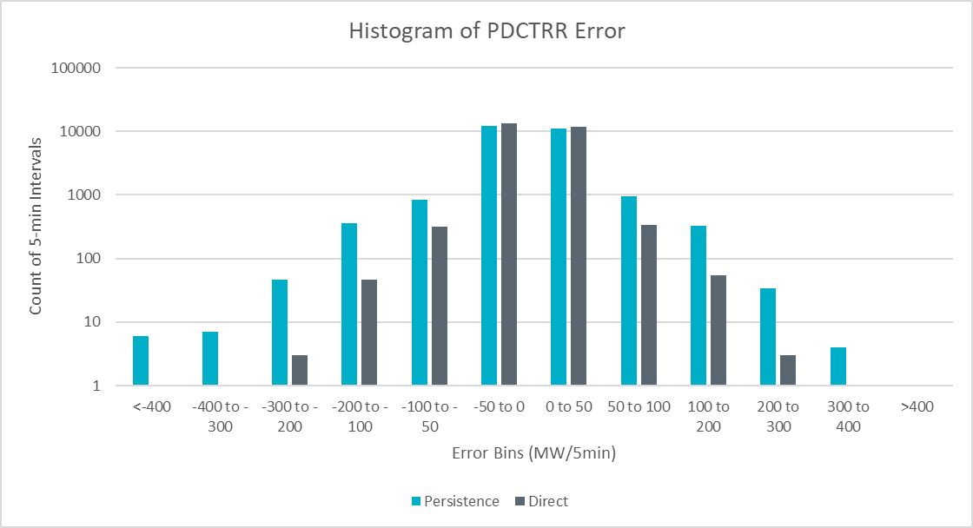
PDCTRR Error, 12/01/2021 to 03/01/2022
Performance Metric | Persistence | Direct
Mean Absolute Error | 13.7 | 7.1
Mean Absolute Error, Absolute Ramp > 100 | 142.9 | 37.4
Mean Absolute Error, Absolute Ramp > 250 | 299.3 | 78.4
Over Forecasted
Export
Under Forecasted Export
Notes:
Persistence Method: predicts a DC tie ramp of 0. This is essentially what is being done in absence of the PDCTRR component in GTBD.
Direct Method: predicts a DC tie ramp using approved e-Tags. Looking ahead at the two nearest future 5 min clock intervals.

Slide 17
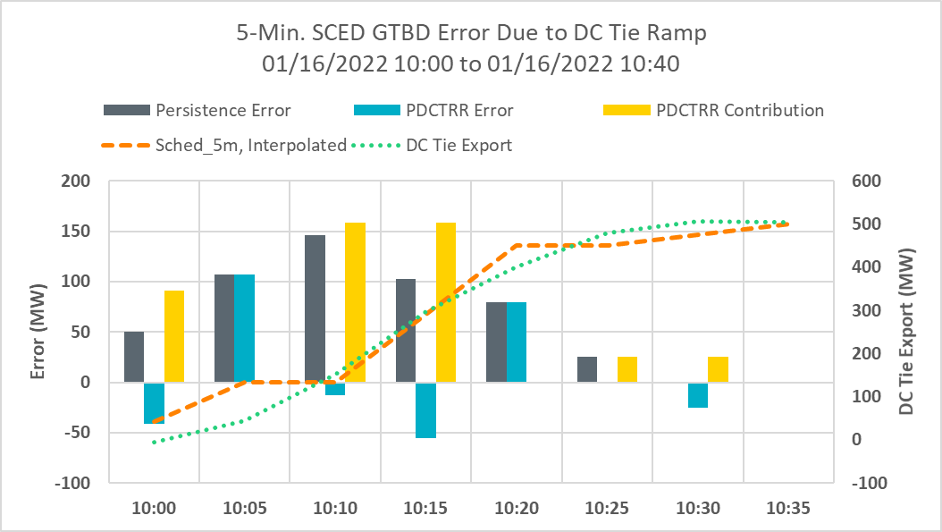
Potential Impact of PDCTRR in GTBD
Time | 10:00 | 10:05 | 10:10 | 10:15 | 10:20 | 10:25 | 10:30 | 10:35
Sched, 5m, Interpolated | 41.5 | 133 | 133 | 291.5 | 450 | 450 | 475 | 500
PDCTRR Contribution to GTBD | 95.1 | 0 | 158.5 | 158.5 | 0 | 25 | 25 | 0

Slide 18
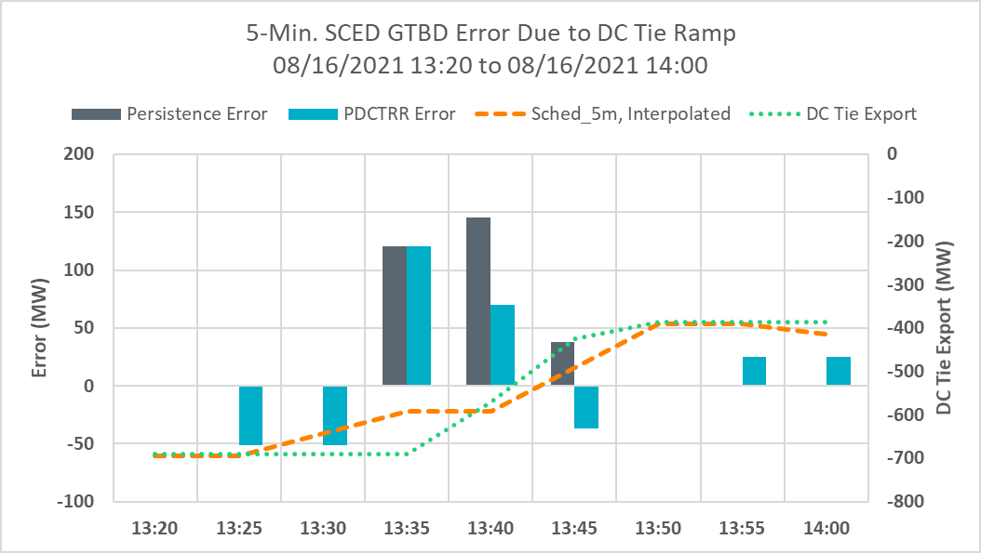
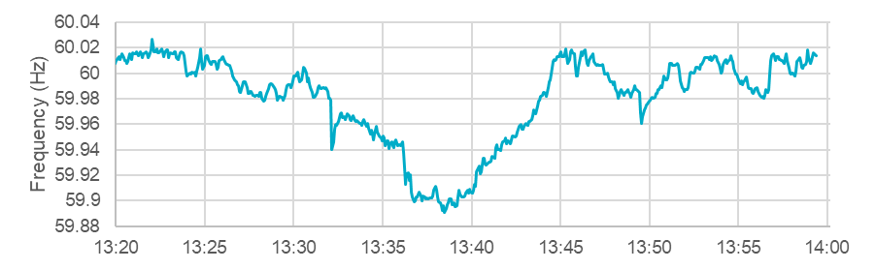
DC Tie Ramp During Frequency Event (300 MW Ramp)
Notes:
Actual-Forecasted

Slide 19
Summary & Next Steps
ERCOT will implement SCR800 during a 2022 off-cycle R3 release.
Initially, K7 will be set to 0 so that it will not impact GTBD calculation.
ERCOT is planning to tune K7 (K7 becomes non-zero) and potentially other GTBD parameters in the first week of June.
  A Market Notice will be sent when this activity is complete.

Slide 20
Appendix

Slide 21
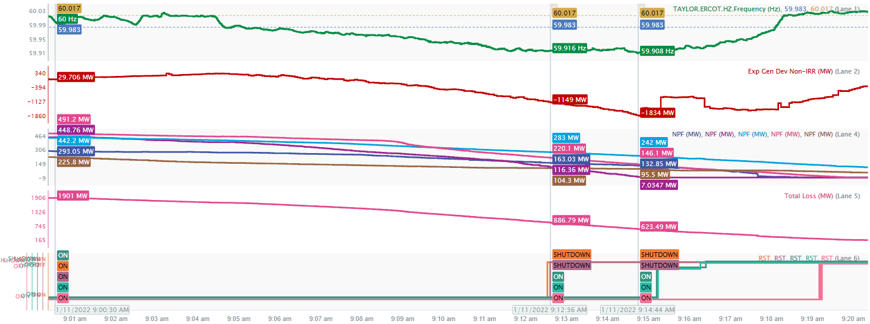
Why is proper use of Startup/Shutdown important?
Appropriate telemetry including use of the Startup/Shutdown sequence is very critical to ensuring ERCOT dispatch signals are able to appropriately account for resource operations. An example of suspect telemetry that impacted frequency control occurred on Jan 11, 2022 around 9:00 AM, several thermal resources entered the shut down sequence and most of the resources involved did not use the Shutdown Resource Status until 9:12 AM. Frequency dropped to 59.908 Hz at 9:14 AM.

Slide 22
Summary of New Validation Rule #A
WHEN a generation resource telemeters
An Offline Resource Status (i.e., OFF, OUT, EMR, OFFNS and EMRSWGR)
AND
2. Net Output is greater than 0.9 MW
IF the resource is connected to the transmission grid, THEN
(Phase 1) RAISE NOTIFICATION
(Phase 2) SET HDL = LDL = MW
ELSE
(Phase 1) RAISE NOTIFICATION
(Phase 2) DISPATCH the unit per its SCED down ramp rate.
*Note that today’s RLC validation do not take connectivity into account and will DISPATCH the unit per its SCED down ramp rate in this situation.

Slide 23
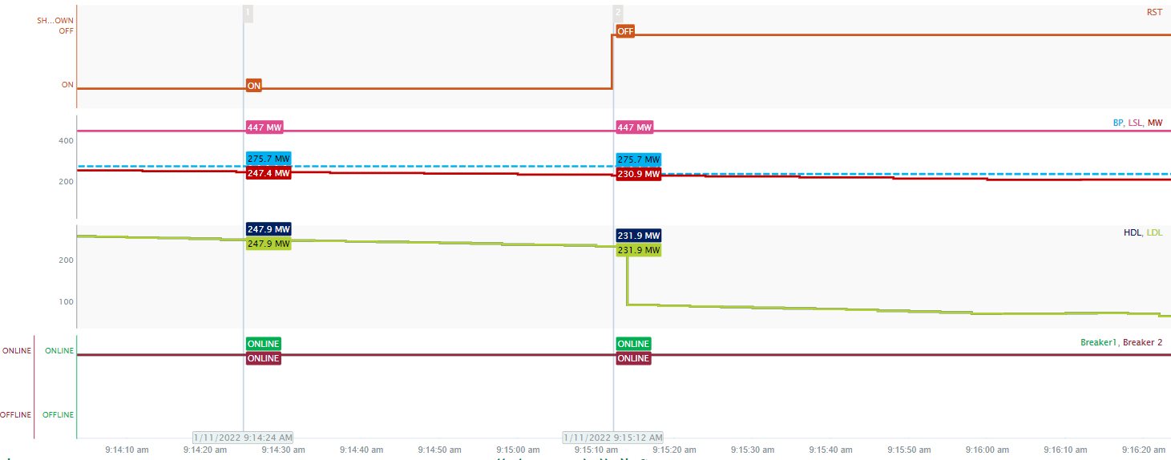
Rule #A: Example 1
Below is an example where a Resource Status (RST) changed from ON to OFF unit is connected to the grid. The unit’s output is decreasing, hence its fair to assume the unit is in shutting sequence.
  ERCOT expects that in this situation this unit use SHUTDOWN status and not transition directly to OFF status.
  Upon implementation of SCR809, this inconsistent telemetry condition will be detected and when phase 2 goes into effect the unit’s HDL and LDL will be set equal to its current output.
RULE A VIOLATED
RST = OFFLINE
MW = 231 MW
LSL = 447 MW
Connected to grid

Slide 24
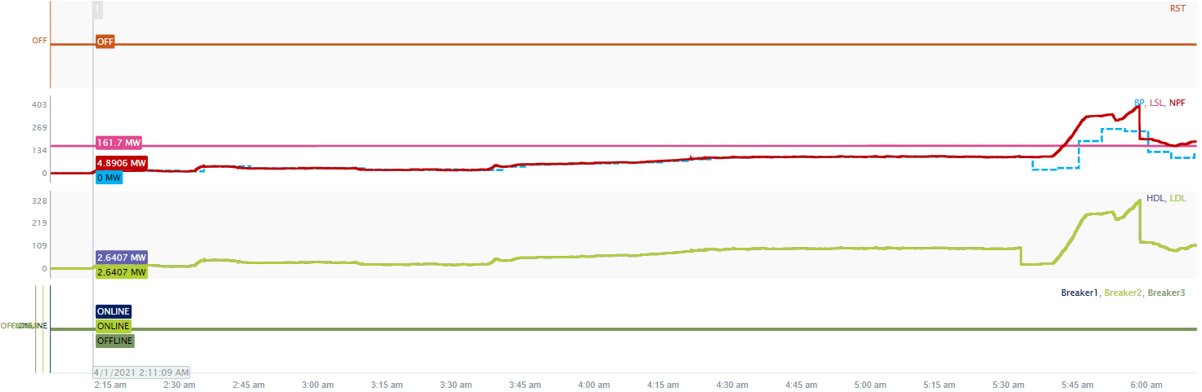
Rule #A: Example 2
Below is an example where a Resource Status (RST) is OFF, unit’s output is greater than 0.9 MW and unit is connected to the grid. The unit’s output is increasing, hence its fair to assume the unit is starting up.
  ERCOT expects that in this situation this unit use STARTUP status and not stay OFF.
  Upon implementation of SCR809, this inconsistent telemetry condition will be detected and when phase 2 goes into effect the unit’s HDL and LDL will be set equal to its current output.
RULE A VIOLATED
RST = OFFLINE
MW = 4.89 MW
LSL = 161.7 MW
Connected to grid

Slide 25
Summary of New Validation Rule #B
WHEN a generation resource telemeters
an online resource status (i.e. ON* excluding OFFQS and ONTEST) AND
net output is greater than 0.9 MW but less than 0.9 * LSL
IF the resource is connected to the transmission grid THEN
(Phase 1) RAISE NOTIFICATION
(Phase 2) SET HDL = LDL = MW
ELSE
(Phase 1) RAISE NOTIFICATION
(Phase 2) DISPATCH the unit per its SCED down ramp rate.
*Note that today’s RLC validation do not take connectivity into account and a special handling does not exist for this situation.

Slide 26
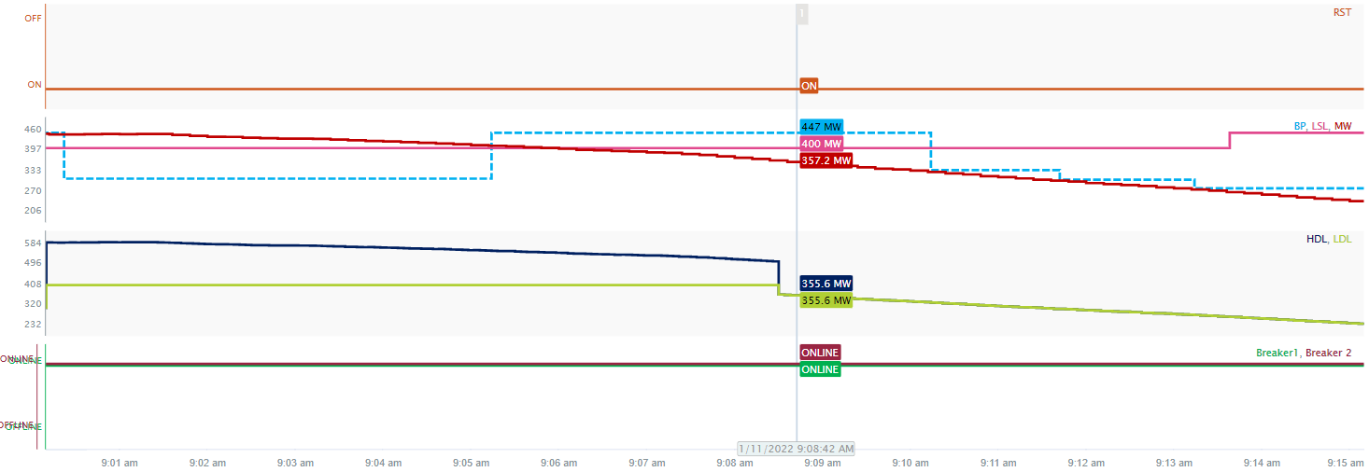
Rule #B: Example 1
Below is an example where a Resource Status (RST) is ON, unit’s output is less than 0.9 * LSL and unit is connected to the grid. The unit’s output is decreasing, hence its fair to assume the unit is shutting down.
  ERCOT expects that in this situation this unit use SHUTDOWN status and not ON.
  Upon implementation of SCR809, this inconsistent telemetry condition will be detected and when phase 2 goes into effect the unit’s HDL and LDL will be set equal to its current output.
RULE B VIOLATED
RST = ONLINE
MW = 357.2 MW
LSL = 400 MW
Connected to grid

Slide 27
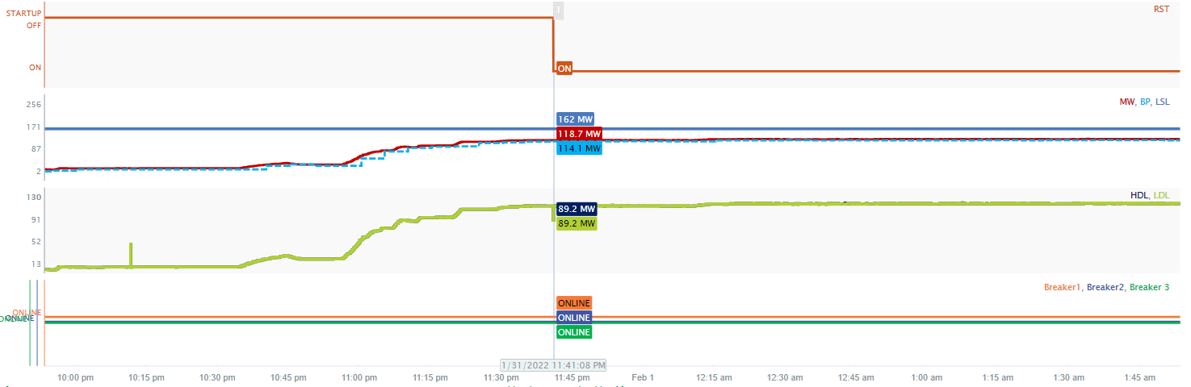
Rule #B: Example 2
Below is an example where a Resource Status (RST) switches to ON, unit’s output is less than 0.9 * LSL and unit is connected to the grid. The unit’s output was ramping up and has stabilized, hence its fair to assume the unit was in STARTUP.
  However, since the unit is still operating below its LSL, ERCOT expects that in this situation this unit use STARTUP status until the unit’s output reaches 0.9 * LSL.
  Upon implementation of SCR809, this inconsistent telemetry condition will be detected and when phase 2 goes into effect the unit’s HDL and LDL will be set equal to its current output.
RULE B VIOLATED
RST = ONLINE
MW = 114.1 MW
LSL = 162 MW
Connected to grid

Slide 28
Summary of New Validation Rule #C
WHEN a generation resource telemeters
an online resource status (i.e. ON* excluding OFFQS and ONTEST) AND
net output is greater than 0.9 * LSL
IF the resource is not connected to the transmission grid THEN
(Phase 1) RAISE NOTIFICATION
(Phase 2) DO NOTHING
*Note that today’s RLC validation do not take connectivity into account and a special handling does not exist for this situation.

Slide 29
Summary of New Validation Rule #D
WHEN a generation resource telemeters
an STARTUP or SHUTDOWN resource status AND
net output is greater than 0.9 MW but less than 0.9 * LSL
IF the resource is not connected to the transmission grid THEN
(Phase 1) RAISE NOTIFICATION
(Phase 2) DISPATCH the unit per its SCED down ramp rate.
*Note that today’s RLC validation do not take connectivity into account and a special handling does not exist for this situation.
* We have provided some examples for these rules in the Appendix

