Slide 1
NPRRs1093 Workshop
ERCOT Staff
April 25, 2022

Slide 2
Agenda
Introduction | Sandip Sharma
Resource Qualification | Steve Krein
DAM Offers and Awards | Alfredo Moreno
Deployment and Recall Process | Nitika Mago
Performance Metrics | Steve Krein
Settlement | Austin Covington
Reports | Jamie Lavas
Q&A | All

Slide 3
NPRR1093 Load Resource Participation in Non-Spinning Reserve
High-priority PUCT project
Expands procurement of Non-Spin to include Load Resources
“Allow Load Resources that are not Controllable Load Resources to participate in Non-Spinning Reserve so that additional capacity is available to ERCOT Operators for the upcoming winter and summer 2022.” excerpt from NPRR
ERCOT worked to minimize interface changes
Relatively minor changes to Market MMS XML submission
Changes limited to new values with AS Self-Arrangement and AS Trades for Non-Spin from Load
Backward compatible (traditional Non-Spin AS type remains the same)
No changes to Telemetry/ICCP

Slide 4
Documents of Interest
NPRR1093, Load Resource Participation in Non-Spinning Reserve
NPRR1101, Create Non-Spin Deployment Groups made up of Generation Resources Providing Off-Line Non-Spinning Reserve and Load Resources that are Not Controllable Load Resources Providing Non-Spinning Reserve
NOGRR232, Related to NPRR1093, Load Resource Participation in Non-Spinning Reserve
OBDRR031,Change Non-Spinning Reserve Service
OBDRR032, Non-Spin Changes Related to NPRR1093, Load Resource Participation in Non-Spinning Reserve
OBDRR033, ORDC Changes Related to NPRR1093, Load Resource Participation in Non-Spinning Reserve

Slide 5
Library of NPRR1093 Requirement Changes
Technical Specification Changes:
Posted at last TWG (https://www.ercot.com/calendar/event?id=1643307467620)
External_Web_Services_XSD_V1.22_NPRR1093
EIP_External_Interfaces_Specification_v1_22
Note the word doc leverages “gray boxed” language to capture multiple protocol changes.
MarketSubmissionValidationRules_NP4-450-NPRR1093
Transaction Changes (more detail in Appendix):
AS Trades (new type of Non-Spin, NSPNM)
AS Self-Arrangement (new type of Non-Spin, NSPNM)
Estimated Key Dates (will be in future Market Notices also):
MOTE availability: May 5, 2022
Scheduled Release 3 Completion: May 26, 2022
First use of NCLRs for Non-Spin in DAM: May 27, 2022
First Operating Day that NCLRs can provide NSRS: May 28, 2022

Slide 6
Resource Qualification
An NCLR must go through a qualification process in order to provide NSRS.
A market notice has been issued requesting Resource Entities to submit a request for their Load Resources to become qualified for NSRS.
For existing LRs qualified for RRS, this request needs to be made at least 10 business days prior to the go-live date for DAM of May 27th.
After we receive that request, those LRs that are currently qualified for RRS, will be given a provisional qualification for 90 days.
New Load Resources will be required to schedule and pass a qualification test after they have been added to the ERCOT systems.
For existing LR that have been given provisional qualification, if a Load Resource is deployed and successfully follows the instruction, that deployment will serve in lieu of a qualification test.
It’s important to note that deployment of the Load Resources for Non-Spin will consist of only an XML Resource Specific instruction. There will not be a verbal instruction associated with the Non-Spin deployments.
We also plan to test all QSEs that plan to use NCLRs for Non-Spin shortly after go-live to insure their systems will function as required.
Successful performance will be measured against the Protocol requirements in section 8.1.1.4.3.

Slide 7
Day-Ahead Market (DAM) Offers and Awards
A Non-Controllable Load Resource (NCLR) that is qualified for RRS and NSRS may submit offers for both services in the DAM. If awarded both services it must move the responsibility to another qualified resource in Real-Time, since both RRS and NSRS can not be carried simultaneously. OFFNS will not be allowed for Load Resources.
There will be NSPIN minimums established for capacity that must be SCED dispatchable. Revision to the Ancillary Services Methodology going through Stakeholder process and currently scheduled for approval at the April 28th Board Meeting. Proposed minimum to be set at the Most Severe Single Contingency value of 1430 MW.
Self-Arranged AS and AS trades may be submitted for NSPNM
MarketSubmissionValidationRules_NP4-450-NPRR1093

Slide 8
Self-Arranged Ancillary Service (AS)
Self-arranged AS NSPIN will continue to be considered for SCED dispatchable resources
NSPIN will be backwards compatible and will not require a NSPNM quantity to be filled
Self-arranged AS NSPNM will be considered for non-SCED dispatchable Resources (i.e. NCLR)
NSPNM will require a NSPIN quantity to be filled (NSPIN=0 and NSPNM ≠ 0 for NSPNM-only self-arrangement)
NSPNM negative self-arrangement and quantities in excess of their obligation will not be allowed

Slide 9
Ancillary Service (AS) Trades
AS trades for NSPIN will continue to be considered for SCED dispatchable resources
AS trades for NSPIN will be backwards compatible and will function as it does today
AS trades for NSPNM will be considered for non-SCED dispatchable Resources (i.e. NCLR)

Slide 10
Off-line NSRS Group Selection Process
The group selection process takes place after DAM awards are made and the QSEs have updated their COPs to reflect awards and trades made during the day ahead process.
An hour of the Operating Day will be randomly selected.
The selection process will use the COPs to randomly pick NCLRs and Off-line GRs and assign them to group 1 until approximately 500 MW of capacity has been selected. That process will continue until all Resources have been assigned to a group.
As part of the DRUC process and no later than 1800 hours, a QSE level certified report will be posted indicating the Group Assignments.
During the Operating Day, if a Resource was not assigned to a group and a deployment occurs, they will automatically get assigned to Group 1, until that group has about 600 MW. Any overflow that occurs will be assigned to the next group.

Slide 11
Provision of Non-Spin by NCLRs in Real Time
While NCLRs will be able to offer and get awarded both RRS and Non-Spin in DAM, in Real Time RRS and Non-Spin cannot be provided simultaneously on the same NCLR.
When providing Non-Spin NCLR must telemeter ONRL Resource Status and, if equipped with an under-frequency relay (HSUF), the relay should not be armed and its telemetered HSUF status should indicate that the relay is disabled.
The following new telemetry rules will be setup in ERCOT EMS to validate the telemetry that is received from NCLRs that are telemetering ONRL status.
Only NCLRs that are qualified to provide Non-Spin may telemeter a non-zero Non-Spin Responsibility (NSRS) and Non-Spin Schedule (NSSC).
If the NCLR has a non-zero Non-spin Responsibility or Schedule AND the HSUF is not disabled then the Responsibility and Schedule will be set to 0.
If the NCLR has a non-zero Responsive Reserve Responsibility or Schedule AND the HSUF is not enabled then the Responsibility and Schedule will be set to 0.

Slide 12
NSRS Deployment Criteria
Off-Line Non-Spinning Reserve can be deployed for:
Capacity Insufficiency – Periodic checks are made to detect capacity available for energy dispatch
Disturbance Conditions – e.g., unit trips, sustained frequency decay or sustained low frequency operations
SCED not having enough energy available to execute successfully.
When Off-Line Generation Resources and NCLRs providing Non-Spin are the only reasonable option available to the Operator for resolving local issues.

Slide 13
NSRS Deployment Process for NCLRs
Quantities being dispatched can be partial or the entire fleet.
For partial deployments, Resources are dispatched for their entire NSRS capacity.
NCLRs and GRs providing Off-Line Non-Spin can be deployed individually, in groups, or as an entire block providing Non-Spin. Deployments that do not encompass an entire block may only be done to manage inertia, congestion, or for other local needs.

Slide 14
NSRS Deployment Process for NCLRs (cont.)
Group deployments can be staged based on operating conditions so that Group 1 may be deployed, and then subsequent groups deployed at a later time.
If subsequent groups are deployed, that group plus all other groups previously deployed will all receive resource specific deployment instructions.
The QSE will be sent a Resource-specific XML Dispatch Instruction for the Non-Spin deployment indicating a time and date stamp, QSE, Dispatch Asset Code, and Deployed MW.
The deployment instruction process will not include a verbal dispatch instruction similar to what is done in Responsive Reserve Service. QSE’s should be prepared to initiate the deployment process solely based on the XML instructions.
The QSE will ensure that the telemetry for the Non-Spin Ancillary Service Schedule for a deployed NCLR has been reduced to zero within one minute of receiving the Dispatch Instruction.
Off-line Non-Spin will automatically be re-dispatched at the top of the hour until recalled. These dispatch instruction will only be issued for those Resources showing a resource status of ONRL and a positive value for the NSRS Responsibility.
The NCLRs must be capable of remaining deployed until recalled.

Slide 15
NSRS Recall Process for NCLRs
The recall of NCLRs that have been deployed for Non-Spin Service will include a resource specific instruction for a 0 MW deployment. All NCLRs that have been deployed should receive a recall instruction at the end of a deployment.
A QSE with a NCLR that has provided Non-Spin and has been recalled will ensure that the Load energy and Non-Spin capability is restored within three hours of the recall instruction issued by ERCOT.
If the QSE cannot restore within three hours of the ERCOT recall instruction, the Non-Spin obligation must be replaced by the QSE from other Non-Spin qualified Resources capable of providing the service.
The QSE will ensure that the Non-Spin Ancillary Service Schedule telemetry for a NCLR continuously and accurately represents the amount of Load capacity that has been restored following a recall instruction and is available for subsequent deployment.

Slide 16
Event Deployment Performance
For Off-Line Generation Resources and Controllable Load Resources there are no changes to the process for Event Deployment Performance
For NCLR event deployment performance:
measured as indicated in Protocol 8.1.1.4.3 (3)(d) &(e)
Performance is measured against a 5-minute average baseline that uses the meter before/meter after performance metric
A QSE level certified report will be posted monthly for NCLR Event Performance for Non-Spin. The report will show Resource level performance for each Non-Spin Deployment Event.

Slide 17
ORDC and RDPA
ORDC treatment addressed in OBDRR033
New determinant (RTNCLRNSCAP) added to RTOFFCAP (the system total Real-Time Off-Line reserve capacity for the SCED interval).
Real-Time On-Line Reliability Deployment Price Adder is addressed in NPRR1093 section 6.5.7.3.1(2)(e).
Deployed MW added to GTBD linearly ramped over the 30-minute ramp period.

Slide 18
Settlements
Changes to Protocol Section 6.7.5, Real-Time Ancillary Service Imbalance Payment or Charge – Updates settlements calculations for Online Imbalance to account for Non-Spin Reserve responsibility and Offline Imbalance to account for capacity and responsibility from Load Resources that are not Controllable Load Resources participating in Non-Spin Reserve.
New Billing Determinants:
Billing Determinant | Short Description | Extract | Extract Table
RTNCLRNSRESPR | Real-Time Non-Controllable Load Resource Non-Spin Responsibility for the Resource | SID & RTM CODE | MKTINPUTHEADER MKTINPUTINTERVAL
RTNCLRNSRESP | Real-Time Non-Controllable Load Resource Non-Spin Responsibility for the QSE | RTM CODE | RTMOUTPUTHEADER RTMOUTPUTINTERVAL
RTNCLRNSR | Real-Time Non-Spin Schedule for the Non-Controllable Load Resource | SID & RTM CODE | MKTINPUTHEADER MKTINPUTINTERVAL
RTNCLRNS | Real-Time Non-Spin Schedule for the Non-Controllable Load Resources for the QSE | RTM CODE | RTMOUTPUTHEADER RTMOUTPUTINTERVAL
RTNCLRNSCAP | Real-Time Capacity from Non-Controllable Load Resources Carrying Non-Spin for the QSE | RTM CODE | RTMOUTPUTHEADER RTMOUTPUTINTERVAL

Slide 19
Report Impact Summary – NPRR1093
Report | Change Summary
NP6-557-CD Group Assignments for NCLRs and Off-Line Generation Resources participating in NSRS | New Report - Daily Certified for QSEs Rpt ID: 21939
NP6-323-CD Real-Time ORDC and Reliability Deployment Price Adders and Reserves by SCED Interval | Report Modification Rpt ID: 13221 Change: Addition of new column ‘RTNCLRNSCAP’
NP6-792-ER Historical Real Time ORDC and Reliability Deployment Price Adders and Reserves | Report Modification Rpt ID: 13231 Change: Addition of new column ‘RTNCLRNSCAP’
NP8-385-ER Monthly Non-Spin NCLR Performance Report | New Report - Monthly Certified for QSEs Rpt ID: 22069
NP3-911 2-Day Ancillary Services Disclosure Output File: 2d_Self_Arranged_AS_NSPNM | Report Modification Rpt ID: 13057 Change: New CSV output file within the 2-Day Self-Arranged AS ‘2d_Self_Arranged_AS_NSPNM’ due to new NSPNM subtype
NP3-966-ER 60D DAM Disclosure Report Output file: 60-Day QSE-Specific Self-Arranged AS in DAM | Report Modification Rpt ID: 13051 Change: Current NSPIN Column to be split out to account for new subtype of NSPNM
NP3-965-ER 60D SCED Disclosure Report Output file: 60-Day QSE-Specific Self-Arranged AS in DAM | Report Modification Rpt ID: 13052 Change: Current NSPIN Column to be split out to account for new subtype of NSPNM

Slide 20
Summary
Allows Non-Controllable Load Resources (NCLRs) that are not SCED dispatchable to provide Non-Spin
There will be limits established for the amount of capacity that must be SCED dispatchable (currently going through the stakeholder process and at TAC).
NCLRs are dispatched with the Off-line Resources (mixed groups of off-line GRs and NCLRs of about 500 MW)
Group assignment methodology is similar to RRS for UFR type LRs and is completed in the Day Ahead Process
No change for the CLR deployments
Project is in execution phase and scheduled as part of Release 3 - 5/24/22-5/26/22
Changes to ORDC and RDPA addressed

Slide 22
Appendix
NPRR 1093 Details

Slide 23
NPRR 1093 XSD changes
External Web Services XSD V1.22_NPRR1093
ERCOTCommonTypes

Slide 24
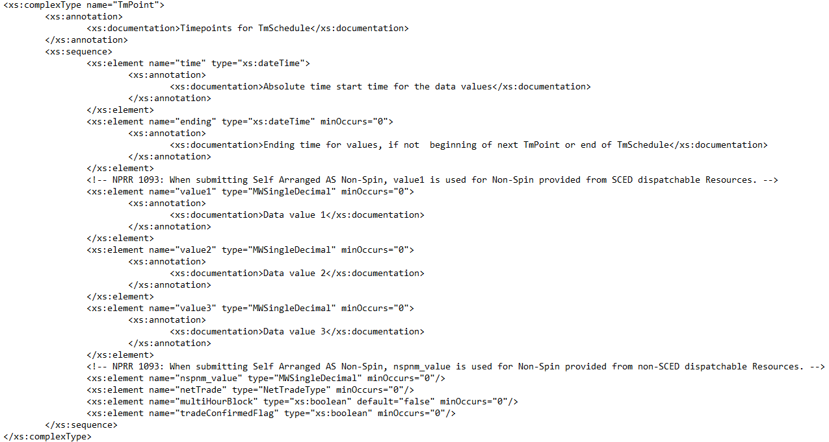
NPRR 1093 XSD changes
ERCOTCommonTypes

Slide 25
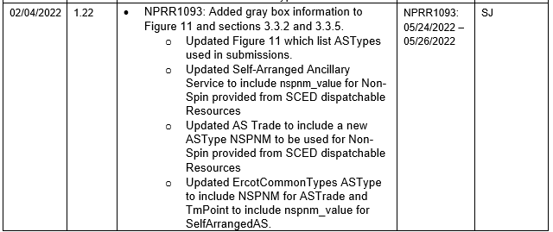
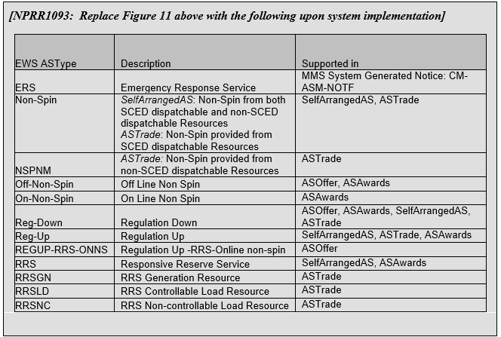
NPRR 1093 Interface changes
EIP_External_Interface_Specifications_v1_22

Slide 26
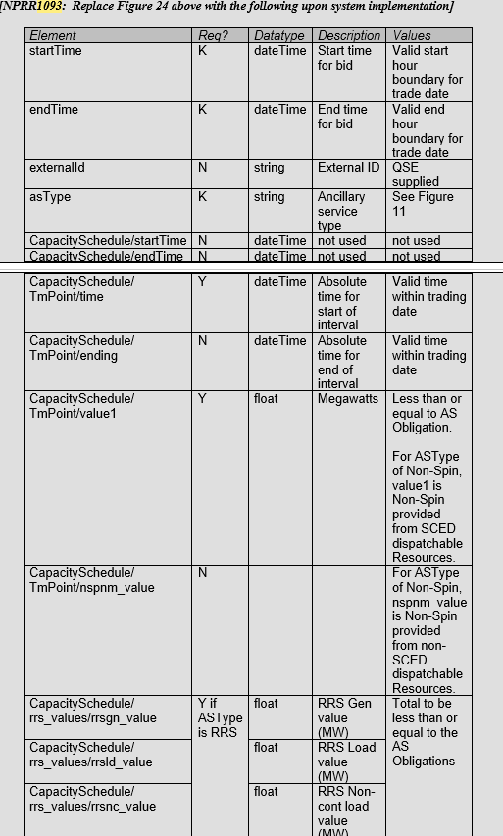
NPRR 1093 Interface changes
EIP_External_Interface_Specifications_v1_22

Slide 27
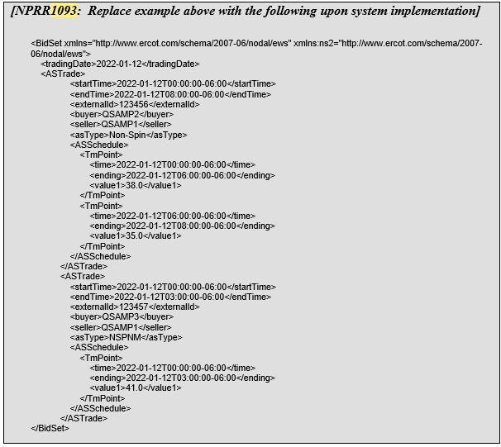
NPRR 1093 Interface changes
EIP_External_Interface_Specifications_v1_22

Slide 28
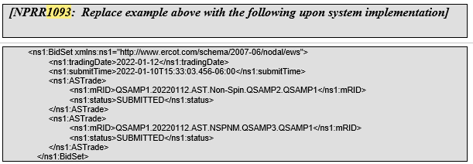
NPRR 1093 Interface changes
EIP_External_Interface_Specifications_v1_22

Slide 29
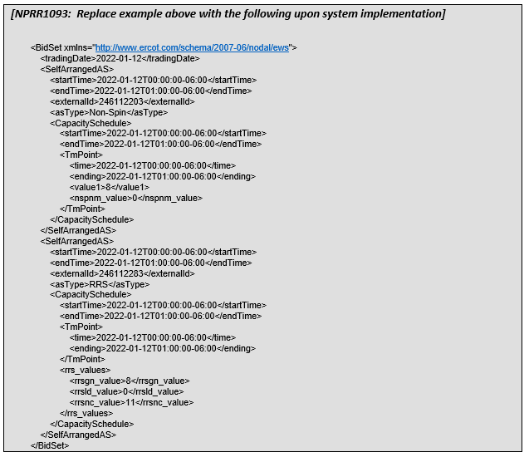
NPRR 1093 Interface changes
EIP_External_Interface_Specifications_v1_22

