Slide 1
Summary of Reliability Unit Commitment (RUC) Activities and Analysis For Q1 2022
Nitika Mago
Manager, Balancing Operations Planning
April 22, 2022

Slide 2
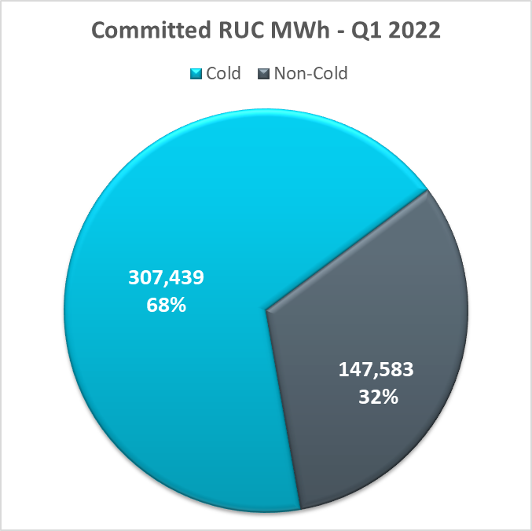
RUCed Capacity by Cause Q1 2022
In Q1 2022, two thirds of the RUC committed MWhs were during three cold weather events (Jan. 1-3, Feb. 2-5 and Feb. 23-25).
In Q1 2022, one third of the RUC commitments were for other reasons
Today’s discussion will focus on the cold-weather RUCs first and then the others.

Slide 3
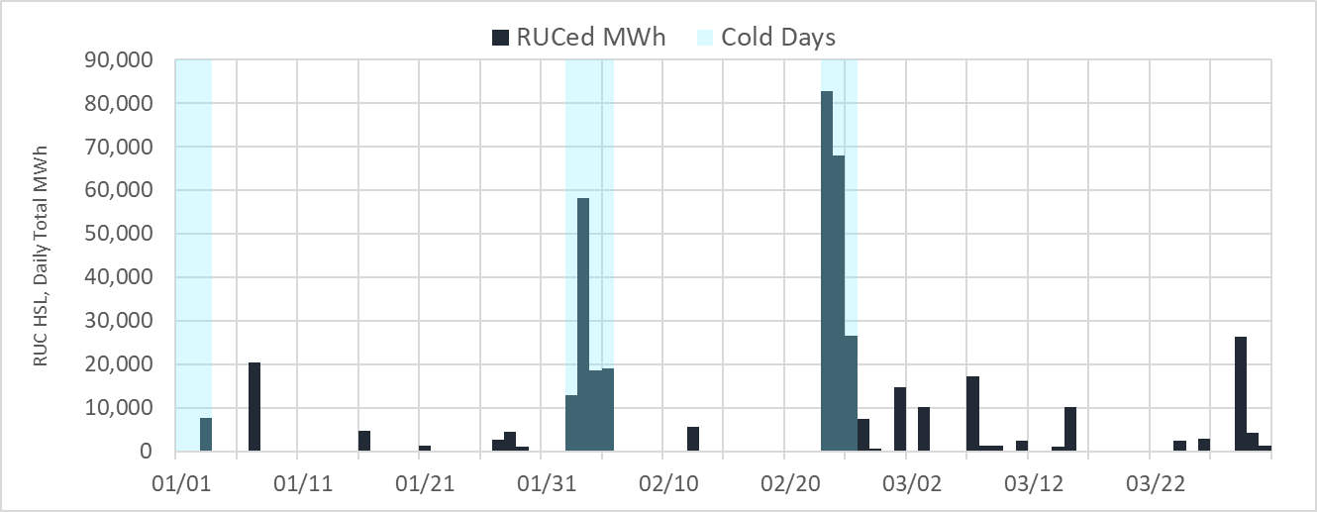
RUCed Capacity (HSL) in Q1 2022
Cold days
To operate the grid in a more conservative manner, in Q1 2022, significant RUC activities occurred for the cold weather days namely Jan. 1-3, Feb. 2-5, Feb. 23-25.
RUC activities on remaining (non-cold) days were for other reasons that will be discussed later in this deck.
RUC activities on Jan. 7 were driven by gas restrictions and a combination of under-commitment and less than 6500 MW margin.
RUC activities on Mar 27 and 29 were for congestion issues.

Slide 4
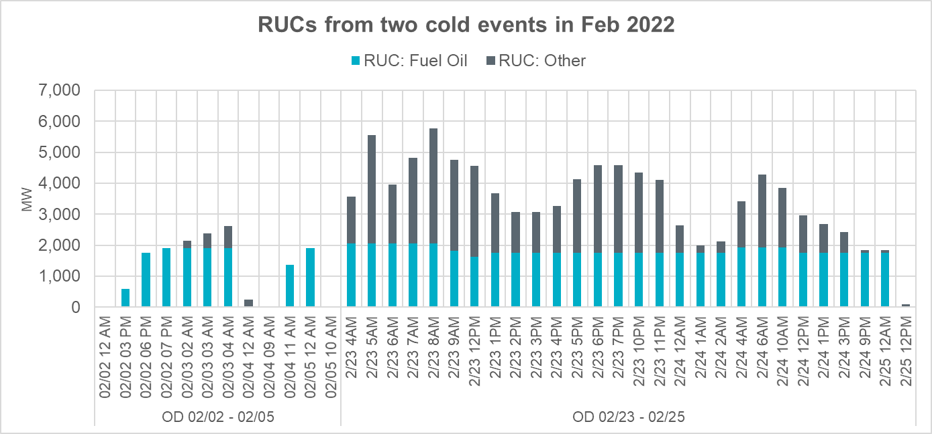
Gas Restrictions and Fuel Oil Use
Most RUCs on the two cold weather events in February 2022 were to keep units available on fuel oil.

Slide 5
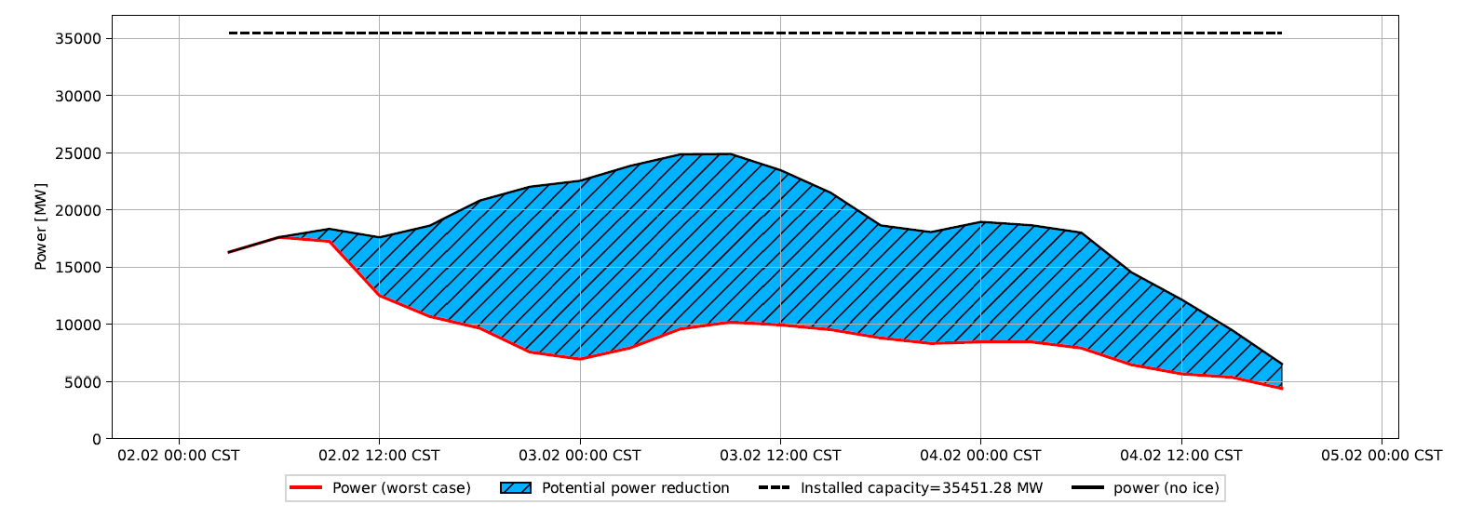
Potential Icing Impact on Wind Power
ERCOT receives an icing forecast from both wind forecast providers, and icing impact is also factored-in when planning to operate during cold weather events.
The graph below shows an example icing forecast that was received for Feb 2nd through Feb 5th as of 08:00 on Feb 2, 2022. The worse case projection was up to ~14,000 MW of icing impact around midnight of Feb 3.

Slide 6
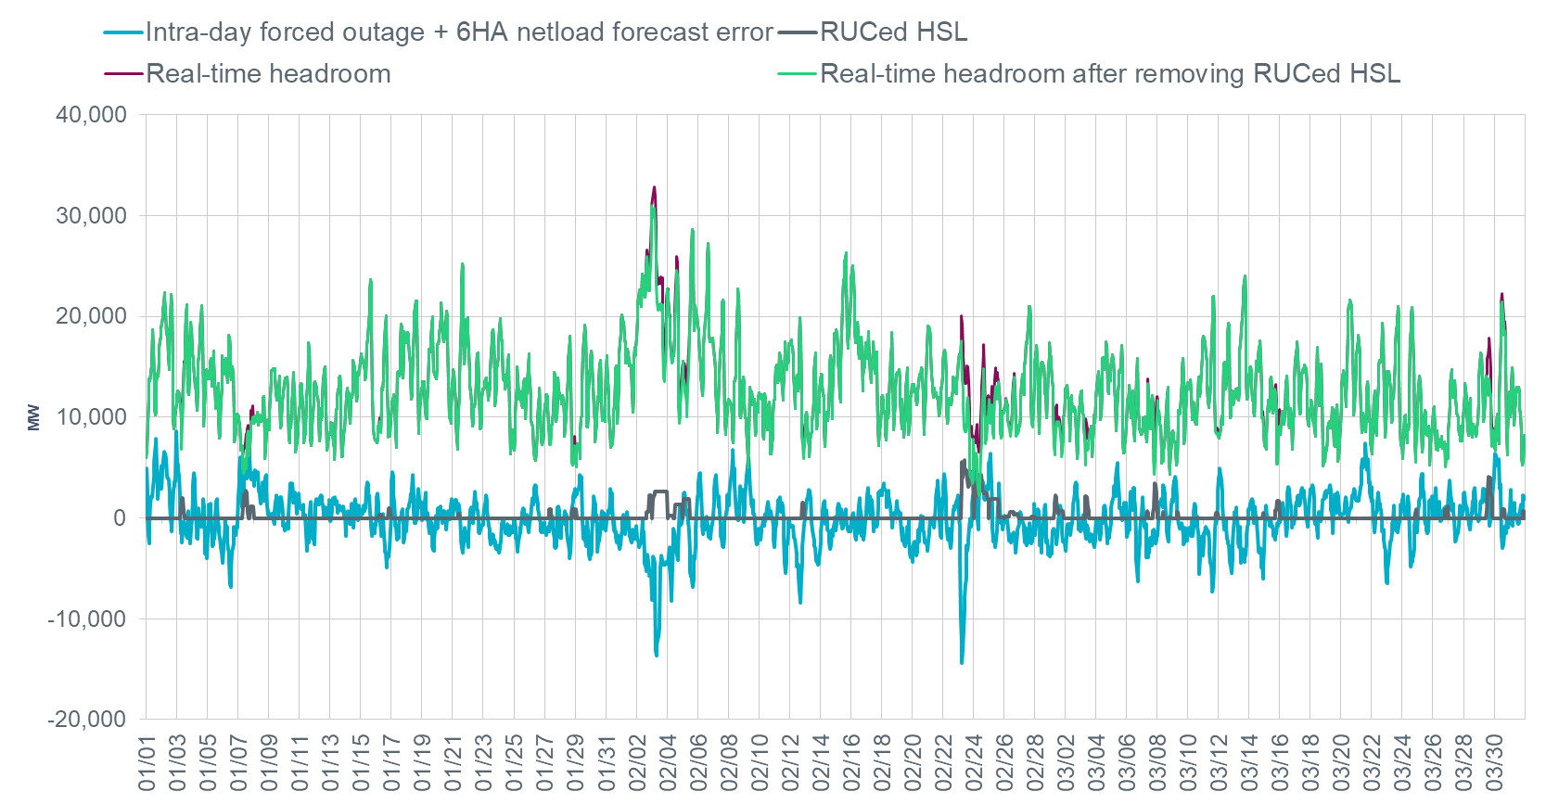
Real-time Headroom Trend Q1 2022
Real Time Headroom = Total Online HSL + Offline Non-Spin – Actual Load
Coldest Temperature (°F):
Dallas | 20
Houston | 27
Austin | 21
San Antonio | 21
Brownsville | 35
Abilene | 13
Midland | 7
Coldest Temperature (°F):
Dallas | 22
Houston | 37
Austin | 29
San Antonio | 30
Brownsville | 42
Abilene | 19
Midland | 19

Slide 7
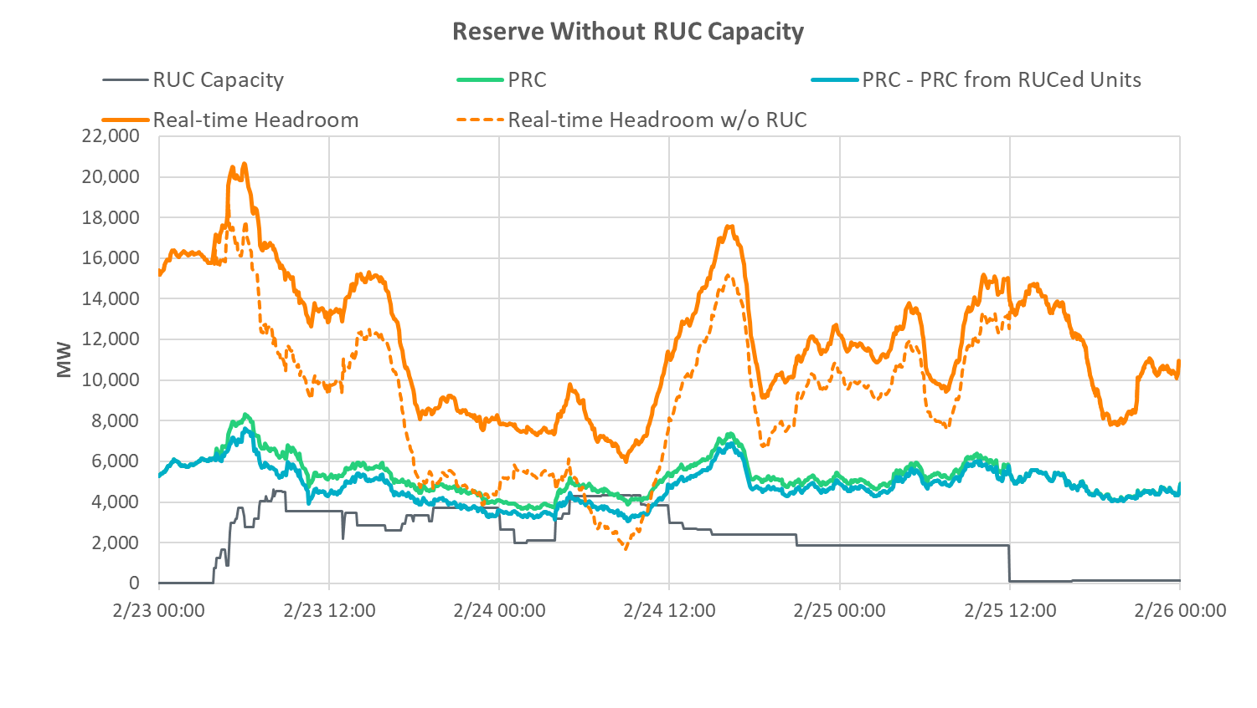
Reserves without RUCs on Feb 23-24, 2022
PRC from RUCed units only counts 20% of headroom and does not count impact of RUCs on other units; PRC would likely have been lower

Slide 8
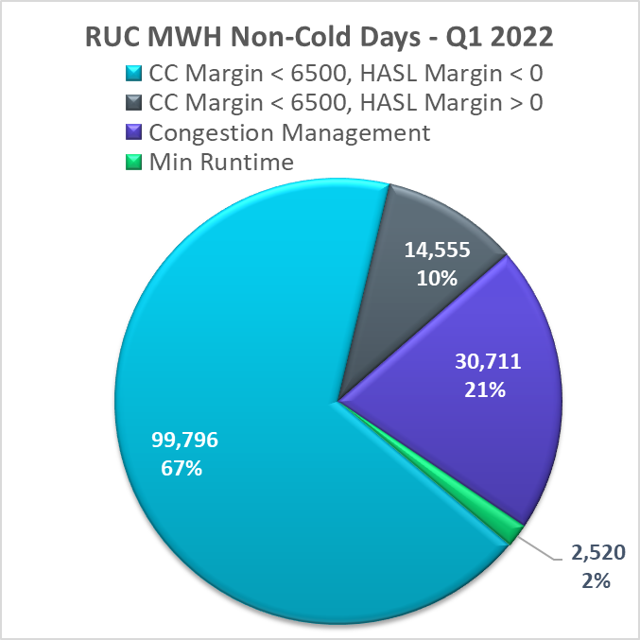
RUCed Capacity by Cause (Non-Cold Days) Q1 2022
Of the RUC commitments outside of the cold weather events:
68% of the remaining commitments occurred when HASL was less than Load Forecast (HASL Margin)
10% of the remaining commitments occurred when HASL Margin was met but the 6500 MW committed generation capacity margin was not met.
21% of the remaining commitments were related to congestion (and occurred in March).
The questions about the RUCs to meet the HASL Margin are about which units are committed and when.
The questions about the RUCs to meet the Committed Capacity Margin are about whether these additional RUCs above the HASL Margin are needed
Will discuss these separately.
HASL: High Ancillary Services Limit = the capacity of generation resources minus their ancillary services commitments
CC Margin: Committed Generation Capacity minus Load Forecast
HASL Margin: HASL – Load Forecast
“Cold Days” = Jan 1-3, Feb 2-5, Feb 23-25

Slide 9
RUC Recommendations
QGSRs not providing NS
8 Hour start time units
QGSRs not providing NS
Short starts not providing NS
Short starts not providing NS
2 Hour start time units
3-6 Hour start time units
Self-Committed Gen
Load+AS
NSRS
REGUP and RRS-Gen
T=-8
T=-6
T=-2
T=-1
T=0
Self-Committed
Not committed
ERCOT-Committed

Slide 10
RUC Recommendations
QGSRs not providing NS
8 Hour start time units - UNAVAILABLE
QGSRs not providing NS
Short starts not providing NS
Short starts not providing NS
2 Hour start time units
OUTAGED
Self-Committed Gen
Load+AS
NSRS
REGUP and RRS-Gen
T=-8
T=-6
T=-2
T=-1
T=0
Self-Committed
Not committed
ERCOT-Committed
The problem comes when ERCOT will forego the longer lead-time units and then some of the shorter lead-time units become unavailable

Slide 11
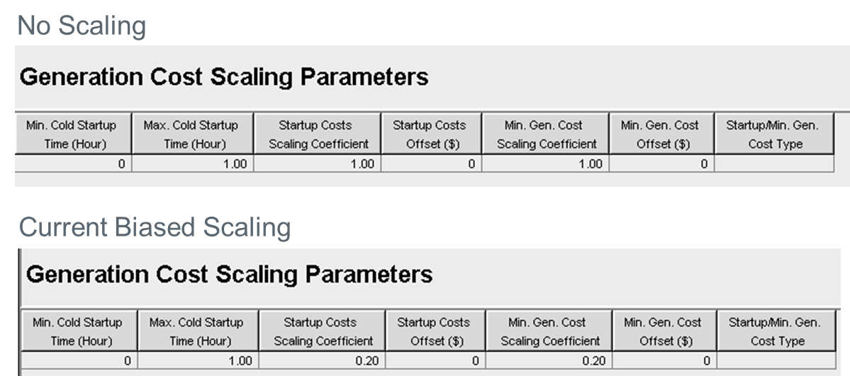
Bias toward Committing Short Lead-Time Units
RUC optimization tool currently has scaling inputs that bias its recommendation toward picking shorter lead time units – NPRR 864 (2018)

Slide 12
Re-ran HRUC for Several Historic Days without Bias Scaling
Generally, changing the scaling induces the HRUC optimization to favor extensions, medium and long lead time Resources over short lead time Resources
This conclusion may not hold for cases with very low HASL margins (10/3/2021 3:00), possibly because HRUC already recommends most of the Resources available
The Scaling Removed cases tend to have similar amounts of HSL capacity, but lower aggregate LSL and fewer Resources
Optimization chooses larger Resources when scaling is removed
The Resource type mix changes when the scaling is removed
We see much more gas steam capacity recommended by HRUC
The gas steam Resources most often replace the simple cycle Resources
Change in behavior is consistent for morning and evening peaks
All cases show positive results for afternoon peak
February case shows that changes happened even when case was only 5 hours before peak
Scaling Removed cases were more aligned with what Operators committed
The counter argument is that, with the biased commitment, commitment of shorter lead time units may be avoided entirely if forecasts moderate or outages do not occur

Slide 13
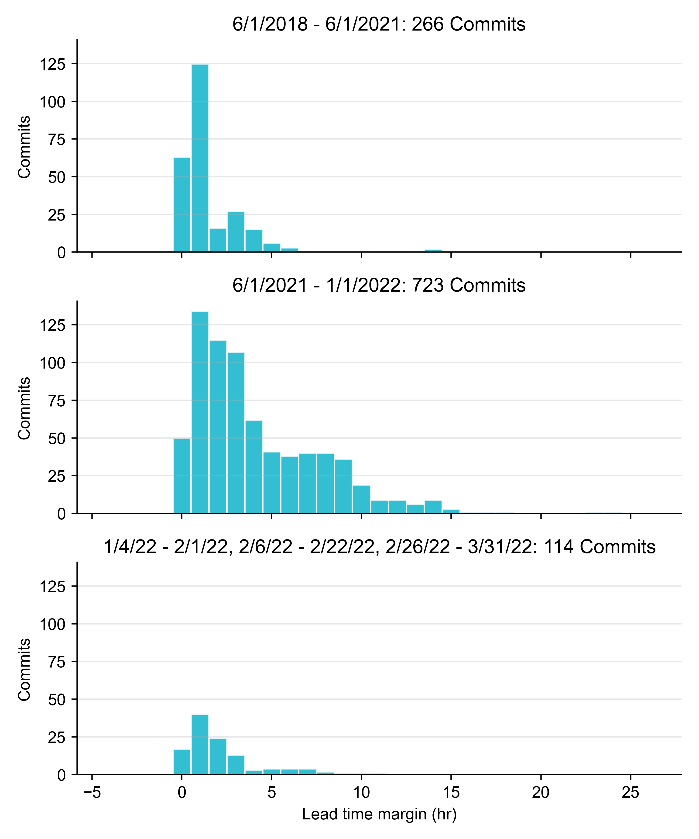
RUC Lead-Time Margin Trend
How to read this graph:
If a RUC instruction was issued 6.5 hours ahead of the hour for which the unit is needed, and the unit has a 6-hour start time, then the lead time margin shown on this graph would be 1 hour.
Since Jan 1, 2022, RUC instructions on non-cold days are not sent far ahead in advance but are mostly 1 to 3 hours prior to the start time of the resource being committed.
Historic
2021 after change
Q1 2022
(non-Cold Days)

Slide 14
RUCs for 6,500 MW Criteria
Recap of how this criteria came about,
For 2021, the original Non-Spin requirements in Ancillary Services (AS) methodology were based 3 hour ahead net load forecast error.
After large number of intraday forced outages on top of forecast errors led to tight conditions in April and June 2021, an additional commitment criteria of having 6,500 MW of generation capacity online above the load forecast for each hour was added
At the beginning, this meant committing very early in the Operating Day to achieve 6,500 MW of committed capacity margin (CCM) in each hour.
Several changes were made during 2021 to this backstop commitment procedure, including consideration of Offline Non-Spin to the CCM calculation, only committing to 6,500 MW CCM for peak load hours and delaying commitment as long as it did not result in foregoing longer lead time resources.
With the impending implementation of NPRR1093, the more AS that comes from Load Resources (LRs), the more often AS quantities from Generation may drop below 6,500 MW.
For this particular issue, a change will be need to the CCM definition will be needed as more LRs start providing NSRS.

Slide 15
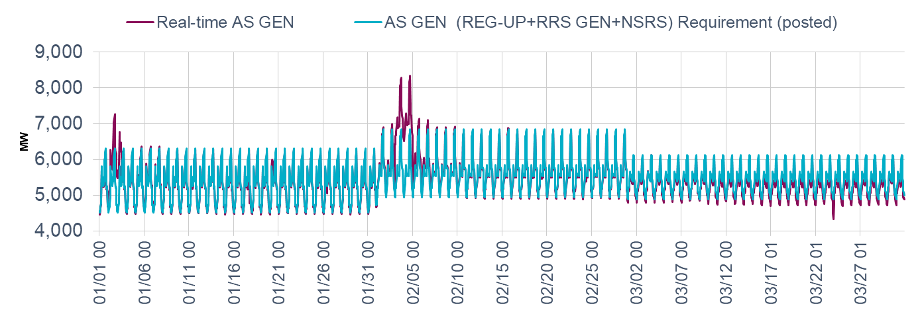
Non-Spinning Reserves Q1 2022
For 2022, the Non-Spinning Reserve Service amounts for each hour were increased to cover:
85th – 95th percentile of the historic MW error in the 6-hour ahead net load forecast (Load-Wind-Solar), and
75th percentile of the historic thermal (non-PUN) generation capacity that is forced out since midnight
At the evening load peak hours in:
Jan. 2022, the total AS GEN Requirement was 6066-6306 MW (HE 16-18).
Feb. 2022, the total AS GEN Requirement was 6682-6849 MW (HE 16-18).
March 2022, the total AS GEN Requirement was 6004-6115 MW (HE 16-18).
For morning load peak hours, the total AS GEN was 5459 – 5842 MW (HE 7-9).
*Due to forecast uncertainty, ERCOT increased NSRS requirement on the following days
Jan. 2 by 500 MW for HE1-12 and by 1,000 MW for HE13-24;
Jan 3 by 1,000 MW for HE1-12 and
Jan. 20 by 500 MW for HE8-12.
Due to cold weather, ERCOT increased NSRS requirement on the following days
Feb. 3-4 by 1,000 MW for all hours

Slide 16
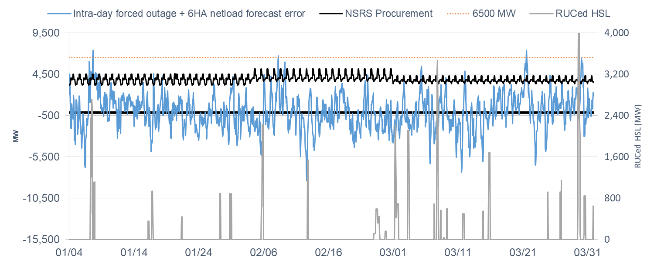
Sufficiency of NSRS Procurement on Non-Cold Days in Q1 2022
*Cold days are excluded.
Procured NSRS capacity was sufficient for the sum of the intraday forced outages and the 6HA netload forecast error for most of the times in Q1 2022.
NSRS was not sufficient during load peak hours on Jan. 7, 8, 18, 29; Feb. 8, 9; and Mar. 21, 29.
Jan 7 was the only day wherein RUCed instructions were sent for ~2,400 MW.
Other times the outages plus error exceeded the procured NSRS were during off-peak.

Slide 17
Summary and some Potential Changes related to RUCs
ERCOT recognizes that additional commitments will occur on cold weather days to reduce risks related to weatherization and gas supply.
If self commitments increase, then the need for ERCOT to take actions reduces. Changes in NPRR 1092 on RUC Opt Out when implemented may result in an increase in self-commitments and help in this regard.
Following the implementation of NPRR1093, as more Load Resources start providing Non-Spin, Committed Capacity Margin will need to be changed include Load Resources providing Non-Spin.
Lastly, ERCOT wants to further discuss the current scaling factors in RUC optimization and evaluate if changes would allow the RUC engine to meet operational goals in a more efficient way.

