Slide 1
Monthly Review of Reliability Unit Commitment Market Impacts - March 2022
ERCOT Staff
WMWG
April 22, 2022
ERCOT Public

Slide 2
RUC Resource-Hours
March 2022 | Total | Opt-Out | Non-Opt-Out
Instructed Resource-Hours
Total Count | 277.0 | 62.0 | 215.0
Effective Resource-Hours*
Total Count | 255.5 | 55.7 | 199.9
Average LSL | 104.6 | 129.4 | 97.7
Average LDL | 112.3 | 158.0 | 99.6
Average BP | 117.3 | 178.3 | 100.4
Average HSL | 335.2 | 314.0 | 341.1
* The difference between “Instructed” and “Effective” values is a result of Resources starting up, shutting down, receiving partial hour instructions, or otherwise not being dispatchable by SCED.

Slide 3
RUC Instruction Reasons
March 2022
255.5 effective RUC Resource-hours.
198.0 Resource-hours (77.46%) for capacity concerns.
57.6 Resource-hours (22.54%) for congestion concerns.
55.7 effective Resource-hours (21.80%) were successfully bought back.

Slide 4
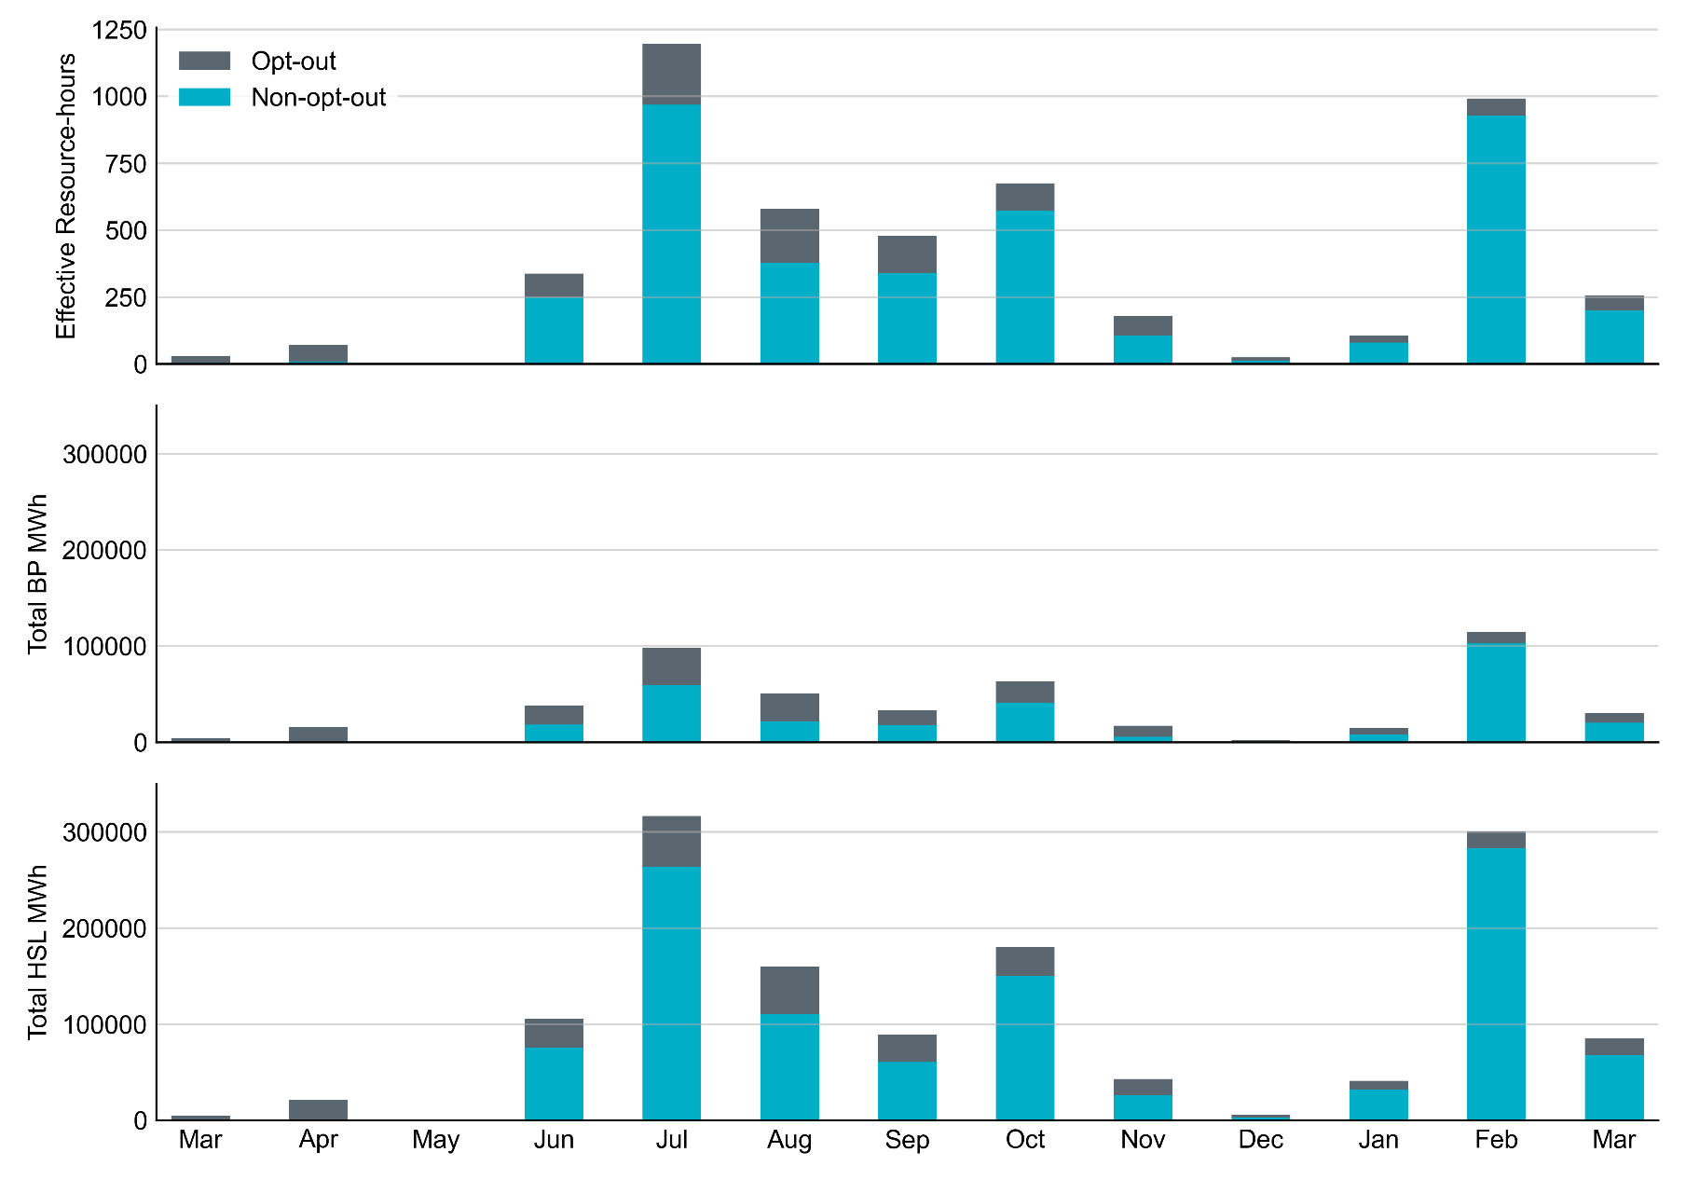
Non-opt-out and Opt-out Totals: Last 13 Months March 2022 has a total of 199.9 non-opt-out effective Resource-hours and 55.7 opt-out effective Resource-hours.

Slide 5
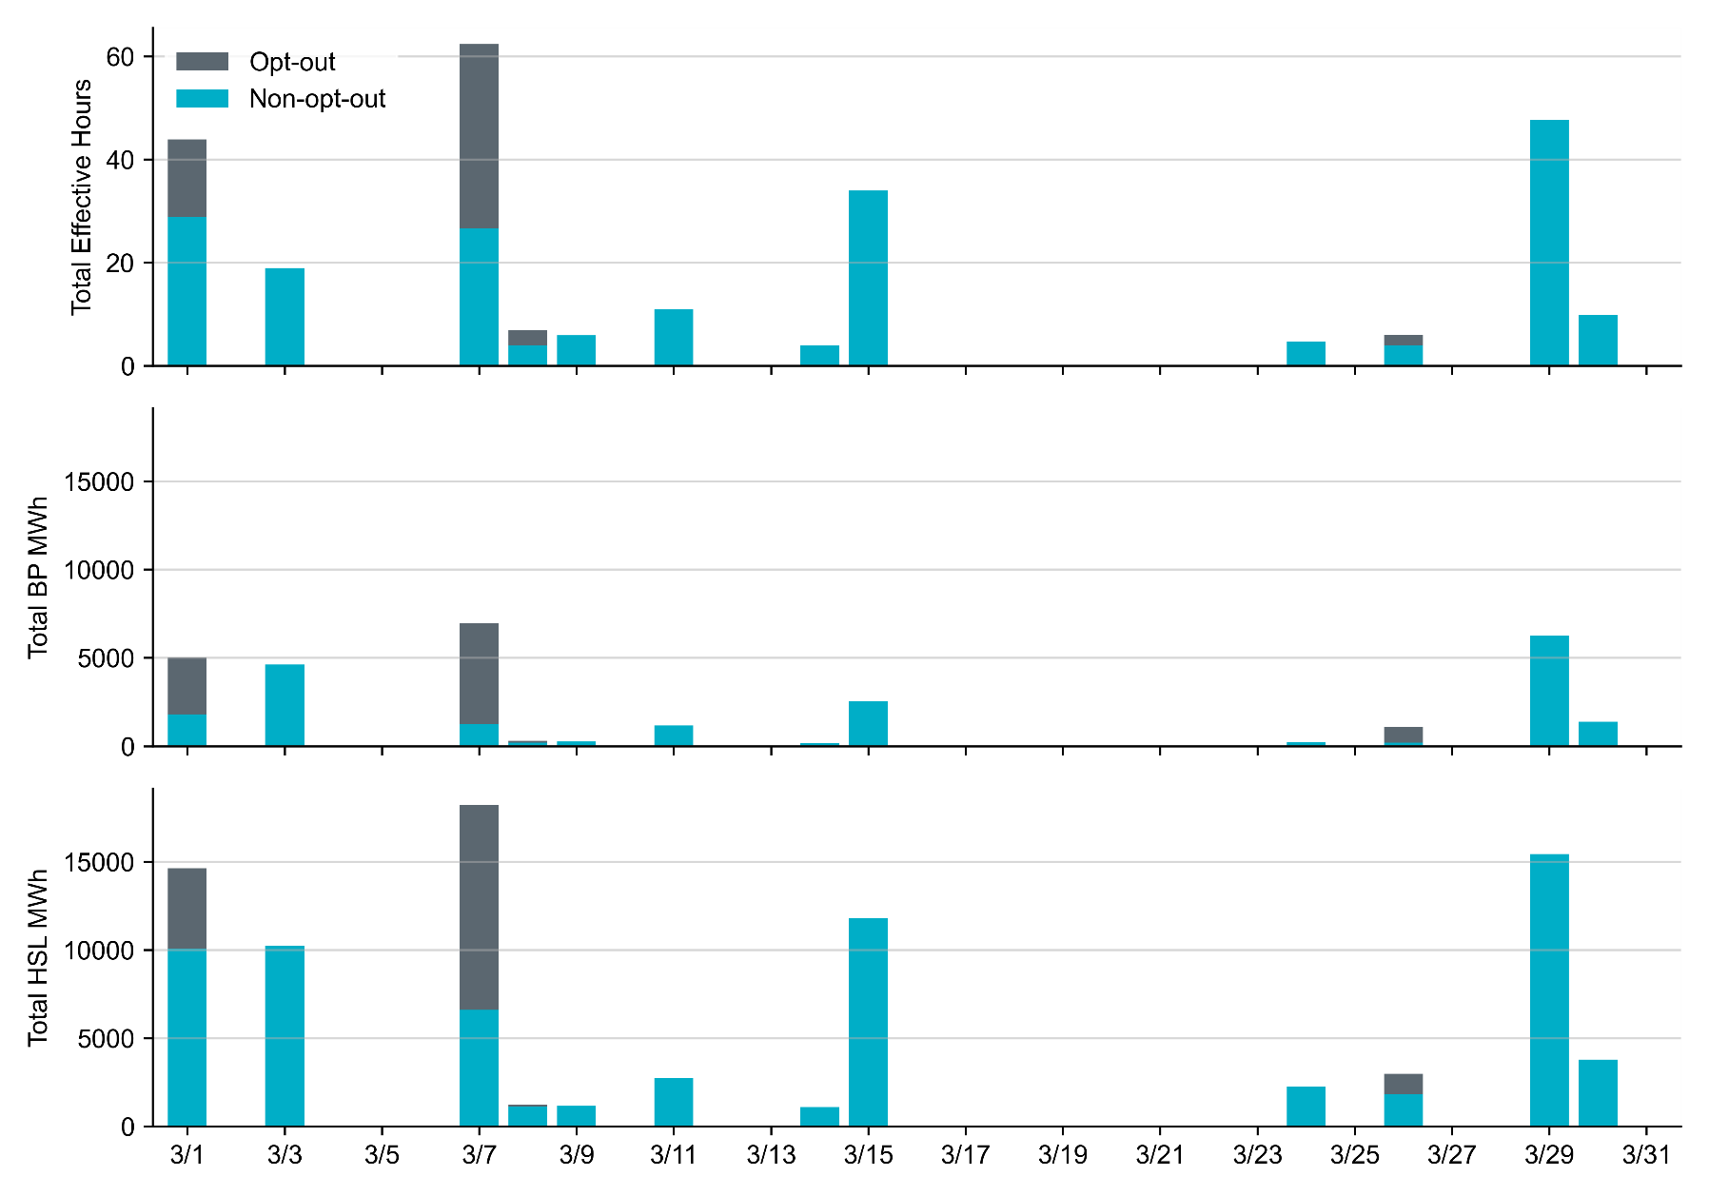
Non-opt-out and Opt-out Totals: March 2022 RUC in March 2022 were primarily driven by capacity concerns. Most Opt-out Resource-hours occurred on Operating Day 3/1/2022 and 3/7/2022.

Slide 6
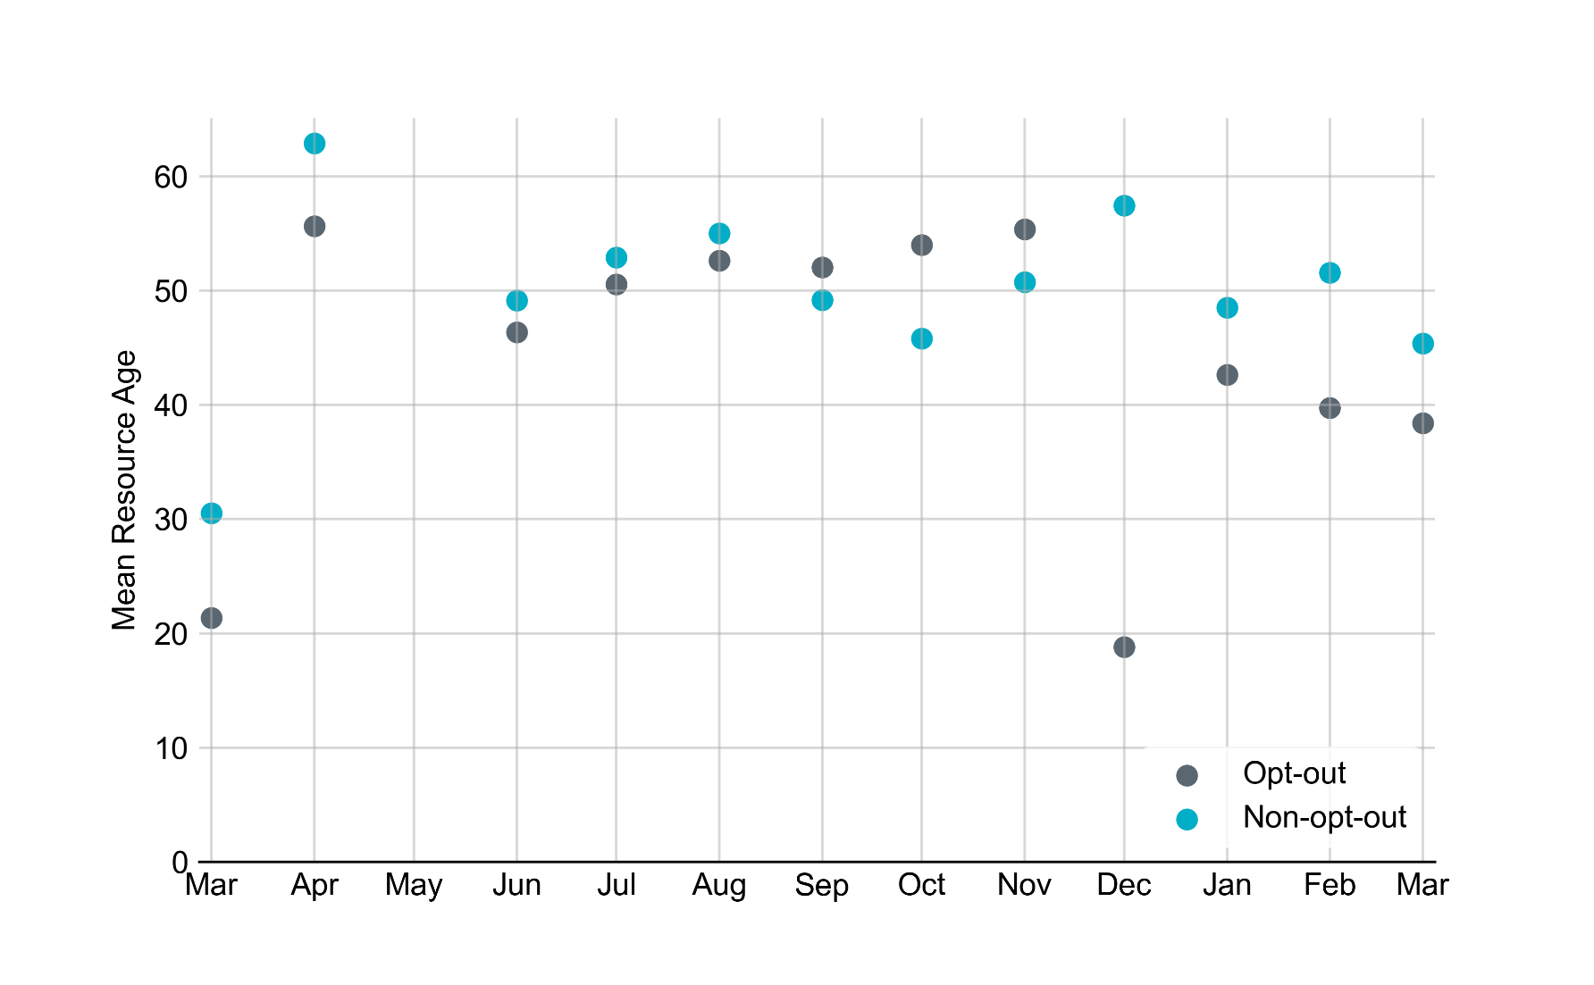
Average Resource Age In March 2022, mean opt-out Resource age is 38 years, and mean non-opt-out Resource age is 45 years.
Note: For Resource configurations with multiple physical generators, the age of the oldest generator is used.

Slide 7
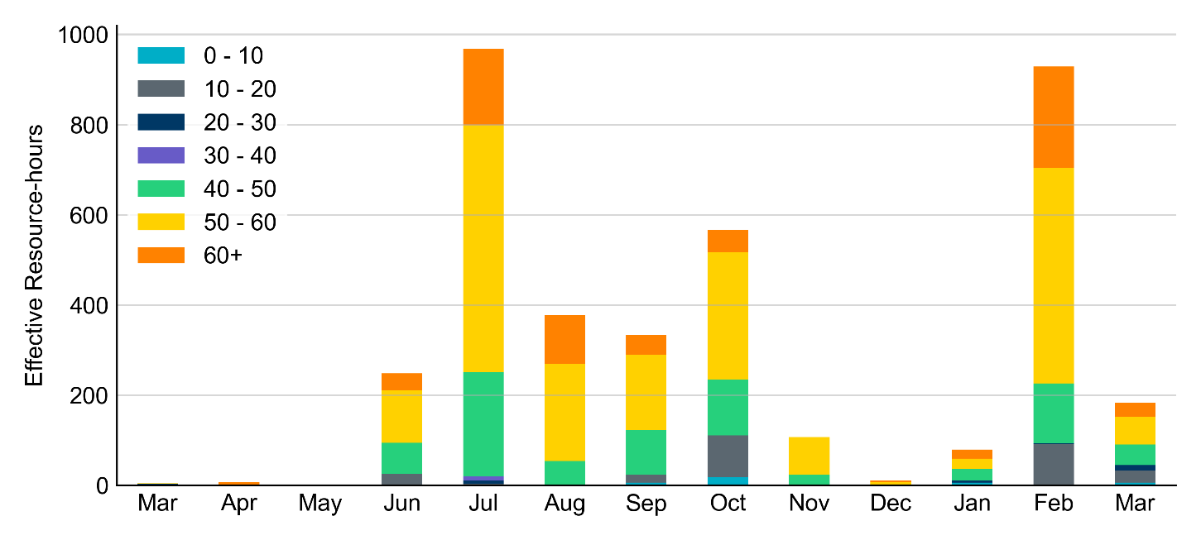
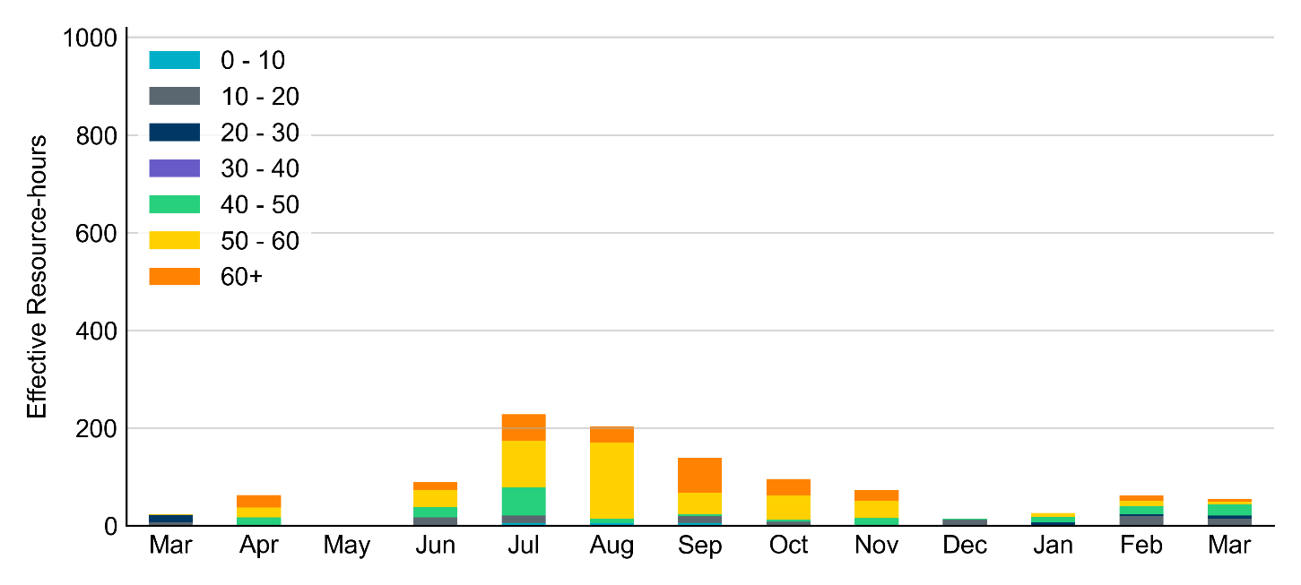
Age Category Majority of RUC Committed Resources in March 2022 were older than 40 years.
Non-opt-out
Opt-out

Slide 8
RUC-Instructed Resource Dispatch above LDL
March 2022
When Resources did not successfully opt out, there were 6.6 effective Resource-hours for which the Resource was dispatched above its LDL.
For 3.3 of these Resource-hours, the RUC-instructed Resource was mitigated.
For the other 3.3 of these Resource-hours, the RUC-instructed Resource was DAM-committed, and the Resource-hours were counted as Opt-out.

Slide 9
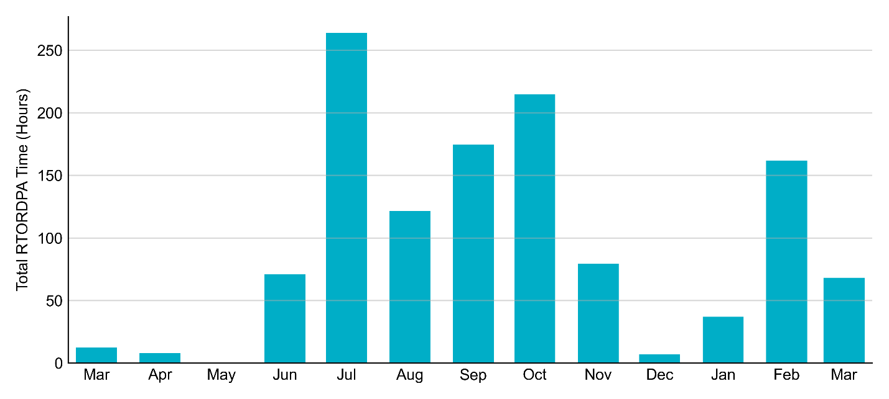
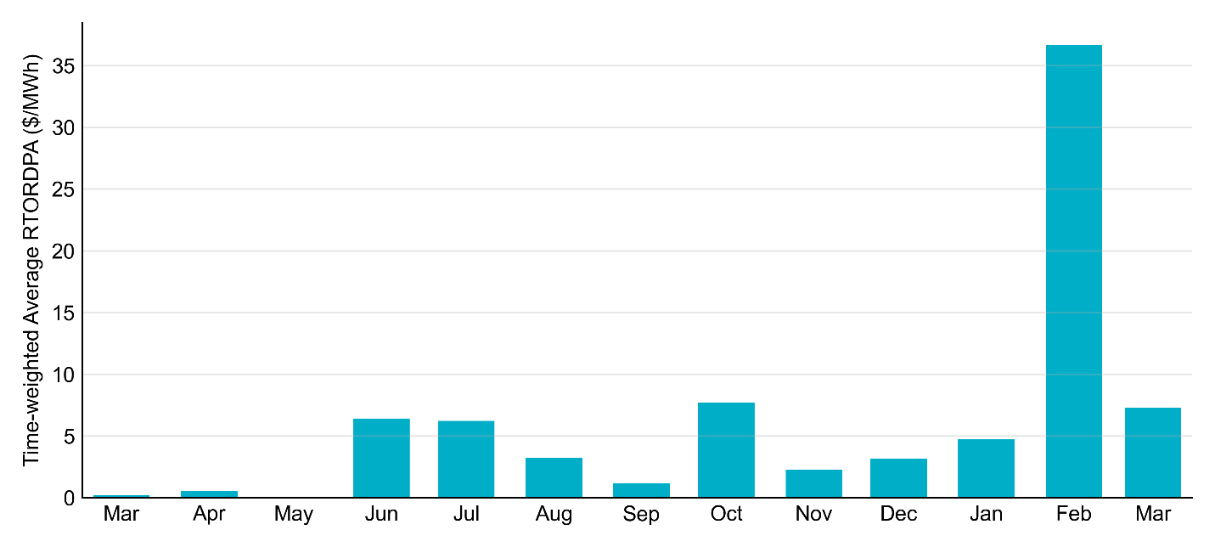
Reliability Deployment Price Adder: Last 13 Months March 2022 has a total of 68.2 RTORDPA hours with an average value of $7.3/MWh

Slide 10
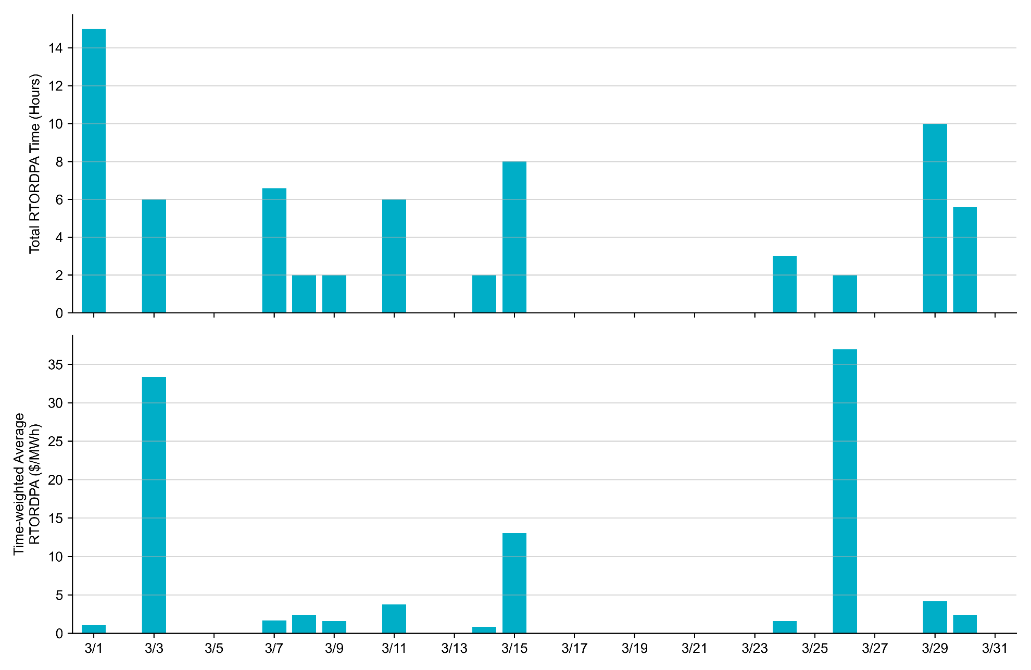
Reliability Deployment Price Adder: March 2022 OD March 26th has the highest daily average RTORDPA of $36.94/MWh within the month

Slide 11
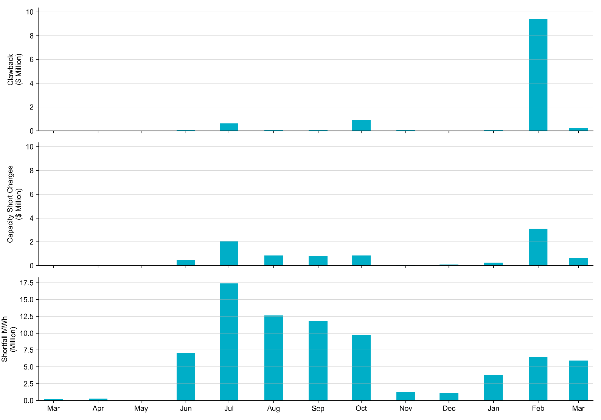
RUC Clawback, Capacity Short Charges, and Shortfall For March 2022, the total Clawback charge was $0.24 million, and the total Capacity Short Charge was $0.64 million. The Capacity Short Charge was nearly fully covered by Make-whole payment.
 | March 2022
Make-whole ($ Million) | 0.636
Uplift to Load ($) | 0.6

