Slide 1
RUCs and Real-Time Pricing
ERCOT Staff
WMWG RUC Workshop
April 22, 2022
ERCOT Public

Slide 2
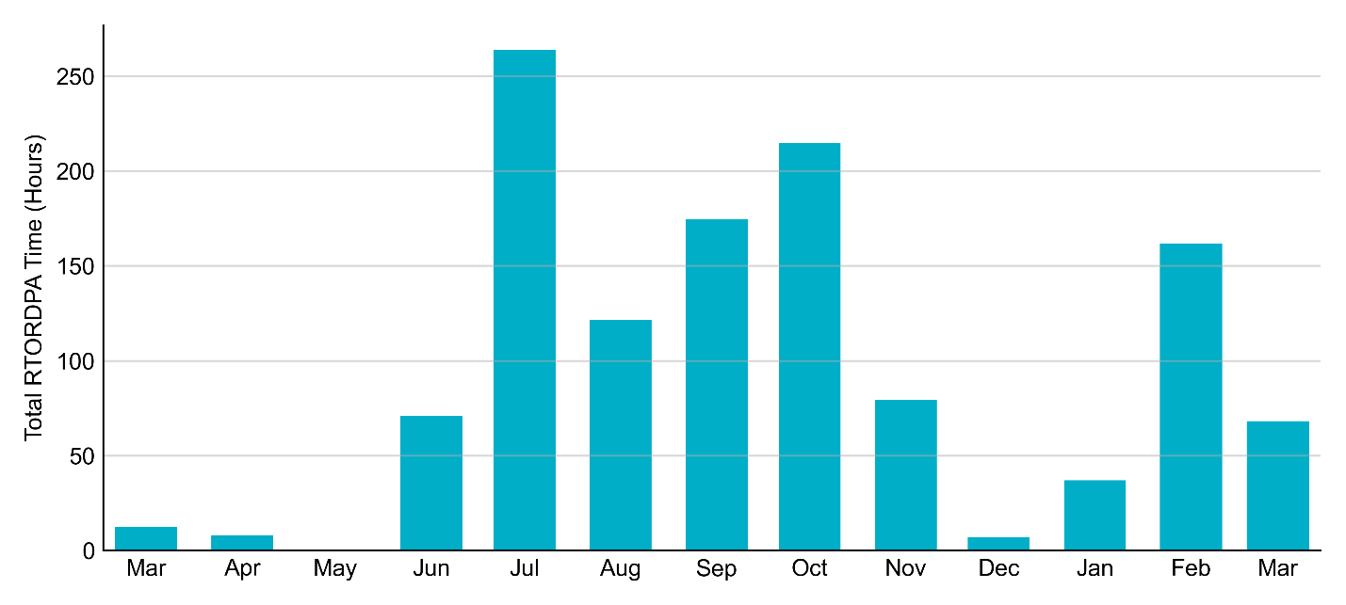
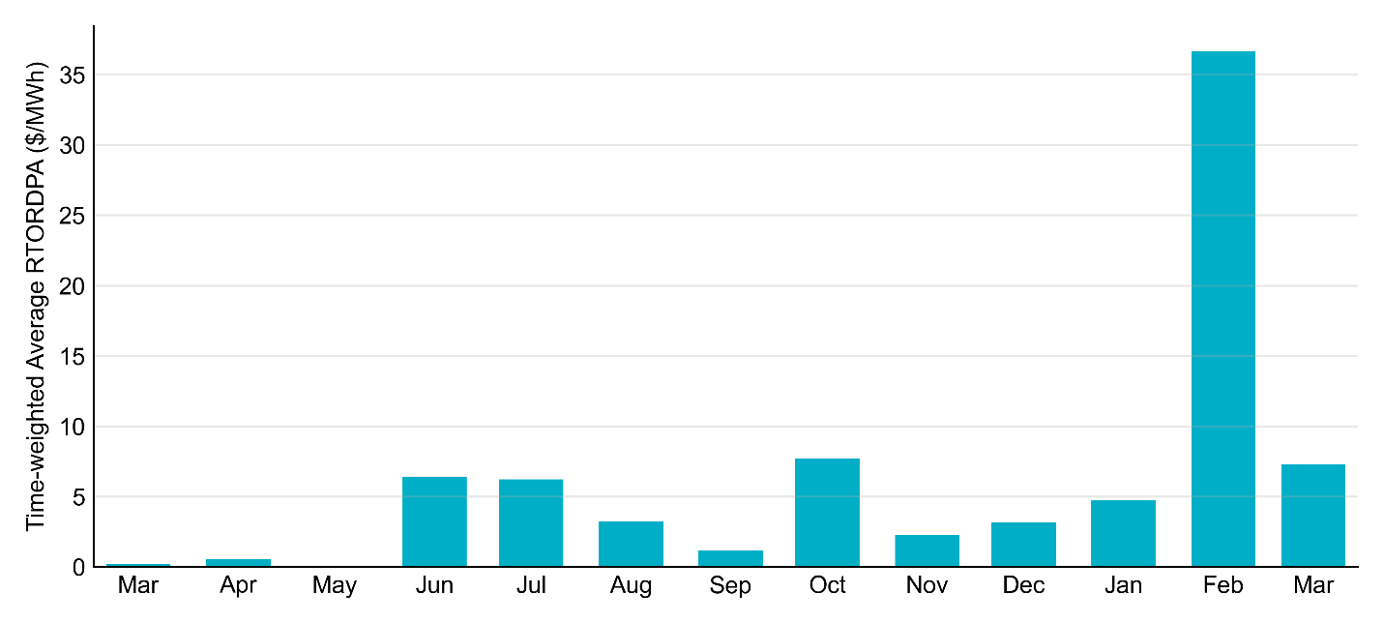
Reliability Deployment Price Adder: Last 13 Months February 2022 has the highest average monthly RTORDPA since winter storm Uri in 2021

Slide 3
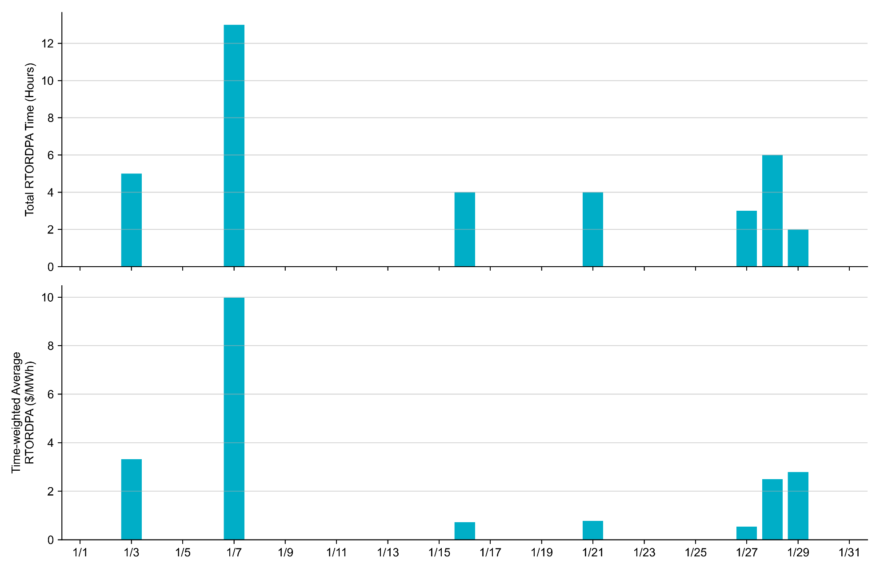
Reliability Deployment Price Adder: January 2022 OD January 7th has the highest daily average RTORDPA within the month

Slide 4
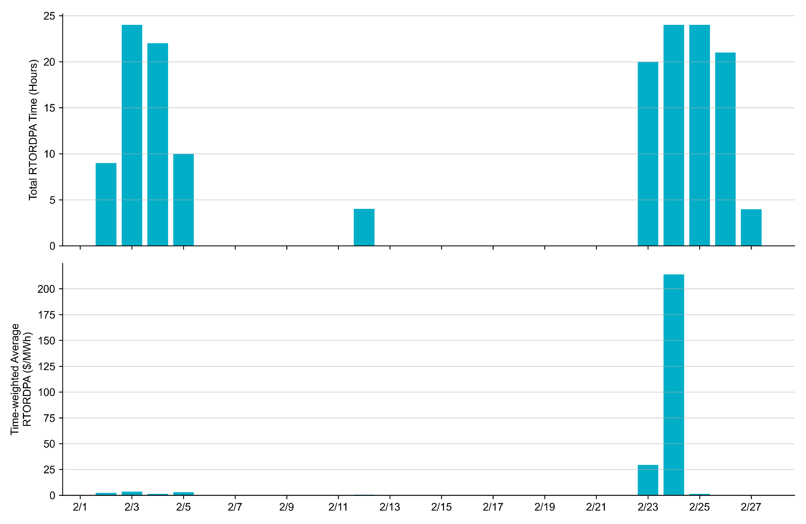
Reliability Deployment Price Adder: February 2022 OD February 24th has the highest daily average RTORDPA within the month

Slide 5
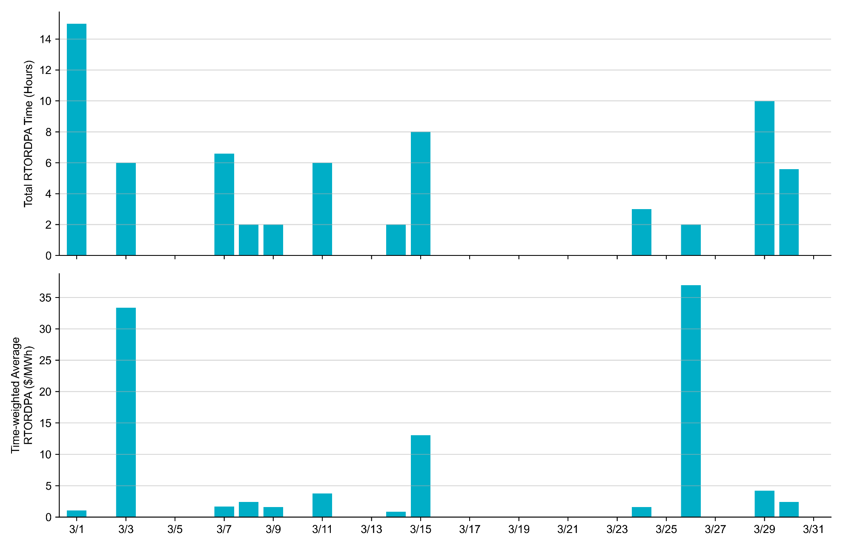
Reliability Deployment Price Adder: March 2022 OD March 26th has the highest daily average RTORDPA within the month

Slide 6
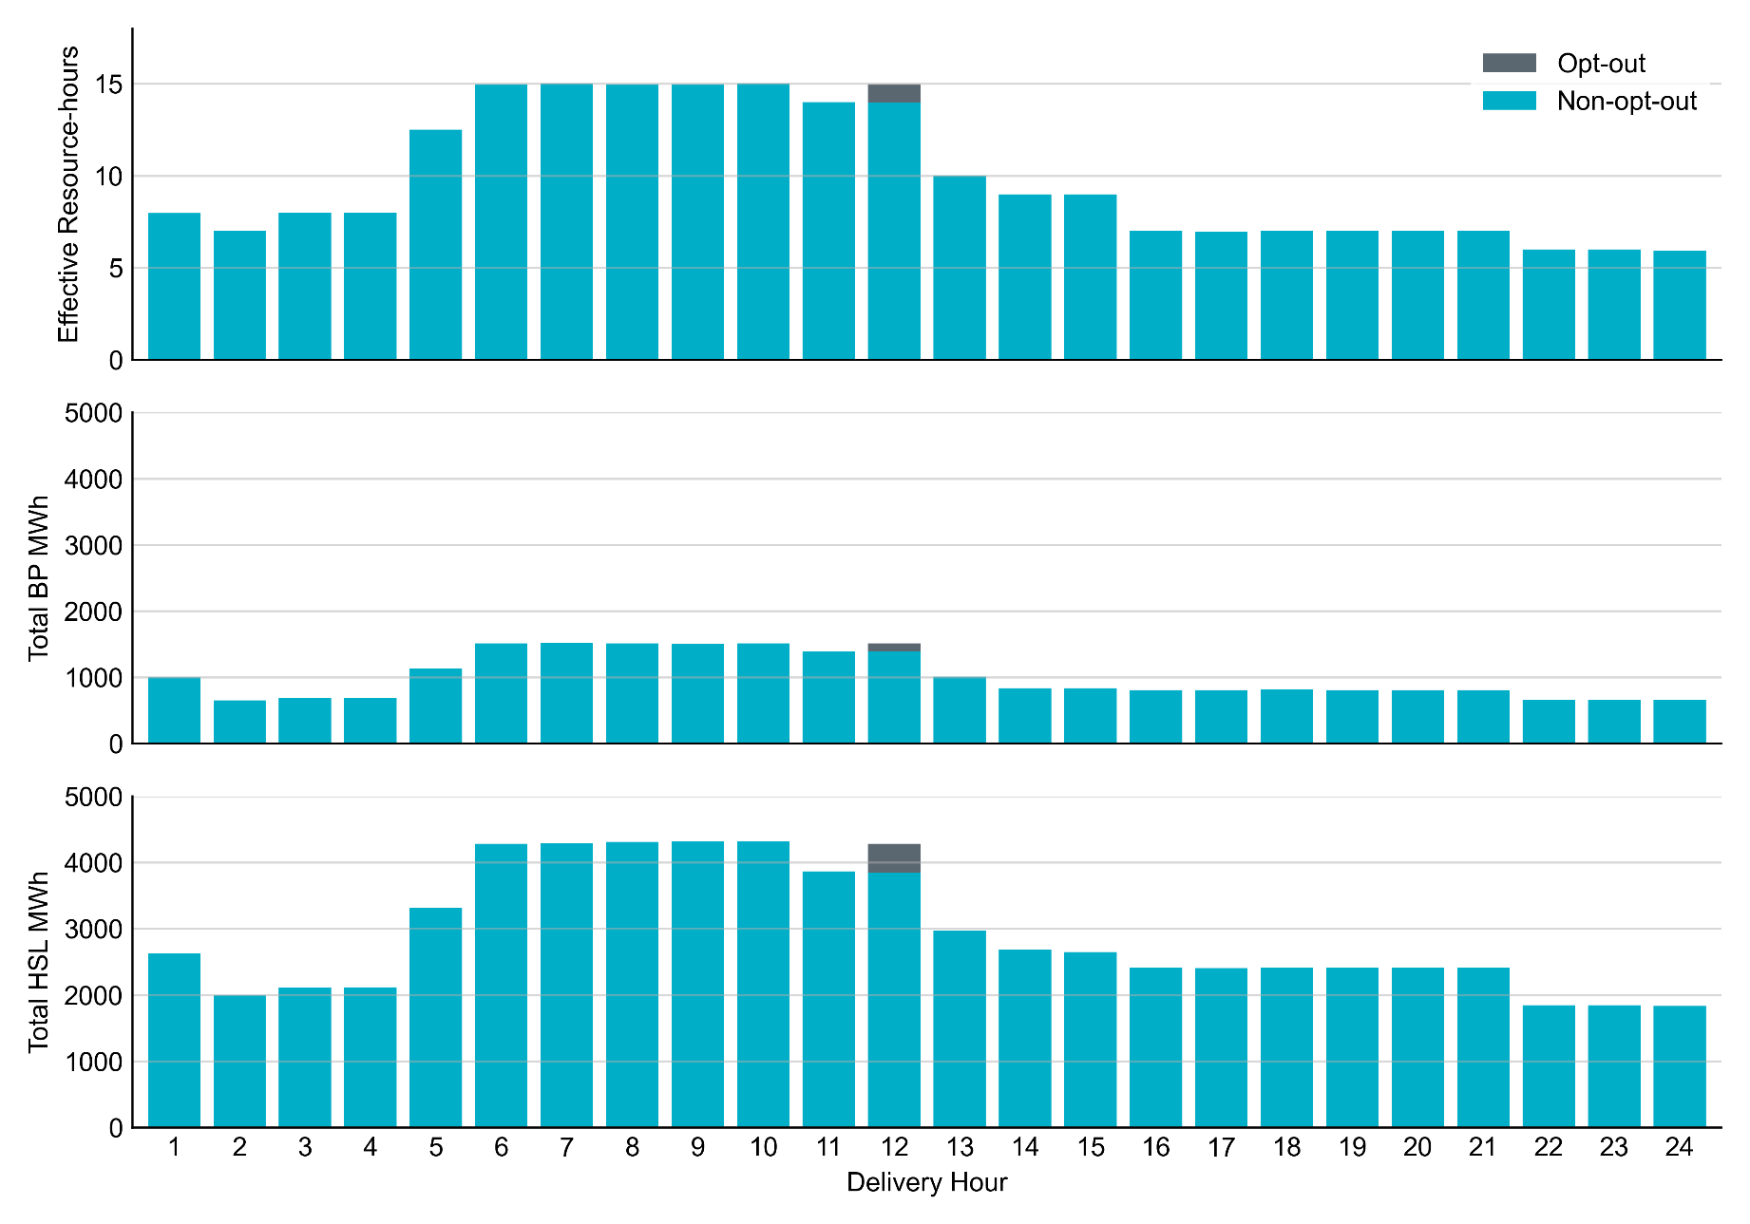
Non-opt-out and Opt-out Totals: February 24, 2022 Most Resources did not opt-out except for one Resource opt-out for HE 12

Slide 7
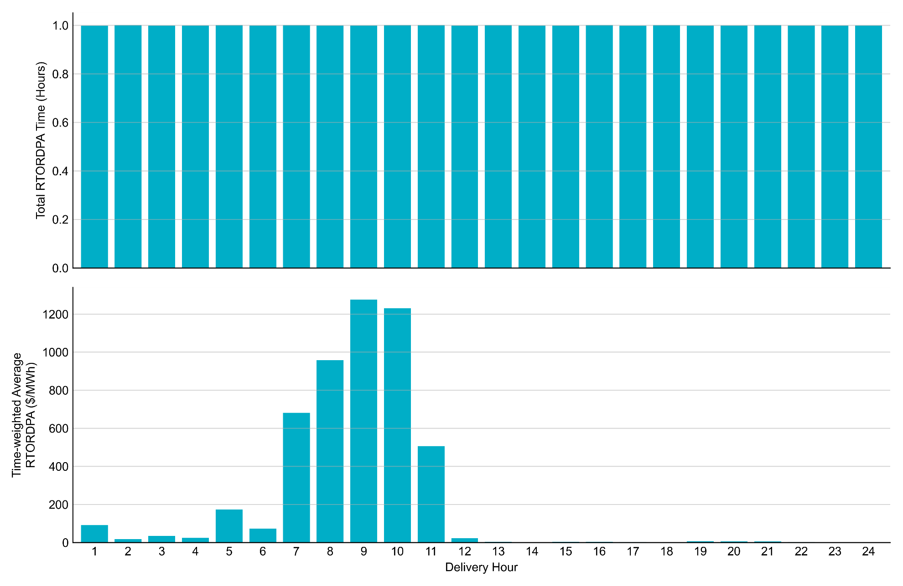
Reliability Deployment Price Adder: February 24, 2022 High RTORDPA occurred during the morning peak; The average hourly RTORDPA went above $1,200/MWh for HE9 and HE10.

Slide 8
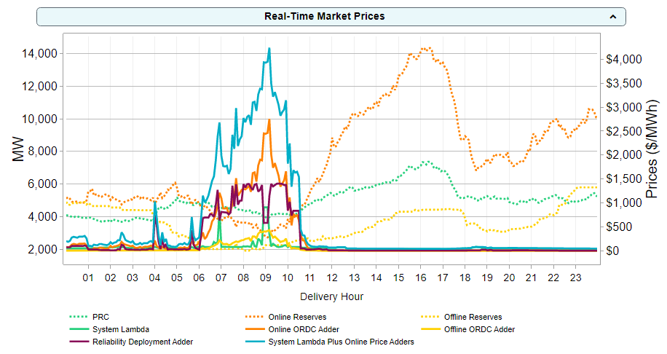
Real-Time Prices on February 24, 2022

Slide 9
Accounting for RUCs in ORDC Calculations
All capacity from a RUC-instructed Resource is removed when calculating ORDC reserves and prices
Headroom on the RUC-instructed Resource is ignored; and
The base point for the RUC-instructed Resource is subtracted from on-line ORDC reserves to account for headroom that the Resource is creating elsewhere on the system
This logic does not apply if the RUC was opted out of
The RUC-instructed Resource may count towards off-line ORDC reserves, if it has a cold start time of less than 30 minutes

Slide 10
Accounting for RUCs in ORDC Calculations– a four-bus example
Status: ON
HSL: 100MW
BP: 60MW
Status: ON
HSL: 100MW
BP: 100MW
S
S
G1
G3
120MW Load
120MW Load
Status: ON
HSL: 100MW
BP: 80MW
Status: OFF
S
S
G2
G4
Resource | Status | RTOLHSL | RTBP | RTOLCAP contribution
G1 | ON | 100 | 100 | 0
G2 | ON | 100 | 80 | 20
G3 | ON | 100 | 60 | 40
G4 | OFF | 0 | 0 | 0
Eligible Resources with ON status contribute HSL-BP to RTOLCAP
Total RTOLCAP is 60MW
G4 capacity is included in RTOFFCAP if its cold start time is less than 30 minutes
Reference: Methodology for Implementing ORDC to Calculate Real-Time Reserve Price Adder

Slide 11
Accounting for RUCs in ORDC Calculations– a four-bus example
Status: ON
HSL: 100MW
BP: 50MW
Status: ON
HSL: 100MW
BP: 100MW
S
S
G1
G3
120MW Load
120MW Load
Status: ON
HSL: 100MW
BP: 70MW
Status: ONRUC
HSL: 100MW
BP: 20MW
S
S
G2
G4
Resource | Status | RTOLHSL | RTBP | RTOLCAP contribution
G1 | ON | 100 | 100 | 0
G2 | ON | 100 | 70 | 30
G3 | ON | 100 | 50 | 50
G4 | ONRUC | 0 | 20 | -20
Eligible Resources with ON status contribute HSL-BP to RTOLCAP
ONRUC Resource contributes -BP to RTOLCAP
Total RTOLCAP is still 60MW
G4 capacity is included in RTOFFCAP if its cold start time is less than 30 minutes
Reference: Methodology for Implementing ORDC to Calculate Real-Time Reserve Price Adder

Slide 12
Accounting for RUCs in RDPA calculations
For the RDPA process, the low dispatch limits of RUC-instructed Resources are relaxed to zero to negate the impacts of the price-taking capacity of the Resource
All capacity from the Resource, from zero to it’s high dispatch limit, is offered in at the higher of the QSE’s submitted offer and the RUC offer floor (note that the offer floor value is part of the NPRR1092 discussion).
SCED is run an additional time to determine the price adder
System demand

Slide 13
How ORDC changes are impacting commitment

Slide 14
How ORDC changes are impacting commitment
How did the PRC/RTOLCAP/RTOFFCAP change given the same level of net load?
Compare Jan – Mar 2022 with Oct – Dec 2021
Compare Jan – Mar 2022 with Jan – Mar 2021
What RTORPA would have been under old VOLL and MCL?
How did RTOFFCAP change during high RTORPA intervals?

Slide 15
Reserves per Net Load:
October ’21- March ‘22

Slide 16
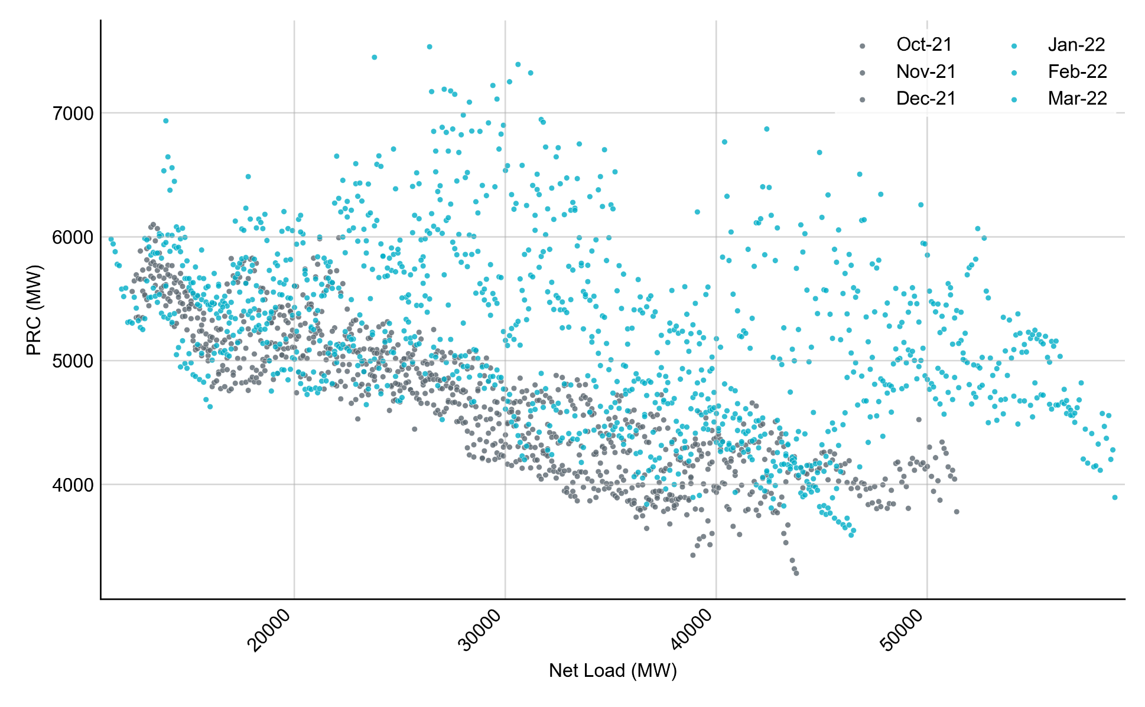
PRC vs Net Load by Month, October 2021 – March 2022
PRC values are averaged over 100 MW Net Load intervals.

Slide 17
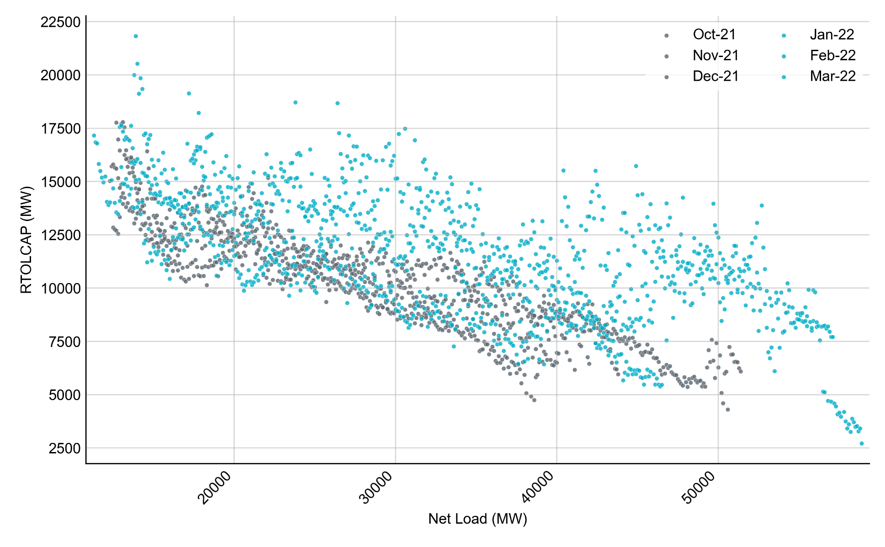
RTOLCAP vs Net Load by Month, October 2021 – March 2022
RTOLCAP values are averaged over 100 MW Net Load intervals.

Slide 18
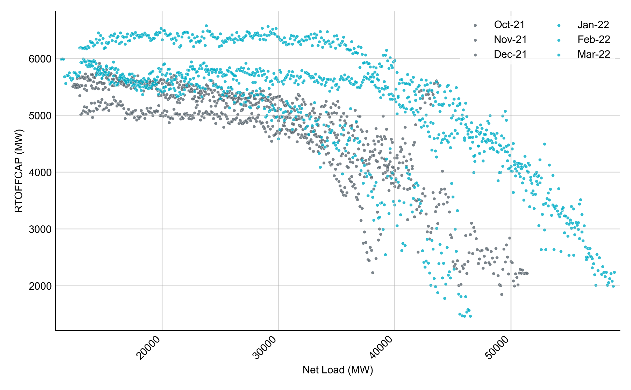
RTOFFCAP vs Net Load by Month, October 2021 – March 2022
RTOFFCAP values are averaged over 100 MW Net Load intervals.

Slide 19
YoY Reserves per Net Load:
Jan-Mar ’21 vs Jan-Mar ‘22

Slide 20
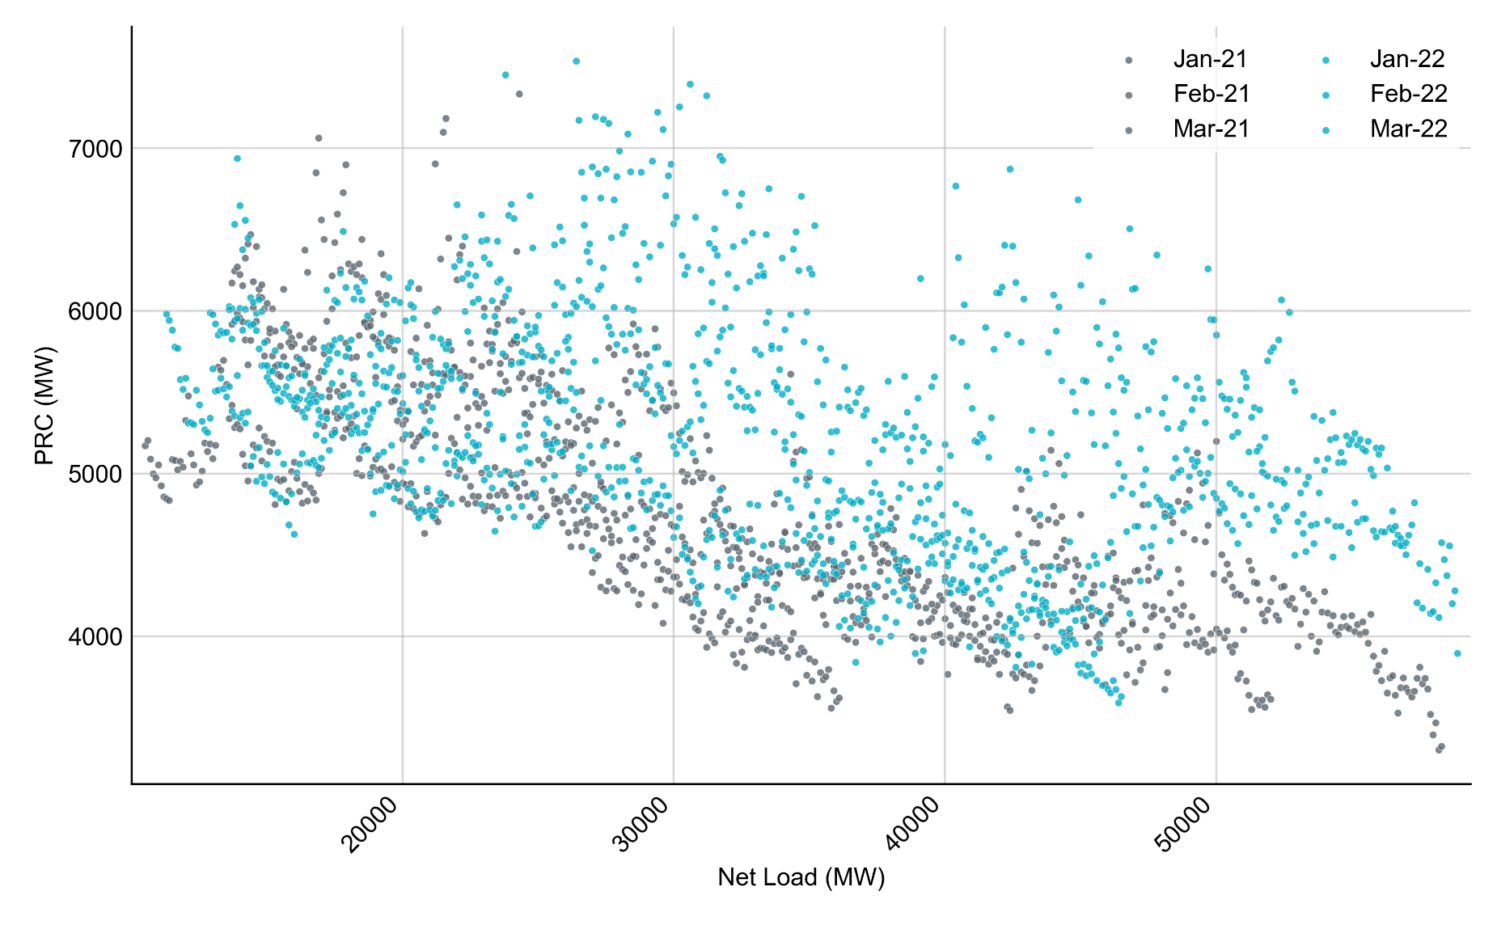
PRC vs Net Load by Month, January – March 2021 and 2022
PRC values are averaged over 100 MW Net Load intervals.
Note: Data between OD 2/14/2021 and 2/20/2021 are not included in the graph

Slide 21
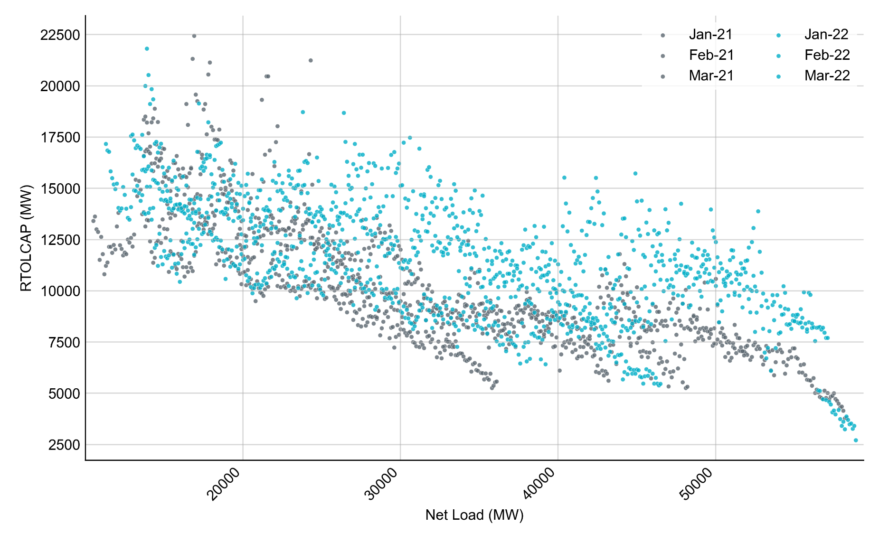
RTOLCAP vs Net Load by Month, January – March 2021 and 2022
RTOLCAP values are averaged over 100 MW Net Load intervals.
Note: Data between OD 2/14/2021 and 2/20/2021 are not included in the graph

Slide 22
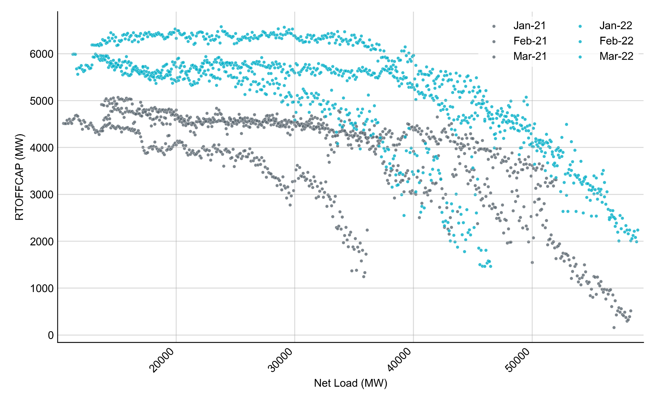
RTOFFCAP vs Net Load by Month, January – March 2021 and 2022
RTOFFCAP values are averaged over 100 MW Net Load intervals.
Note: Data between OD 2/14/2021 and 2/20/2021 are not included in the graph

Slide 23
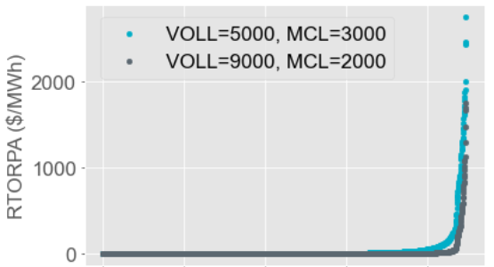
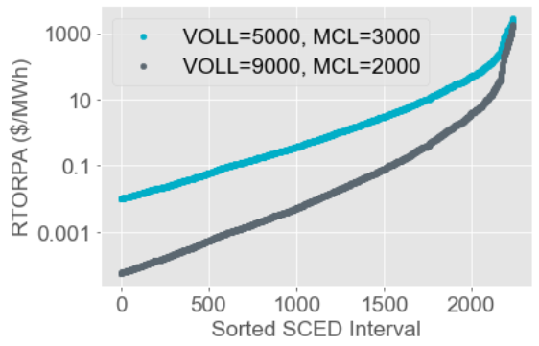
RTORPA changes under updated VOLL and MCL – January to March 2022
Linear Scale
Logarithmic Scale
Note: Each point represents one SCED interval in 2022 where the production RTORPA > $0.01/MWh.

Slide 24
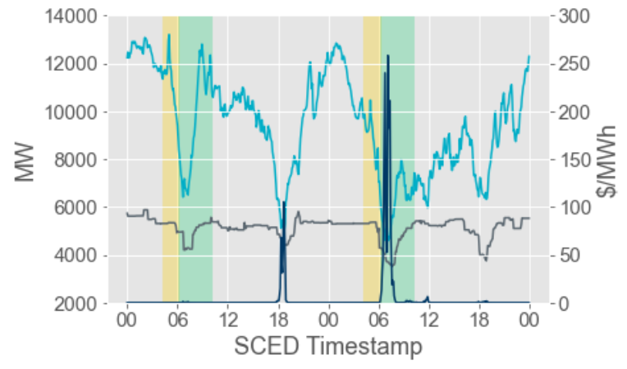
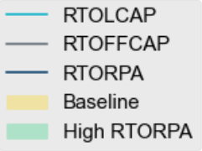
RTOFFCAP and ORDC Adders January – March 2022
Estimate how much the average RTOFFCAP changed during a high RTORPA period (where RTORPA > $10/MWh for 4 hours) compared to the preceding 2-hour period.

Slide 25
RTOFFCAP and ORDC Adders January – March 2022
RTOFFCAP change high RTORPA days | -1,159
RTOFFCAP change neighbor days | -311
For the 16 days in 2022 with a high ORDC (average RTORDPA > $10/MWh during a 4-hour period), RTOFFCAP decreased by 1,159 MW on average. This compares to a 311 MW decrease on neighbor days—these days typically have similar conditions but a lower RTORPA.
We observed Resources with short lead times came online in response to the high price adders.

