Slide 1
RUC Activities Overview – January to March 2022
ERCOT Staff
WMWG RUC Workshop
April 22, 2022
ERCOT Public

Slide 2
RUC Resource-Hours
 | January 2022 |  |  | February 2022 |  |  | March 2022
 | Total | Opt-Out | Non-Opt-Out | Total | Opt-Out | Non-Opt-Out | Total | Opt-Out | Non-Opt-Out
Instructed Resource-hours | 114.0 | 26.0 | 88.0 | 1014.0 | 64.0 | 950.0 | 277.0 | 62.0 | 215.0
Effective Resource-hours* | 105.8 | 26.0 | 79.8 | 991.8 | 62.5 | 929.4 | 255.5 | 55.7 | 199.9
Average LSL | 128.0 | 208.8 | 102.5 | 110.5 | 109.0 | 110.6 | 104.6 | 129.4 | 97.7
Average LDL | 132.0 | 220.0 | 104.1 | 113.9 | 164.8 | 110.5 | 112.3 | 158.0 | 99.6
Average BP | 137.8 | 241.2 | 105.1 | 115.7 | 190.6 | 110.6 | 117.3 | 178.3 | 100.4
Average HSL | 386.9 | 353.9 | 397.3 | 303.3 | 283.7 | 304.7 | 335.2 | 314.0 | 341.1
* The difference between “Instructed” and “Effective” values is a result of Resources starting up, shutting down, receiving partial hour instructions, or otherwise not being dispatchable by SCED.

Slide 3
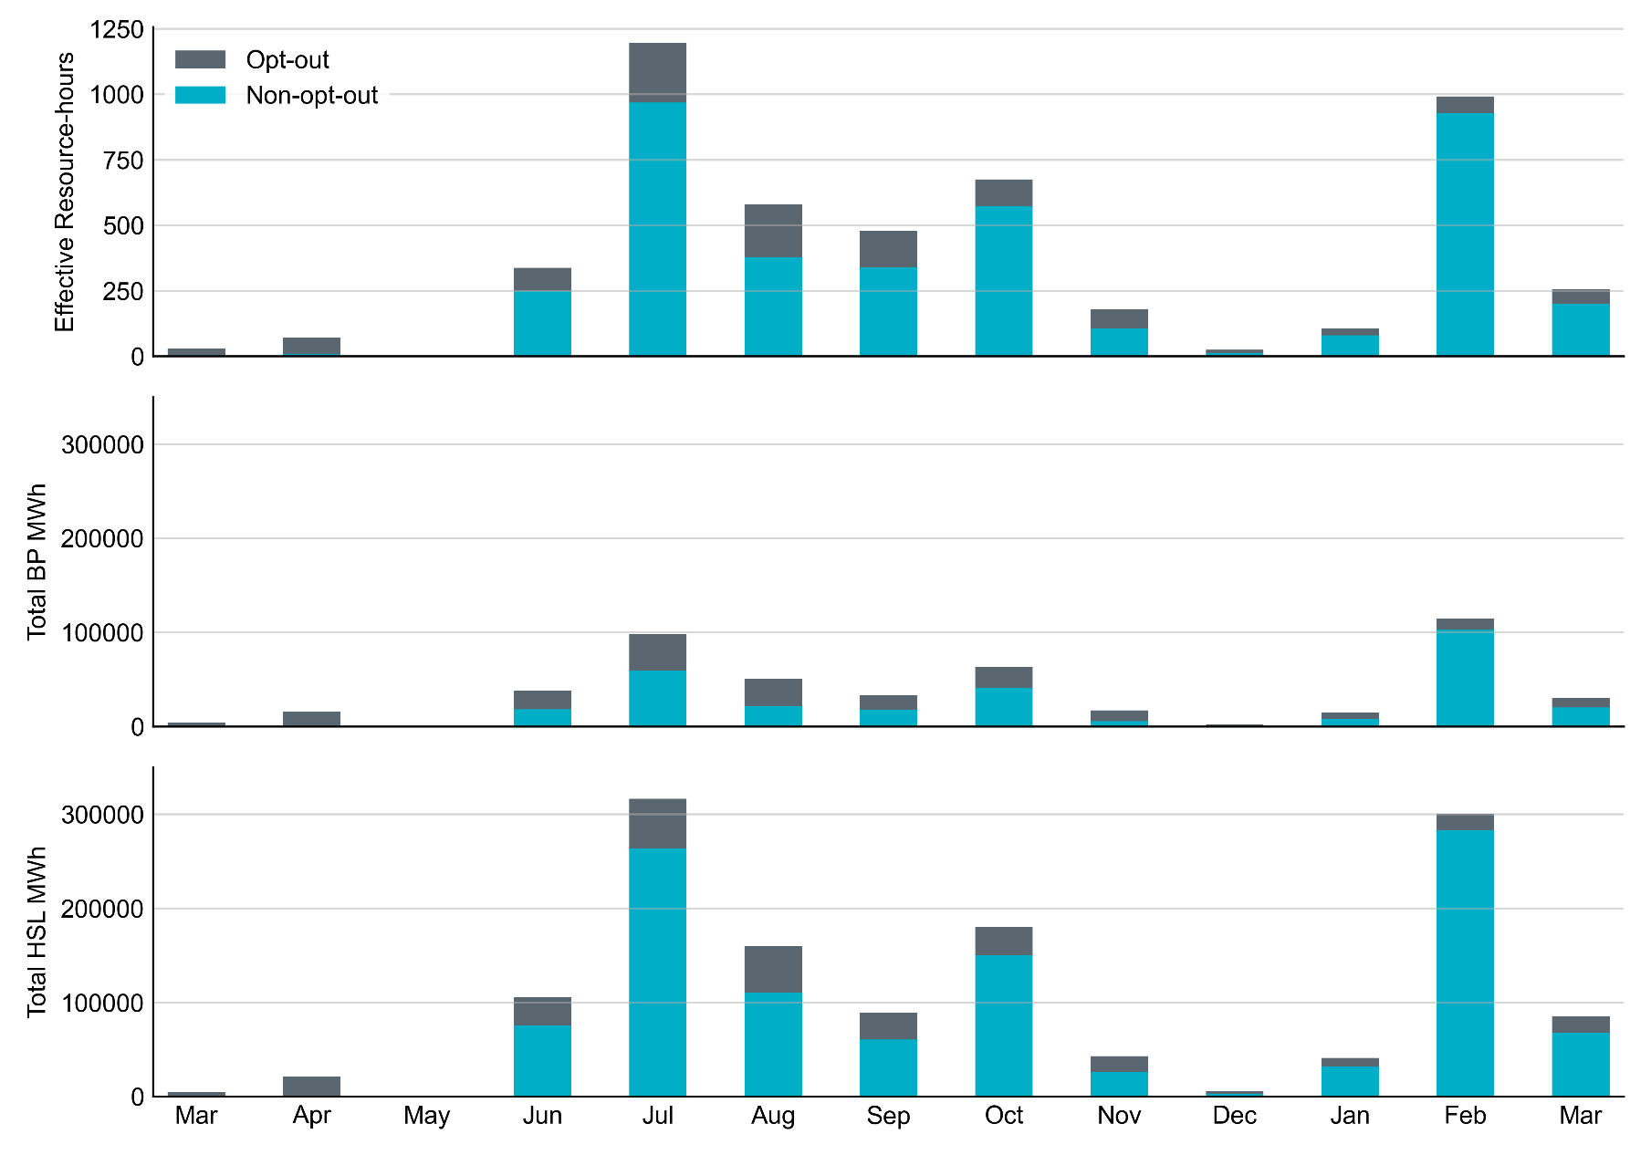
Non-opt-out and Opt-out Totals: Last 13 Months February 2022 has a total of 929.4 non-opt-out effective Resource-hours and 62.5 opt-out effective Resource-hours. Its total BP MWh and HSL MWh were highest since July 2021.

Slide 4
RUC Instruction Reasons
January 2022
105.8 effective RUC Resource-hours, 100% for capacity concerns.
26.0 effective Resource-hours (24.6%) were successfully bought back.
February 2022
991.8 effective RUC Resource-hours in February 2022. 991.2 Resource-hours (99.94%) for capacity concerns, and 0.6 Resource-hours (0.06%) for congestion concerns.
62.5 effective Resource-hours (6.3%) were successfully bought back.
March 2022
255.5 effective RUC Resource-hours, 198.0 Resource-hours (77.46%) for capacity concerns, and 57.6 Resource-hours (22.54%) for congestion concerns.
55.7 effective Resource-hours (21.80%) were successfully bought back.

Slide 5
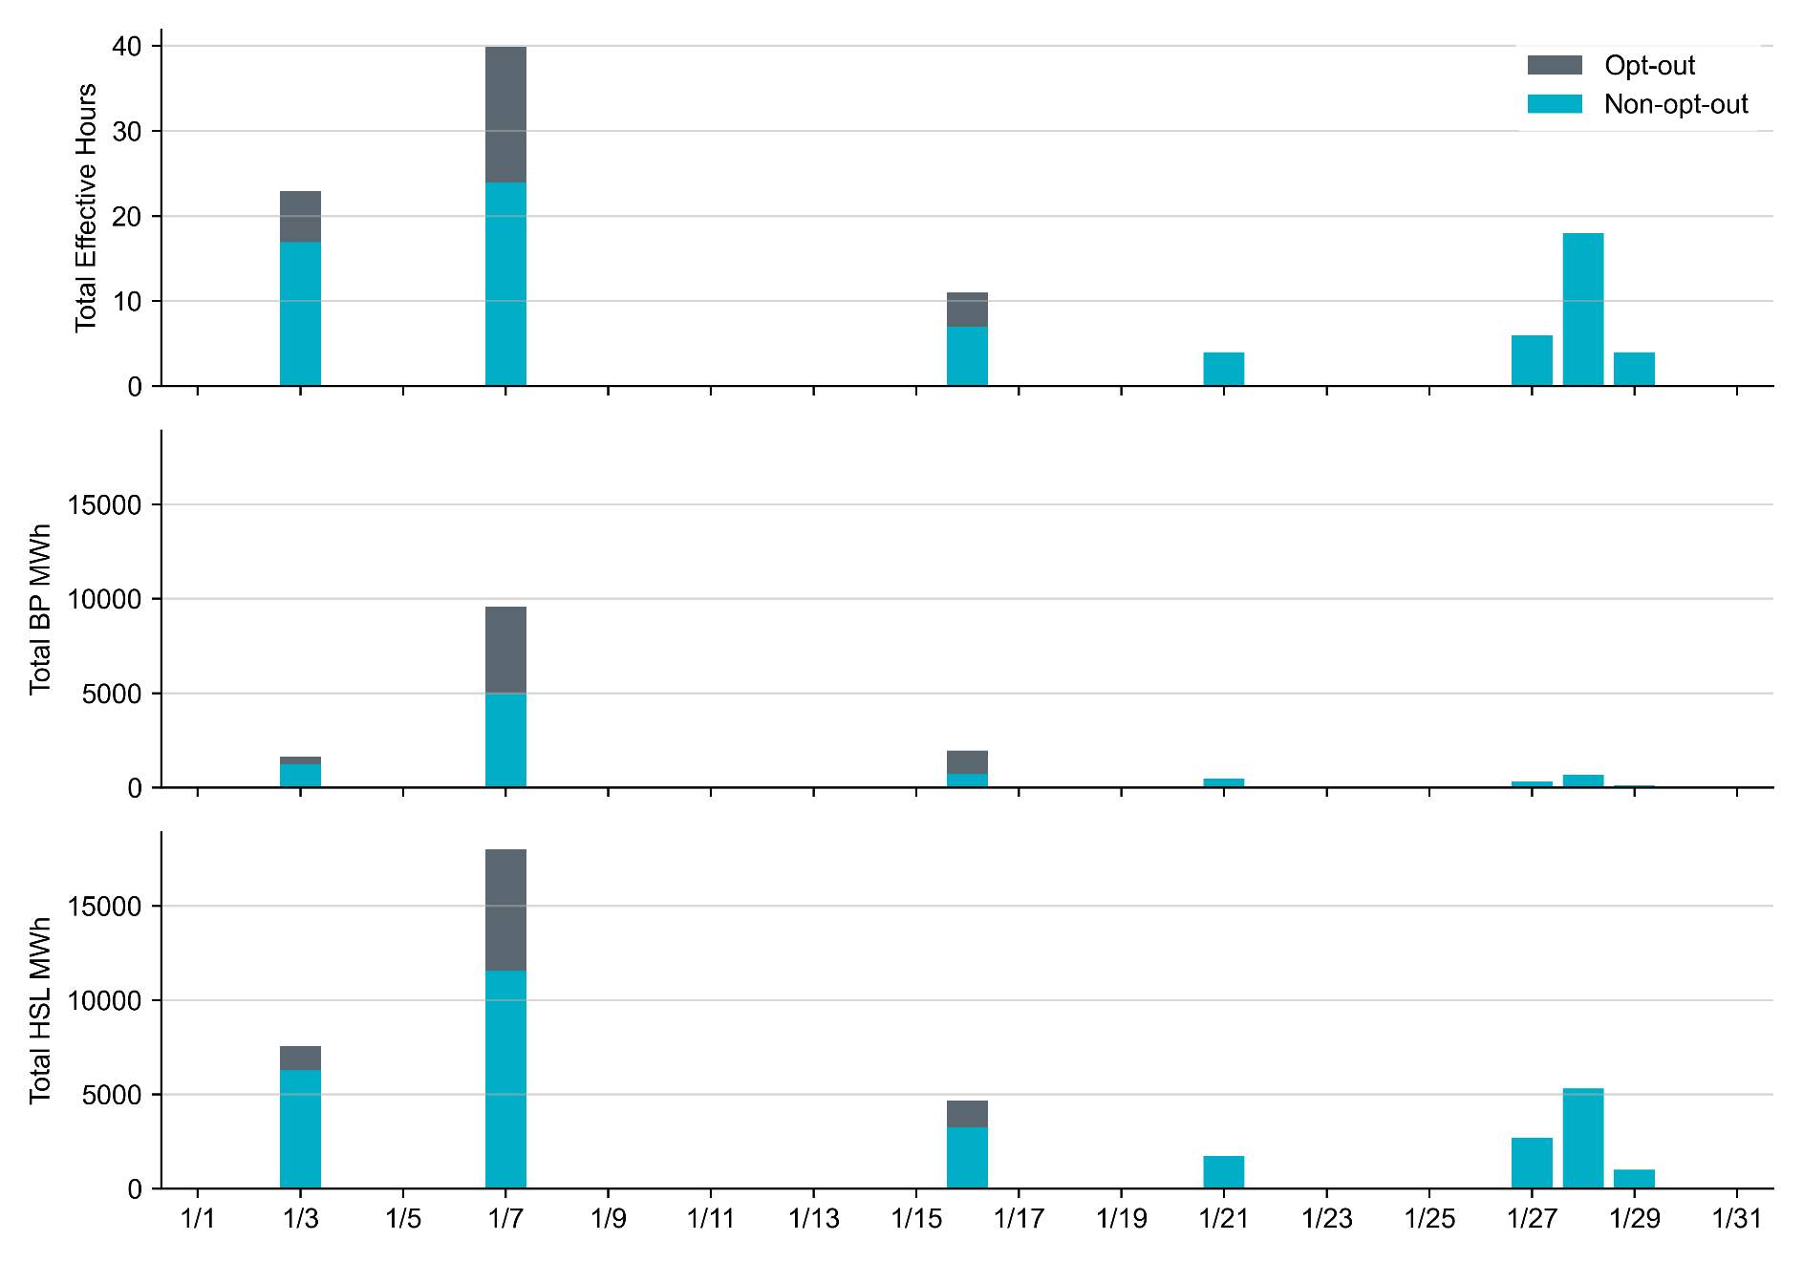
Non-opt-out and Opt-out Totals: January 2022 RUC in January 2022 were all driven by capacity concerns. Operating Day 1/7/2022 has the highest Resource-hours, total BP MWh and HSL MWh due to cold weather

Slide 6
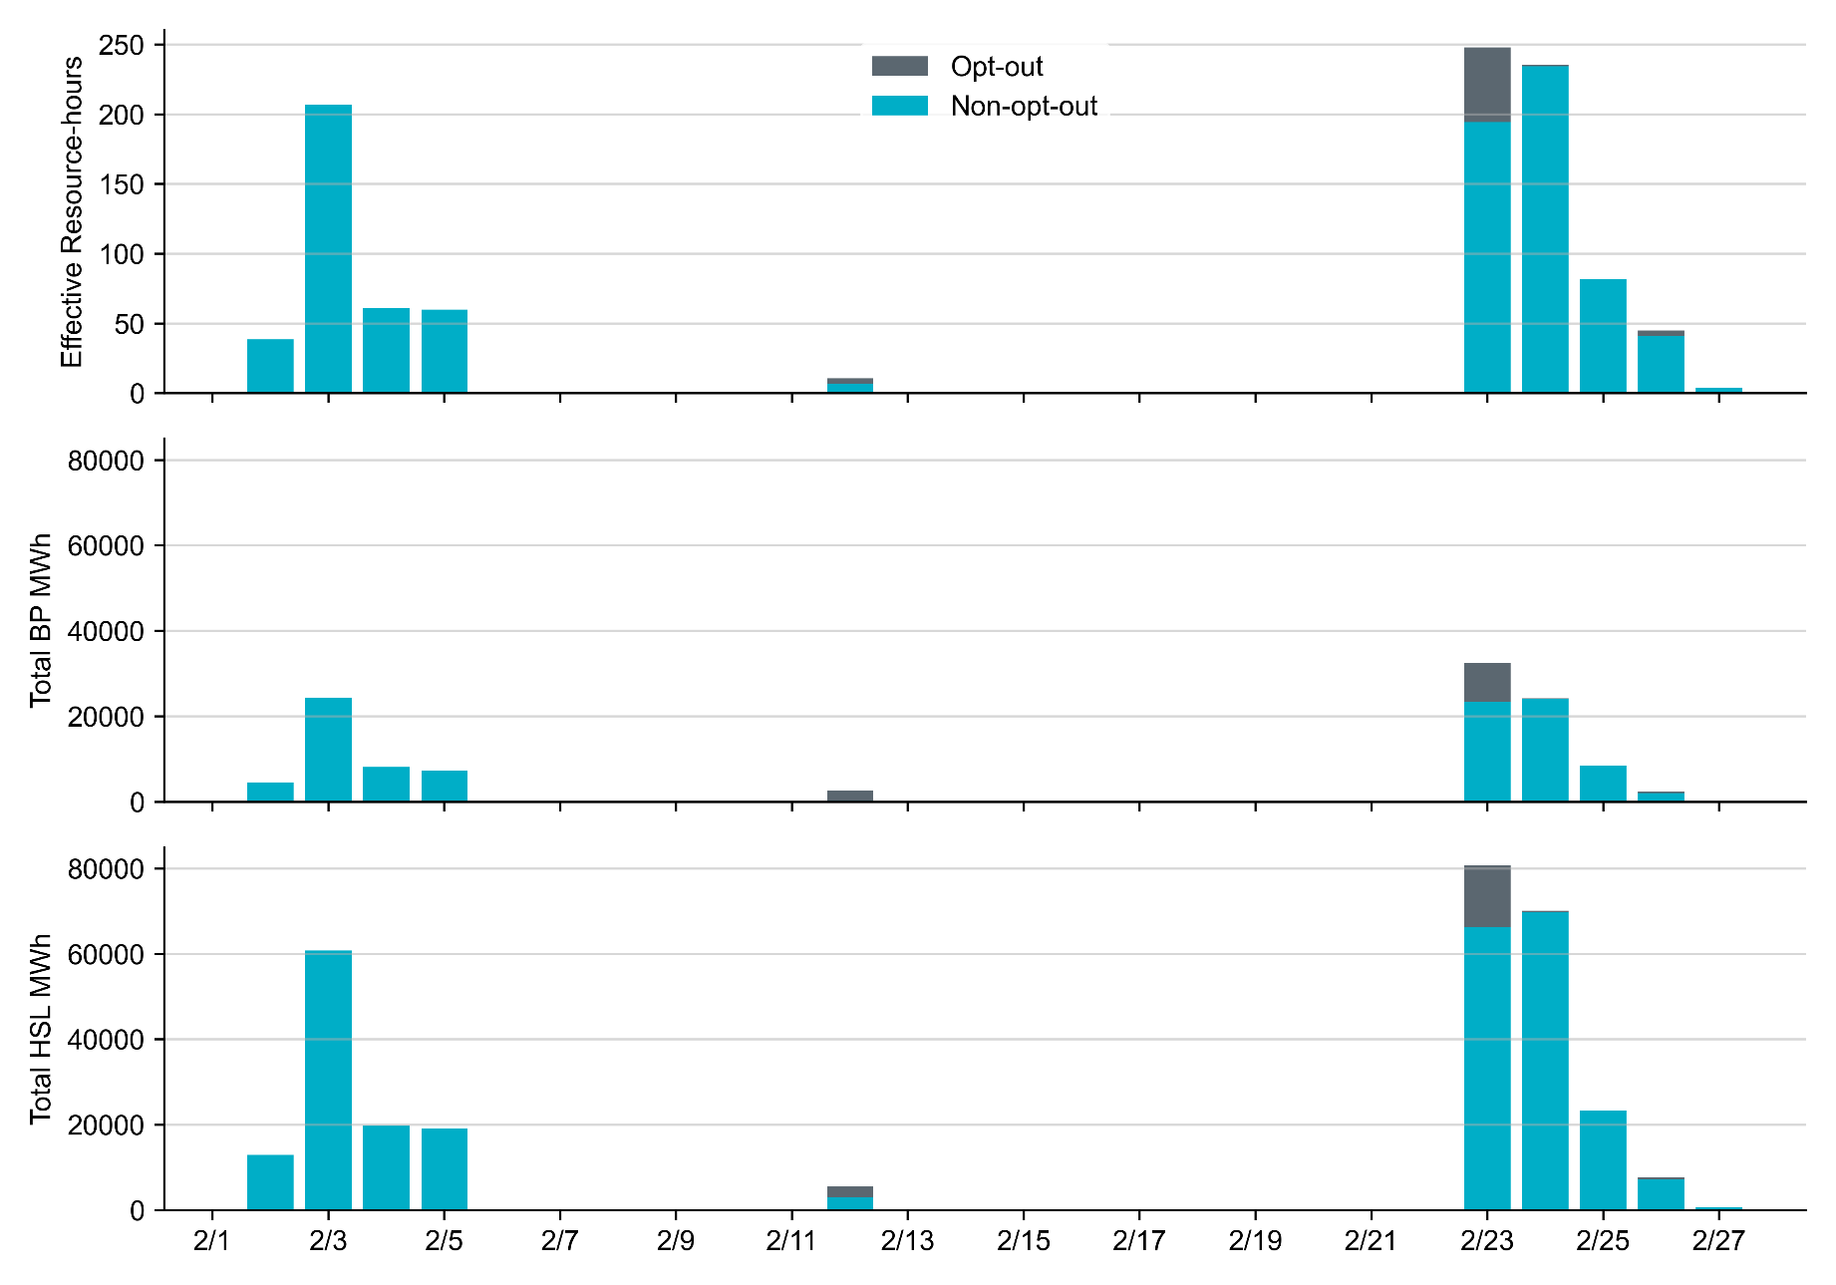
Non-opt-out and Opt-out Totals: February 2022 RUC in February 2022 were primarily driven by two separate cold events. Most Opt-out Resource-hours occurred on Operating Day 2/23/2022

Slide 7
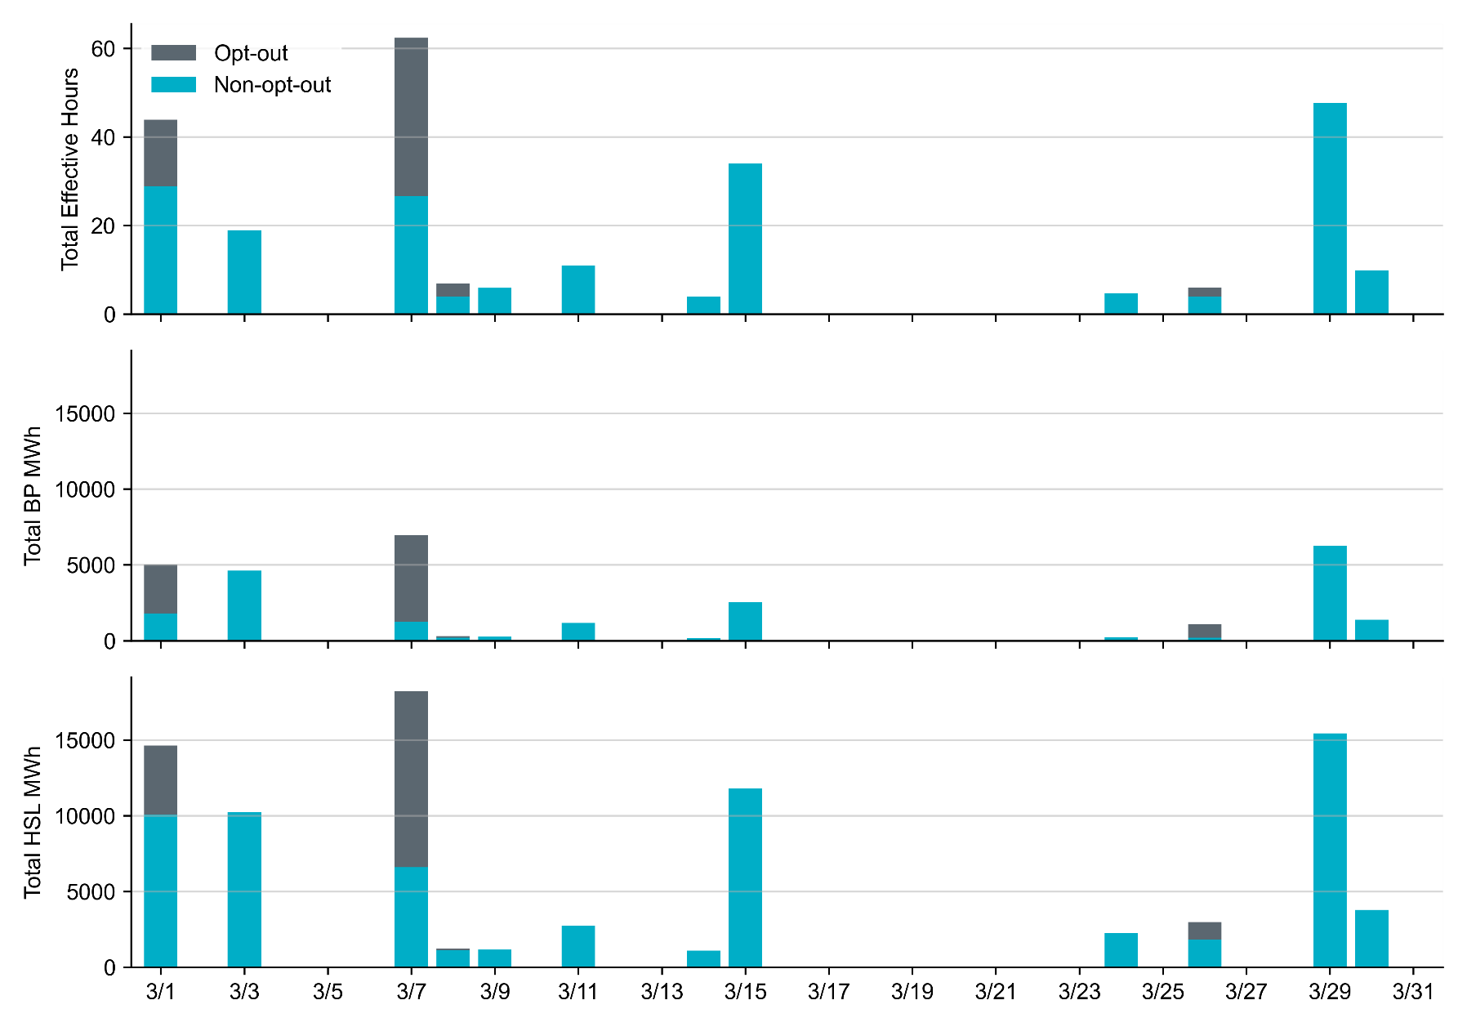
Non-opt-out and Opt-out Totals: March 2022 RUC in March 2022 were primarily driven by capacity concerns. Most Opt-out Resource-hours occurred on Operating Day 3/1/2022 and 3/7/2022

Slide 8
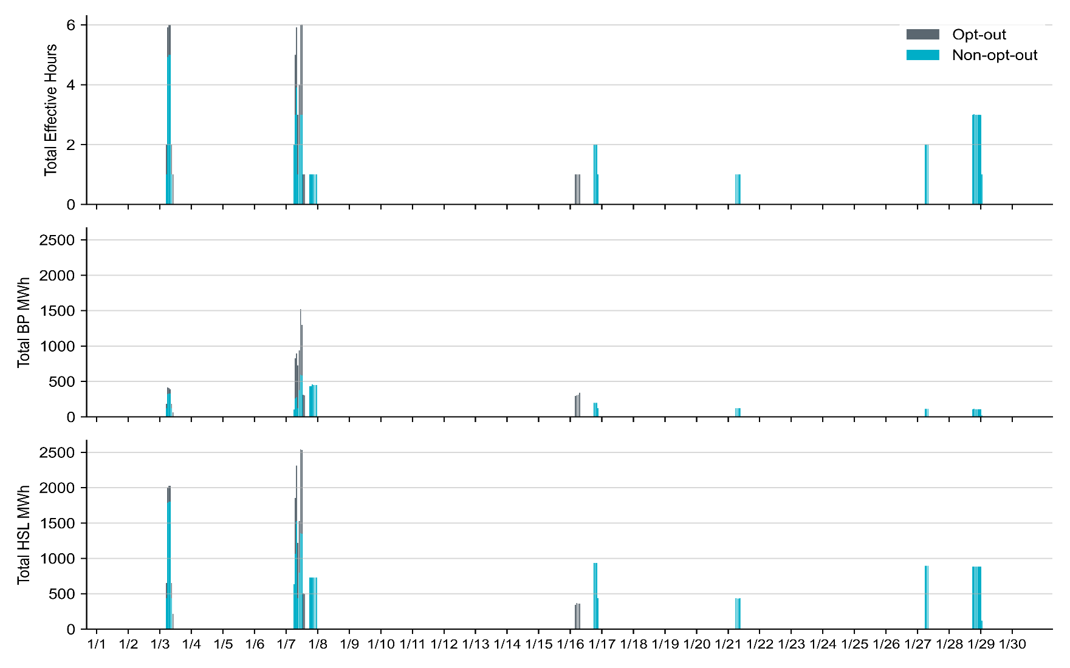
Hourly RUC Effective Hours and MWh in January 2022 RUC in January 2022 were all driven by capacity concerns. Operating Day 1/7/2022 has the highest Resource-hours, total BP MWh and HSL MWh due to cold weather
Note: HSL MWh is calculated as Real-Time HSL times SCED duration, summed over all SCED intervals on an hourly basis.

Slide 9
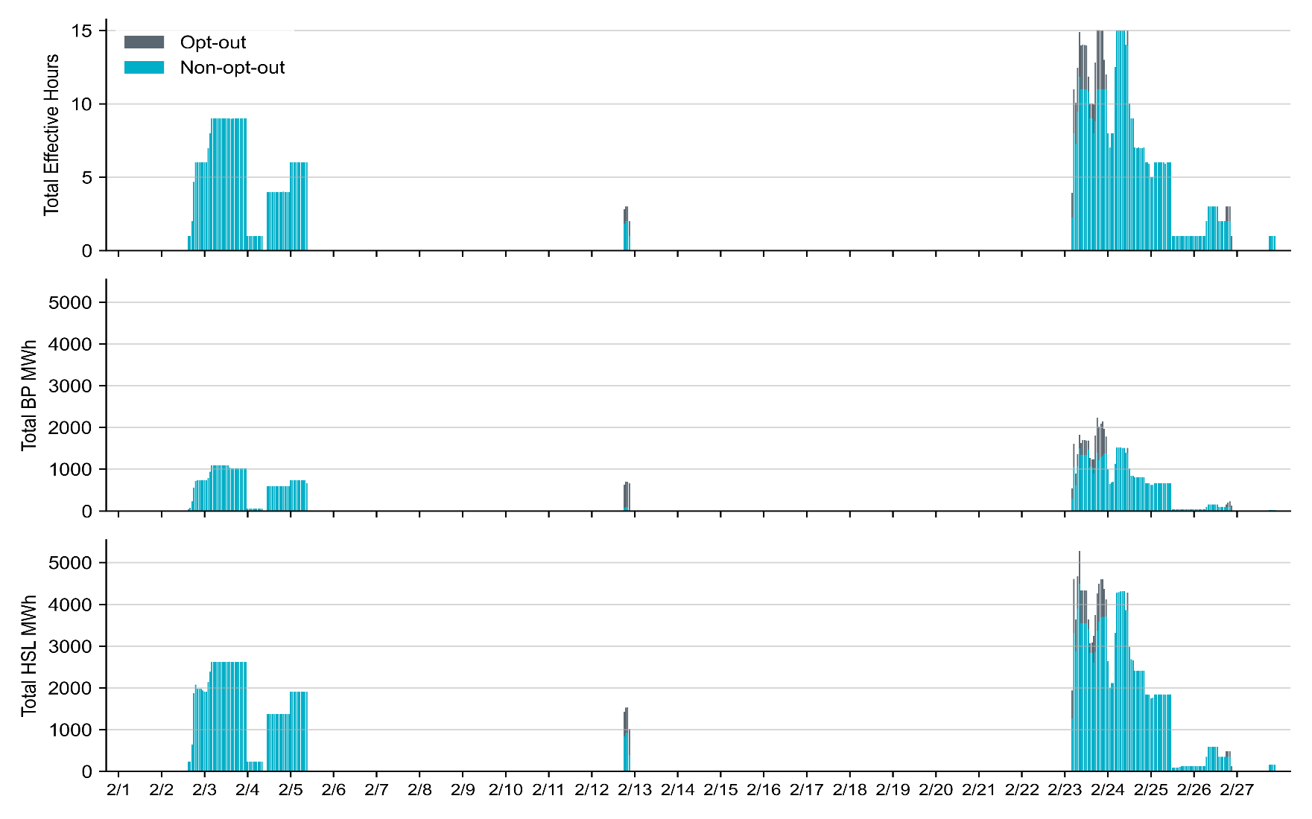
Hourly RUC Effective Hours and MWh in February 2022 RUC in February 2022 were primarily driven by two separate cold events. Most Opt-out Resource-hours occurred on Operating Day 2/23/2022
Note: HSL MWh is calculated as Real-Time HSL times SCED duration, summed over all SCED intervals on an hourly basis.

Slide 10
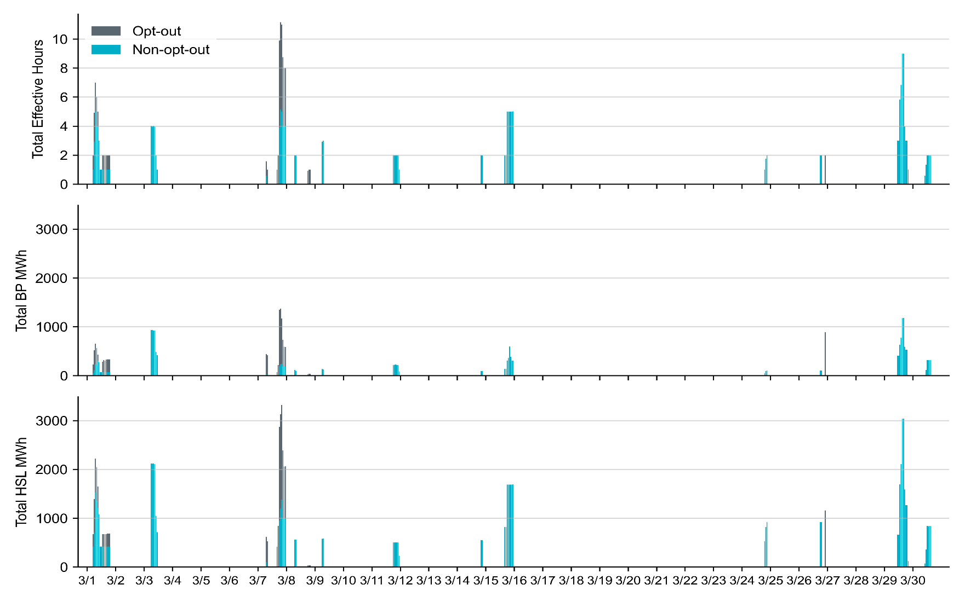
Hourly RUC Effective Hours and MWh in March 2022 RUC in March 2022 were primarily driven by capacity concerns. Most Opt-out Resource-hours occurred on Operating Day 3/1/2022 and 3/7/2022
Note: HSL MWh is calculated as Real-Time HSL times SCED duration, summed over all SCED intervals on an hourly basis.

Slide 11
RUC-Instructed Resource Dispatch above LDL
January 2022
When Resources did not successfully opt out, there were 1.8 effective Resource-hours for which the Resource was dispatched above its LDL.
For all these Resource-hours, the RUC-instructed Resource was mitigated.
February 2022
When Resources did not successfully opt out, there were 0.3 effective Resource-hours for which the Resource was dispatched above its LDL.
For all these Resource-hours, the RUC-instructed Resource was mitigated.
March 2022
When Resources did not successfully opt out, there were 6.6 effective Resource-hours for which the Resource was dispatched above its LDL.
For 3.3 of these Resource-hours, the RUC-instructed Resource was mitigated.
For the other 3.3 of these Resource-hours, the RUC-instructed Resource was DAM-committed, and the Resource-hours were counted as Opt-out.

Slide 12
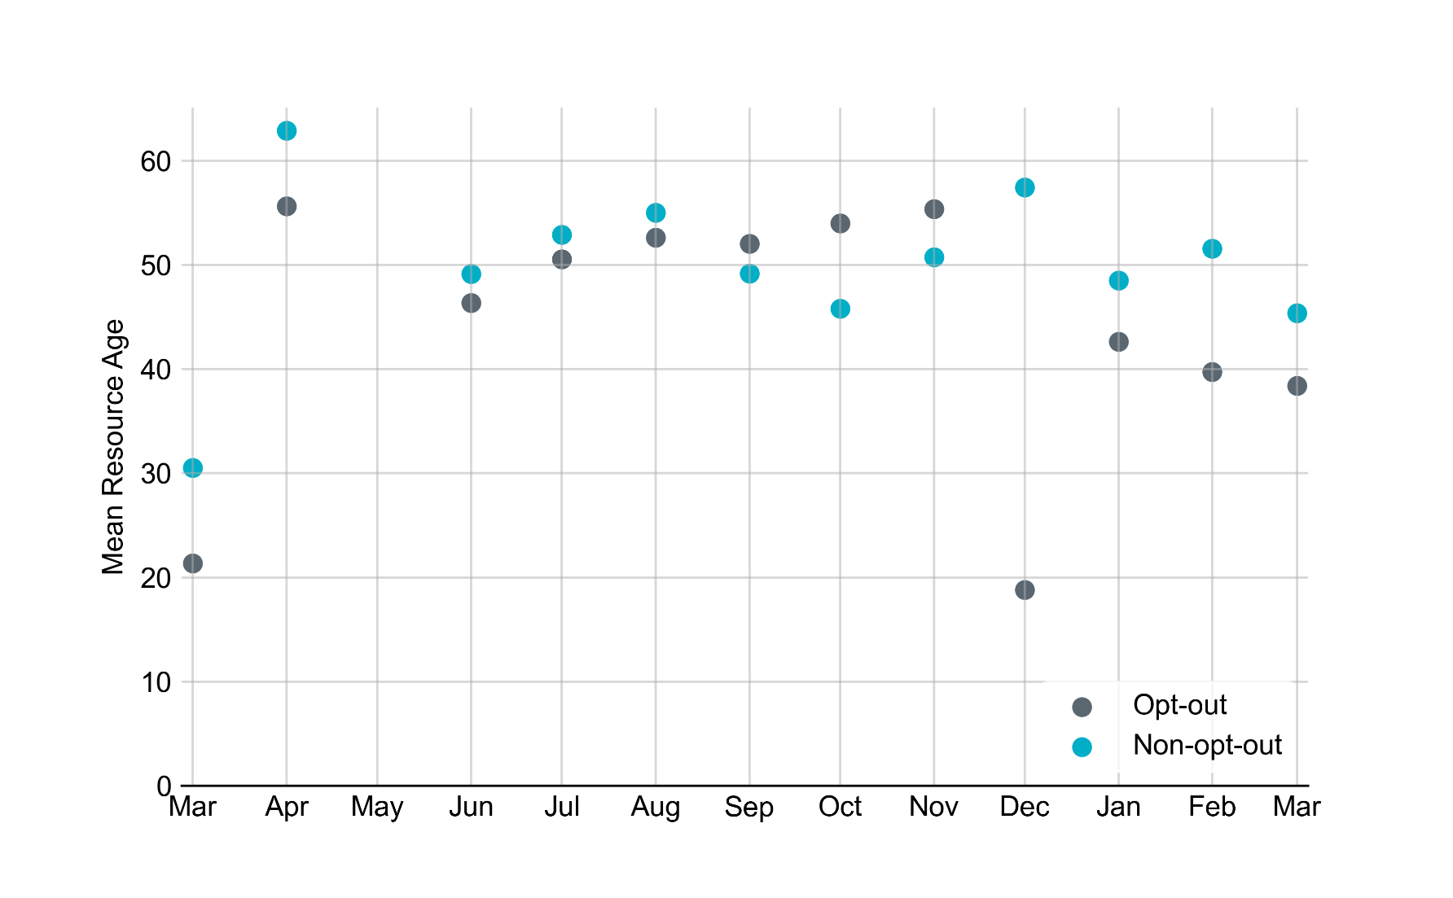
Average Resource Age For the first three months of 2022, the mean opt-out Resource age is 50.4 years and mean non-opt-out Resource is 39.7 years.
Note: For Resource configurations with multiple physical generators, the age of the oldest generator is used.

Slide 13
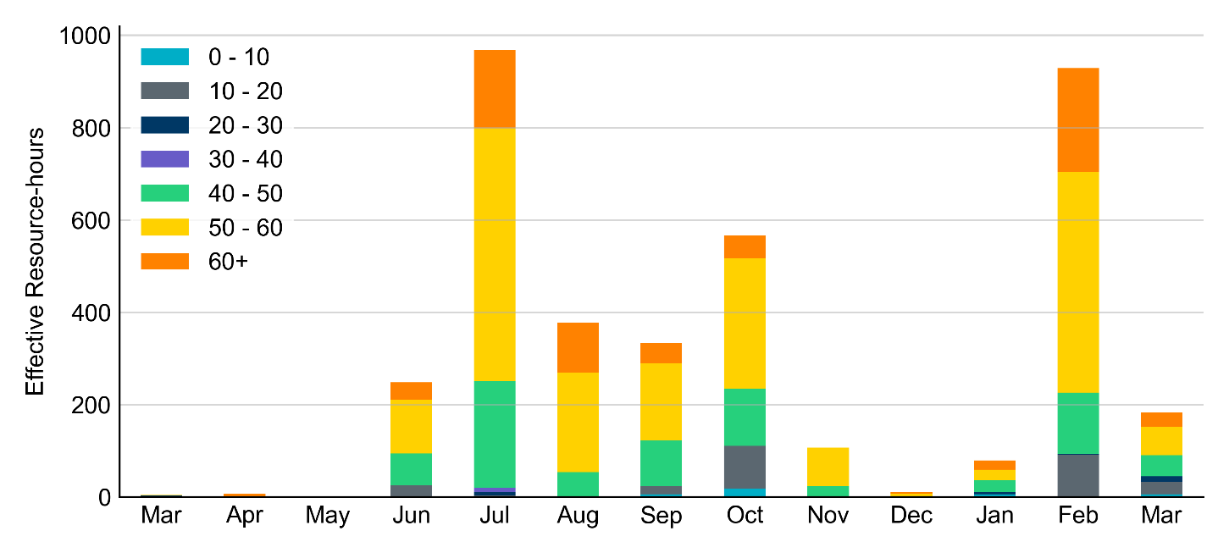
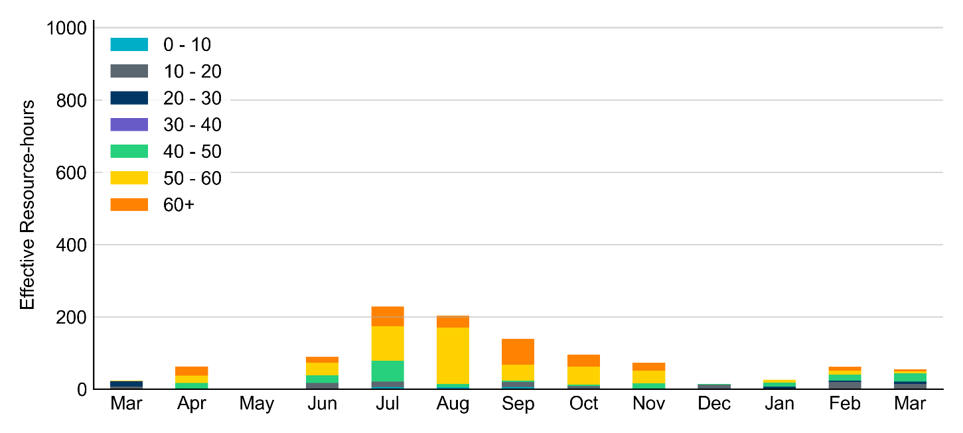
Age Category Majority of RUC Committed Resources in the first three months of 2022 were older than 40 years.
Non-opt-out
Opt-out

Slide 14
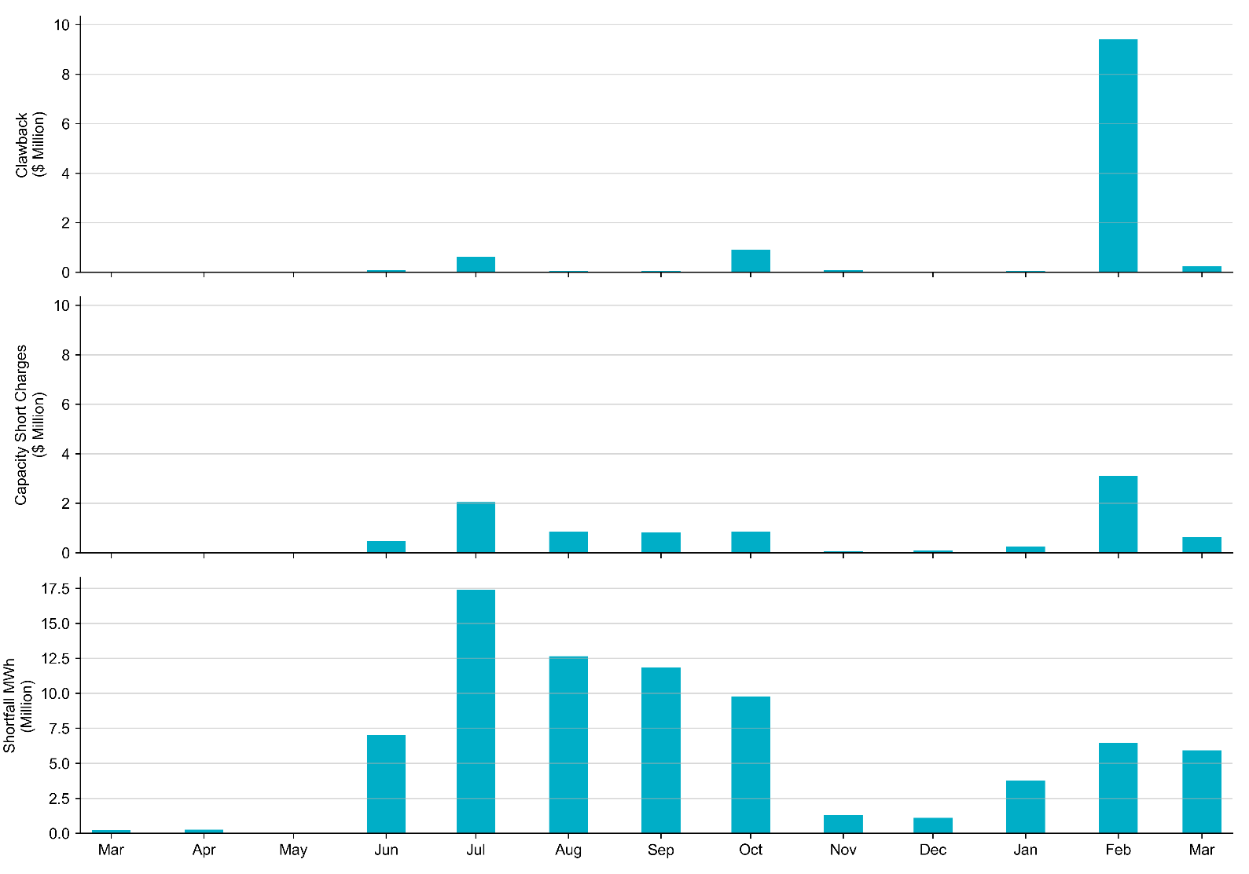
RUC Clawback, Capacity Short Charges, and Shortfall The highest monthly clawback charge was $9.4 million in February 2022, and the highest monthly total Capacity Short Charge was $3.1 million in the same month. The Capacity Short Charge was nearly fully covered by Make-whole payment.
 | January 2022 | February 2022 | March 2022
Make-whole ($ Million) | 0.245 | 3.102 | 0.636
Uplift to Load ($) | 0.31 | 2.01 | 0.6

