Slide 1
ERCOT Frequency Control Report
March 2022
ERCOT
Operations Planning
PDCWG | April 20th, 2022

Slide 2
Summary of March 2022
CPS1: 171.07%
Current CPS1 12-Month Rolling Average: 171.65%
0 BAAL Exceedance(s)
3 hourly CPS1 score below 100%
BAAL-003 Events have updated through 2020
2020 BAAL-003 FRM Performance: -789.34
2022 RMS1 Statistics
  Mean: 15.17 mHz
  Min: 12.43 mHz
  Max: 19.20 mHz
Energy Statistics
  Total Energy: 30,450,997 MWh
  Wind Energy: 11,016,800 MWh
  Percent Energy from Wind: 36.18 %
  Solar Energy: 1,773,088 MWh
  Percent Energy from Solar: 5.82%
Minimum System Inertia
  Mean: 144,298 MW*s
  Max: 246,062 MW*s on March 8th
  Min: 114,674 MW*s on March 21st

Slide 3
Frequency Control
CPS1, BAAL, & RMS1

Slide 4
Hourly CPS1 by Day
Mar-22 CPS1 (%): 171.07
Notes:
1. 93.4%@ 3/21/2022 HE 14:00
Expected Generation Deviation
Between 1:30-2:00pm the Expected gen dev remained negative. The largest expected gen dev was -2320 MW @ 1:51pm with signification contribution from solar and wind generation.
IRR Ramps
Between 1:45-1:55pm wind ramped down by ~700MW and solar ramped down by ~300MW
Regulation: Regulation up was exhausted during most of the second half of the hour. A 350 MW SCED manual offset was applied and 620 MW of RRS was deployed.
2. 92.2% @ 3/23/2022 HE 21:00
Expected Generation Deviation
Expected gen dev remained negative for the hour. The largest expected gen dev was -2660 MW @ 8:54pm with signification contribution from thermal resources and wind generation.
IRR Ramps
Between 8:40pm to 9:00pm wind ramped down by ~1750 MW.
Regulation: Regulation up was exhausted during the second half of the hour. Multiple SCED offsets were applied, the largest being a 350 MW SCED manual offset.
3. 62.4%@ 3/24/2022 HE 20:00
Expected Generation Deviation
Expected gen dev remained negative for the whole hour. The largest expected gen dev was -4247 MW @ 7:30pm with signification contribution from solar and wind generation.
IRR Ramps
Between 7:00pm and 8:00pm, solar ramped down ~3,900 MW and wind ramped down ~2,000 MW
Regulation: Regulation up was exhausted during first half of the hour. Multiple SCED offsets were applied, the largest being a 500 MW SCED manual offset.

Slide 5
BAAL Exceedances & Violations
There are 0 BAAL exceedance(s) in March

Slide 6
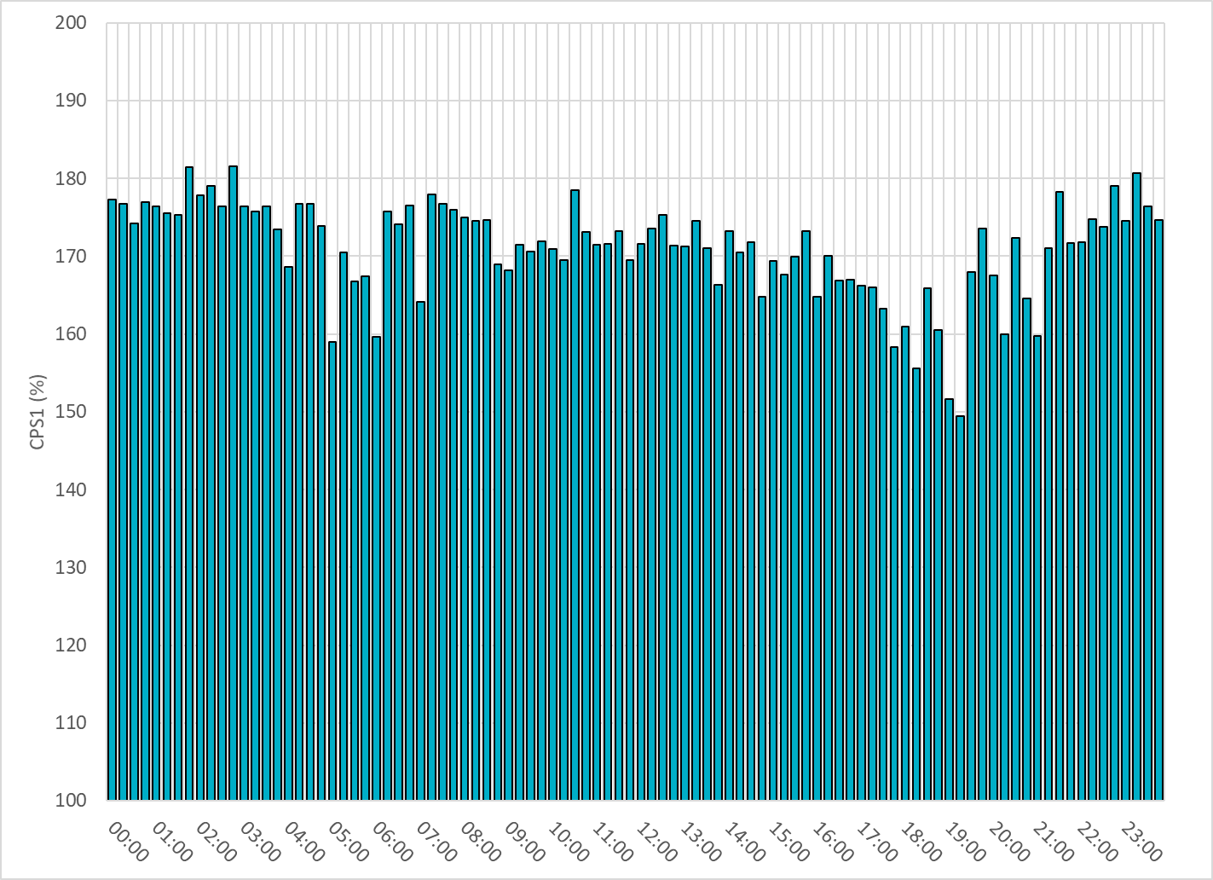
15-Minute Average CPS1%
Mar-22 CPS1 (%): 171.07

Slide 7
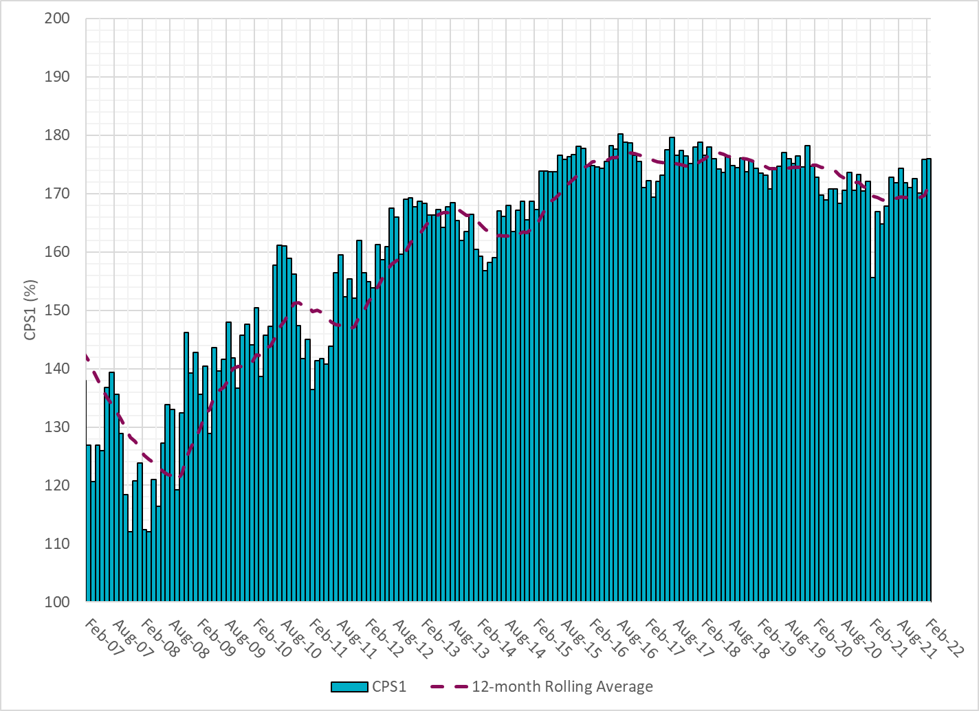
12-Month Rolling Average CPS1
Current 12-Month Rolling Average: 171.65%

Slide 8
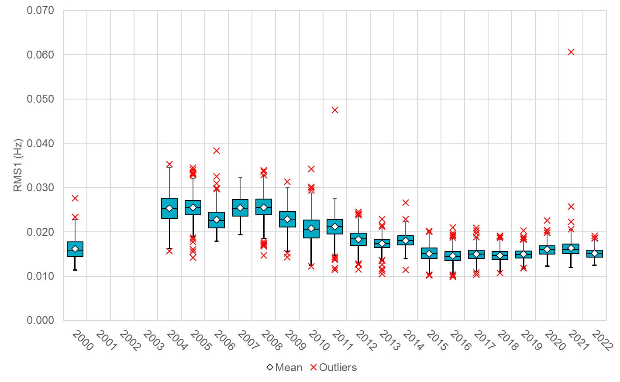
Daily RMS1 of ERCOT Frequency by Year
Notes:
Mean: 15.17 mHz
Min: 12.43 mHz
Max: 19.2 mHz

Slide 9
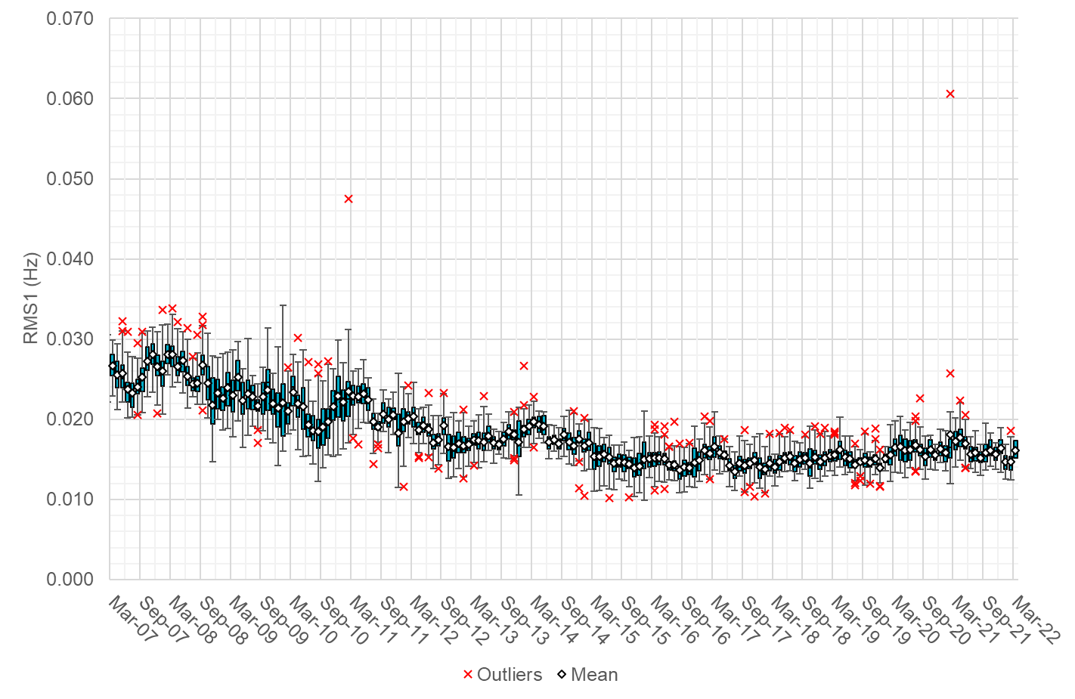
Daily RMS1 of ERCOT Frequency by Month

Slide 10
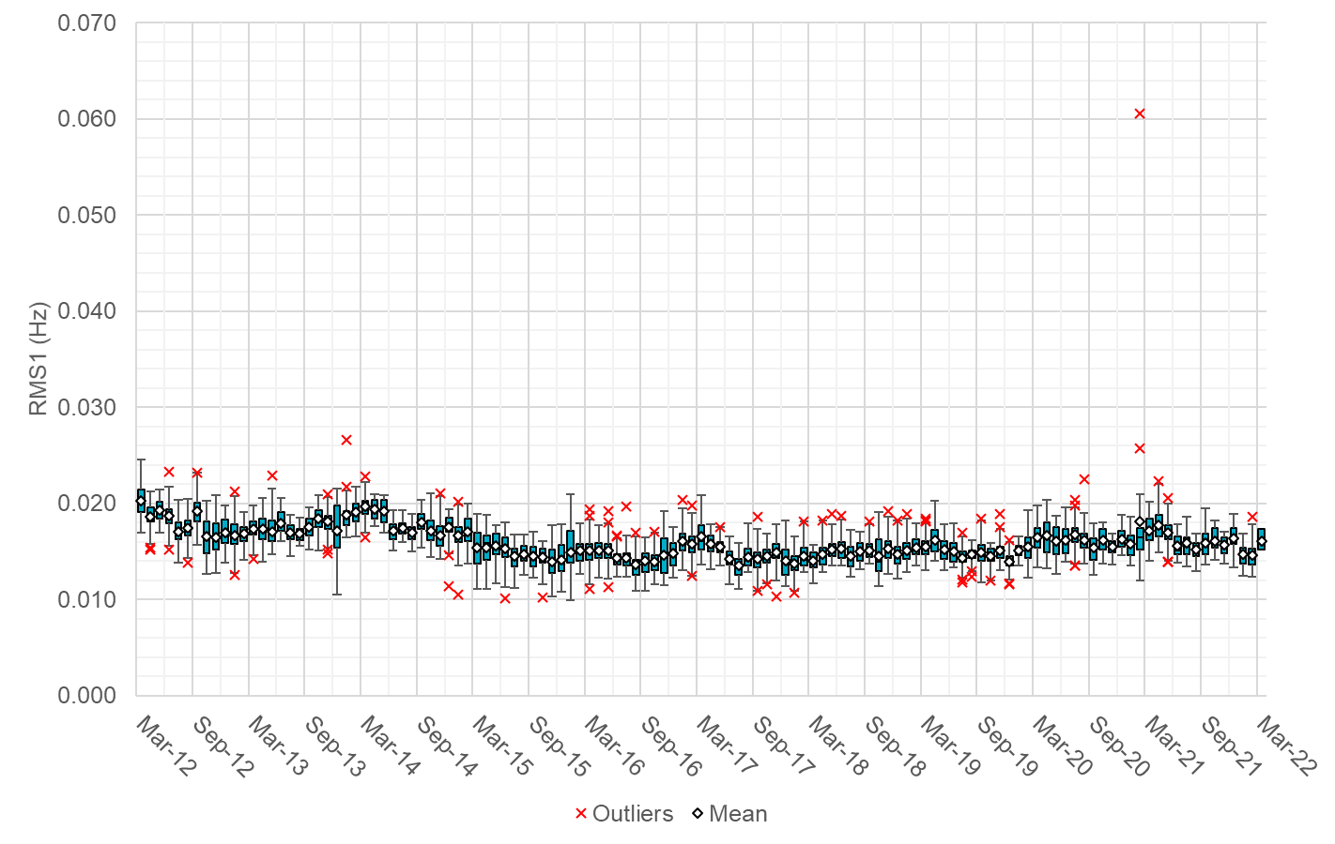
Daily RMS1 of ERCOT Frequency by Month
Notes:
16.1mHz on avg

Slide 11
Frequency Profile Comparison

Slide 12
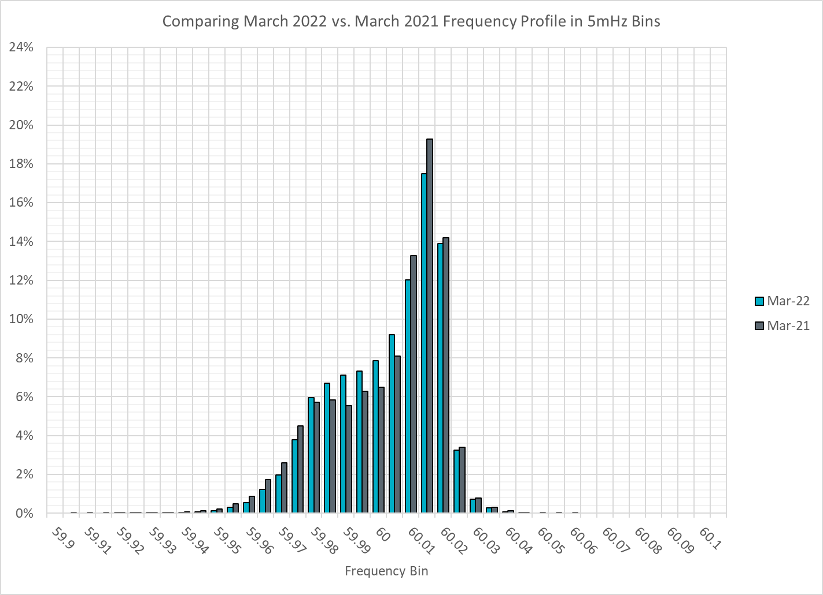
Frequency Profile Comparison

Slide 13

Frequency Profile Comparison

Slide 14
Time Error Correction

Slide 15
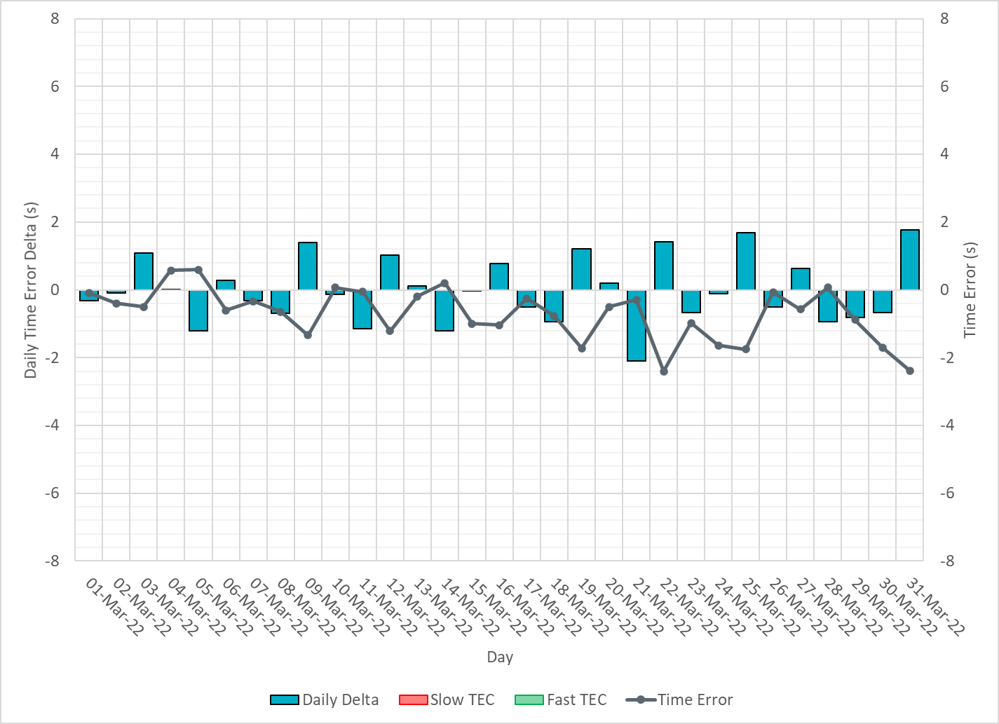
ERCOT Daily Time Error

Slide 16
Time Error Corrections Log Summary
There have been no time error corrections since December 2016

Slide 17
BAL-003 Performance

Slide 18
Op. Year 2020 BAL-003 Selected Events – Update
Notes:
BAL-003

Slide 19
Op. Year 2020 BAL-003 FRM Performance - Update
Notes:
OP2018: FRO = -381.0, FRM_median = -843.17, FRM_average = -959.7
OP2019: FRO = -381.0, FRM_median = -811.14, FRM_average = -892.5
OP2020: FRO = -425.0, FRM median = -789.34, FRM average = -879.0
OP2021: FRO =

Slide 20
ERCOT Energy Statistics

Slide 21
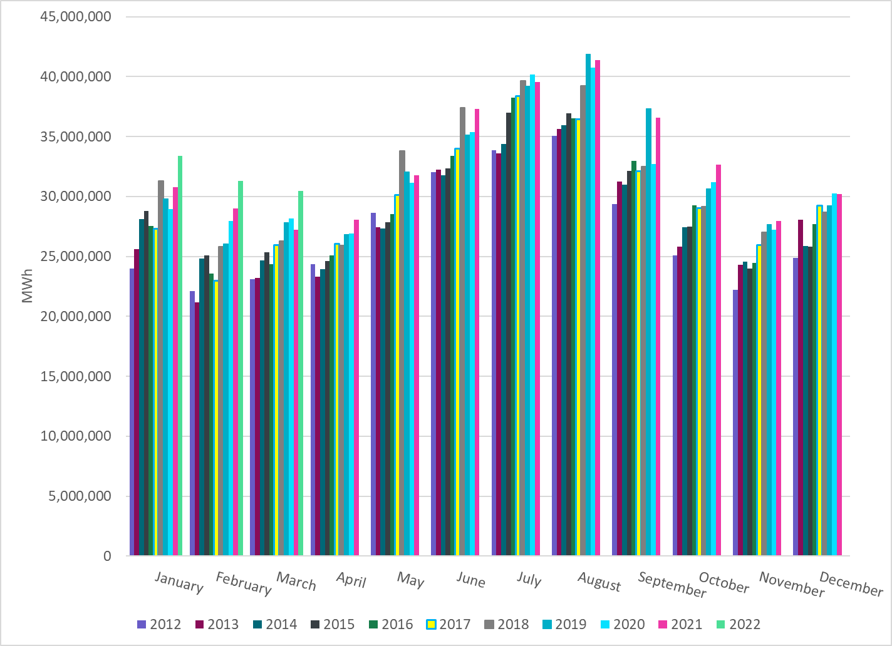
Total Energy
Notes:
30,450,997 MWh

Slide 22
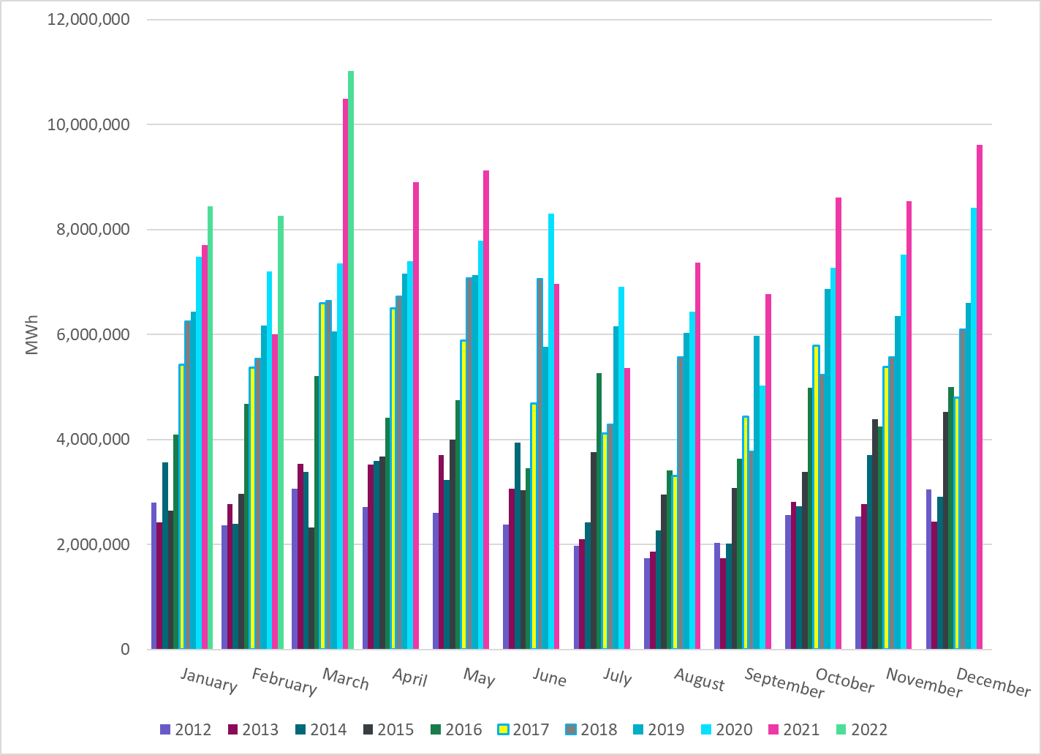
Total Energy from Wind Generation
Notes:
11,016,900 MWh

Slide 23
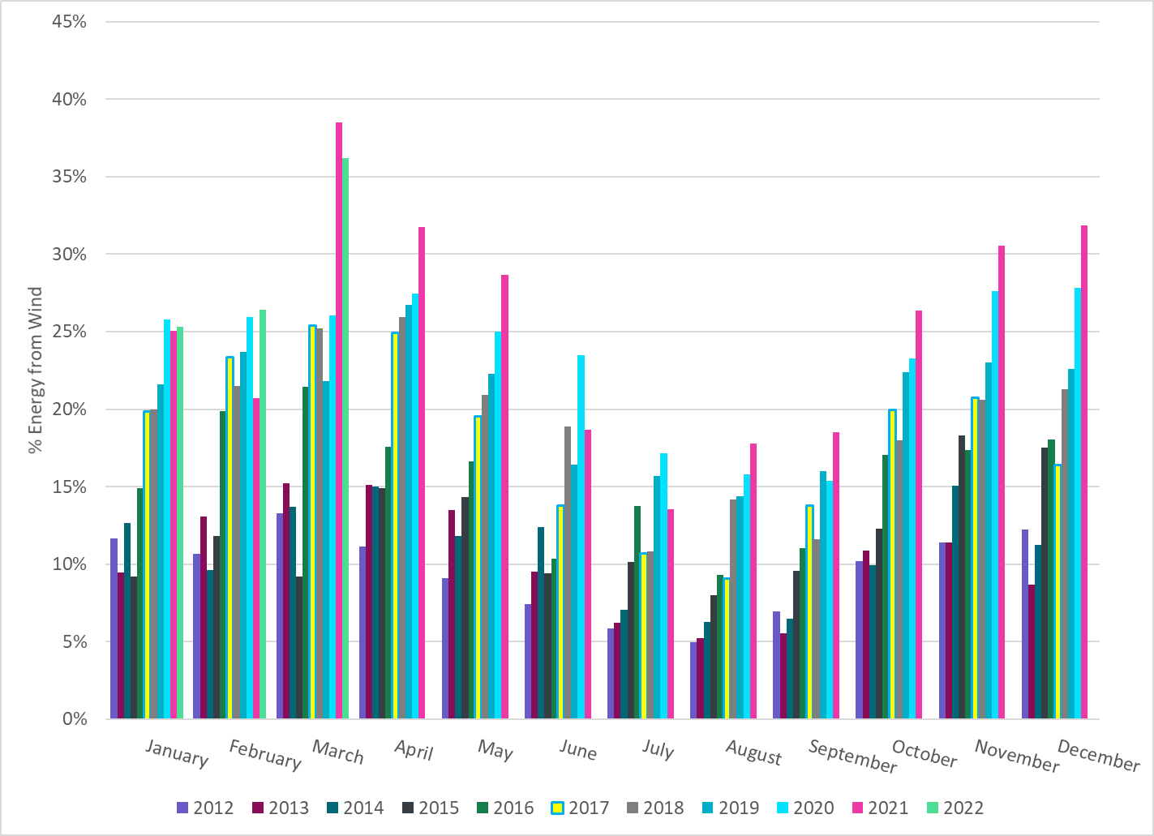
% Energy from Wind Generation
Notes:
36.18% %

Slide 24
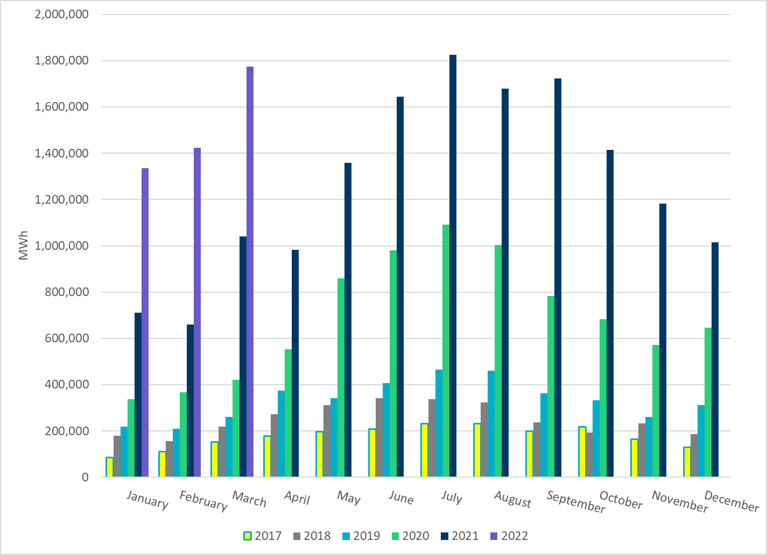
Total Energy From Solar Generation
Notes:
1,773,088 MWh

Slide 25
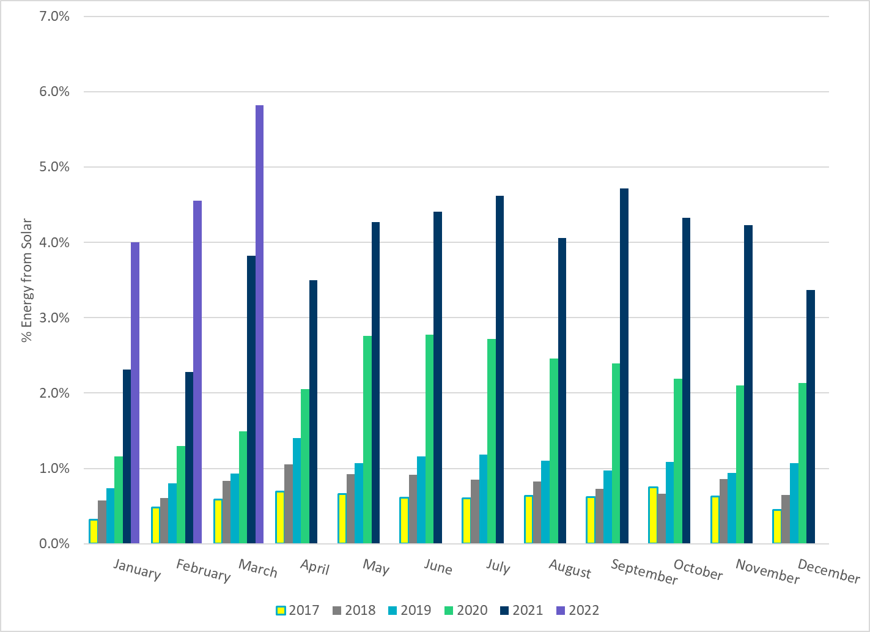
% Energy from Solar Generation
Notes:
5.82%

Slide 26
ERCOT System Inertia

Slide 27
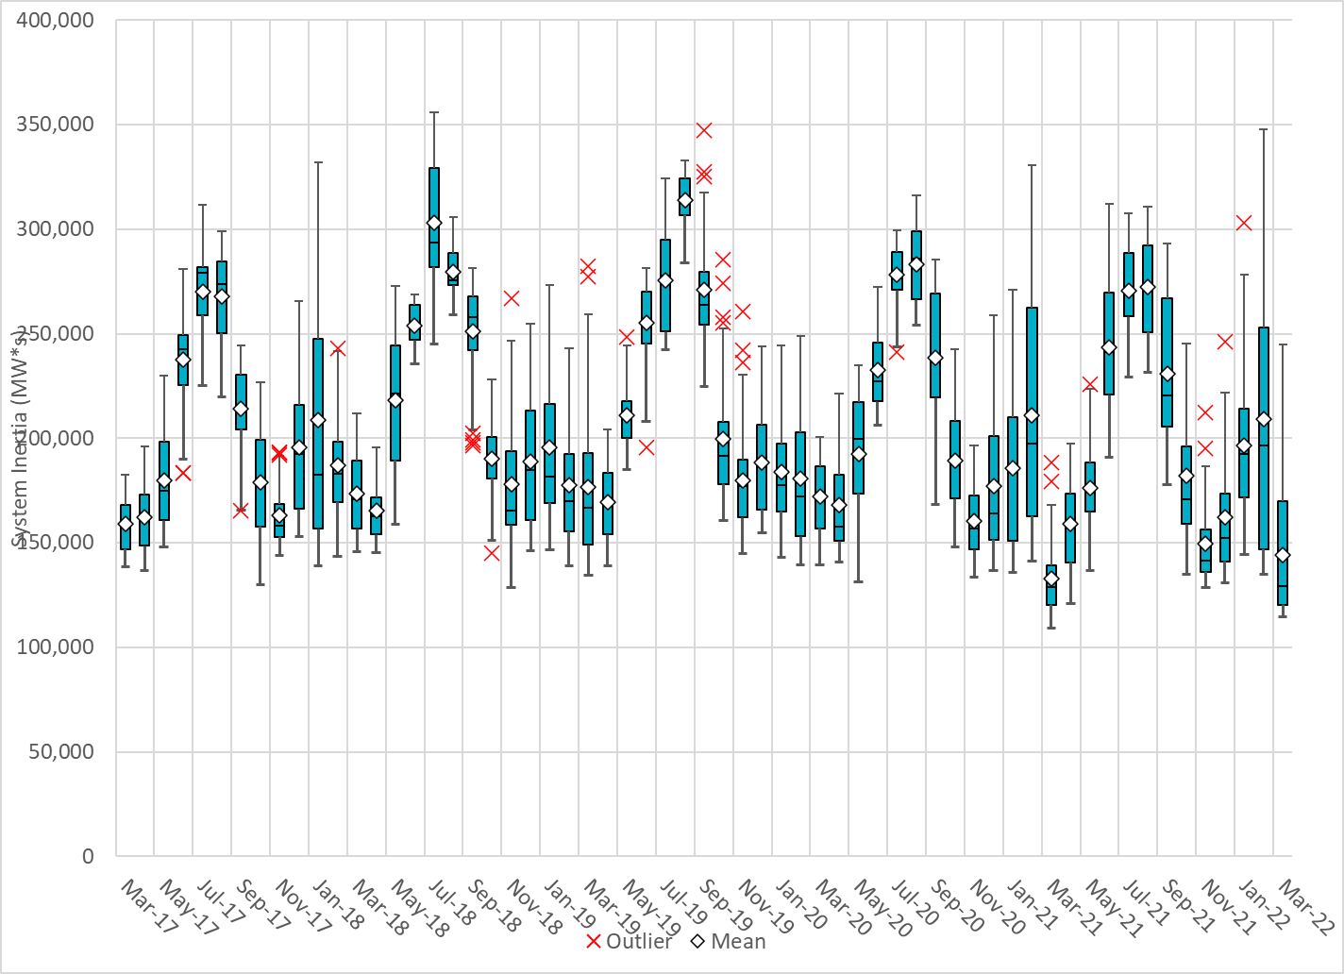
Daily Minimum System Inertia
Notes:
Minimum Inertia =114,674 MW*s on 3/21/2022
Previous Minimum was 109,029 MW*s on 3/22/2021
Data:
Mean: 144,298 MW*s
Max: 246,062 MW*s on Mar 8th
Min: 114,674 MW*s on Mar 21st

Slide 28
Questions?
Thank you!

