Slide 1
ERCOT Frequency Events
March 2022
ERCOT
Operations Planning
PDCWG | April 20, 2022

Slide 2
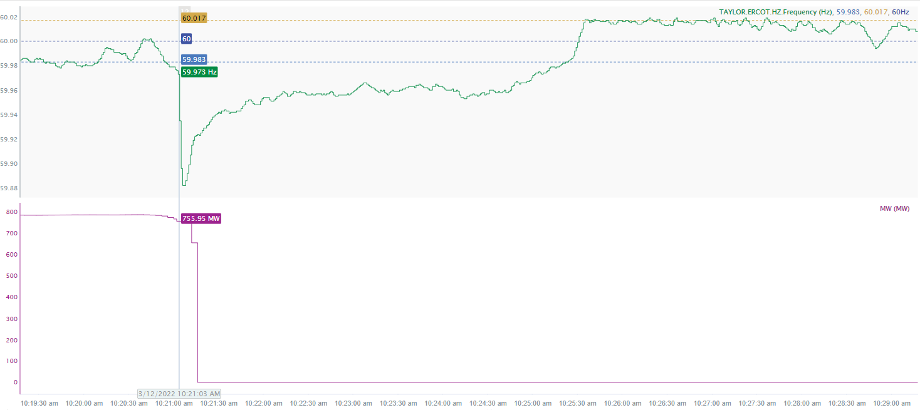
3/12/2022 10:21:03(FME)
Notes:
The unit tripped offline while carrying approximately 756 MW.
Starting Frequency: 59.973 Hz
Minimum Frequency: 59.882 Hz
A-C Time: 3 seconds
Recovery Time (back to deadband): 4 minutes
RRS Deployed: 469 MW
Trip Reason: high pressure
Contextual Information: A total of 390 MW of regulation up was deployed during the event.

Slide 3
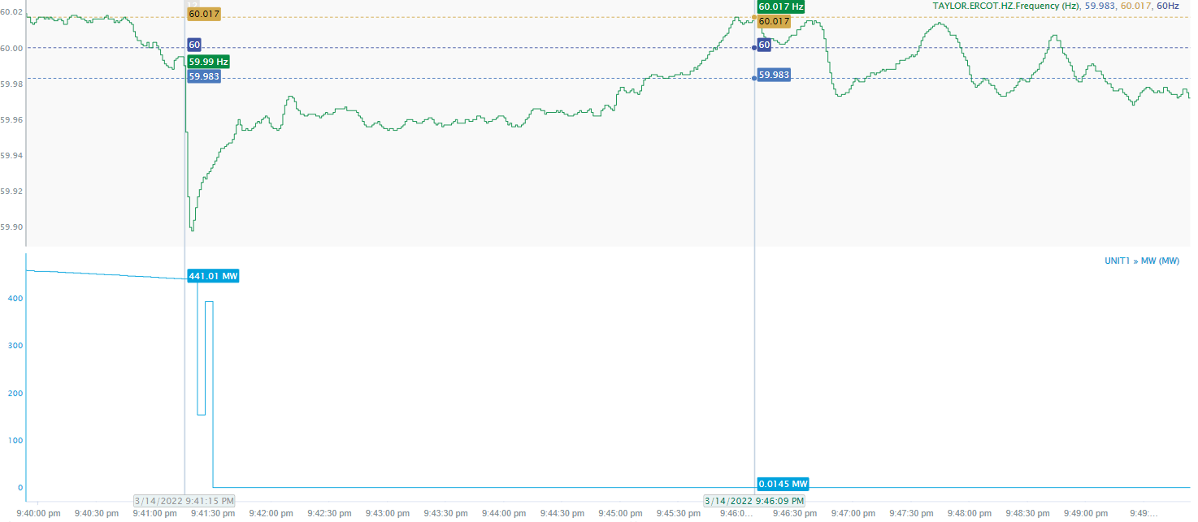
3/14/2022 21:41:15(FME)
Notes:
The unit tripped offline while carrying approximately 441 MW.
Starting Frequency: 59.99 Hz
Maximum Frequency: 59.898 Hz
A-C Time : 4 seconds
Recovery Time(back to deadband): 3 minutes , 58 seconds
RRS Deployed: 543 MW
Trip Reason: Lighting Strike
Contextual Information: A total of 146 MW of regulation up was deployed during the event.

Slide 4
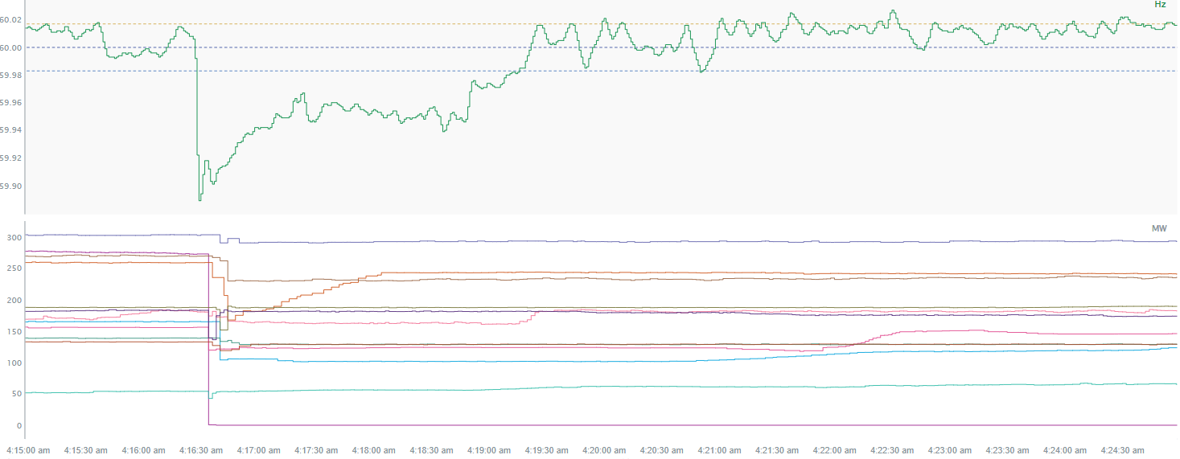
3/22/2022 4:16:26(FME)
Notes:
Several wind units tripped offline or reduced their output temporarily for total loss of 703 MW
Starting Frequency: 60.017Hz
Minimum Frequency: 59.889 Hz
A-C Time : 3 seconds
Recovery Time(back to deadband): 2 minutes and 50 seconds
RRS Deployed: 524 MW
Trip Reason: The units that tripped offline had a fault on the tie line and the line tripped.
Contextual Information: A total of 166 MW of regulation up was deployed during the event.
Notes: RFI’s were sent out for units that temporarily reduced their output.

Slide 5
Questions?
Thank you!

