Slide 1
General Updates
Joel Koepke
April 18, 2022

Slide 2
Topics
Minor MAGE Release Completed
ERCOT Staffing Updates
ERCOT Modeling-Related Projects Update
Large Flexible Load Information

Slide 3
Minor MAGE Release - Completed
Issue - Certain users were unable to launch MAGE after receiving a new computer
Resolution - A new MAGE release will be released at the end of this month. If prompted, please download and update MAGE.
Details – The release does not update any code within MAGE therefore no functionality will be changed. The only change is to a backend DLL to support authentication.
DEPLOYED 3/30

Slide 4
ERCOT Staffing Updates
Sujatha Kotamarty - Supervisor of Network Model Maintenance
10 years experience with ERCOT Modeling group
5 years experience with ERCOT Operations Support
Eric Meier - Supervisor of Network Model Administration
5 years experience with ERCOT Model Administration group

Slide 5
NMMS Projects - Tech Health Project
Status:
In “Execution”
Scope:
Update backend hardware
Upgrade database version
No changes to “grid” data
(due to the above) Upgrade SGEM
Schedule (Tentative)
Cutover to New NMMS: October/November 2022
MP Training: July/August 2022
MP Testing: July/August 2022

Slide 6
NMMS Projects – Schema Upgrade to CIM16
Status:
Concept; not scheduled.
Scope:
Convert underlying NMMS schema from CIM10 to CIM16
Example – Transformers are modeled differently
Posted CIM models will change to version 16
Ensure non-native NMMS extracts are unaffected
Ensure proper awareness to all MPs
Schedule
Still in discussion but no earlier than Q4 2022
Duration tentatively 18/24 months.
CIM16 file is available today on ECEII NMMS Postings folder

Slide 7
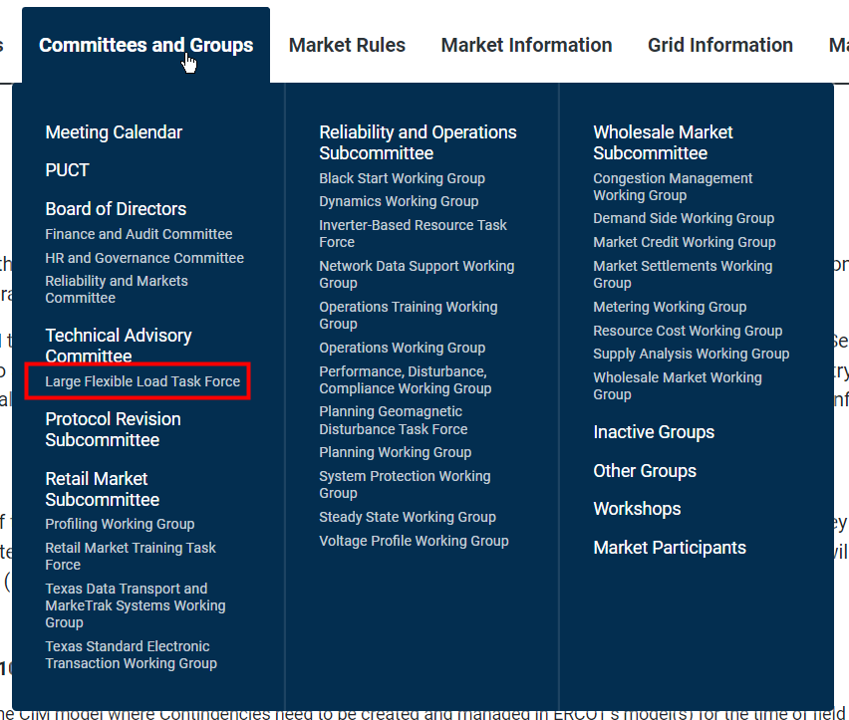
Large Flexible Loads - Update
Large Flexible Load Task Force created:
https://www.ercot.com/committees/tac/lfltf
Next meeting on 4/26
New email address for LFL process:
LargeLoadInterconnection@ercot.com
ERCOT’s Network Model Coordinators are now asking for additional information on all loads created via NOMCRs

Slide 8
DGR Conversion Update
Joel Koepke
April 19, 2022

Slide 9
DGR Conversion Update
ERCOT is currently working through a trial conversion for one distribution resource.
Working to determine the appropriate data and timelines for registration, ERCOT, and TSP submissions.
Goal is to make all changes >90 days in the future

Slide 10
Transition from “old-style” to “new-style” DGR modeling
Before
TSP Station
Transmission Network
After
Transmission Network
DGR Station
TSP Station
CIM Load
CIM Load
Line
Transitioning to the “new-style” of DGRs will greatly simplify modeling and allows for improved handling of transmission outages

Slide 11
Pre-Work: DGR Conversion Information Sheet
ERCOT, RE, and TSP will provide information for the “Conversion Information Sheet”
The updated Excel file will be attached to the Service Request for each conversion

Slide 12
Execution - Coordinated Change Request Submissions
Before
TSP Station
Transmission Network
After
Transmission Network
DGR Station
TSP Station
CIM Load
CIM Load
Line

Slide 13
Execution - Coordinated Change Request Submissions
Before
TSP Station
After
Transmission Network
TSP Station
Transmission Network
DGR Station
Green = TSP Equipment
CIM Load
CIM Load
Line
Blue = Reg. Equipment

Slide 14
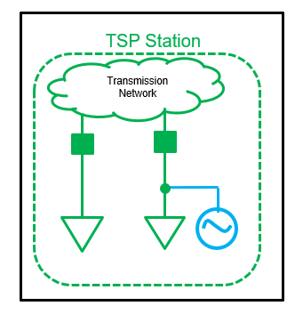
Execution - ERCOT CAMR #1
Final State
Green = TSP Equipment
Blue = Reg. Equipment
ERCOT submits a CAMR removing the DGR equipment and adding end-caps.
TSP Station
TSP Station
Transmission Network
Transmission Network
DGR Station
End Cap
CIM Load
CIM Load
Line
CIM Load
CIM Load

Slide 15
Execution - TSP NOMCR
Final State
Green = TSP Equipment
Blue = Reg. Equipment
TSP submits a NOMCR removing the distribution equipment and replacing load transformer with CIM Load
TSP Station
Transmission Network
TSP Station
Transmission Network
End Cap
CIM Load
CIM Load
CIM Load
CIM Load

Slide 16
Execution - ERCOT CAMR #2
Final State
Green = TSP Equipment
Blue = Reg. Equipment
ERCOT submits a CAMR adding the “new” DGR and connecting to the load connectivity node.
TSP Station
TSP Station
Transmission Network
Transmission Network
CIM Load
CIM Load
CIM Load
CIM Load

Slide 17
Execution - Coordinated Change Request Submissions
Before
TSP Station
Transmission Network
After
Transmission Network
DGR Station
TSP Station
CIM Load
CIM Load
Line

